Slide 1
MarketLens AI
Explainable marketplace intelligence
and historical price auditing
[Student names] · [Institution] · [Supervisor]
Notes:
Sources: submission/REPORT.md, submission/evaluation.json and actual local application screenshots. Synthetic observations only. See submission/DEMO_AND_VIVA.md for presenter details. External Bright Data contract and deployment are not live-verified.

Slide 2
The problem: a discount is not a historical comparison
Reference price
An advertised percentage compares two displayed prices. It does not establish the usual observed price.
Historical context
Seller, shipping, availability and promotion evidence can change. A single snapshot cannot recreate missing history.
Project objective
Make comparisons inspectable, preserve uncertainty, and abstain when the evidence is insufficient.
MarketLens AI | Synthetic demonstration
02
Notes:
Sources: submission/REPORT.md, submission/evaluation.json and actual local application screenshots. Synthetic observations only. See submission/DEMO_AND_VIVA.md for presenter details. External Bright Data contract and deployment are not live-verified.

Slide 3
One evidence workflow
1
2
3
4
5
→
→
→
→
Collect / import
Preserve raw data
Normalize
Analyze
Explain
Every analysis retains its cutoff, source observations, mode and version.
MarketLens AI | Synthetic demonstration
03
Notes:
Sources: submission/REPORT.md, submission/evaluation.json and actual local application screenshots. Synthetic observations only. See submission/DEMO_AND_VIVA.md for presenter details. External Bright Data contract and deployment are not live-verified.

Slide 4
Full-stack architecture
Browser
React + TypeScript, TanStack Query and ECharts with exact-value table alternatives.
API and storage
FastAPI and MongoDB. Separate demo, imported and live databases; immutable observations.
Separate worker
Durable job leases, collection polling, analysis recalculation and watch-condition evaluation.
MarketLens AI | Synthetic demonstration
04
Notes:
Sources: submission/REPORT.md, submission/evaluation.json and actual local application screenshots. Synthetic observations only. See submission/DEMO_AND_VIVA.md for presenter details. External Bright Data contract and deployment are not live-verified.

Slide 5
A transparent historical discount score
100 × (baseline − current) / baseline
Baseline: median of daily comparable prices in the preceding window.
Exclude the current day; require at least 14 days and 60% coverage.
60% historical savings + 25% price position + 15% claim agreement
A versioned heuristic, not a probability of honesty
MarketLens AI | Synthetic demonstration
05
Notes:
Sources: submission/REPORT.md, submission/evaluation.json and actual local application screenshots. Synthetic observations only. See submission/DEMO_AND_VIVA.md for presenter details. External Bright Data contract and deployment are not live-verified.

Slide 6
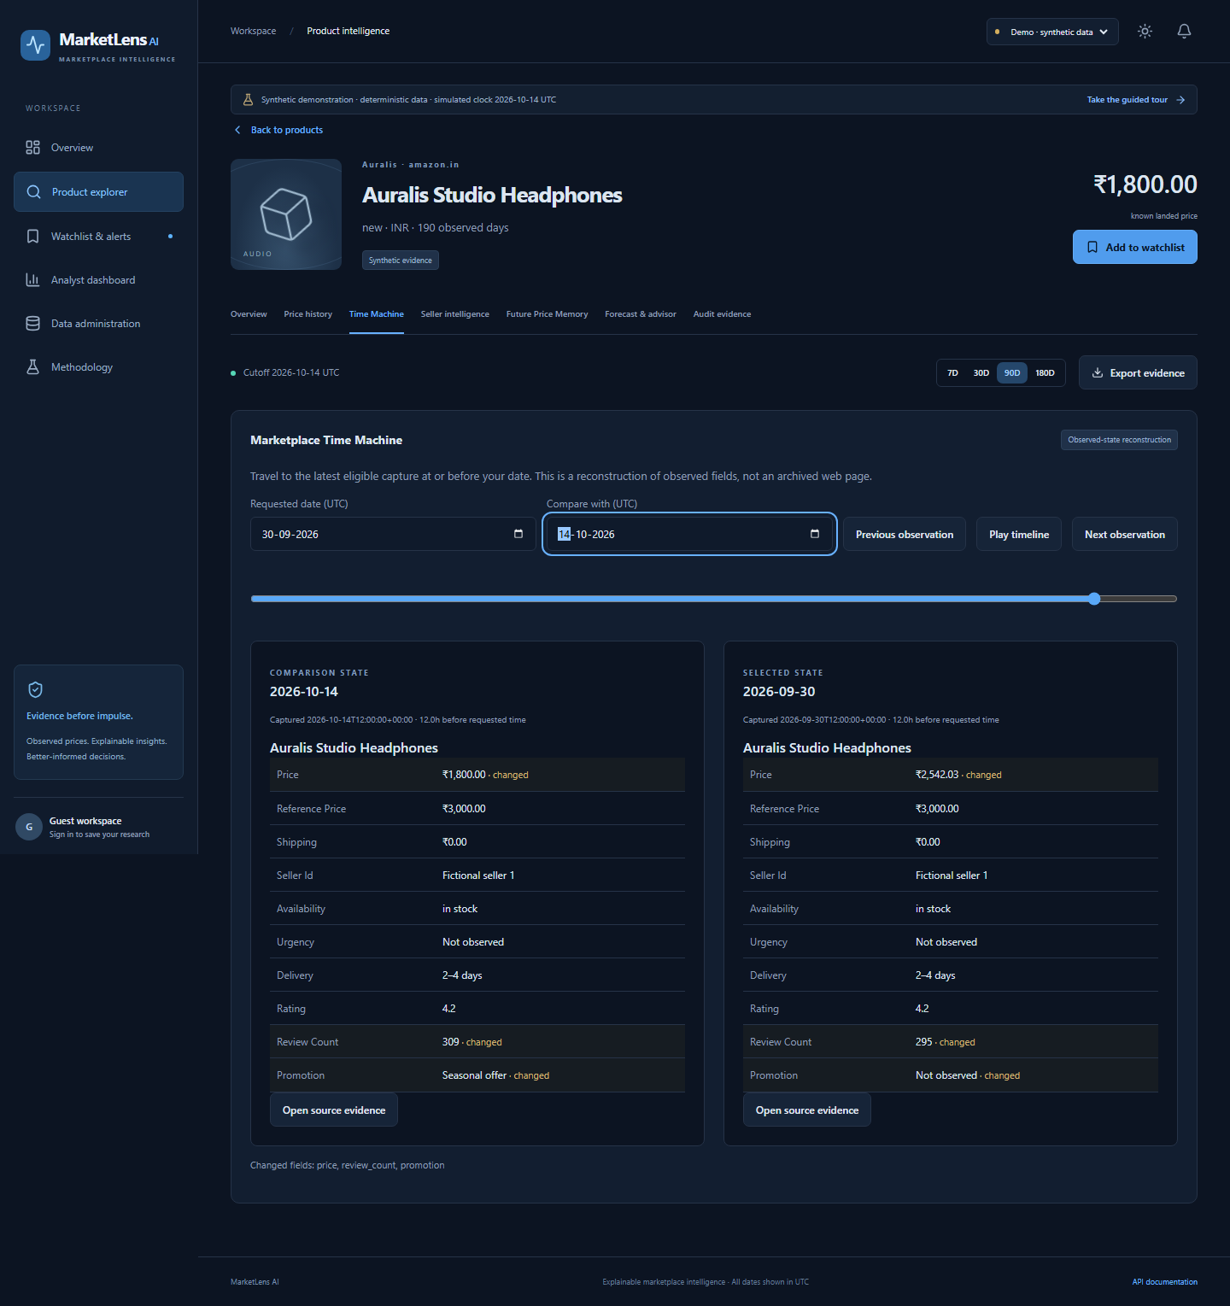
Time Machine preserves the observed state
At or before
the requested time
Actual capture time
Changed fields
Historical metadata
Raw source evidence
MarketLens AI | Synthetic demonstration
06
Notes:
Sources: submission/REPORT.md, submission/evaluation.json and actual local application screenshots. Synthetic observations only. See submission/DEMO_AND_VIVA.md for presenter details. External Bright Data contract and deployment are not live-verified.

Slide 7
Seller patterns require alternative explanations
Eligibility
Identified offers, consecutive observed days, enough overlap and enough nonzero price changes.
Evidence
Return correlation, same-direction changes, shuffled null comparison and pair-count adjustment.
Interpretation
Other sellers help explain common movement. Demand and seasonality remain uncontrolled. No collusion claim.
MarketLens AI | Synthetic demonstration
07
Notes:
Sources: submission/REPORT.md, submission/evaluation.json and actual local application screenshots. Synthetic observations only. See submission/DEMO_AND_VIVA.md for presenter details. External Bright Data contract and deployment are not live-verified.

Slide 8
Historical analogs and forecasts answer different questions
Future Price Memory
Price forecasting
Retrieve similar past price episodes.
Only completed outcome windows.
Report match counts and observed
1 / 3 / 7 / 14-day outcomes.
Compare persistence, moving average,
smoothing and eligible seasonal naive.
Chronological model selection and testing.
Report MAE and measured interval coverage.
MarketLens AI | Synthetic demonstration
08
Notes:
Sources: submission/REPORT.md, submission/evaluation.json and actual local application screenshots. Synthetic observations only. See submission/DEMO_AND_VIVA.md for presenter details. External Bright Data contract and deployment are not live-verified.

Slide 9
Measured synthetic scenario results
Genuine discount
Score 86; historical savings about 27.67% in the seeded headphone scenario.
Seller scenarios
One flagged pair for unusual synchronization; zero pairs flagged for broad common movement.
Forecast limitation
The genuine-discount example has 66.7% held-out interval coverage across 12 origins. Regime changes matter.
MarketLens AI | Synthetic demonstration
09
Notes:
Sources: submission/REPORT.md, submission/evaluation.json and actual local application screenshots. Synthetic observations only. See submission/DEMO_AND_VIVA.md for presenter details. External Bright Data contract and deployment are not live-verified.

Slide 10
Verification and honest limits
Verified locally
Real MongoDB integration, API ownership and CSRF, browser product journeys, watch persistence and worker alerts.
Reproducible package
36 products, 7,818 synthetic observations, source code, Docker configuration, evaluation JSON and actual screenshots.
External limits
Original snapshot absent. Bright Data fixtures are not live verification. No email or public deployment claimed.
MarketLens AI | Synthetic demonstration
10
Notes:
Sources: submission/REPORT.md, submission/evaluation.json and actual local application screenshots. Synthetic observations only. See submission/DEMO_AND_VIVA.md for presenter details. External Bright Data contract and deployment are not live-verified.

Slide 11
Live demonstration
1 Explore a product and explain its discount
2 Compare historical captures and inspect evidence
3 Review seller patterns and completed analogs
4 Read forecast uncertainty and the advisor
5 Save a target watch and inspect the worker alert
6 Show an insufficient-history case
Start locally: docker compose up --build -d
MarketLens AI | Synthetic demonstration
11
Notes:
Sources: submission/REPORT.md, submission/evaluation.json and actual local application screenshots. Synthetic observations only. See submission/DEMO_AND_VIVA.md for presenter details. External Bright Data contract and deployment are not live-verified.

