Slide 1
Deep Neural Networks in Speech and Vision Systems
Published on May, 2020
Shailesha Prasad Maganahalli

Slide 2
Introduction
Neural Networks has mostly been limited to the application of industrial control and robotics.
Recent advancement in Neural Networks have led to successful applications in Intelligent System.
This presentation is intended to understand comprehensive surveys on the latest developments in intelligent vision and speech applications from the perspectives of both software and hardware systems.
Many of these emerging technologies using deep neural networks show tremendous promise to revolutionize research and development for future vision and speech systems.
The advancement in speech and vision processing systems has enabled tremendous research and development in the areas of human-computer interactions , biometric applications , security and surveillance , and most recently in computational behavioral analysis .
Google, Facebook, Apple, Microsoft, IBM, and others have adopted deep learning as one of their core areas of research in artificial intelligence (AI).

Slide 3
DESIGN AND ARCHITECTURE OF NEURAL NETWORKS FOR DEEP LEARNING
Artificial Neural Networks (ANN) consists of multiple levels of nonlinear modules arranged hierarchically in layers. This design is inspired by the hierarchical information processing observed in the primate visual system. Such hierarchical arrangements enable deep models to learn meaningful features at different levels of abstraction. Several successful hierarchical ANNs known as deep neural networks (DNNs) are proposed in the literature.
Few examples include
1. Convolutional neural networks (CNN)
2. Deep generative models and auto-encoders (DBN)
3. Generative Adversarial Networks (GAN)
4. Recurrent neural networks (RNN)

Slide 4
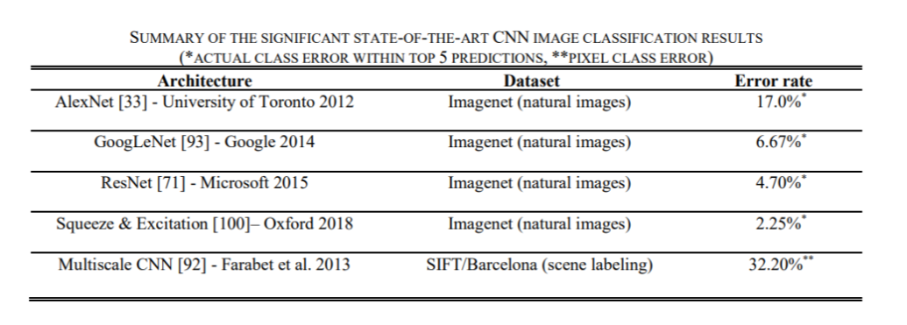
Deep learning in computer vision
Image classification and scene labeling : The CNN model is first introduced to perform recognition of ten hand-written digits using image examples from the MNIST database. The proposed CNN model has shown significant performance improvement in hand-written digit recognition task compared to earlier state-of-the-art machine learning techniques. Since then CNNs have seen several evolutions and the current versions of CNN are tremendously successful in solving more complex and challenging image recognition tasks.

Slide 5
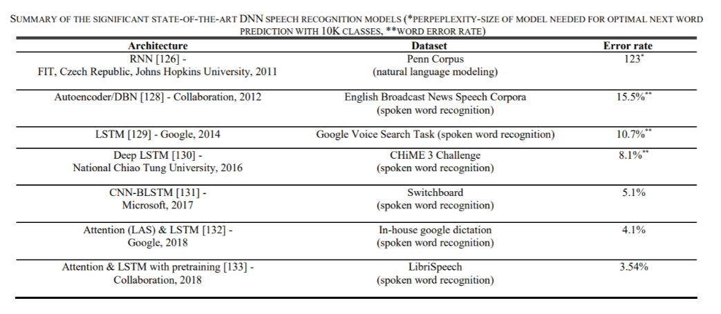
Deep learning in speech recognition
A significant milestone is achieved in acoustic modeling research with the aid of DBNs at multiple institutions. DBN architecture and training process has been extensively tested on a number of large-vocabulary speech recognition datasets including TIMIT, Bing-Voice-Search speech, Switchboard speech, Google Voice Input speech, YouTube speech, and the English-Broadcast-News speech dataset

Slide 6
LIMITATIONS OF DEEP COMPUTATIONAL MODELS
Despite unprecedented successes of neural networks in recent years, we identify a few specific areas that may greatly impact the future progress of deep learning in intelligent systems. The first area is to develop a robust learning algorithm for deep models that requires a minimal amount of training samples.
Effect of sample size
Computational burden on mobile platforms
Interpretability of models
Pitfalls of over-optimism

Slide 7
Future Forward
Despite tremendous success and performance gain of deep learning algorithms, there remain substantial challenges in implementing standalone vision and speech applications on mobile and resource constrained devices. Future research efforts will reach out to billions of mobile phone users with the most sophisticated deep learning-based intelligent systems.
From sentiment and emotion recognition to developing self-driving intelligent transportation systems, there is a long list of vision and speech applications that will gradually automate and assist human’s visual and auditory perception to a greater scale and precision. With an overview of emerging applications across many disciplines such as behavioral science, psychology, transportation, and medicine, this story serves as an excellent foundation for researchers, practitioners, and application developers and users.

Slide 8
Thank You

