Slide 1

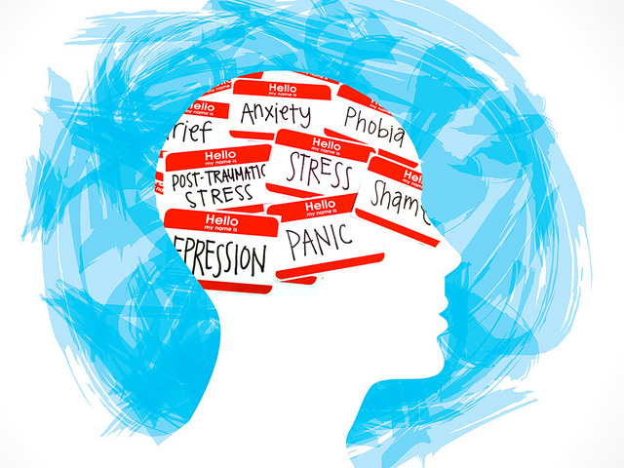
Title : Detecting-Depression-in-Tweets.
Authors : Shailesh Sachan, Taha Khan, Mujtaba Sayyed
Mentor : Prof. Diksha Kumar.

Slide 2
Index
Introduction
Problem Statement
Literature Survey
Proposed Methodology
Results
Conclusion
References

Slide 3
Introduction :
1.Depression is a mental illness that is not taken seriously.
2.Everybody have experimented sadness at times. However, depression is very different from this. Depression is a psychiatric disorder that need to be addressed with medication.
>Definition:
According to Our World in Data Website, Depressive disorders occur with varying severity. The WHO’s International Classification of Diseases (ICD-10) define this set of disorders ranging from mild to moderate to severe. The The Institute for Health Metrics and Evaluation( IHME) adopt such definitions by disaggregating to mild, persistent depression (dysthymia) and major depressive disorder (severe).

Slide 4
Literature Survey:
1. Choudhury et al. considered online networking as a promising instrument for public health, concentratingon the utilization of Twitter presents on fabricating predictive models about the forthcoming impact of childbirth on the conduct and disposition of new mothers . Utilizing Twitter posts, they measured postpartum changes in 376 mothers along measurements of social engagement, feeling, informal community, and phonetic style.
2. O’Dea et al. examined that Twitter is progressively researched as methods for recognizing psychological well-being status, including depression and suicidality in the population. Their investigation revealed that it is conceivable to recognize the level of worry among suicide-related tweets, utilizing both human coders and a programmed machine classifier.
3. Zhang et al. have shown that if individuals with a high danger of suicide can be recognized through online Islam et al. Health Inf Sci Syst (2018) 6:8 Page 3 of 12 networking like microblog, it is conceivable to actualize a dynamic intervention system to save their lives . Many researchers have demonstrated that utilizing user-created content (UGC) accurately may help decide individuals’ psychological wellness levels.
4. For instance,Aldarwish and Ahmad examined that the utilization of Social Network Sites (SNS) is expanding these days , particularly by the more youthful eras. Because the accessibility of SNS enables clients to express their interests, sentiments and offer day by day schedule .

Slide 5
Problem Statement :
All forms of depressive disorder experience some of the following symptoms:
reduced concentration and attention
reduced self-esteem and self-confidence
ideas of guilt and unworthiness (even in a mild type of episode)
bleak and pessimistic views of the future
ideas or acts of self-harm or suicide
disturbed sleep
diminished appetite
Worldwide Statistics :
322 million people worldwide live with depression.
>Depression is the leading cause of disability worldwide. Almost 75% of people with mental disorders remain untreated in developing countries with almost 1 million people taking their lives each year.
> The WHO reports that anxiety disorders are the most common mental disorders worldwide with specific phobia, major depressive disorder and social phobia being the most common anxiety disorders. Depression on Social Media
Proposed methodology :explain flow of project with block diagram or flow chart .
Technology used : sw and hw been used in project
Innovation : Describe about new innovation in your project which could help india to become aatam-nirbhar.
Cost effective – explain in what way project is cost effective

Slide 6
Proposed Methodology :
>Social media platforms are becoming an integral part of people’s life. They reflect user’s personal life. People likes to share happiness, joy and sadness on social media. These platforms are used for researchers to identify the causes of depression and detect it.
>In an old article in the Time News Website about how Twitter knows when you’re depressed and the possibility of creating an artificial intelligence model that can scan your Twitter feed and tell you if you’re at risk for depression or receive notices from third parties, for instance, that warned you that you may want to seek help, just based on an automated scan of your tweets. That day has finally come. There are many ways for detecting sentiment in tweets.
> In Machine Learning, there are many ways for sentiment analysis such: decision-based systems, Bayesian classifiers, support vector machine, neural networks and sample-based methods
> After reading some papers about using different Machine Learning and artificial intelligence techniques to detect depression on Social Media, it is decided to apply sentiment analysis through a powerful theorem from probability theory called Bayes' Theorem. The model will be write in python and it will tell whether a given tweet is depressive or not.
Proposed methodology :explain flow of project with block diagram or flow chart .
Technology used : sw and hw been used in project
Innovation : Describe about new innovation in your project which could help india to become aatam-nirbhar.
Cost effective – explain in what way project is cost effective

Slide 7
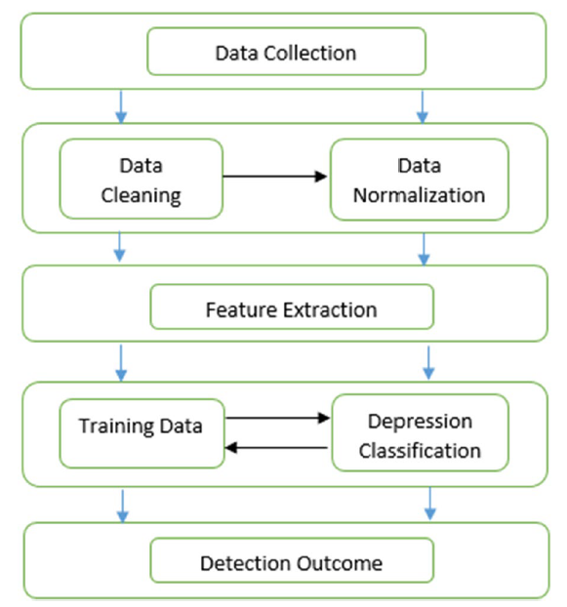
Fig. Block Diagram
Proposed methodology :explain flow of project with block diagram or flow chart .
Technology used : sw and hw been used in project
Innovation : Describe about new innovation in your project which could help india to become aatam-nirbhar.
Cost effective – explain in what way project is cost effective

Slide 8
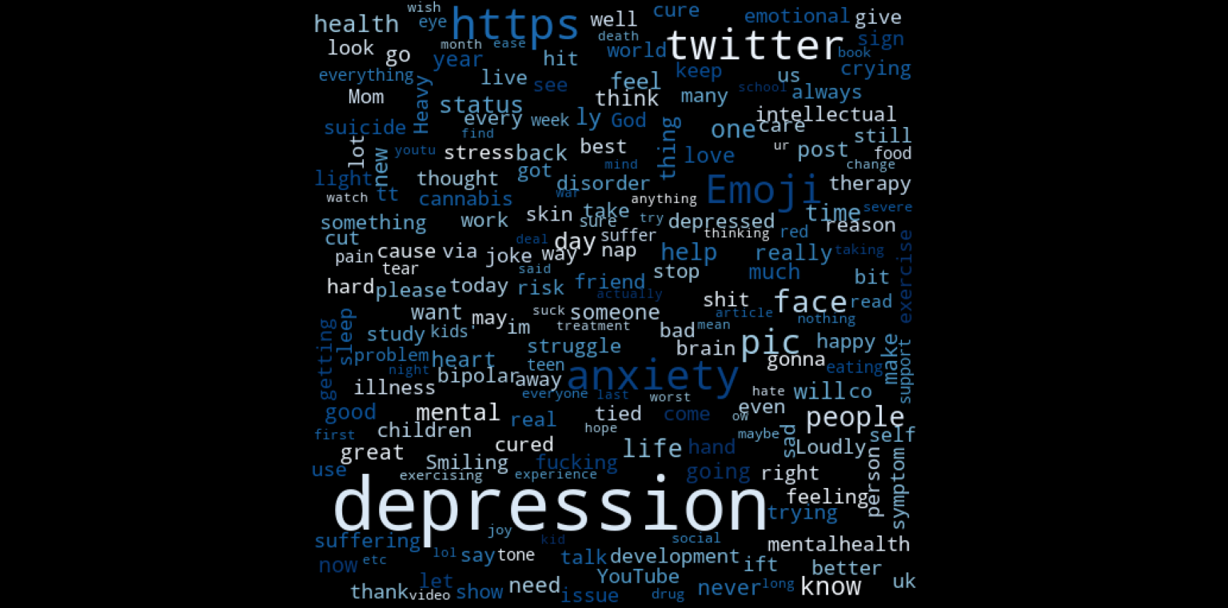
Results:
Word cloud of depressing words

Slide 9
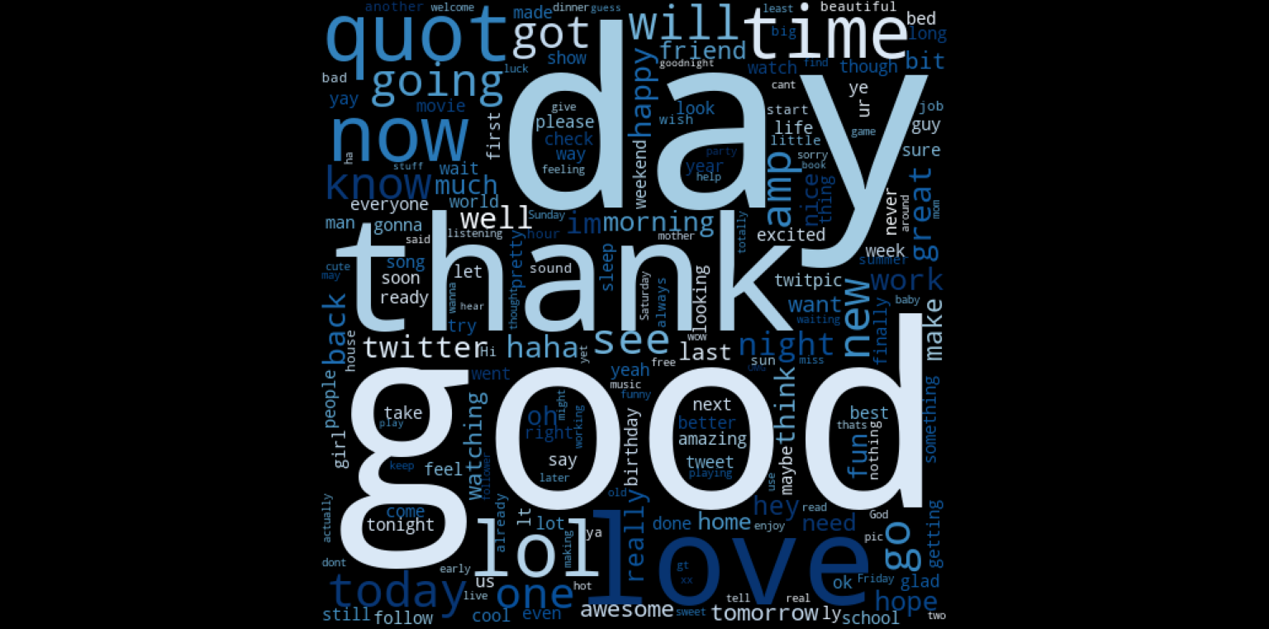
Word Cloud of positive/Non-depressive words.

Slide 10
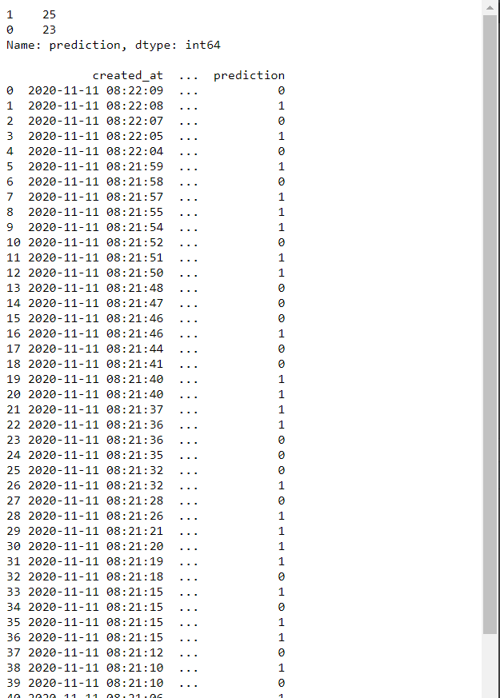
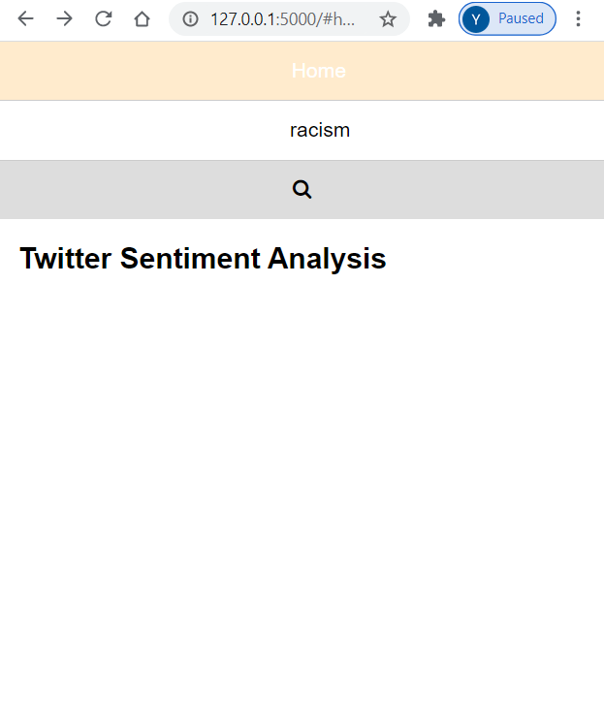
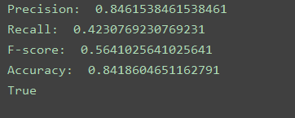

Slide 11
Conclusion
Machine learning techniques identify high quality solutions of mental health problems among Twitter users.
Keywords: Social network, Emotions, Depression, Sentiment analysis
Proposed methodology :explain flow of project with block diagram or flow chart .
Technology used : sw and hw been used in project
Innovation : Describe about new innovation in your project which could help india to become aatam-nirbhar.
Cost effective – explain in what way project is cost effective

Slide 12
Thank You!
References:
1. Scott J. Social network analysis. Thousand Oaks: Sage; 2017. [Google Scholar]
2. Serrat Olivier. Knowledge Solutions. Singapore: Springer Singapore; 2017. Social Network Analysis; pp. 39–43. [Google Scholar]
3. Mikal J, Hurst S, Conway M. Investigating patient attitudes towards the use of social media data to augment depression diagnosis and treatment: a qualitative study. In: Proceedings of the fourth workshop on computational linguistics and clinical psychology—from linguistic signal to clinical reality. 2017.
4. Conway M, O’Connor D. Social media, big data, and mental health: current advances and ethical implications. Curr Opin Psychol. 2016;9:77–82. doi: 10.1016/j.copsyc.2016.01.004. [PMC free article] [PubMed] [CrossRef] [Google Scholar]
5. Ofek Nir, Katz Gilad, Shapira Bracha, Bar-Zev Yedidya. Advances in Knowledge Discovery and Data Mining. Cham: Springer International Publishing; 2015. Sentiment Analysis in Transcribed Utterances; pp. 27–38. [Google Scholar]
6. Yang Y, et al. User interest and social influence based emotion prediction for individuals. In: Proceedings of the 21st ACM international conference on Multimedia. 2013. New York: ACM.
7. Tausczik YR, Pennebaker JW. The psychological meaning of words: LIWC and computerized text analysis methods. J Lang Soc Psychol. 2010;29(1):24–54. doi: 10.1177/0261927X09351676. [CrossRef] [Google Scholar]

