Slide 1
Final Project DATA 1204: Statistical Predictive Modelling
Submitted by: Shaili Jani
Student ID: 100958447 Submitted to: Prof. Varga

Slide 2
1. Research Requirements
Mr. John Hughes has collected dataset on newborn baby weights consisting of 1174 rows and 7 variables.
He wants to understand the effect of smoke (a categorical independent variable) on newborn baby weights (bwt) (a dependent numerical variable).
He also wants to study the effect of other 6 independent variables on newborn baby weights (bwt) the dependent target variable.

Slide 3
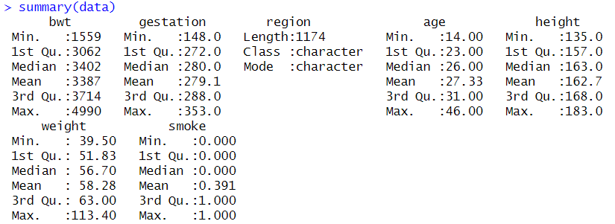
2. Basic Descriptive Statistics

Slide 4
2. Basic Descriptive Statistics
1. For Birthweights:
The basic descriptive statistics derived from analytics for birthweights says that the average birthweight of newborn babies is 3387lb. It gives us an idea that despite the least weight starting from 1559lb unit, majority of data points in the dataset would be clustered around the value of mean value. The value of first quartile being 3062, does further strengthen above statement. Min. and Max. says the least weight 1559lb and the maximum weight 4990lb of newborn baby in the dataset. This gives us an idea of the range of the data points in our data set, how it is spread.

Slide 5
2. Basic Descriptive Statistics
2. For Gestation: The basic descriptive statistics derived from analytics for gestation says that the average gestation period is 279.1. It gives us an idea that the average gestation time-period for pregnant mothers was 279.1 days. Min. and Max. says the least time taken for gestation is 184 days while the most time taken by pregnant mother from our dataset for gestation is 353 days. This gives us an idea of the range of the data points in our data set, how it is spread. 3. For Age: The average age of mothers at which they got pregnant is 27.33 years old. The age group of mothers in our dataset range from 14 years of age (the minimum) till 46 years of age (the maximum). 4. For Height: The average height of mothers in our dataset is 162.7 cms, 135 cms being the smallest height value in the dataset and 183 being the tallest mother. 5. For weight of mothers: The average weight of pregnant mothers is 58.28, stating that the majority of data points regarding the age of mother lie around the mean. The median being 56.70 further strengthens the preceding statement. The range of weight within which the weights of mother fall between in our dataset is between 39.50 and 113.40. 6. Smoking habits: The average of categorical variable smoking habit is 0.391 which translate into 39% of all the mothers in our dataset are smokers.

Slide 6
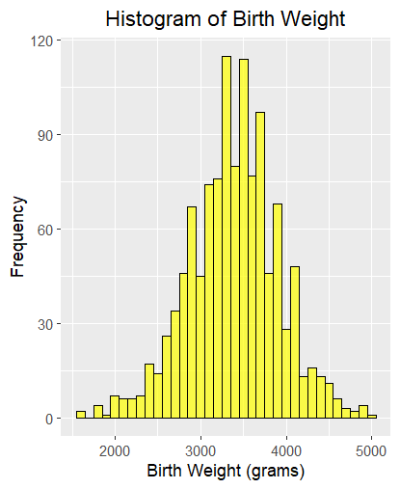

2. Basic Descriptive Statistics
The histogram of shows the distribution of birth weights of newborn babies very vividly. I have highlighted the portion of graph where the majority of data points are concentrated and that is our mean 3387.

Slide 7
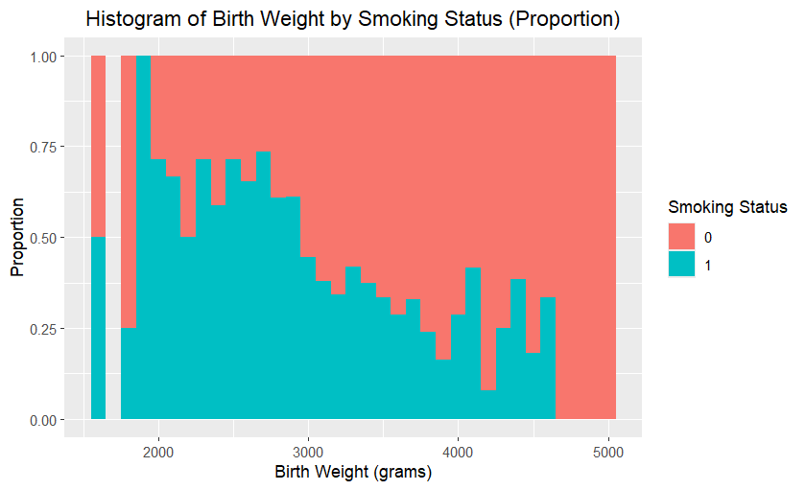






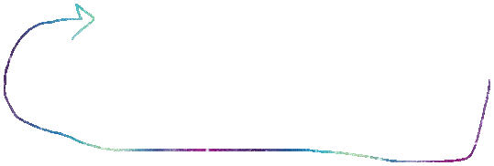
2. Basic Descriptive Statistics
The histogram shows the correlation of mother being a smoker or a nonsmoker with the weight of newborn babies at the time of birth. We can clearly see that lighter weights of newborn babies is associated with mothers being a smoker. Here green depicts mother being a smoker and the linked birthweights of babies.

Slide 8
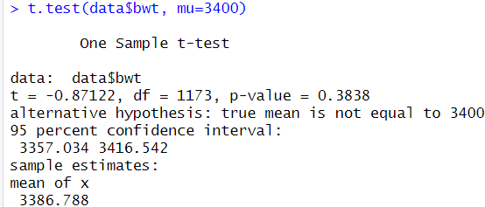
3. Two tailed T-test results
Hypothesis:
H0 -> null hypothesis = 3400 ->The average birth weight of newborn babies is 3400lb. H1 -> alternate hypothesis ≠ 3400 -> The average birth weight of newborn babies is NOT 3400lb.
Results:
Since we are checking whether the mean is equal to 3400 or not, the dataset will be tested as two tailed t-test. The results give us a p-value of 0.3838 which is less than the confidence level alpha = 0.5. Therefore, we reject the null. Thus, we can conclude that the mean of birth weights of newborn babies is not equal to 3400lb. We can also support the above results from the descriptive statistics results that we obtained before which does state that the mean = 3387lb.

Slide 9
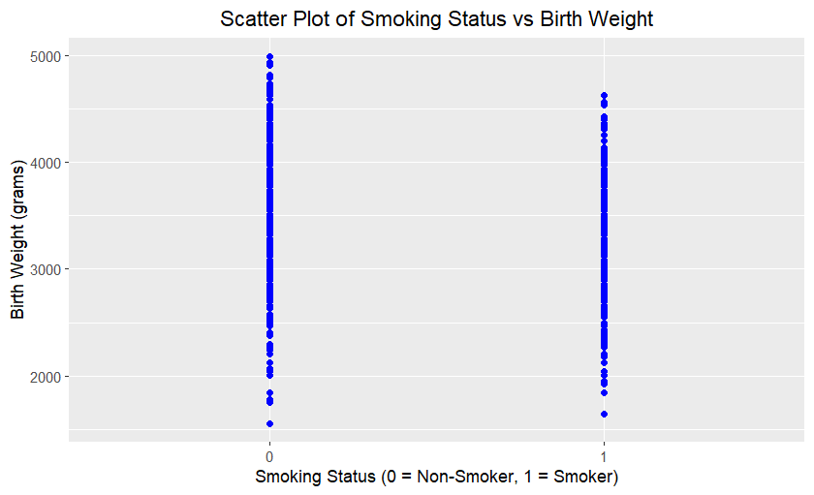
4. Simple linear regression – Scatter Plot
Both groups (smokers and non-smokers) have similar ranges of birth weights, but the graph does not clearly show if smoking affects birth weight.

Slide 10
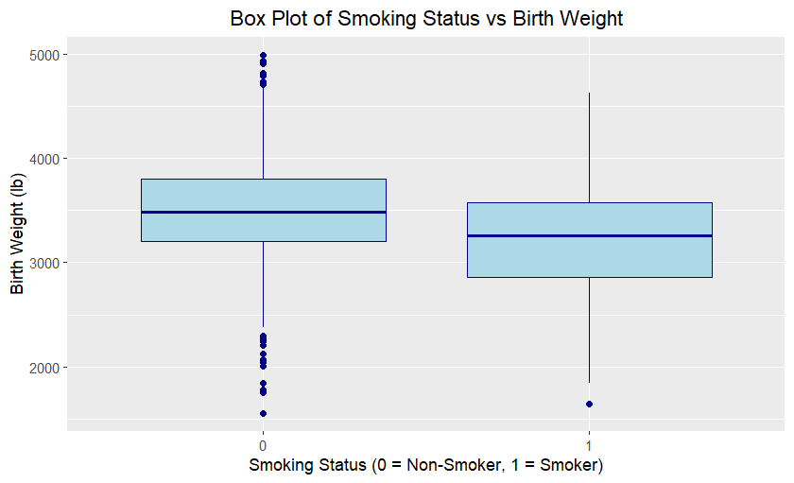
4. Simple linear regression – Box Plot (For better explanation of relation between mother being smoker and birth weights)
Non-smokers generally shows higher median birth weights and greater variability, while smokers show lower median weights with less variability. Outliers are present for both groups, with smokers having more on the lower end. This suggests an association between smoking during pregnancy and lower birth weights. This can further be backed by the second histogram mentioned in this report.

Slide 11
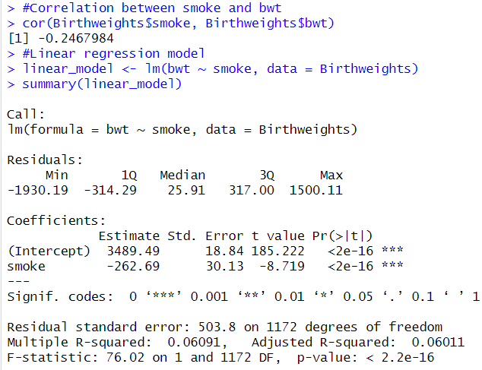
4. Simple linear regression
The equation: Y(bwt) = 3489.49 + (-262.69)*Smoker(X)
The correlation between smoking status and birth weight is -0.247, which indicates a weak negative relationship. This means that as smoking increases (from non-smoker to smoker), birth weight tends to decrease slightly.
The linear regression results show that smoking has a statistically significant effect on birth weight (p < 0.001). The intercept (3489.49) represents the average birth weight (in grams) for non-smokers. The slope (-262.69) means that babies born to smokers weigh, on average, 262.69 grams less than those born to non-smokers. However, the model explains only 6% of the variation in birth weights (R-squared = 0.06091), suggesting that other factors also influence birth weight.

Slide 12
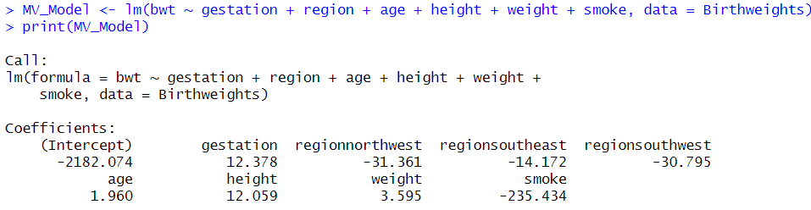
5. Multiple linear regression

Slide 13
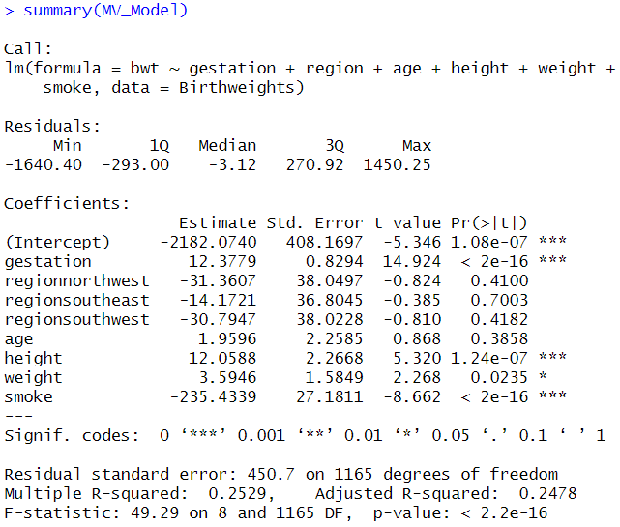
5. Multiple linear regression
The equation: Birth Weight (bwt)= (−2182.0740)+(12.378*gestation)+(−31.361*regionnorthwest)+(−14.172*regionsoutheast)+(−30.795*regionsouthwest)+(1.960*age)+(12.059*height)+(3.595*weight)+(−235.434*smoke)

Slide 14
5. Multiple linear regression
Intercept = -2182.07 which represents the predicted birth weight when all independent variables are at their baseline (e.g., gestation = 0, non-smoker, etc.). Since this situation is unrealistic, the intercept primarily serves as a reference point.
Gestation = 12.38 which means that for every additional day of gestation, birth weight increases by approximately 12.38 grams. This is statistically significant (p < 0.001).
Height = 12.06, meaning for every additional centimeter of height, birth weight increases by 12.06 grams (p < 0.001).
Weight = 3.59, for every kilogram of maternal weight, birth weight increases by 3.59 grams (p = 0.0235).
Smoking = -235.43, If the mother smokes, the baby’s birth weight decreases by 235.43 grams on average (p < 0.001), making it a significant negative factor.
Region and Age - these variables are not statistically significant as they have p-values > 0.05, meaning they don’t have a meaningful impact on birth weight in this dataset. The Multiple R-squared value = 0.2529, indicates that the model explains about 25.3% of the variability in birth weight due to the independent variables. This is a moderate level of explanation, suggesting other factors outside the model might also influence birth weights of newborns.

Slide 15
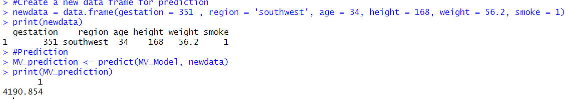
5. Multiple linear regression – Prediction
This predicted value indicates a healthy birth weight, despite the negative impact of smoking. Factors like a full-term pregnancy (40 weeks), the mother's height, and her weight would have probably contributed positively to the birth weight, outweighing the reduction caused by smoking.

Slide 16
6. Conclusion
The average birth weight is approximately 3387lbs, with most weights falling between 3062 and 3714 lbs.
Smoking during pregnancy is associated with a lower average birth weight.
Longer gestation periods are strongly linked to higher birth weights.
Taller and heavier mothers tend to have babies with higher birth weights.
There is no significant difference in birth weights across regions.
Predictive Model: A mother who smokes, is from the southwest, and has specific characteristics (e.g., gestation = 351, height = 168 cm) is predicted to have a baby weighing about 4191 grams.
Correlation: There is a weak negative correlation (-0.25) between smoking and birth weight.
Model Fit: The multivariate regression model explains 25.3% of the variation in birth weights which is due to the independent variables, indicating that other factors may also play a role.

