Slide 1
BUGLENS
AI-Powered Jira Defect Intelligence
Search bug history in plain English. Verify every answer. Gate every release.
Shailja Tyagi · Capgemini AI Hackathon

Slide 2
PROBLEM STATEMENT
QA teams re-discover the same bugs, over and over.
1
Manual triage doesn’t scale
Engineers manually search years of Jira tickets to check “has this happened before” — slow, inconsistent, and dependent on individual memory.
2
Jira’s keyword search misses paraphrased duplicates
Two tickets describing the same root cause in different words never surface as related unless someone searches the exact right term — genuine duplicates get missed, not for lack of looking.
3
Release sign-off is a manual read, not a decision
Jira can list every bug tagged to a release, but nothing evaluates that list against a rule — someone has to scan it and decide, with no consistent, auditable record of why.
Result: duplicate tickets that were never connected, and release sign-off that depends on who read the list — not on a repeatable rule.
02

Slide 3
SOLUTION & KEY FEATURES
One pipeline, from Jira to a verified answer.
BugLens connects to your Jira instance, embeds every bug locally using Ollama, and lets anyone ask questions in plain English. It combines vector similarity with keyword scoring, independently verifies each match with a separate AI call, and returns a grounded answer citing only confirmed bugs — or honestly says nothing was found.
60
real Jira bugs
5
AI verifications / search
🔍
Hybrid search
Vector + BM25 keyword scoring — catches rare qualifier terms pure vector search dilutes
70/30
vector / keyword blend
✅
Independent verification
One separate AI call per retrieved bug — false positives caught and shown, never hidden
Release readiness gate
Deterministic GO/NO-GO in Python — the AI only explains a verdict it didn’t make
100%
local, nothing leaves
🚦
🔌
MCP integration
Same engine callable from GitHub Copilot, Claude Desktop, or any MCP-compatible assistant
03

Slide 4
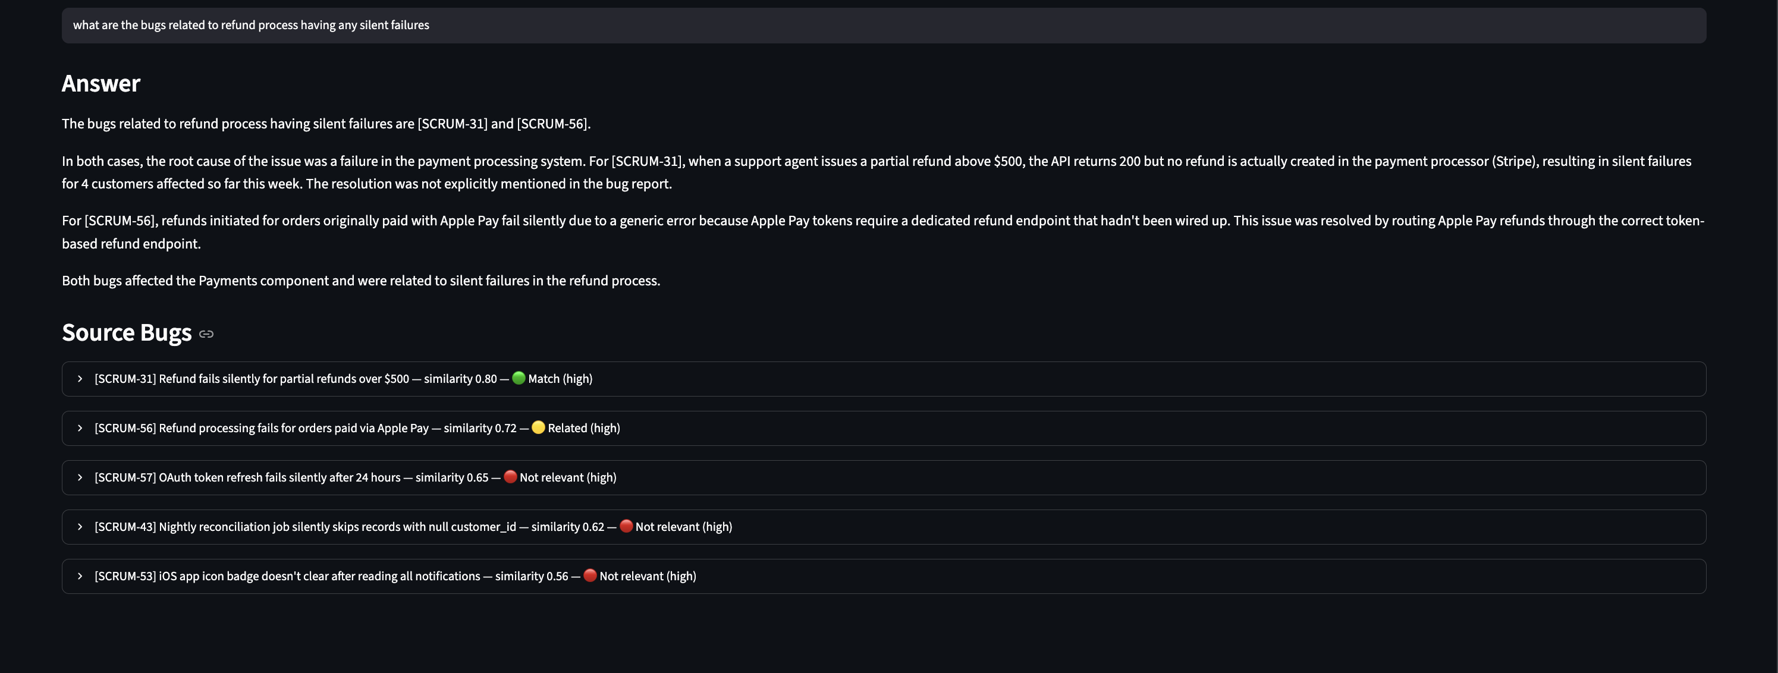
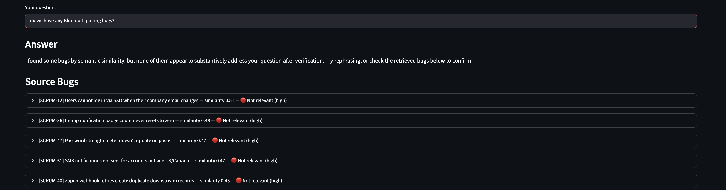
SOLUTION & KEY FEATURES
Every match is verified. When nothing fits, it says so.
Bluetooth query — no such bug exists; all 5 honestly rejected
Refund query — 2 of 5 candidates verified relevant, 3 correctly rejected
🟢 Match (same root cause) 🟡 Related (same feature, different issue) 🔴 Not relevant (different feature entirely)
The answer only cites verified bugs. Rejected ones stay visible for transparency — never silently hidden.
04

Slide 5
BUSINESS VALUE & IMPACT
From manually scanning the tracker to one verified answer.
QUANTIFIED IMPACT
WHO BENEFITS
One question, not 60 tickets
QA Engineers
Finding a historically-similar bug — from manually opening and reading every candidate ticket, to one typed question, answered live in this demo
Find similar past bugs in seconds instead of hours — with verified, cited evidence, not just keyword matches
Zero hallucinated citations
Release Managers
Every cited bug ID is validated in Python before it reaches the screen — the AI cannot fabricate a reference
One-click readiness check against a fixed, auditable rule — no manual triage, no guesswork
Deterministic release gate
Dev Teams
GO/NO-GO decisions are auditable, repeatable, and not dependent on who ran the check or when
Pattern detection across releases — same root cause surfacing again? BugLens shows you, with the ticket that proved it
100% local execution
Leadership
No bug data, ticket text, or resolution detail ever leaves the developer’s machine — critical for client-facing projects
Measurable reduction in duplicate investigation effort; fully local data handling for compliance-sensitive accounts
05

Slide 6
SOLUTION ARCHITECTURE
Six files, two front doors, one engine.
The core engine lives in search.py. Everything else either feeds it data, presents its output, or tests it.
BugWhisperer_hackathon_JIRA/
📥 Data pipeline
jira_fetch.py pulls real bugs from Jira (incl. custom fields). ingest.py embeds them into a local ChromaDB store via Ollama.
├── jira_fetch.py
├── ingest.py
├── search.py
🧠 Core engine
├── app.py
search.py — hybrid retrieval, per-bug verification, synthesis, citation guardrails, and the deterministic release gate.
├── bugLens_mcp.py
├── quality_checks.py
🖥 Two front doors
├── tests/
app.py (Streamlit UI) and bugLens_mcp.py (MCP server for Copilot) — same engine, no duplicated logic.
│ ├── run_regression_suite.py
│ ├── test_guardrails.py
│ └── test_quality_checks.py
🧪 Testing layer
Automated regression suite + unit tests that caught real AI mistakes (fabricated citations, swapped counts) before any demo.
└── .vscode/mcp.json
06

Slide 7
SOLUTION ARCHITECTURE
Five phases, question to verified answer.
→
→
→
→
1
2
3
4
5
Embed
Hybrid
Search
Verify
Synthesize
Guard
768-dim vector via nomic-embed-text (local)
Vector (ChromaDB) + BM25 keyword, merged 70/30
One independent LLM call per bug — concurrent
Answer from verified bugs only; ungrounded citations stripped
Contradiction detection + citation validation + consistency
Release path (separate pipeline): Jira bugs → deterministic rule (open + High/Blocker?) → GO / NO-GO → AI writes the explanation, doesn’t make the call.
07

Slide 8
SOLUTION ARCHITECTURE
Where the LLM is — and isn’t — trusted.
The interesting part of this build is the boundary between what the model decides and what Python decides.
AI
Is a retrieved bug actually relevant to the question (judgment call, one call per bug)
AI
duplicate vs. related — the model conflates same-component with same-defect; a similarity-floor guardrail catches it
✓
Release GO/NO-GO — a gate that can hallucinate is not a gate
✓
Which bug IDs may be cited — the model will invent IDs (proven in this project)
✓
Priority/count breakdowns — the model’s arithmetic silently swapped counts in a live run
✓
is_relevant vs. badge consistency — whichever field says “not relevant” always wins
The LLM writes the explanation for a go/no-go verdict it is handed. It never makes the verdict.

Slide 9
LIVE DEMONSTRATION
Let’s see it work.
1
Jira fetch + ingest pipeline (live)
2
“checkout broken for European customers” — hybrid search in action
3
“Bluetooth pairing bugs?” — honest rejection
4
Release readiness gate — v2.5.0 NO-GO
5
MCP — same query from inside GitHub Copilot

Slide 10
ROADMAP
What’s next.
1
2
3
Per-component risk scoring
Multi-project support
Hybrid search tuning
Beyond a binary gate — continuous risk signals using severity distribution and defect trends per component.
One broader JQL plus a project filter at query time — no re-architecture needed.
Refine the vector/keyword weighting as the corpus grows well beyond today’s 60-bug dataset.
10

Slide 11
Thank you.
Questions welcome — including the hard ones.
BugLens — Shailja Tyagi — Capgemini AI Hackathon

