Slide 1
BUGLENS
AI-Powered Jira Defect Intelligence
Search bug history in plain English. Verify every answer. Gate every release.
Shailja Tyagi · Capgemini AI Hackathon

Slide 2
THE PROBLEM
QA teams re-discover the same bugs, over and over.
1
Manual triage doesn't scale
Engineers manually search years of Jira tickets to check “has this happened before” — slow, and inconsistent across team members.
2
Keyword search alone misleads
A bug that sounds similar in wording isn’t always the same root cause — semantic search on its own produces false positives.
3
Release risk is assessed by memory
Go/no-go decisions depend on someone remembering which open bugs actually block shipping — there’s no systematic check.
Result: repeated debugging effort, and release risk that’s assessed by memory — not data.
02

Slide 3
THE SOLUTION
An AI assistant that answers with evidence, not guesses.
🔍
Search bug history
✅
Independent verification
Ask in plain English, get an answer citing real, verified Jira tickets with clickable links back to the source.
Every retrieved bug is checked by a second AI pass before being trusted — false positives are caught and shown, not hidden.
🚦
Release readiness gate
🔌
Works inside your tools
Deterministic GO/NO-GO decision based on open High/Blocker bugs, with an AI-written explanation of the verdict.
Same engine available via a standalone UI, or directly inside GitHub Copilot and any MCP-compatible AI assistant.
03

Slide 4
ARCHITECTURE
Two pipelines, one shared knowledge base.
SEARCH PATH
Question
→
Hybrid Search
→
AI Verification
→
Grounded Answer
Vector (ChromaDB) + BM25 keyword
one independent check per bug
cites only verified bugs
RELEASE PATH
Jira Bugs
→
Deterministic Rule
→
GO / NO-GO
→
AI Explanation
open + High/Blocker priority?
decided in plain code
writes up the verdict, doesn’t make it
🔒 All retrieval and reasoning runs on a local Ollama stack — no bug data ever leaves the machine.
04

Slide 5
TECH STACK
Built entirely on a local, production-realistic stack.
Ollama
ChromaDB
BM25
llama3.1 + nomic-embed-text
persistent vector store
rank_bm25
Local LLM + embeddings — no bug data ever leaves the machine
Cosine-similarity search over embedded Jira tickets
Keyword scoring that catches rare terms vector search dilutes
Streamlit
MCP
Jira Cloud API
interactive UI
Model Context Protocol
REST + custom fields
Search tab + release readiness tab, running locally
Exposes the same engine as tools inside Copilot / any AI assistant
Real defect data — including custom dropdowns this project type lacks natively
05

Slide 6
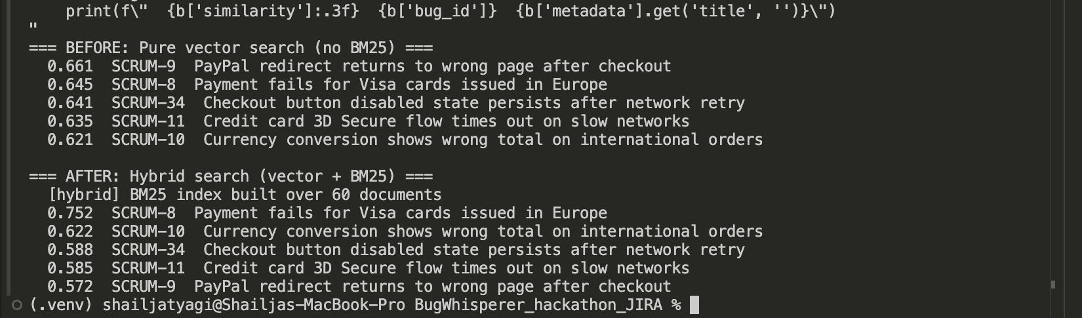
RETRIEVAL
Vector search alone buried the right answer at #2.
Query: “checkout broken for European customers”
Pure vector search ranked the correct bug (Visa cards issued in Europe) at #2, similarity 0.645
BM25 keyword scoring catches the word “European” — a rare, high-signal term that vector embeddings dilute when surrounded by common words like “checkout”
Live terminal output — same query, before and after hybrid scoring
After hybrid scoring: correct bug moved to #1, similarity 0.752
06

Slide 7
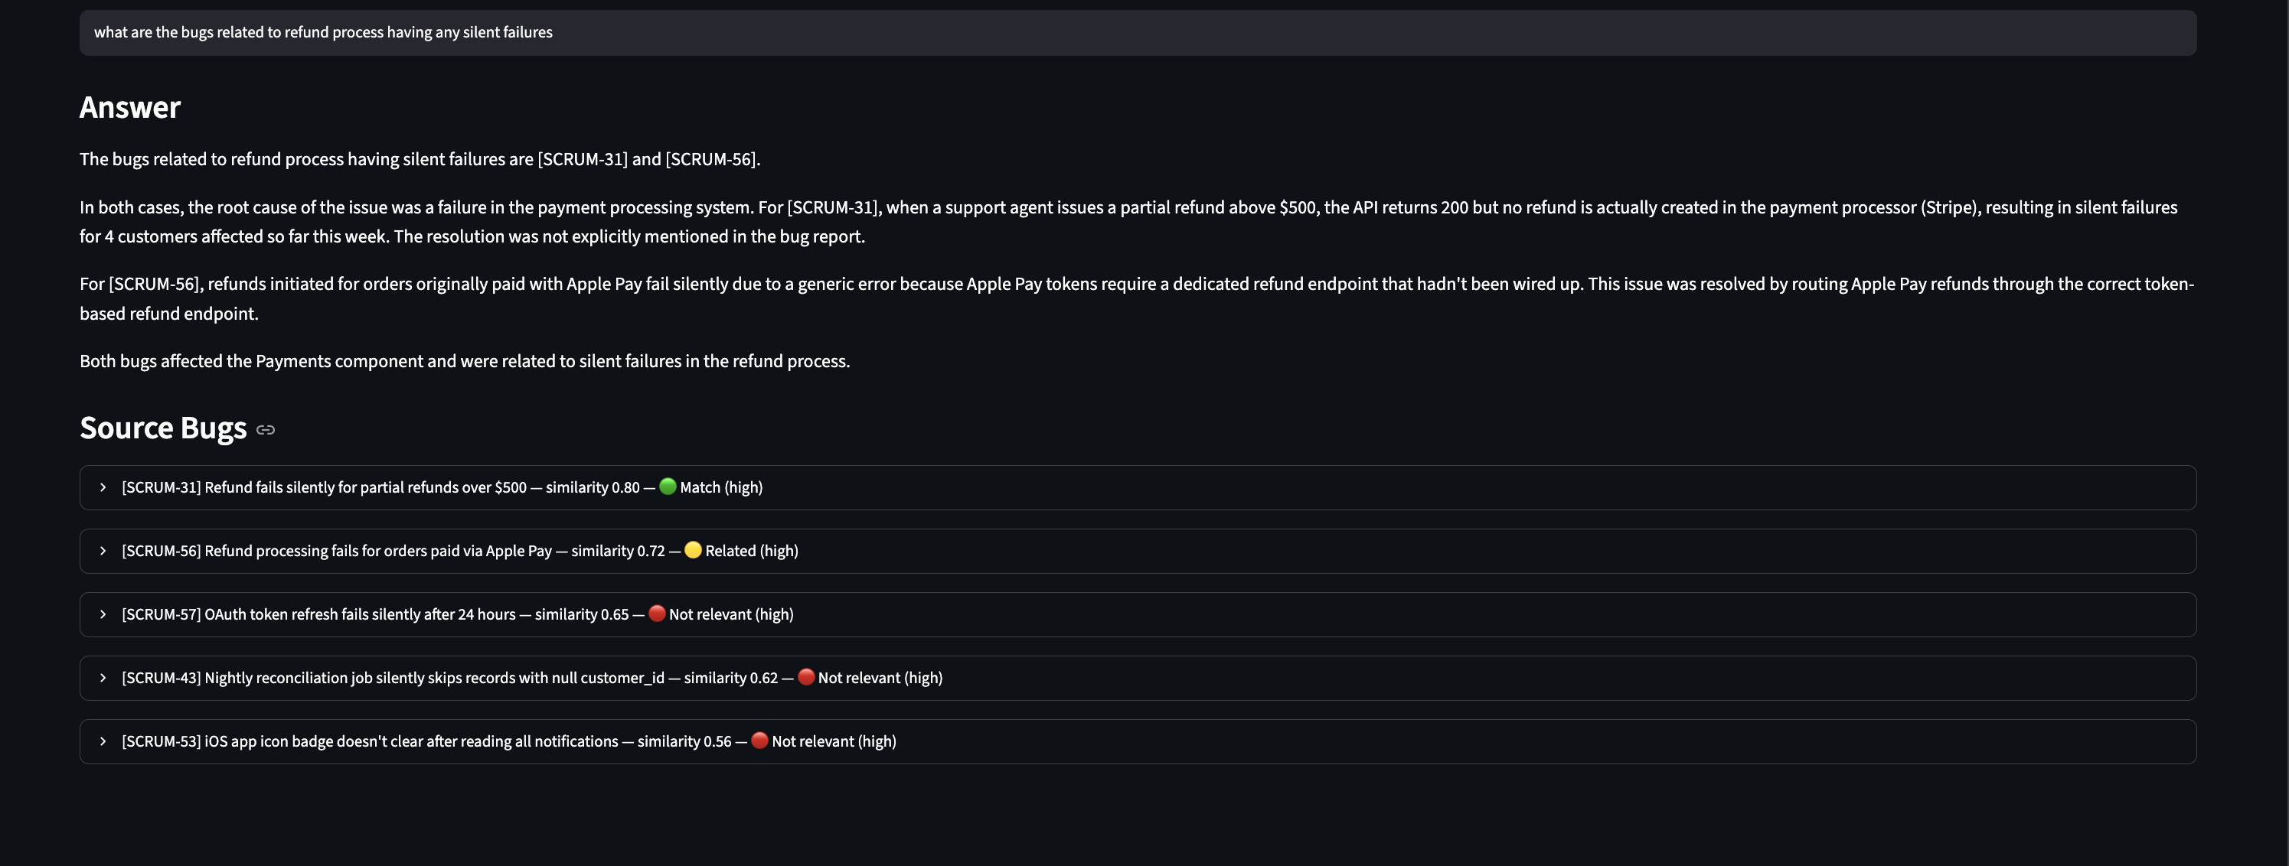
TRUST LAYER
Retrieval finds candidates. A second AI pass decides what’s true.
3 verdicts: 🟢 Match (same root cause) 🟡 Related (same feature, different issue) 🔴 Not relevant — the answer only cites verified bugs; rejected ones stay visible below.
07

Slide 8
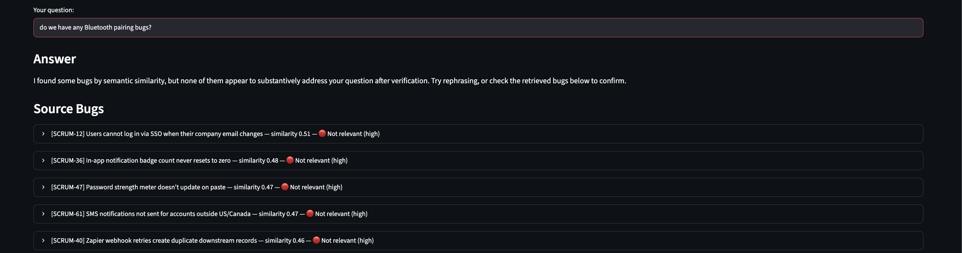
TRUST LAYER
If nothing is actually relevant, BugLens says so.
Query: “do we have any Bluetooth pairing bugs?” — no such bug exists. All 5 candidates score 0.46–0.51 similarity (high enough that a naive system would force an answer) — every one is correctly rejected.
08

Slide 9
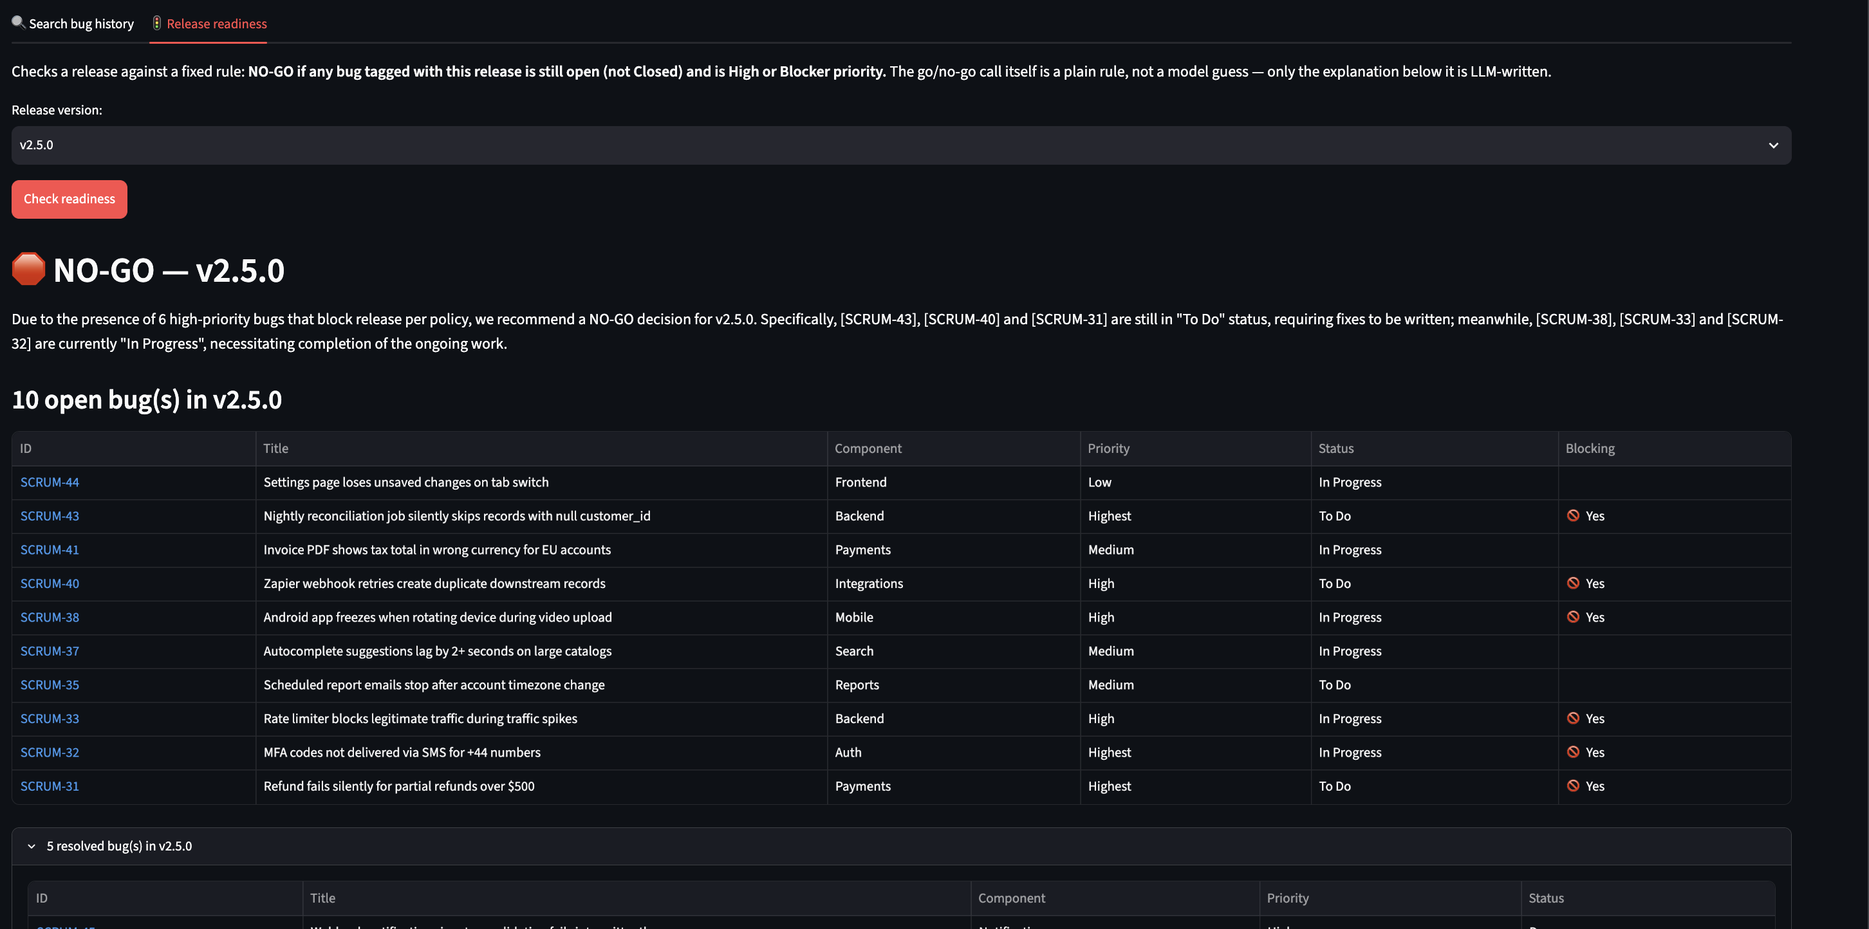
RELEASE GATE
The GO/NO-GO call is a fixed rule in code — not an AI guess.
09
Rule: NO-GO if any bug tagged to this release is open AND High/Blocker priority. v2.5.0 example: 6 of 10 open bugs correctly flagged as blocking — each marked individually in the table above.

Slide 10
RELIABILITY
Guardrails catch the AI’s own mistakes.
✓
Contradiction detection
If the AI’s own reasoning says “related to X” but labels a bug “Match,” the label is automatically corrected to reflect what the reasoning actually says.
✓
Citation validation
The AI is stripped of any bug ID it cites that isn’t in the actual retrieved context — preventing fabricated references from ever reaching the screen.
✓
Consistency enforcement
If two AI-generated fields (the relevance flag and the displayed badge) disagree with each other, the system always defaults to the more conservative reading.
Not theoretical: each guardrail exists because it was built after observing the AI actually make that exact mistake once, live, during testing.
10

Slide 11
RELIABILITY
Tested like production, not like a demo.
📋
Automated regression suite
Every code change re-runs a fixed set of real queries and grades each answer against specific rules: fabricated citations, dropped citations, contradictory badges, wrong arithmetic — not just “did it crash.”
📋
A real catch, not a hypothetical
One run produced a GO recommendation that had swapped its own bug-count numbers ('3 low / 4 medium' became '4 low / 3 medium') while also dropping a bug ID — confidently wrong, and invisible without automated grading.
📋
Guardrails have their own tests
Unit tests cover the guardrail functions themselves (contradiction detection, citation stripping) against known bad inputs — the safety net has its own safety net.
The takeaway: trust in an AI system's output isn't assumed — it's checked, automatically, every time the system changes.
11

Slide 12
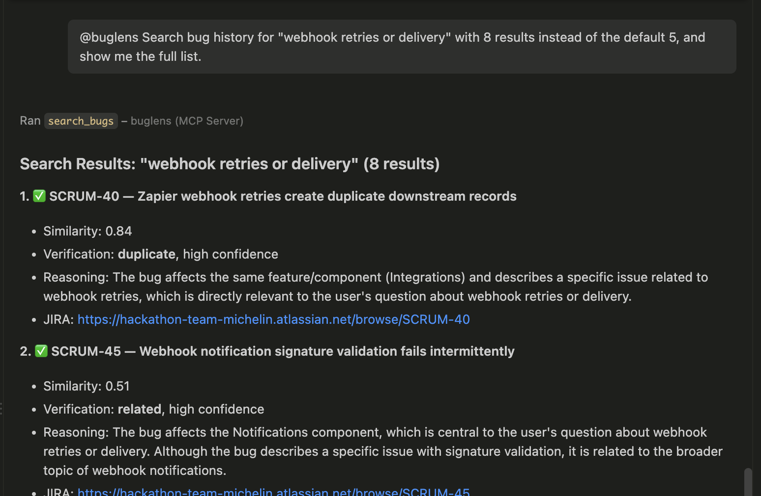
INTEGRATION
Works inside the tools you already use.
Exposed as three MCP tools: search_bugs, check_release, list_releases
Tested live in GitHub Copilot Chat inside VS Code — no separate UI required
Same transparency — clickable Jira links and verification detail, right inside the chat
GitHub Copilot Chat calling search_bugs via MCP
12

Slide 13
HOW MCP ACTUALLY WORKS
Two AI models, working together.
→
→
Copilot's Cloud LLM
BugLens Local LLM (Ollama)
Back to Copilot Chat
Reads your message, decides WHEN to call a BugLens tool
Does the actual retrieval, verification, and grounded reasoning — entirely on your machine
Relays the verified result — Copilot never touches your Jira data directly
Why this matters: even though Copilot might rephrase your question before calling the tool, the actual fact-finding, verification, and citation grounding always happens locally, in BugLens — Copilot is just the interface, not the source of truth.
13

Slide 14
ROADMAP
What's next.
1
2
3
Per-component risk scoring
Multi-project support
Hybrid search tuning
Move beyond a binary release gate toward continuous risk signals — severity distribution and defect trends per component.
One broader JQL plus a project/module filter at query time — no re-architecture of ingest or search needed.
Refine the vector/keyword weighting as the corpus grows well beyond today’s 60-bug dataset.
14

Slide 15
Thank you.
Questions welcome — including the hard ones.
BugLens — Shailja Tyagi — Capgemini AI Hackathon

