Slide 1
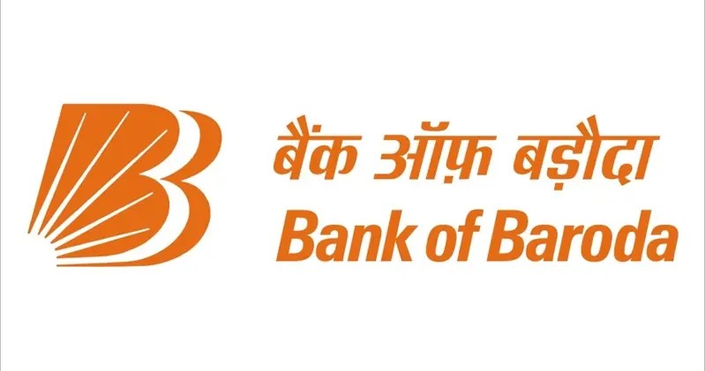
TEAM NAME :- TECH DIWANE
Bank of Baroda Hackathon - 2022

Slide 2
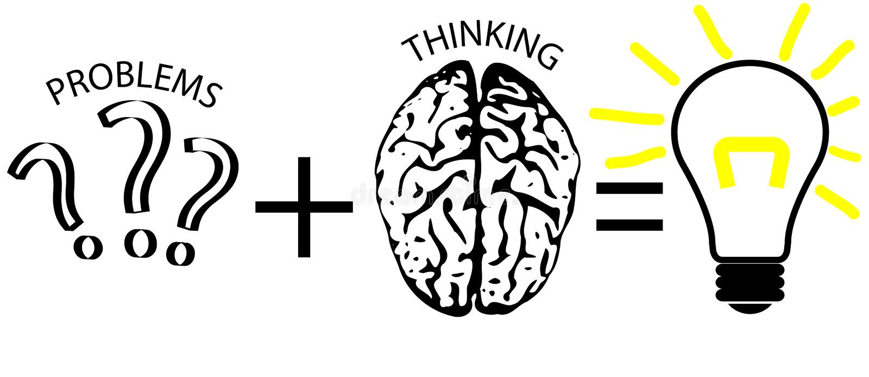
Problem Statement?
Why did you decide to solve this Problem statement?
In a country like India with such huge population, the cheque clearance is one of the most challenging
missions to accomplish.
Not to mention time consuming, prone to errors and being tiresome are the major factors to choose this as the Problem Statement.
Although, there are numerous proposed models for this existing Problem Statement, the problem arises is that they might not fit well into financial scenario.
Putting effort to make our Prototype effective and scalable in all required times.

Slide 3
User Segment & Pain Points
Which user /advertiser segment would be early adopter of your product & why?
Local Merchants, Businesses person, Vendors, or even the bank customers are the early adopter of our product.
Bank, start-up firms.
In short, all that people who are directly connected & are handling financial on daily basis are our target customers.
Handling finances in short amount of time that too which directly involve banks
As our product is –
Time-efficient.
User Friendly.
Secure & Automated.
Economical & Adaptable

Slide 4
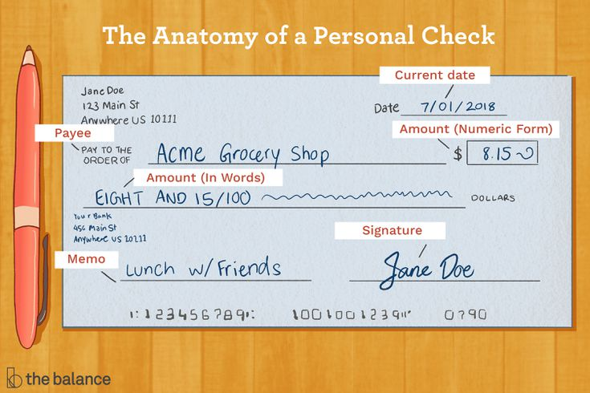
Pre-Requisite
What are the alternatives/competitive products for the problem you are solving?
In case of unclear or unreliable extraction of detail from the cheque images, we can use API & IDP as an alternative for web scrapping and OCR.
APIs- A substitute to web scraping which can be operated for MICR & other text extraction from the cheque image, if the results are not clear.
IDP(Intelligent Document Processing)- It can be an another possible way for the OCR(Optical Character Recognition) as it brings context to content.
Some other alternatives are-
Test Complete
Use coordinate-based user actions

Slide 5
Azure tools or resources
Azure tools or resources which are likely to be used by you for the prototype,
if your idea gets selected
Deep Visual Studio Code to shift from local to cloud training seamlessly and for auto-scaling with powerful cloud-based CPU and GPU clusters.
Central registry to store and track data, models and metadata. Automatically capture lineage and governance data with audit trail.
Microsoft Power BI and services such as Azure Synapse Analytics, Azure Cognitive Search, Azure Data Factory, Azure Arc, Azure Security Centre- to accelerate the productivity.
Azure Stack Edge to extend rapid machine learning inference from the cloud to on-premises or edge scenarios.

Slide 6
Any Supporting Functional Documents
Present your solution, talk about methodology, architecture & scalability
We are extracting details from the cheques using image processing which includes image segmentation, signature verification & MICR detection.
The solution is-
You need to take the image of the cheque(partially similar to scanning), our model will
extract the details from the cheque and verify it with the existing database of the bank.
Later, a request will be generated in the bank system for further processing & requests for granting the cheque clearance.
It will reduce the process time from 3-4 days to hours.
Reduces the probability of committing fraud as a result, the security system is upgraded.
Compliance requirement.

Slide 7
Process Flow Diagram Of Proposed Work
Image Processing
Extraction of items
Date identification
Courtesy amount identification
Legal amount identification
Signature Verification
Cheque Validation
Account verification
Using System date
Using Cnn
Using Cnn
Using signver library
Using MICR, IFSC
Using Cnn, database
Validate All Parameters
No
YES
Invalid
Valid

Slide 8
Key Differentiators & Adoption Plan
How is your solution better than alternatives and how do you plan to
build adoption?
Multi-linguistic(English & Hindi)
An easy to use & handy application that can be used by the bank as well as bank customers.
It can also be utilized for document verification and receipt-verification; Multipurpose.
Better Accuracy in economical point of view.
Particular security & compliance requirements.
Provides better customer services.
Produce maximum part of end product without excessive usage of manual input from the user;Automatic.
All these are better alternatives for existing models and that is the major building block for adoption!

Slide 9

GitHub Repository Link & supporting diagrams, screenshots, if any
How far it can go?
Invoice verification : It can be added to this model using which re-verification of the extracted details through image processing, can be done by the customer.
Customer diversity : India, being a various languages speaking country and BOB is one of the leading banks of the nation, the requirement of making our model multilinguistic becomes a mandatory piece of work.
This add-on will eventually provides a favorable service to the local customers.
https://github.com/Shailly0502/Tech-Diwane

Slide 10
THANK YOU
Team Members –
Astha Goel
Amisha Singh
Shailly Raj
Anubhav Yadav

