Slide 1
Assignment-I
STOCK WEB ORACLE
Web Development Framework using Flask
Submitted by:
Shail Sharma
2210993837
Sonali Saini
2210993848
Submitted to:
Dr. Rajan Kumar
Chitkara University Institute of Engineering and Technology, Punjab

Slide 2
Table of Contents
Introduction
Methodology
Tools and Technologies
Major Findings/Outcomes/Output/Results
Conclusion and Future Scope
References
Appendices

Slide 3
Introduction
This project aims to predict stock prices using machine learning algorithms integrated into a Flask web application.
2. By leveraging historical stock price data and relevant features, the project seeks to empower users with accurate predictions for informed decision-making.
3. The primary objective is to provide users, including investors and traders, with a user-friendly platform to access stock price forecasts.
4. The project utilizes Python, Flask, Pandas, Scikit-learn, and Visual Studio Code as its core technologies for development.
5. Methodologically, it involves data collection, preprocessing, model training, Flask application development, and deployment.
6. The significance lies in bridging machine learning and web development to address challenges in financial market prediction.
7. The project's interface allows users to input data, select features, and obtain predictions seamlessly.

Slide 4
Methodology
1. Data Collection: Obtain historical stock price data from reliable sources.
2. Preprocessing: Cleanse and preprocess the data, handling missing values and outliers.
3. Model Selection: Choose a suitable machine learning algorithm for stock price prediction.
4. Training: Train the selected model using preprocessed data.
5. Web Development: Develop a Flask web application for user interaction and prediction display.
6. Deployment: Deploy the Flask application on a web server for accessibility to users.

Slide 5

Tools and Technologies
1. Python: Utilized as the primary programming language for its versatility.
Flask: Chosen as the web framework for its simplicity and flexibility.
Pandas and NumPy: Employed for data manipulation and numerical computing.
Scikit-learn: Utilized for implementing machine learning algorithms.
Visual Studio Code: Used as the integrated development environment (IDE) for coding efficiency.
6. SQL Alchemy: Employed for managing and persisting user data, historical stock data, and model configurations within the Flask application.

Slide 6
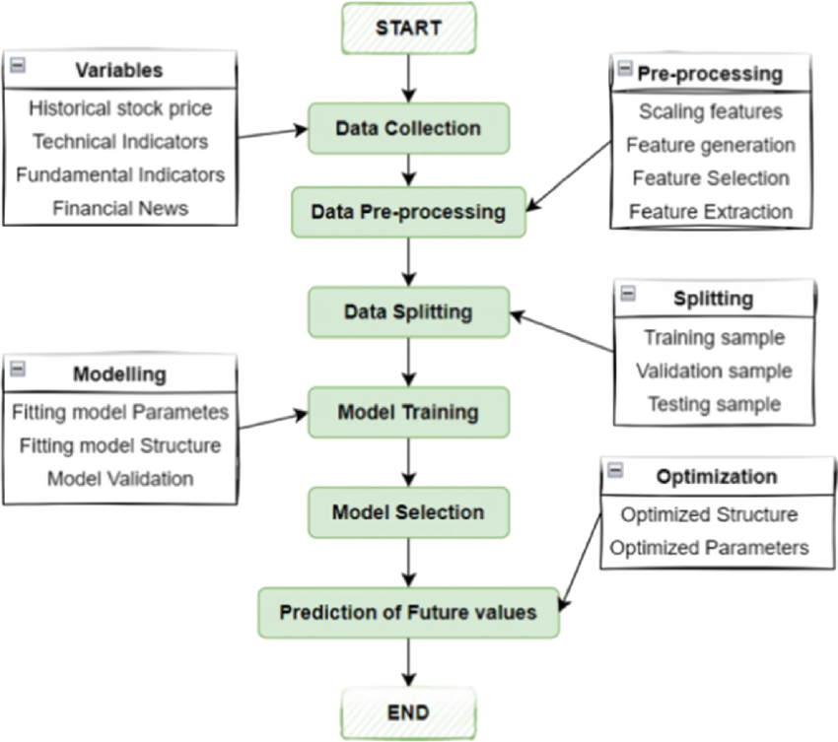
Flowchart
(Login/Sign up)

Slide 7
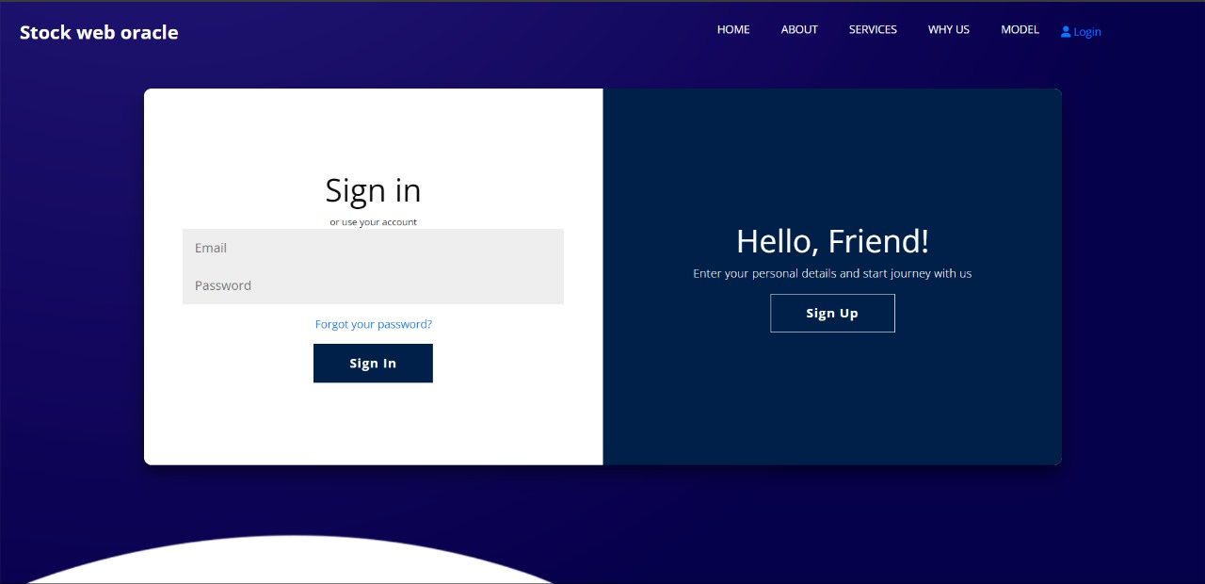
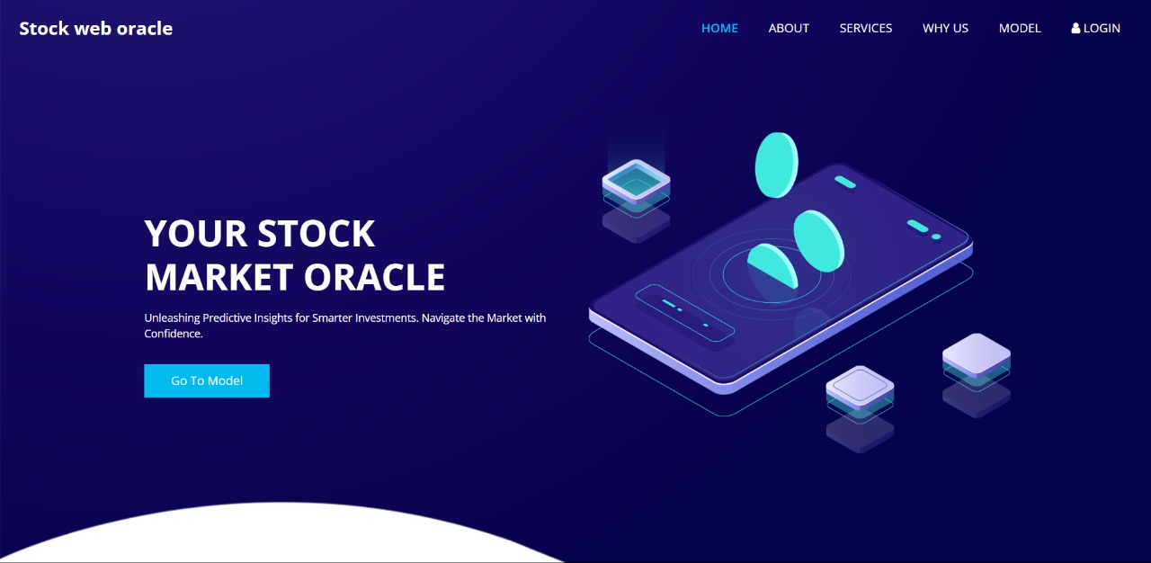
Findings

Slide 8
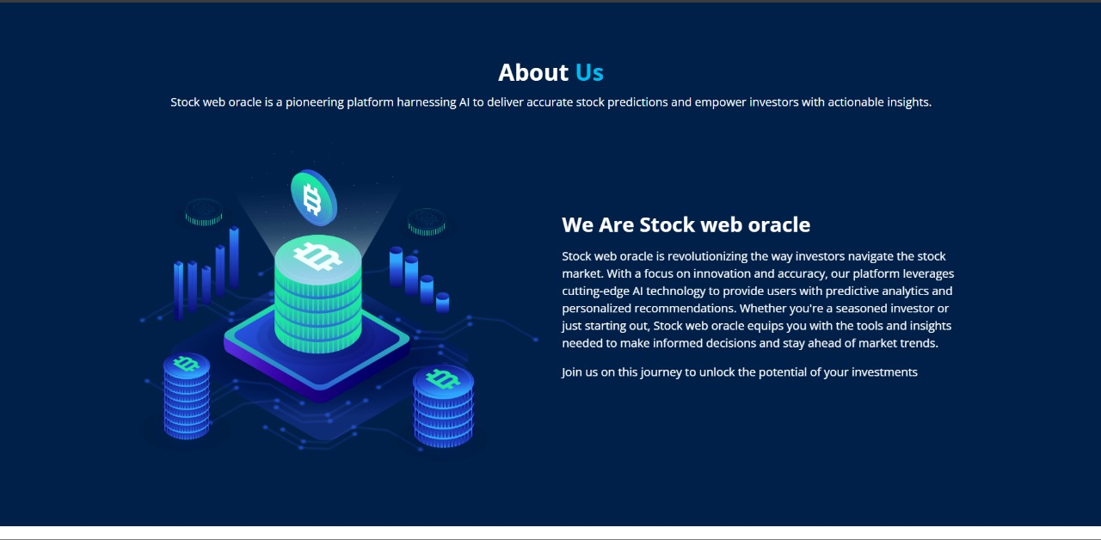
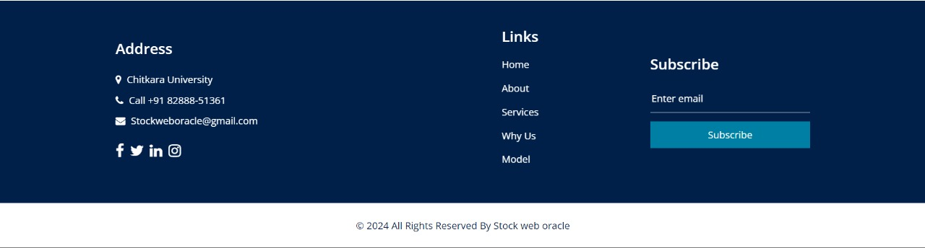
Findings

Slide 9
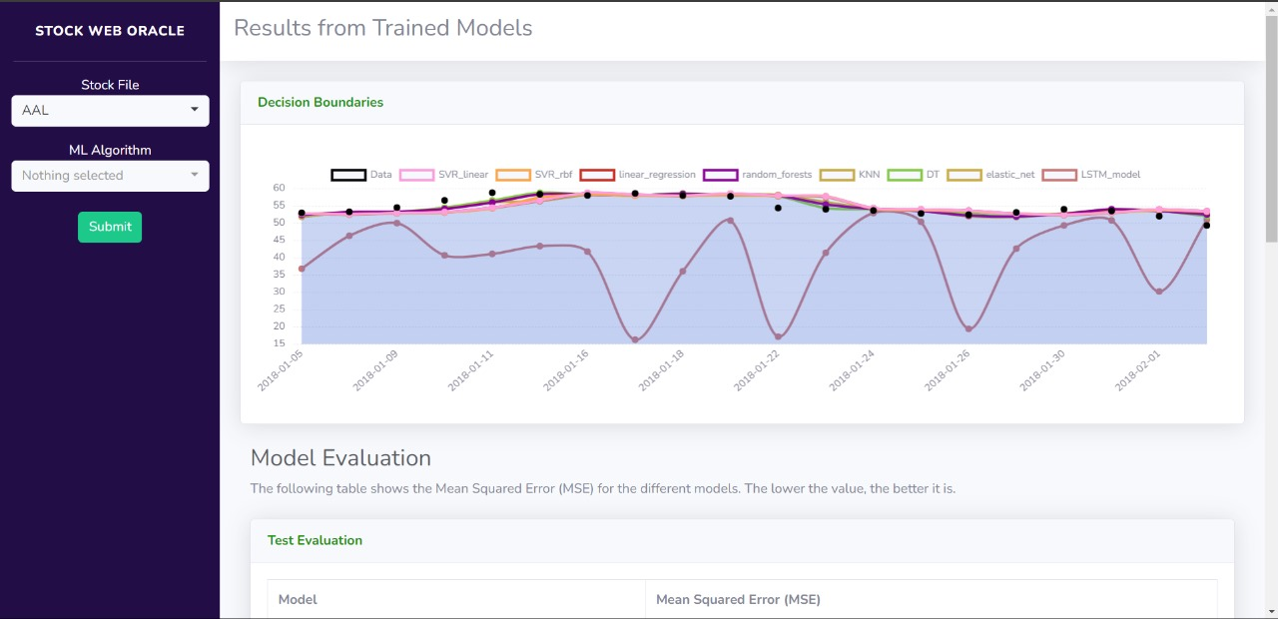
Findings

Slide 10
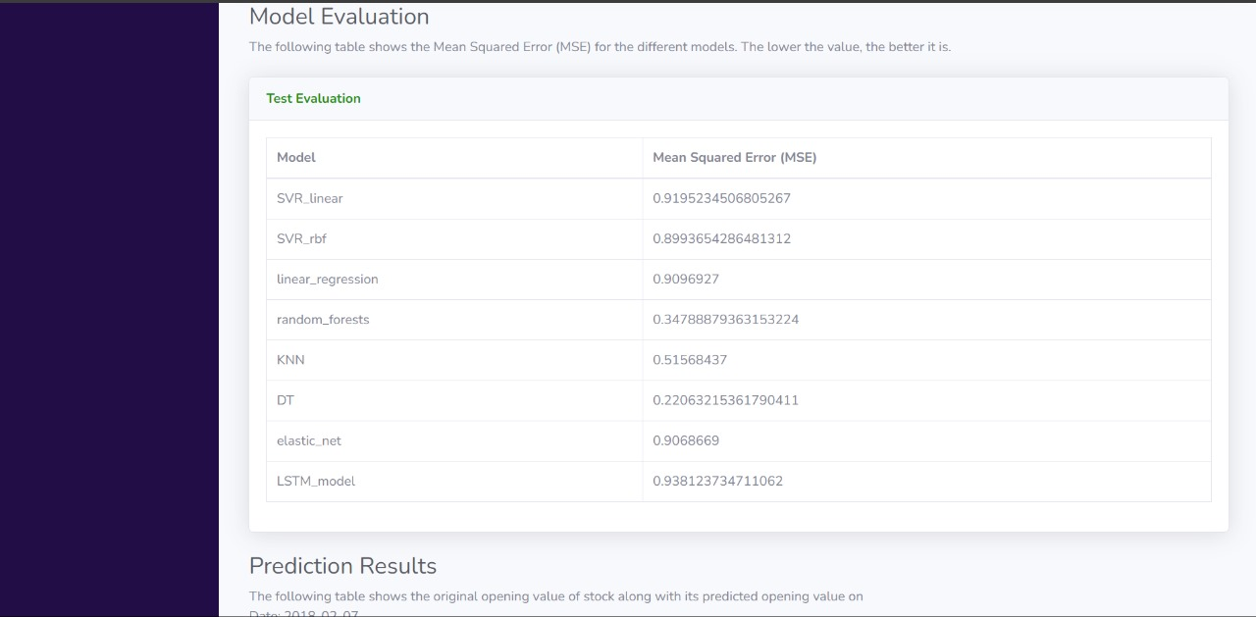
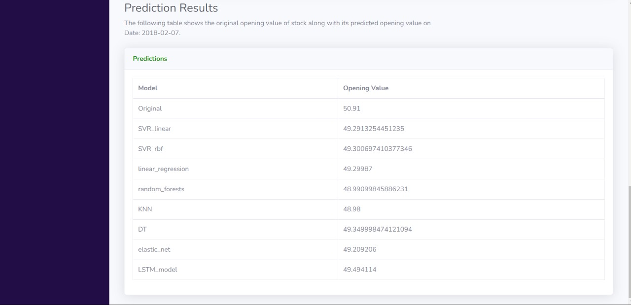
Findings

Slide 11
Conclusion
1. Accomplishments: Highlight the achievements and goals met during the project, such as successfully implementing a Flask-based web application for stock price prediction.
2. Key Findings: Summarize the main findings or insights gained from the project, such as the performance of different machine learning algorithms in predicting stock prices.
3. Challenges: Discuss any challenges or obstacles encountered during the development and implementation of the project, such as data preprocessing issues or model optimization difficulties.
4. Lessons Learned: Reflect on lessons learned from the project, including new skills acquired, best practices discovered, or areas for improvement in future projects.
5. Impact: Discuss the potential impact or relevance of the project, both in terms of its contribution to the field of stock market prediction and its practical applications for investors or financial analysts.
6. Acknowledgments: Thank any individuals or organizations that contributed to the project's success, such as mentors, collaborators, or sources of funding or support.

Slide 12
Future Scope
1. Advanced Algorithm Integration: Explore the integration of more advanced machine learning algorithms and techniques, such as deep learning models or ensemble methods, to further improve the accuracy and robustness of stock price predictions.
2. Real-time Data Analysis: Enhance the application to support real-time data analysis and streaming updates, enabling users to make timely decisions based on the latest market trends and information.
3. Predictive Analytics: Extend the predictive capabilities of the application beyond stock price prediction to include features like trend analysis, volatility forecasting, and anomaly detection, providing users with comprehensive insights into market behavior.
4. User Customization: Implement features that allow users to customize their analysis and prediction models based on their specific investment preferences, risk tolerance, and financial goals, enhancing the application's versatility and relevance to diverse user needs.
5. Integration with External APIs: Integrate with external financial data APIs, news feeds, and sentiment analysis tools to enrich the application with additional data sources and contextual information, enabling more informed and comprehensive decision-making for users.

Slide 13
References
Flask Documentation: Flask is a lightweight web framework for Python, known for its simplicity and flexibility in building web applications. The official Flask documentation provides comprehensive guides, tutorials, and API references for developers. Visit Flask Documentation https://flask.palletsprojects.com/en/3.0.x/
SQL Alchemy Documentation: SQL Alchemy is a powerful ORM tool for Python, enabling developers to interact with databases using high-level objects and queries. The SQL Alchemy documentation offers detailed explanations of its features, usage, and best practices. Visit SQL Alchemy Documentation https://flask-sqlalchemy.palletsprojects.com/en/3.1.x/
3. Scikit-learn Documentation: Official documentation for Scikit-learn library, which provides tools for machine learning tasks like model training and prediction.
4. TensorFlow Documentation. (n.d.). Retrieved from https://www.tensorflow.org/
5. Visual Studio Code Documentation (n.d.). Retrieved from https://code.visualstudio.com/docs

Slide 14


