Slide 1
Inside a Neural Network
How layers, neurons, weights, activation functions, loss functions, and optimizers work together
Shailu Beesupaka · AIML-501 Model Development · Indiana Wesleyan University

Slide 2

How data flows through a network
Input layer
features X1, X2
Hidden layer 1
4 neurons
Hidden layer 2
2 neurons
Output layer
1 prediction
Forward pass: inputs move left to right and become a prediction
Backward pass (training only): the error flows back to adjust every weight
Shown: the Playground's default network. Learning type: supervised. Task: binary classification (blue = +1, orange = −1). Sources: Goodfellow et al. (2016); Smilkov et al. (2017)

Slide 3
Layers organize the work
1
Input layer
Hidden layers
Output layer
Receives the raw features. In the Playground, these are each point's X1 and X2 coordinates. It does no calculation.
Transform the data step by step. Each layer builds more complex patterns from the simpler patterns found by the layer before.
In the Playground, one tanh neuron outputs a value from −1 to 1. Positive values mean blue (+1); negative values mean orange (−1).
Deep learning simply means a network with many hidden layers. My third Playground experiment used four.
Sources: Goodfellow et al. (2016); Google for Developers (n.d.); TensorFlow (n.d.-a)

Slide 4
A neuron is a small calculator
2
1
Weigh
Multiply each input by its weight.
x₁
w₁
Σ + b
f( )
2
Add
Sum the results and add a bias (b).
x₂
w₂
y
w₃
3
Activate
Pass the total through an activation function f to get the output y.
x₃
4
Pass on
In a fully connected network like the Playground's, y goes to every neuron in the next layer.
y = f(w₁x₁ + w₂x₂ + w₃x₃ + b)
Sources: Goodfellow et al. (2016); Google for Developers (n.d.)

Slide 5
Weights decide what matters
3
Strength
A larger weight gives an input more influence on the neuron's output.
25
Direction
Positive weights keep an input's effect; negative weights reverse it. In the Playground: blue = positive, orange = negative, thicker = larger.
learnable values in the Playground's default network: 18 weights + 7 biases
Learned, not set
In the Playground, weights start as random numbers between −0.5 and 0.5. Training then adjusts them to reduce the loss.
151
in my 4-layer network (126 weights + 25 biases)
Bias
Each hidden and output neuron also has a bias (starting at 0.1 in the Playground) that shifts when the neuron becomes active.
Counts: weights = connections between layers; biases = one per hidden and output neuron. Sources: Goodfellow et al. (2016); TensorFlow (n.d.-a)

Slide 6
Activation functions let networks bend
4
ReLU max(0, x)
Passes positives, blocks negatives. Fast and the most common choice for hidden layers.
Sigmoid squashes to 0 to 1
Useful for outputs that are probabilities.
Tanh squashes to −1 to 1
Centered on zero. The Playground's default.
Without them, any stack of layers collapses into a single linear model, which can only draw a straight boundary, never a circle or a spiral.
Sources: Goodfellow et al. (2016); Nair & Hinton (2010)

Slide 7
Loss functions measure mistakes
5
Squared error (used by the Playground)
Loss = ½ × (output − label)² for each point, averaged over all points. A perfect prediction scores 0; the worst possible scores 2.
Cross-entropy (common elsewhere)
Many classification models use cross-entropy instead, which punishes confident wrong answers even more heavily.
Every loss value in my experiments is this average squared error, measured on the 250 test points.
Chart values calculated as 0.5 × (output − 1)². Sources: Goodfellow et al. (2016); TensorFlow (n.d.-a)

Slide 8
Optimizers turn mistakes into learning
6
new weight = old weight − learning rate × gradient
1 Forward pass
Inputs flow through to a prediction
2 Measure loss
Compare prediction with the true answer
Mini-batch gradient descent
Averages gradients over a small batch, then updates. The Playground updates after every 10 points.
repeat
Adam
Adapts each weight's step size automatically. Widely used, but not in the Playground.
4 Update weights
Nudge every weight to reduce the loss
3 Backpropagation
Calculate each weight's gradient: how the loss changes if that weight changes
Learning rate
Too high overshoots the best weights; too low learns slowly. The Playground default is 0.03.
Sources: Rumelhart et al. (1986); Kingma & Ba (2015); TensorFlow (n.d.-a)

Slide 9

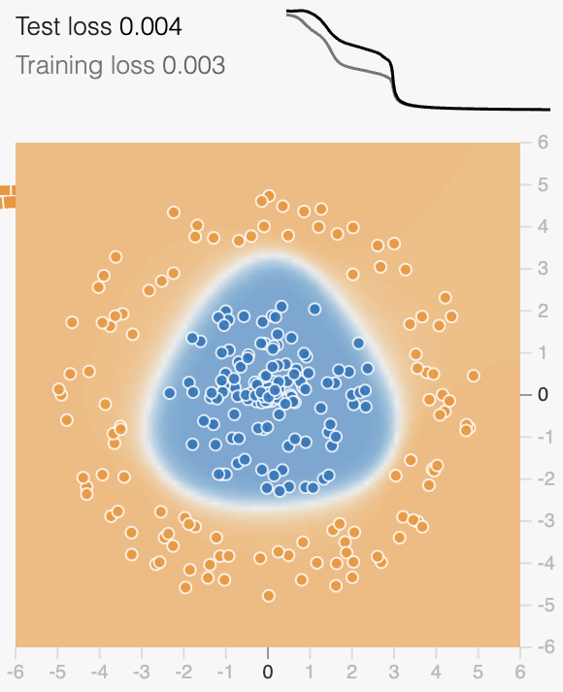
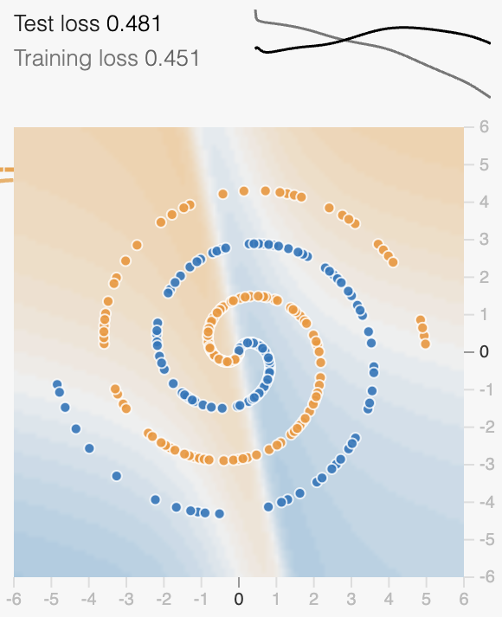
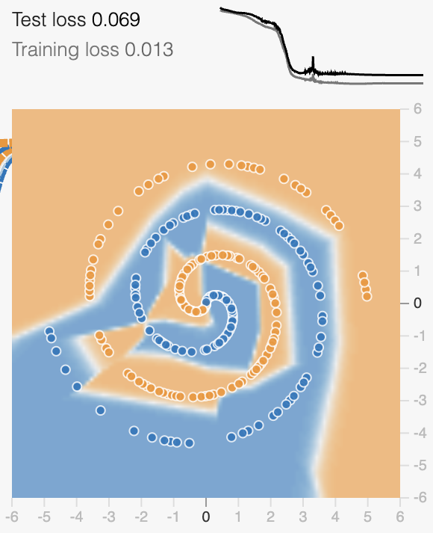
My TensorFlow Playground experiments
1 · Circle data
2 · Spiral, same network
3 · Spiral, bigger network
2 hidden layers (4, 2) · Tanh
323 epochs
2 hidden layers (4, 2) · Tanh
313 epochs
4 hidden layers (6 each) · ReLU
512 epochs
0.004 test loss
0.481 test loss
0.069 test loss
All runs: supervised binary classification, 500 points (250 train, 250 test), learning rate 0.03, batch 10, noise 0, no regularization, inputs X1, X2. TensorFlow (n.d.-b)
Notes:
To repeat these experiments, open each link, click Play, and pause at the epoch shown.
Experiment 1 (circle, 4-2 network, tanh, paused at epoch 323):
https://playground.tensorflow.org/#batchSize=10&regDataset=reg-plane&learningRate=0.03&regularizationRate=0&noise=0&seed=0.20480&showTestData=false&discretize=false&percTrainData=50&x=true&y=true&xTimesY=false&xSquared=false&ySquared=false&cosX=false&sinX=false&cosY=false&sinY=false&collectStats=false&problem=classification&initZero=false&hideText=false&activation=tanh&dataset=circle&networkShape=4,2
Experiment 2 (spiral, 4-2 network, tanh, paused at epoch 313):
https://playground.tensorflow.org/#batchSize=10&regDataset=reg-plane&learningRate=0.03&regularizationRate=0&noise=0&seed=0.20480&showTestData=false&discretize=false&percTrainData=50&x=true&y=true&xTimesY=false&xSquared=false&ySquared=false&cosX=false&sinX=false&cosY=false&sinY=false&collectStats=false&problem=classification&initZero=false&hideText=false&activation=tanh&dataset=spiral&networkShape=4,2
Experiment 3 (spiral, 6-6-6-6 network, ReLU, paused at epoch 512):
https://playground.tensorflow.org/#batchSize=10&regDataset=reg-plane&learningRate=0.03&regularizationRate=0&noise=0&seed=0.20480&showTestData=false&discretize=false&percTrainData=50&x=true&y=true&xTimesY=false&xSquared=false&ySquared=false&cosX=false&sinX=false&cosY=false&sinY=false&collectStats=false&problem=classification&initZero=false&hideText=false&activation=relu&dataset=spiral&networkShape=6,6,6,6
The seed fixes the dataset. Starting weights are random, so repeated runs give similar but not identical loss values.

Slide 10

What the experiments showed me
The data sets the difficulty. After about 300 epochs, the same small network reached 0.004 on the circle but only 0.481 on the spiral.
More layers and ReLU solved the spiral. Test loss dropped about 86%, from 0.481 to 0.069, and the boundary followed the spiral's arms.
Bigger has a cost. Learnable values grew from 25 to 151, and training loss (0.013) ended below test loss (0.069), a gap that can signal overfitting.
You can see ReLU at work. The spiral's boundary is made of straight-edged pieces, because networks of ReLU neurons build piecewise-linear boundaries.
Values from my three Playground runs. 86% = (0.481 − 0.069) ÷ 0.481. Starting weights are random, so repeat runs vary slightly.

Slide 11
Why visualizing neural networks matters
Why it matters
Key insights I gained
It opens the black box: you can watch weights and decision boundaries change as the network learns.
It makes problems visible, such as a network too small for its data or one starting to overfit.
It helps explain AI to non-technical audiences without a single equation.
Each component has one job, and together they form a loop: predict, measure the loss, backpropagate, update.
Activation functions are what let networks learn curved patterns.
The right network size depends on the data, and the gap between training and test loss is the warning light.
Watching the network learn turned six separate definitions into one connected system.

Slide 12

References
Goodfellow, I., Bengio, Y., & Courville, A. (2016). Deep learning. MIT Press. https://www.deeplearningbook.org/
Google for Developers. (n.d.). Neural networks. Machine Learning Crash Course. https://developers.google.com/machine-learning/crash-course/neural-networks
Kingma, D. P., & Ba, J. (2015). Adam: A method for stochastic optimization. In 3rd International Conference on Learning Representations. https://doi.org/10.48550/arXiv.1412.6980
Nair, V., & Hinton, G. E. (2010). Rectified linear units improve restricted Boltzmann machines. In Proceedings of the 27th International Conference on Machine Learning (pp. 807–814).
Rumelhart, D. E., Hinton, G. E., & Williams, R. J. (1986). Learning representations by back-propagating errors. Nature, 323(6088), 533–536. https://doi.org/10.1038/323533a0
Smilkov, D., Carter, S., Sculley, D., Viégas, F. B., & Wattenberg, M. (2017). Direct-manipulation visualization of deep networks (arXiv:1708.03788). arXiv. https://doi.org/10.48550/arXiv.1708.03788
TensorFlow. (n.d.-a). Playground [Source code]. GitHub. https://github.com/tensorflow/playground
TensorFlow. (n.d.-b). A neural network playground [Online tool]. https://playground.tensorflow.org/

