Slide 1

Job Matrix
Sakshi Jadhav 23107110
Vishal Gupta 23107139
Mayur Gosavi 23107092
Shaily Gupta 23107085
Project Guide
Ms. Aavani N

Slide 2
Contents
Introduction
Objectives
Scope
Features
Project Outcomes
Technology Stack
Block Diagram

Slide 3
1. Introduction
Problem Identified :
Job seekers face difficulties in finding suitable job openings and tracking their applications efficiently.
Companies struggle with managing and filtering job applications, leading to a time-consuming hiring process.
Solution Proposed :
Develop an online platform where users can easily search and apply for jobs, streamlining the application process.
Provide companies with a dashboard to post jobs, review applications, and accept or reject candidates efficiently.

Slide 4
2. Objectives
To develop an efficient platform for job applications and recruitment by using python(tkinter) for creating GUI and Mysql (8.0.39) for storing the data.
To allow users to search and apply for jobs easily by using filter method in python(tkinter).
To enable companies to review applications and make hiring decisions python(tkinter) for creating GUI and Mysql (8.0.39) for storing the data .
To provide a structured job management system for both parties python(tkinter) for creating GUI and Mysql (8.0.39) for storing the data.

Slide 5
3. Scope
The platform will be accessible to job seekers and companies.
Users can register, create profiles, and apply for jobs.
Companies can post job listings and manage applicants.
Admin functionalities for system monitoring and maintenance.

Slide 6
4. Features
Candidate & Employer Registration & Profile Management
Both job seekers and employer must register to access this platform.
Job seekers can create profiles, upload resumes, and update personal details, while employer can set up company profiles and job postings.
Job Search & Application
Job seekers can browse available jobs, search by title, location, and salary, and apply with a single click.

Slide 7
4. Features
3. Recruiter Job Management
Recruiters can post job openings, manage applications, review candidate profiles, and accept or reject applications based on suitability.

Slide 8
5. Outcome of Project
Candidate and Employer can log in securely.
Candidate can search for job options available.
Candidate can filter and search jobs by providing following input Job titles , Locations , Salary.
Employer can create jobs , manage jobs and can hire candidates wisely.

Slide 9
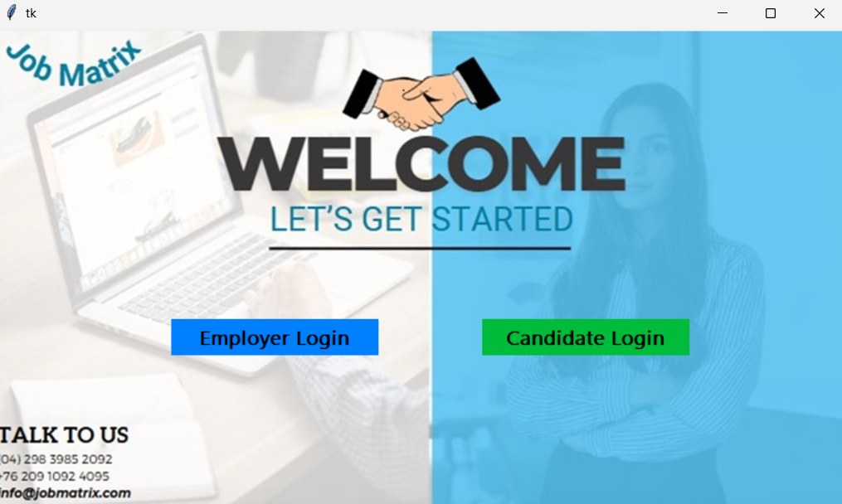
Welcome page

Slide 10
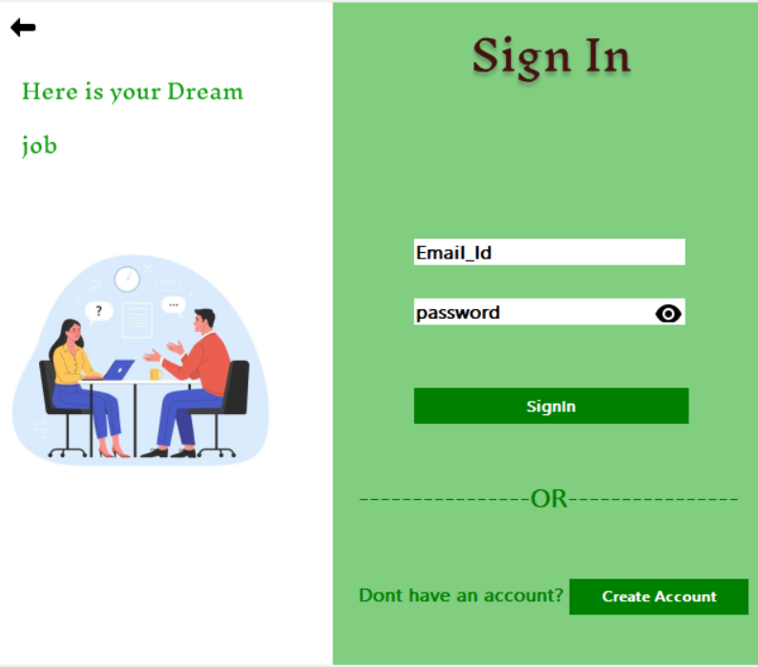
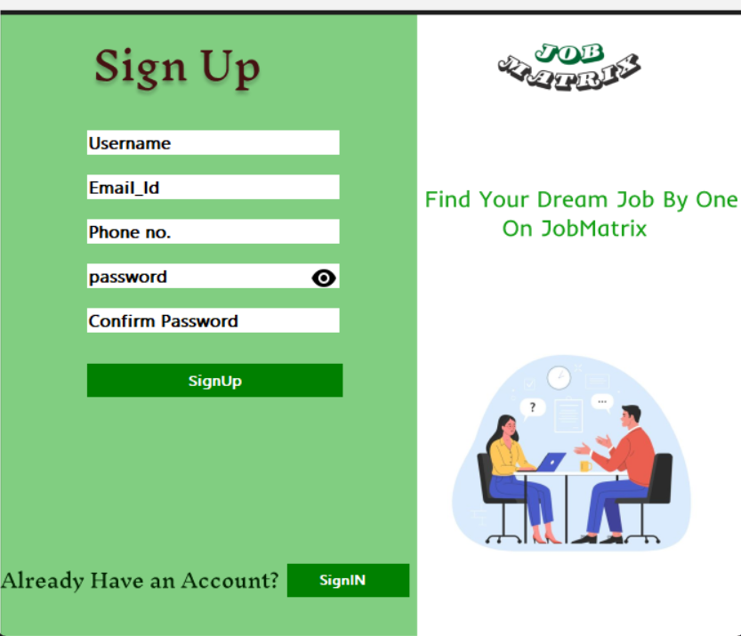
Candidate sign in
Candidate sign up

Slide 11
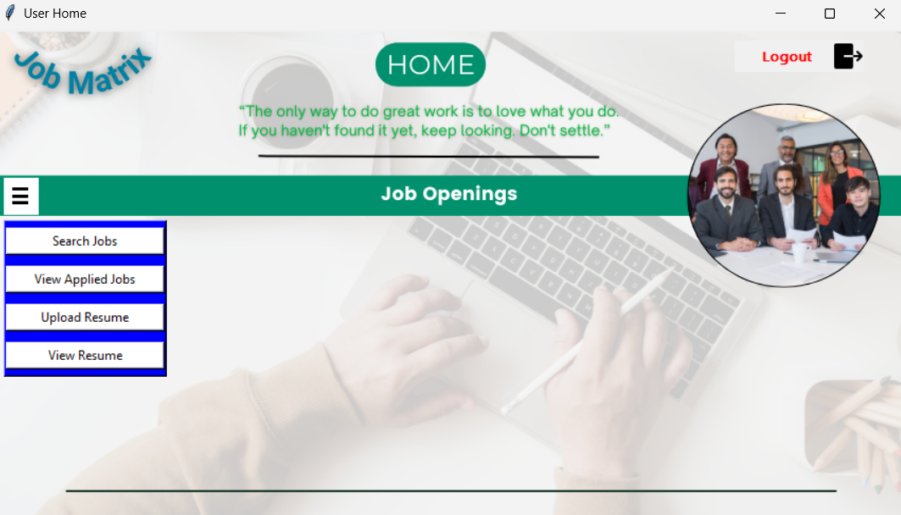
Candidate home page

Slide 12
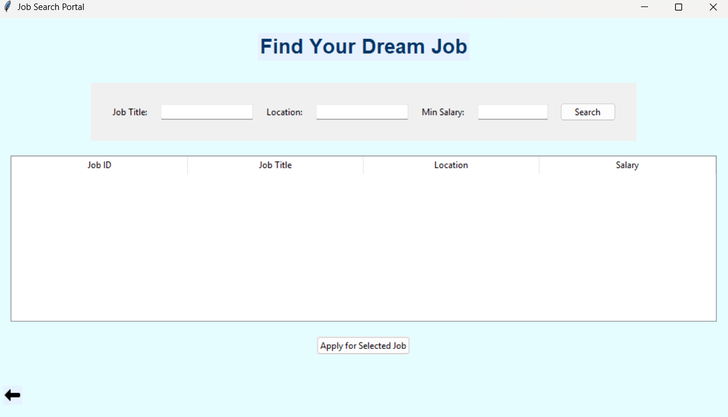
Job Search

Slide 13
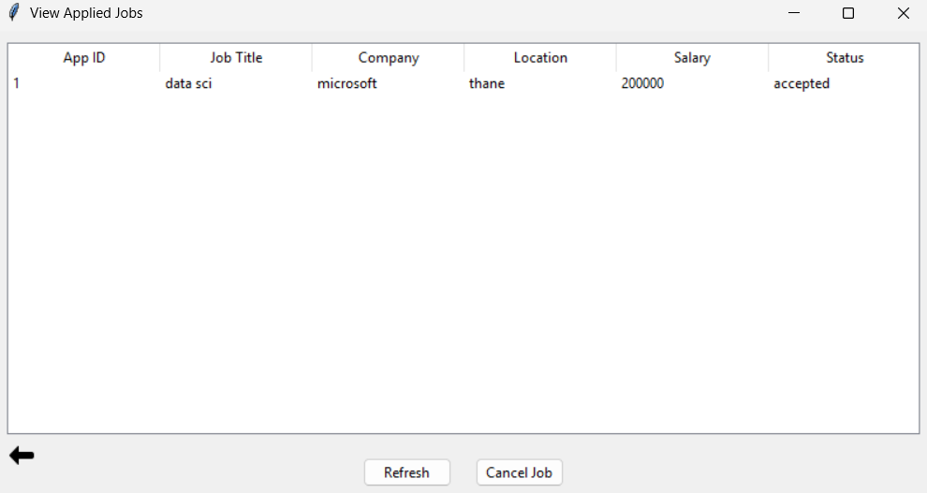
View Applied Job

Slide 14
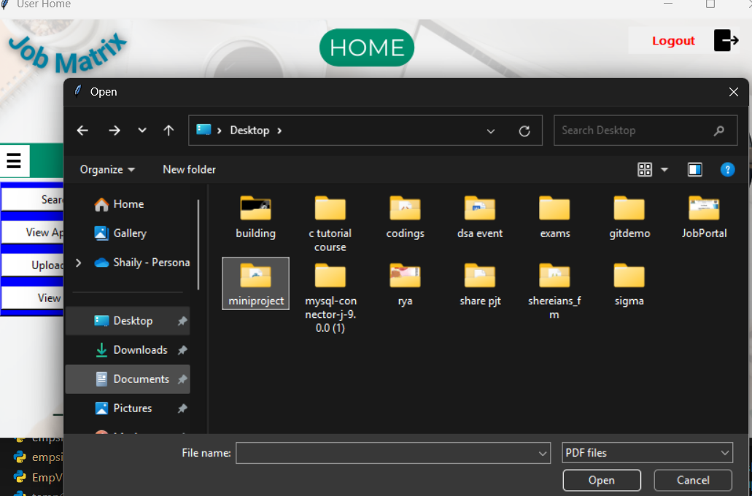
Upload Resume

Slide 15
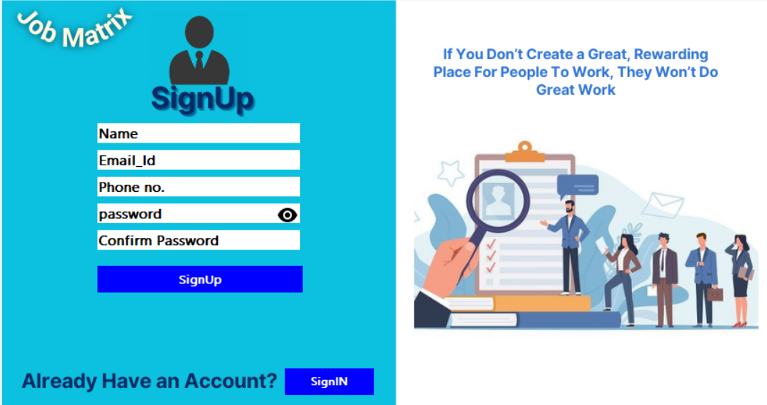
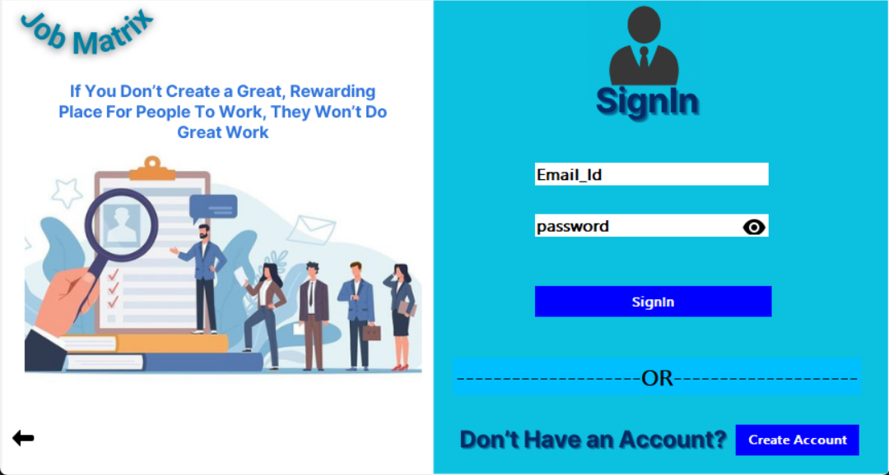
Employer Signup
Employer sign in

Slide 16
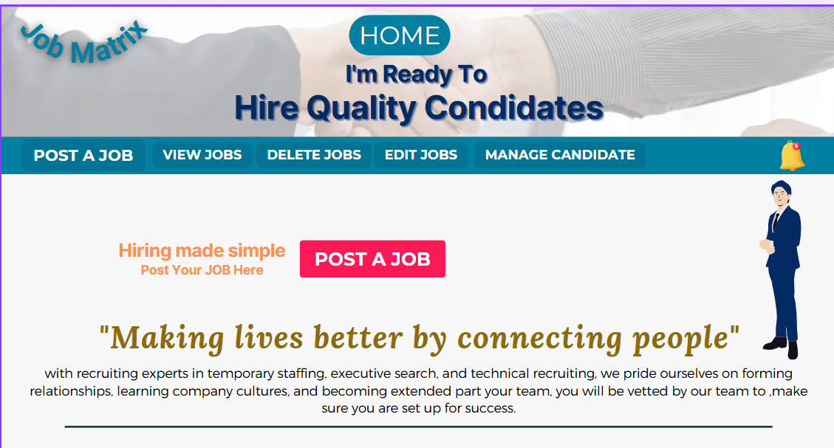
Employer home page

Slide 17
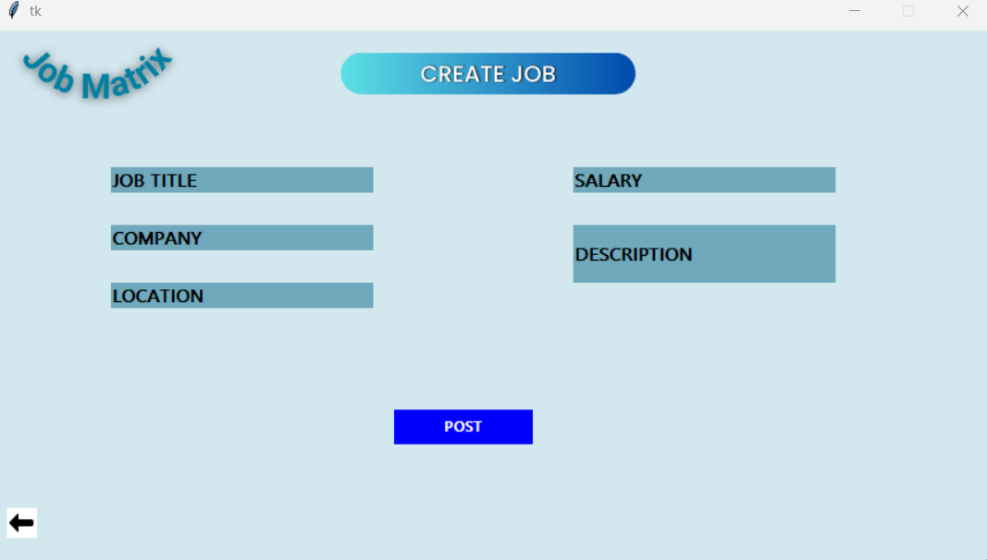
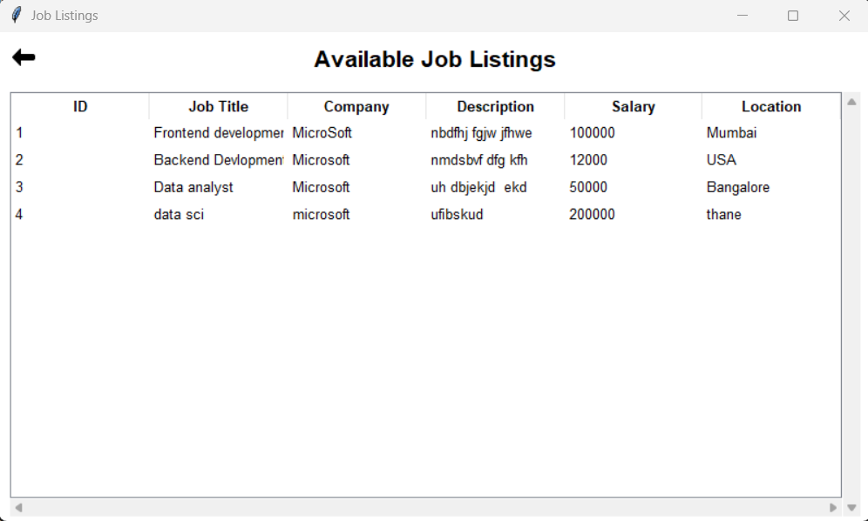
Create A Job
Available job Listing

Slide 18
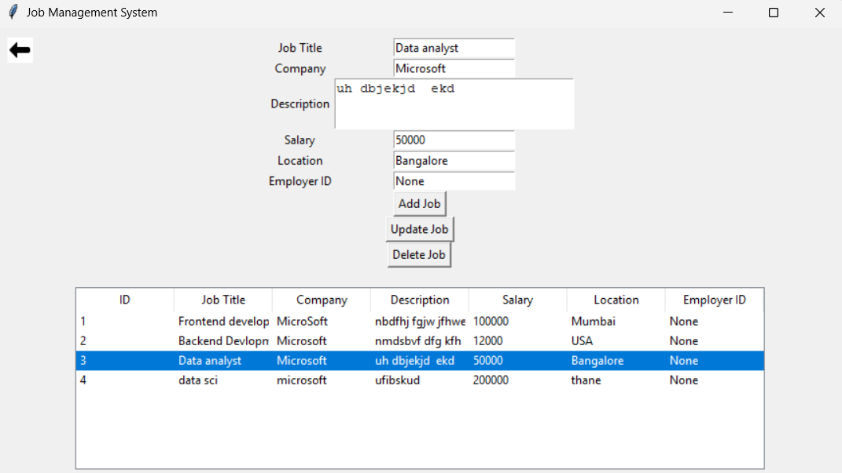
Manage jobs

Slide 19
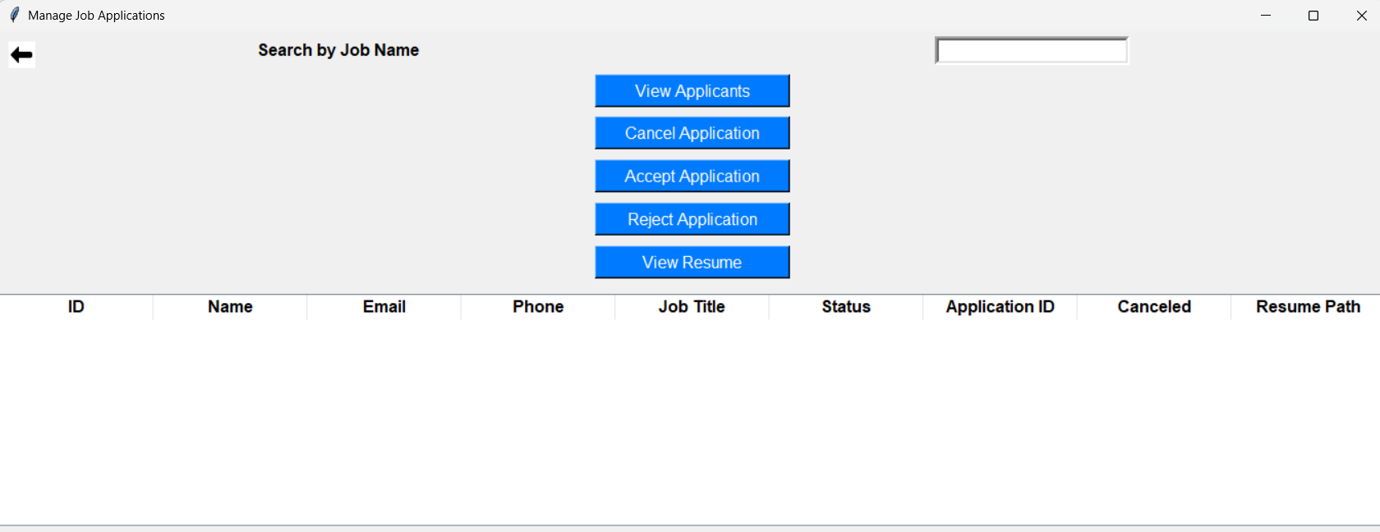
Manage Candidates

Slide 20
6. Technology Stack
-Using Python (Tkinter) for creating front end GUI
-Using MySQL for database
-pyMySQL or connecting MySQL database with Python

Slide 21
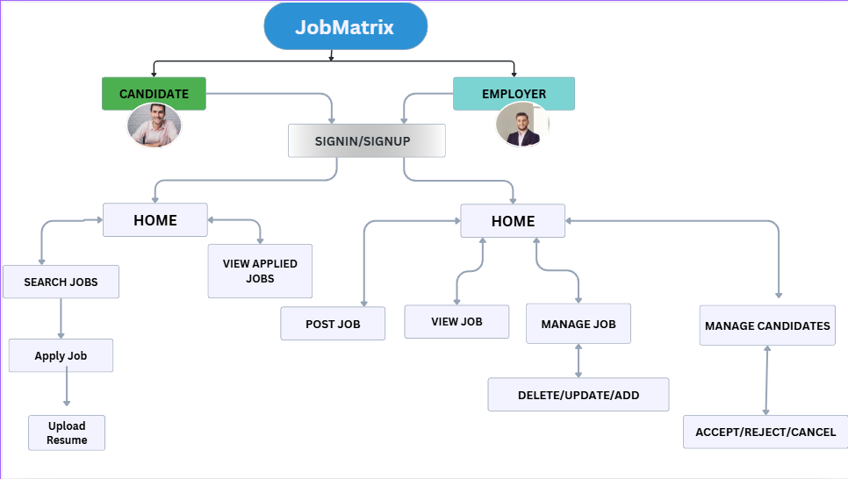
7. Block Diagram

Slide 22
Thank You...!!

