Slide 1


Rockbuster Stealth LLC
Business Insight's for 2020 Marketing campaign

Slide 2
Project motives and Objectives
Rockbuster Stealth LLC, is a movie rental company that used to have stores around the world. Facing stiff competing from other streaming services such as Netflix and Amazon Prime, the management team is planning to use it’s existing movie licenses to launch an online video rental service in order to stay in competition
Key Questions:
Which movie contributed the most/least to the revenue?
What was the average rental duration for all videos?
Do sales figures vary between geographic regions
Which countries are customers based?
Where are customers with high lifetime value based?

Slide 3
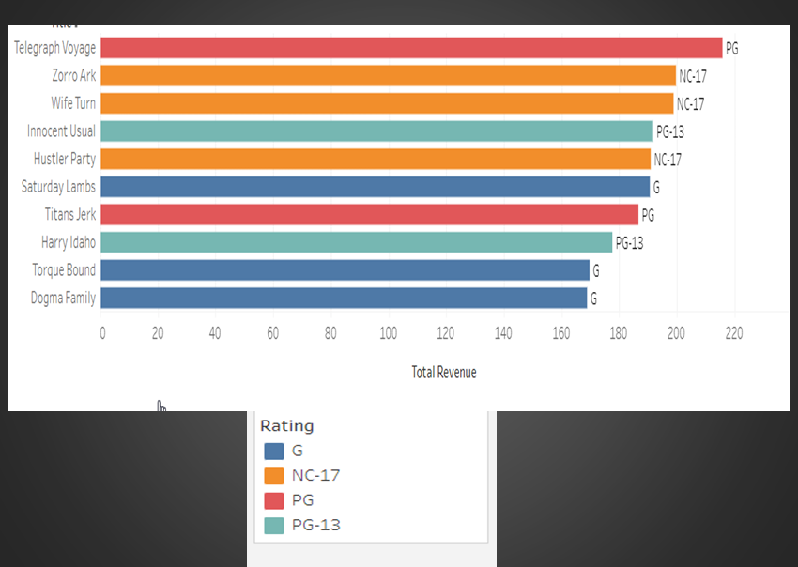
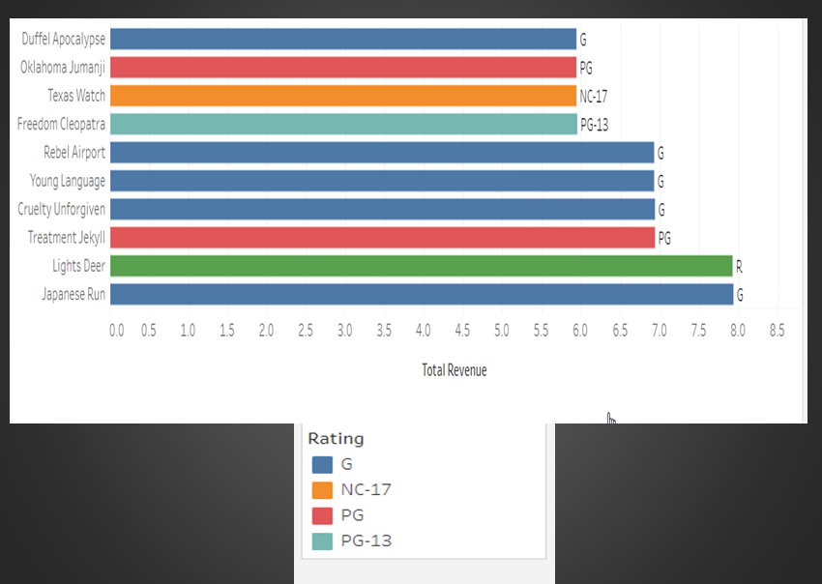
Sales for Genre and Ratings: The below chart includes movies that generated most and the least sales for Rockbuster. We can see that PG movie Telegraph voyage was sold(or rented) the most.
Top revenue generating movies
Least revenue generating movies

Slide 4
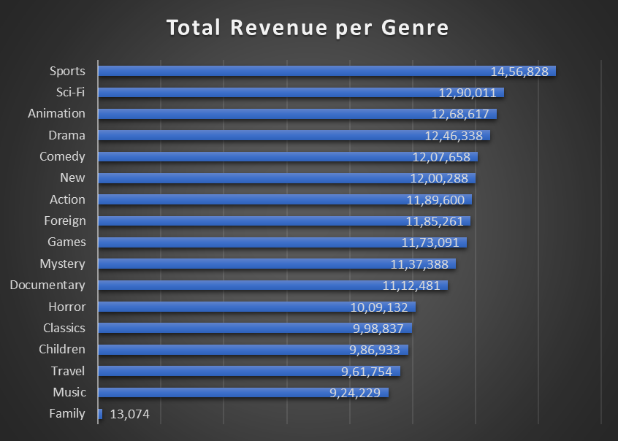
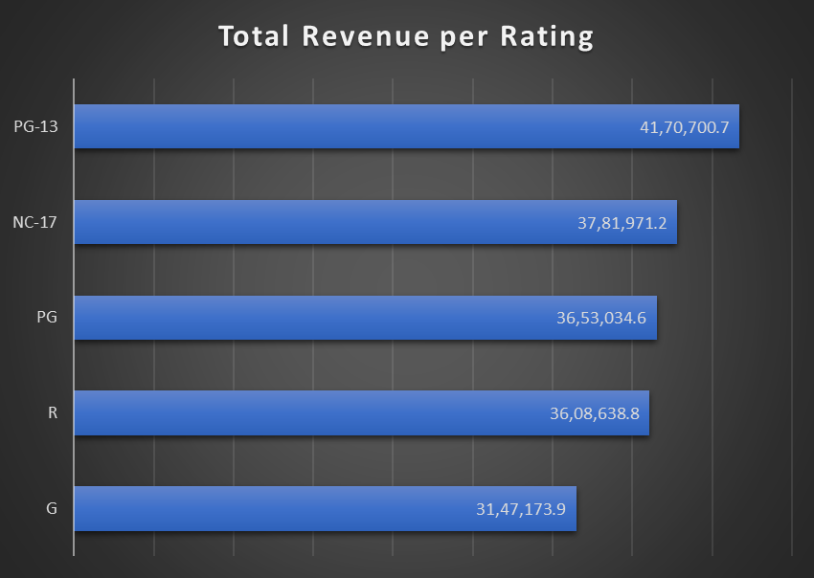
Sales for Genre and Ratings: The 2 bar charts depict the revenue generated by the movies and their different genre’s. PG-13 genre has topped the revenue charts.
Revenue per genre
Revenue per rating

Slide 5
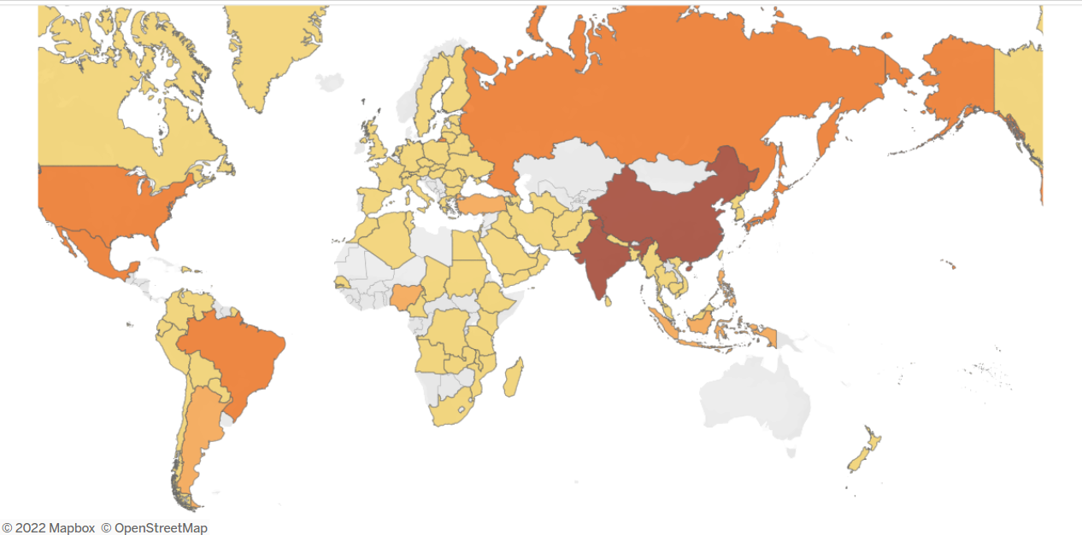

Rockbuster customer base across Globe: The following geographical chart depicts the customer’s of Rockbuster from least to most.

Slide 6
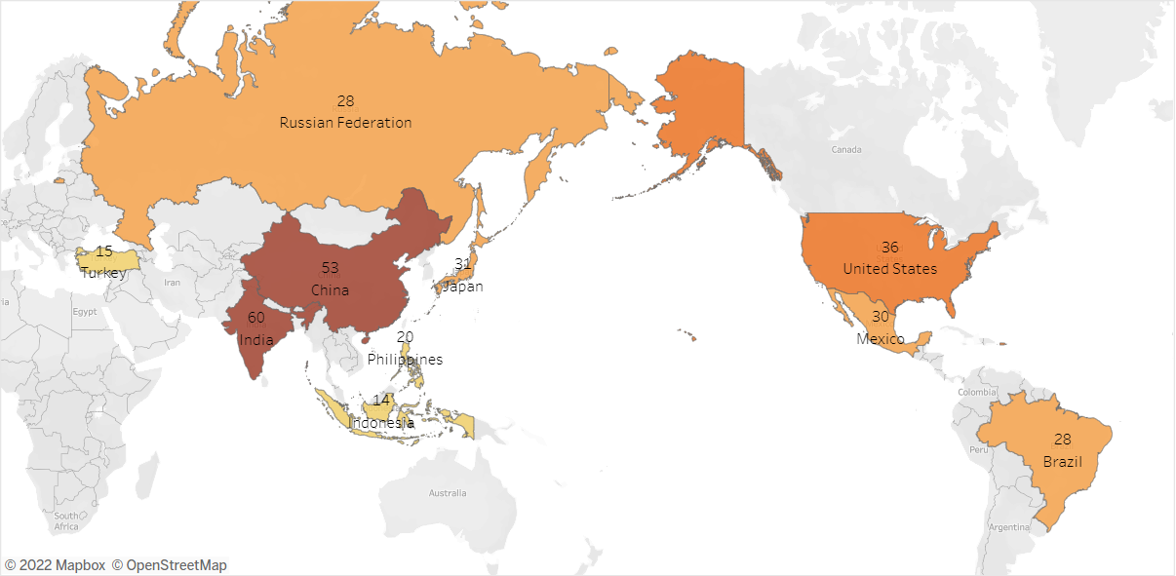
Rockbuster’s maximum Customer and Revenue base: The map below shows the countries with the maximum customer base for Rockbuster.

Slide 7
From previous slide, Rockbuster’s maximum customer’s are in the America and Asia.
As we can see from the previous slide that Rockbuster’s maximum customer’s are in the America and Asia and a few countries. Here is a list of top 10 countries where Rockbuster has a strong customer base.
India
China
Unites States of America
Japan
Mexico
Brazil
Russia
Philippines
Turkey
Indonesia
Here is the link to the geographical representation with customer count: https://public.tableau.com/app/profile/shaily7118/viz/Countrieswithcustomercount/Sheet1?publish=yes

Slide 8
Insights and Recommendations:
Asia is the most profitable region as we have noticed maximum customer base in India and China. These 2 countries also make up for the highest revenue proportion for Rockbuster, therefore it would be beneficial for the company to invest and market more to the customer base in both India and China as well as neighbouring countries.
The most favourable genre are sports and animation and the most favourable ratings are PG-13, nc-17 and PG. As a result it is imperative to focus on leveraging highest-rated and genre specific on –demand films and expanding the inventory to accommodate a wider selection of titles.
Lastly, it is important to reward top-paying subscribers to support client relationships and offer them new services that may be of interest to them.

