Slide 1
Report of Perceptrons
By: Shaima Nabeel Albokhari
The experiment involved training a multi-class perceptron model on the MNIST dataset to classify handwritten digits (0-9). The dataset was split into training and test sets, and pixel values were normalized to the range [0, 1]. A bias term was added to the feature vectors, and binary labels were created for each digit to train 10 separate perceptrons (one for each digit).
The model was trained using three different learning rates (0.001, 0.01, and 0.1) over 50 epochs, and the training and test accuracies were recorded for each learning rate.
A custom confusion matrix was implemented to evaluate the model's performance, and the results were visualized using heatmaps.
The experiment revealed that a learning rate of 0.1 resulted in less confusion between digits compared to
0.001 and 0.01, suggesting that a larger learning rate updates weights more precisely. However, the small dataset size limited the generalizability of the results, and further experimentation with larger datasets, cross-validation, and intermediate learning rates was
recommended to determine the optimal learning rate.

Slide 2
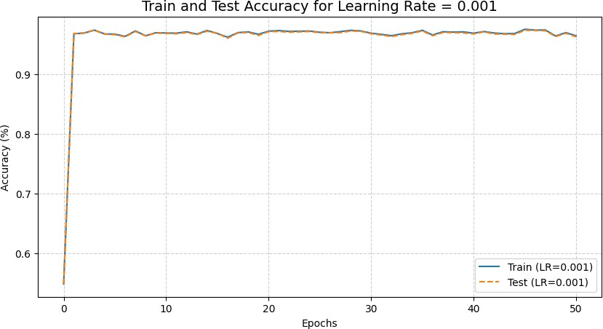
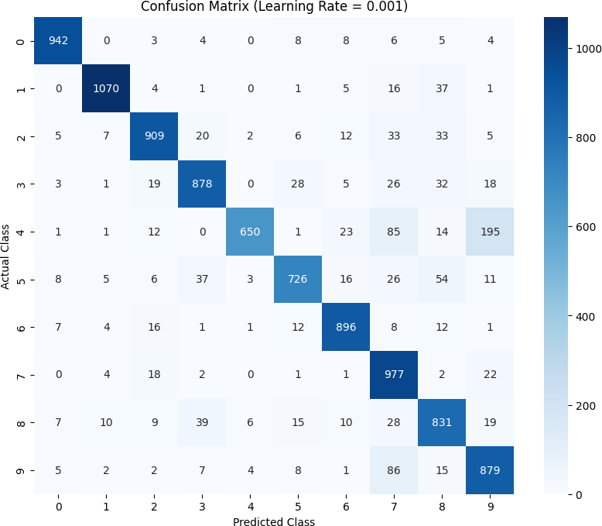

For 0.001 learning rate:
which digits are classified most accurately? The most highly ranked number is number 1 with the correct classifications being 1070.
and which digits tend to be confused with one another?
The most classified number is number 1. every numbers confused with one another. the most numbers confused is:
1. (4 , 9) = 195
2. (9 , 7) = 86
3. (4 , 7) = 85
And the less confused number is (0,1) or (1,0) = zero, also (3,4) or (4,3) = zero.
When the learning rate is 0.01, the number of correct predictions is 8,758.
Note: (actual , predicated)

Slide 3
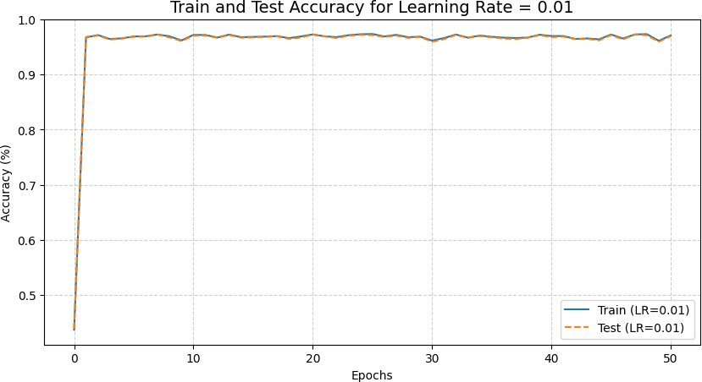
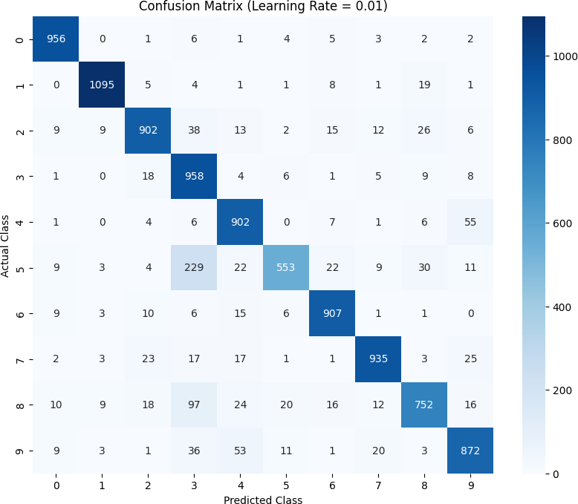

For 0.01 learning rate:
which digits are classified most accurately? The most highly ranked number is number 1 with the correct classifications being 1095.
and which digits tend to be confused with one another?
The most classified number is number 1. every numbers confused with one another. the most numbers confused is:
1. (5 , 3) = 229
2. (8 , 3) = 97
3. (4 , 9) = 55
And the less confused number is (0,1) or (1,0) = zero.
When the learning rate is 0.01, the number of correct predictions is 8,832.
Note: (actual , predicated)

Slide 4
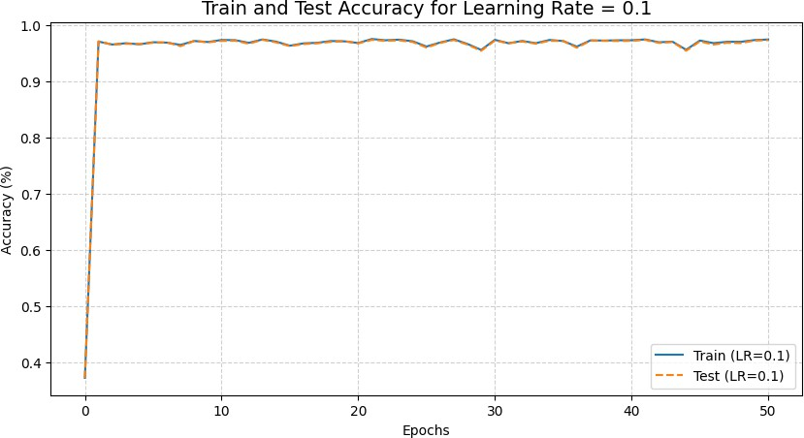
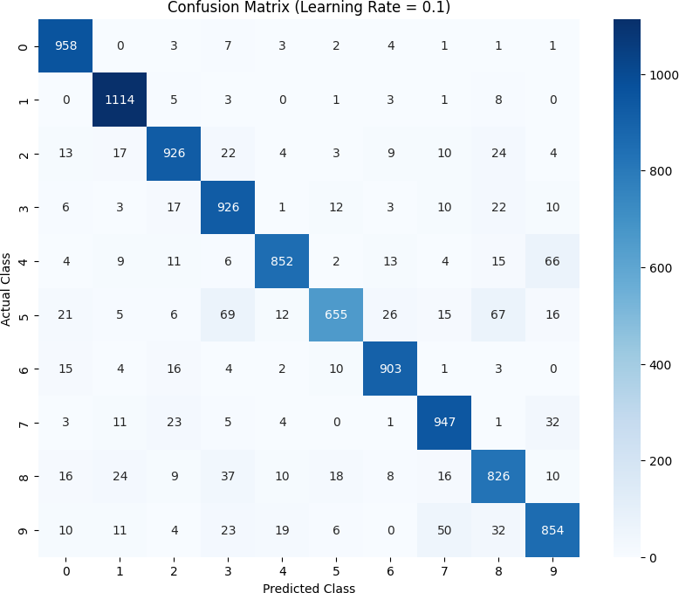

For 0.1 learning rate:
which digits are classified most accurately? The most highly ranked number is number 1 with the correct classifications being 1114.
and which digits tend to be confused with one another?
The most classified number is number 1. every numbers confused with one another. the most numbers confused is:
1. (5 , 3) = 69
2. (5 , 8) = 67
3. (4 , 9) = 66
And the less confused number is (0,1) or (1,0) = zero, also (9,6) or (6,9) = zero.
When the learning rate is 0.01, the number of correct
predictions is 8961.
Note: (actual , predicated)

Slide 5
comparing results of different learning rates.
Did you see any difference in the results when using different learning rates?
When comparing the results of different learning rates (0.001, 0.01, and 0.1), I observed that the difference in accuracy is not significant. However, the confusion matrix shows that a learning rate of 0.1 results in less confusion between numbers compared to 0.001 and 0.01.
This suggests that the larger learning rate (0.1) updates the weights more effectively, reducing classification errors.
That said, I am not certain if 0.1 is the best choice due to the small dataset used in the experiment. With more data, the results might differ, and another learning rate (such as 0.15) could perform better.
To make a more informed decision, I suggest testing the model on a larger dataset and using techniques such as cross-validation and learning curve analysis.
Additionally, experimenting with intermediate learning rates (such as 0.05 or 0.07) could help determine if there is a learning rate that provides a better balance between speed and accuracy.

