Slide 1
What we do , how we do it and who do we serve ?
▶ We are a website that provide services in fitness and give healthy lifestyle to people
▶ We do what we do by using trusted experts in the field of fitness , providing healthy meals and products
▶ We serve everyone from all ages .

Slide 2
What is our customers problems and how we give them the solutions ?
▶ Many people neglect the issue of health and fitness because they are too busy/lazy to care for their fitness and lifestyle .
▶ We provide advice , guidance ,
healthy meals and products while you are in your home .

Slide 3
How do we decide our prices , and where does our income come from ?
▶ Our prices is determined by cost of the session with the experts and products prices
▶ We take a percentage from the expert who work through our website , as well we take an additional percentage on the prices of meals that are displayed on our website by restaurants who provide healthy food

Slide 4
Who do we reach our customers and what is our referral generation strategy ?
▶ We use Ad's on social media , and commercials to be our voice and reach the maximum number of people who want to change
▶ And for our referral strategy we use feedback from our changed clients , show the results of their changes and how it's effect there life's in positive way .

Slide 5
Who do we compete with and why would you chose us every time ?
▶ In our business market there is fitness clinics , fitness self-employed coaches and more of healthy restaurants around
▶ We only allow the most distinguished experts in the market to work through our website , and we are different from almost any other competitor that our work entirely is Online .

Slide 6
What is our goals next year ?
▶ To change 4,000 lifestyles (4,000 new signups) to a healthy lifestyle with the help of our partner experts .
▶ To reach 10,000 product sales from all kind of products in our website

Slide 7
What is the internal factors that affect us ?
▶ In our strengths side we don’t have big expenses other than commercials and web development
▶ In the other hand because this project base team specialize in programming not business we can call it a weakens .

Slide 8
What is the external factors that affect us in positive way ?
▶ Our biggest opportunities lies in :
▶ 1- as we work online we have an opportunity to reach and be reached by big companies and long distance experiences
▶ 2- Any one (customer) can reach us because we done our full work online
▶ 3- Our website include everything a person need to have a
healthy lifestyle (healthy meals , fitness experts , trainers )

Slide 9
What is the external factors that affect us in negative way ?
▶ Our biggest threats is :
▶ 1- Competitive is high in this market
▶ 2- the people lack of awareness of the importance of healthy food
▶ 3- Some people don’t prefer to use online
ways in these matters .

Slide 10
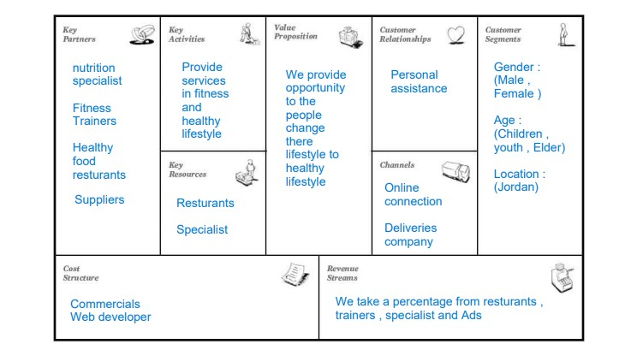
Our Business model :

Slide 11
But your seat belts on and get ready for a tour in our wonderful website , we hope you enjoy it .
https://miro.com/app/board/uXjV POy_zvk=/

