Slide 1



Google Play Store Apps
SDA Final Project For The Data Science Camp
Shaima Mohammed Alamri
Project On GitHub: https://github.com/ShaimaM/GooglePlayStoreApps
Notes:
Hffffffffffffffffffffffffffffffffffffffffffffffff

Slide 2

Google Play Store Apps
What Is Google Play Store ?
Who Can Use It ?
What We Can Use It For ?
What Does The Google Play Store Offer To The Users?

Slide 3


Data Processing:
1- Data Exploration
2- Data Preprocessing
Handling Duplicated Records
Handling Null Values
Handling Outliers Values
3- Exploratory Data Analysis (EDA)
4- Data Encoding
5- Data Separation
6- Build Machine Learning Models

Slide 4

Goals & Results

Slide 5
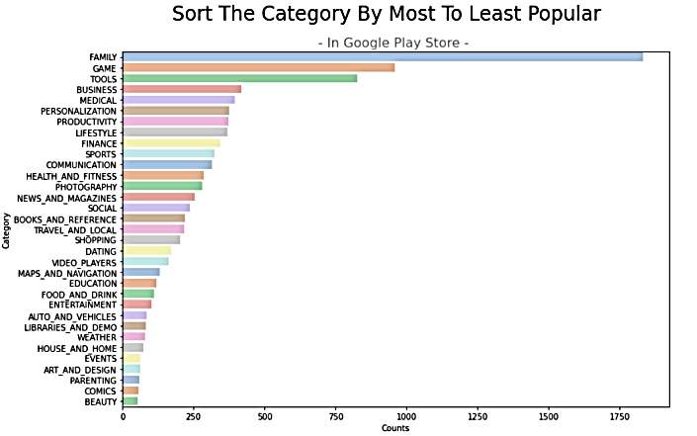
1-What Is The Most And Least Popular Category In Google Play Store ?

Slide 6
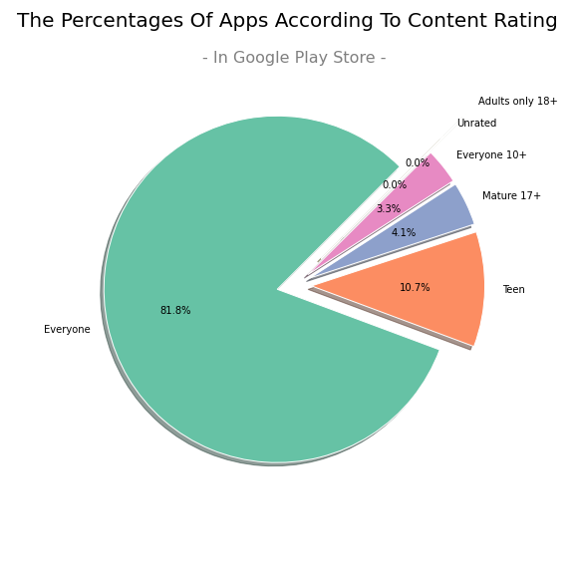
2-What The Kind Of Content Rating That Most Apps Belong To In Google Play Store ?

Slide 7
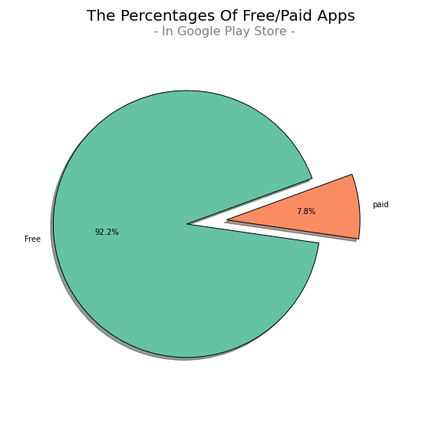
3-What Is Ratio Of Paid To Free Apps In Google Play Store ?

Slide 8
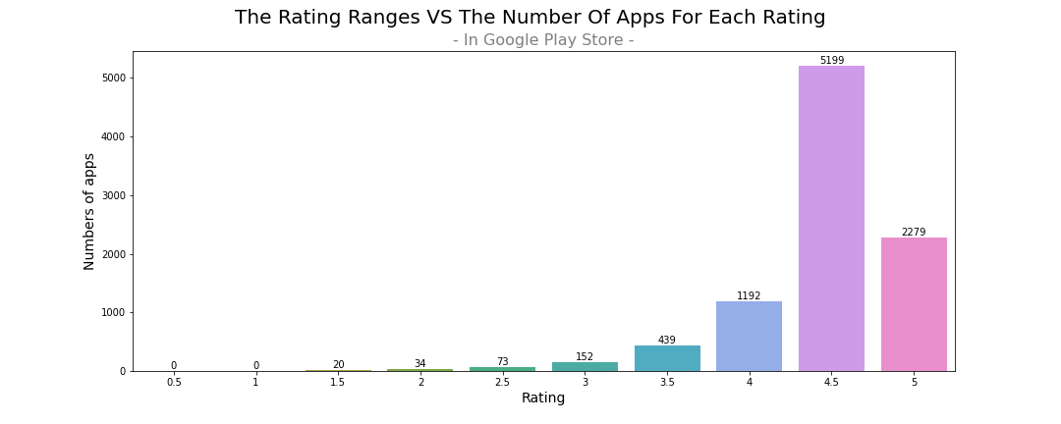
4-The Most Frequently Used Value For Rating Apps In Google Play Store ?

Slide 9
Model Result
Linear Regression Model:
R2 Score: 0.93
MAE: 32.8
MSE: 24.0
RMSE: 1.08
GridSearch CV :
All The Result Unchanged
Baseline Model :
MAE: 82.3

Slide 10




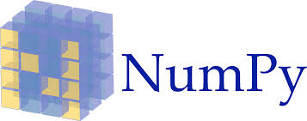


Technologies

Slide 11

Any Questions ?

