Slide 1
CheckIt
AI Assisted Employment Contract Risk Analyzer

Slide 2
Course Title: Entrepreneurship & Project Management
Course Code: AIML501 Semester: Summer 2026 Section: 01
Submitted By
Shairin Akter Hashi
ID: 2026-2-74-022
Submitted To
Khaza Newaz Muhammad, PMP
Adjunct Faculty
Department of Computer Science & Engineering
East West University

Slide 3
PROJECT
OBJECTIVES
  Build a secure AI contract-analysis platform.
  Identify risky and unfair contract clauses.
  Simplify complex legal and employment terms.
  Detect potential labour-rights concerns.
  Generate an overall contract risk score.
  Produce fast, downloadable analysis reports.

Slide 4
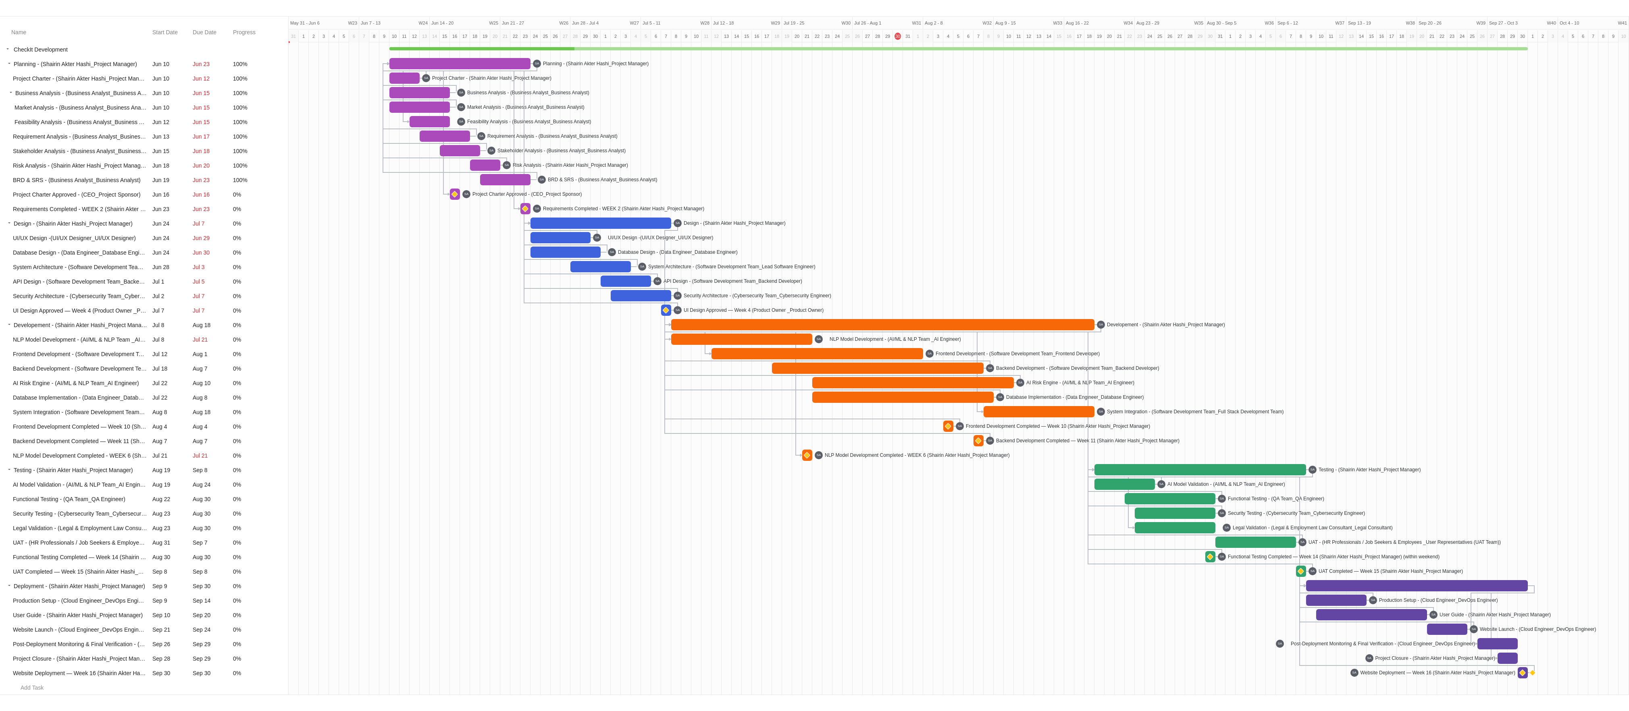
LINK: https://drive.google.com/file/d/1btf5uppJQ6KOjm7Ys8s8pISQU1wWf9Ua/view?usp=drive_link

Slide 5
PROJECT STAKEHOLDERS
Stakeholder Group | Stakeholders Included | Role in the Project
Project Sponsor & Product Governance | CEO(Project Sponsor )and Product Owner | Approve the project charter, product direction, major decisions, key deliverables, and final project outcomes.
Project Management & Business Analysis | Shairin Akter Hashi, Project Manager, and Business Analyst | Plan and coordinate the project, gather requirements, prepare the BRD and SRS, manage risks, and monitor progress.
AI, Data & Software Development | AI/ML and NLP Team, AI Engineer, Data Engineer, Lead Software Engineer, Frontend Developer, Backend Developer, and Full-Stack Team | Develop the NLP model, AI risk engine, database, APIs, frontend, backend, and integrated CheckIt platform.
Design, Quality & Security | UI/UX Designer, QA Team, and Cybersecurity Team | Design the user experience, conduct functional and security testing, and ensure system quality, privacy, and usability.
Legal Experts & User Representatives | Legal and Employment Law Consultant, HR Professionals, Job Seekers, and Employees | Validate legal interpretations and assess the platform’s clarity, usefulness, and acceptability through user-acceptance testing.
Cloud, DevOps & Operations | Cloud Engineer and DevOps Engineer | Configure the production environment, deploy the website, monitor system performance, and complete post-deployment verification.

Slide 6
PROJECT MILESTONES
No. | Milestone | Date | Project stage | Responsible stakeholder
1 | Project Charter Approved | 16 June 2026 | Planning | CEO / Project Sponsor
2 | Requirements Completed – Week 2 | 23 June 2026 | Planning | Project Manager
3 | UI Design Approved – Week 4 | 7 July 2026 | Design | Product Owner
4 | NLP Model Development Completed – Week 6 | 21 July 2026 | Development | Project Manager / AI Team
5 | Frontend Development Completed – Week 10 | 4 August 2026 | Development | Project Manager / Frontend Team
6 | Backend Development Completed – Week 11 | 7 August 2026 | Development | Project Manager / Backend Team
7 | Functional Testing Completed – Week 14 | 30 August 2026 | Testing | Project Manager / QA Team
8 | UAT Completed – Week 15 | 8 September 2026 | Testing and acceptance | Project Manager / User representatives
9 | Website Deployment – Week 16 | 30 September 2026 | Deployment | Project Manager / DevOps Team

Slide 7
Thank You

