Slide 1
Natural Language to code: Enhancing source code generation with GPT Integration
Team Details
Shaista Firdous (20EG105442)
M. Sathvika Reddy (20EG105428)
K. Shiva Sai (19H61A05L6)
Project Supervisor
Dr. K. Madhuri
Associate Professor

Slide 2
Introduction
NLP stands for Natural Language Processing. It's a field of artificial intelligence that focuses on the interaction between computers and humans using natural language. NLP enables machines to understand, interpret, and generate human language, facilitating communication between computers and people.
Incorporating GPT into source code generation elevates project efficiency by enabling intuitive natural language commands for code creation and refinement.
In this project, we aim to improve source code generation by integrating GPT into the process. By leveraging natural language, our goal is to enhance the efficiency and accuracy of code creation, fostering a more intuitive development experience. This integration seeks to bridge the gap between human-like language understanding and code synthesis, ultimately streamlining the software development workflow.

Slide 3
Introduction
Benefits:
1)Accessibility
2)Improved development productivity
3)Enhanced collaboration
Applications:
Assistance in Learning Programming: Support beginners in learning programming concepts by translating their natural language queries into code examples, providing a more interactive and accessible learning experience.
Cross-language Code Translation: Enable developers to express logic in one programming language through natural language and have ChatGPT translate it into another language, facilitating multi-language development.

Slide 4
Problem Statement
The project presents an NLP-based system limited to Python and C and lacking Python loop support. In response, our project integrates ChatGPT for language-agnostic code generation, refines NLP with stemming algorithms and an XML-based pseudo-code system, and comprehensively covers Python, overcoming the base paper's restrictions( lack of proper dataset for this particular application and conversion of natural language into one specified programming language) for a more versatile solution.
Existing methods:
1)NLP based Natural language interface
Limited adaptability to diverse languages
Limited coverage of Python constructs, especially loops.
2) Statistical language models- Struggle with rare or unseen language patterns. Requires large and diverse training data sets.
3)Template based approaches- Struggle with complex or diverse language limited expressiveness and adaptability.
This project aims to address these challenges by implementing A Natural Language Interface for generating the source through ChatGPT integration. Using ChatGPT to enhance code and improve productivity, accessibility and collaboration.

Slide 5
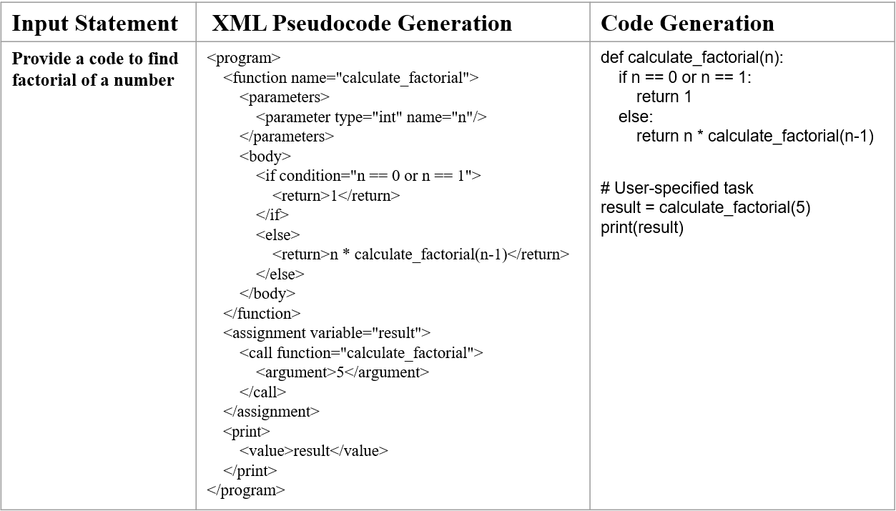
Problem Statement

Slide 6
Proposed Method
Natural language to code generation, this proposed method involves fine-tuning a GPT-3.5 model for source code generation and training a sequence-to-sequence model for language translation. For source code generation, conversational training data is structured and uploaded, and a fine-tuning job is created using the OpenAI SDK. Once completed, the fine-tuned model efficiently generates Python code snippets in response to user queries. In language translation, English-Hindi parallel sentences are preprocessed and used to train the translation model, with specific configurations for batch size, learning rate, and epochs. Post-training, the model is saved for future use, enabling seamless translation of new English sentences into Hindi. The translation process involves tokenization and model inference, ensuring accurate translations by leveraging the interplay between the encoder and decoder components of the Transformer model. This systematic approach enhances the capabilities of machine learning models for code generation and language translation tasks, promising significant improvements in efficiency and accuracy across various applications in software development and natural language processing.

Slide 7
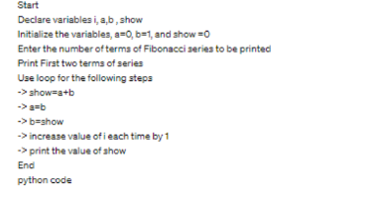
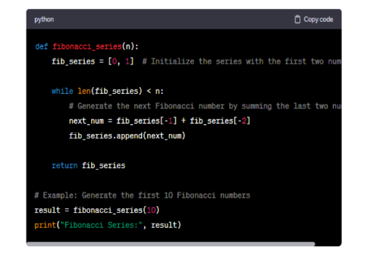
Proposed Method
Let
-q be the user’s query
-C be the generated code
1. Input Representation
q is the user’s question
2. Code Representation
C={c_1,c_2,c_3……, c_n}
c_i is the vector representating the ith element of the code like variable name, function name, operator etc.
3. Conditional Probability Distribution
P(C|q)
This represents the probability of generating particular code C to the given user’s query.
4. Model Training
The model learns to map these queries to code sequences by adjusting its internal parameters to maximize the probability P(C|q).
5. Code Generation at Inference
When a new user query q_new is provided, the model uses the learned probability distribution to predict most likely code sequence C_new.

Slide 8
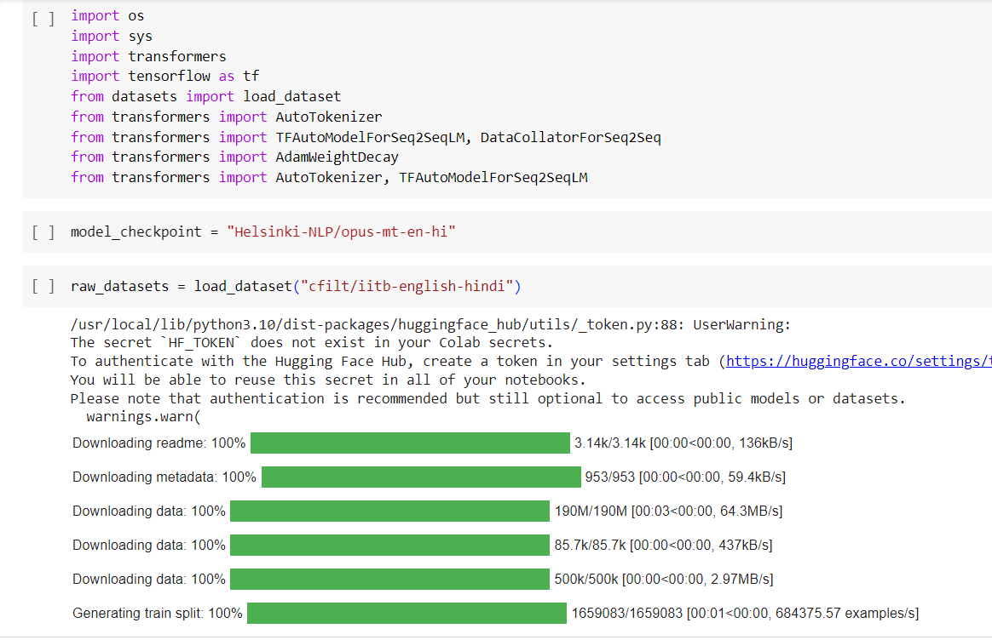
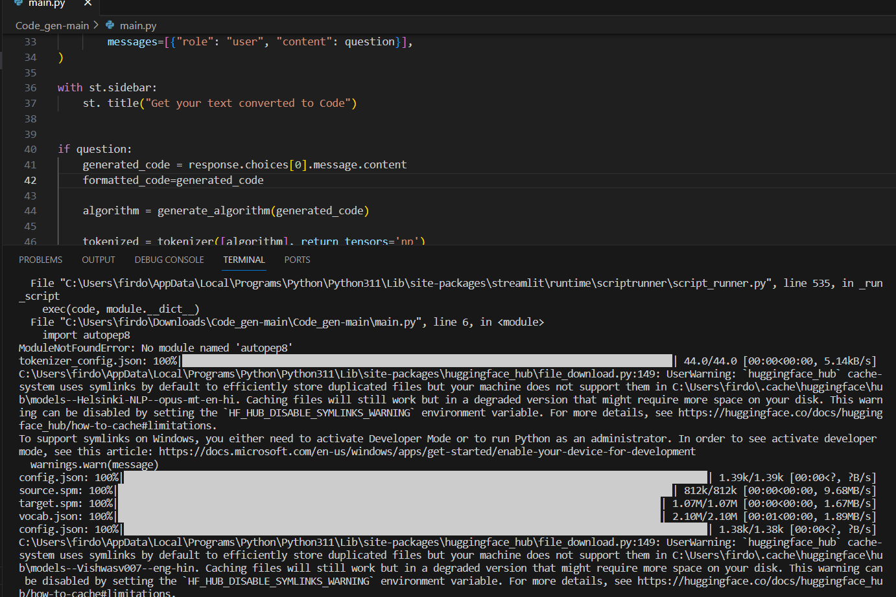
Experiment Environment
Tool: Jupyter Notebook, Visual code studio
Language: Python
Dataset: csv- json line dataset

Slide 9
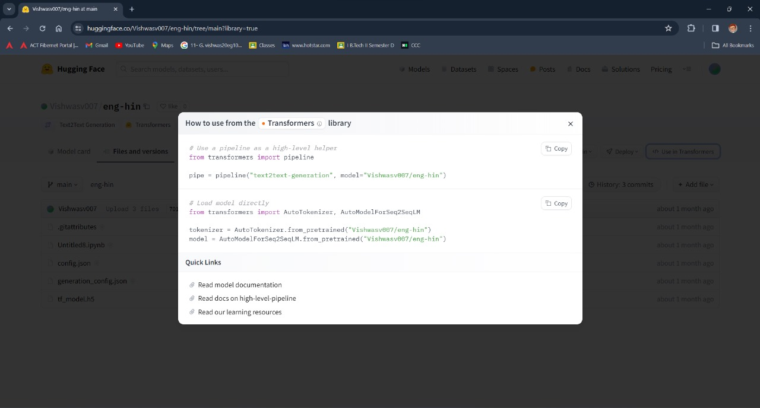
Experiment Screenshots

Slide 10
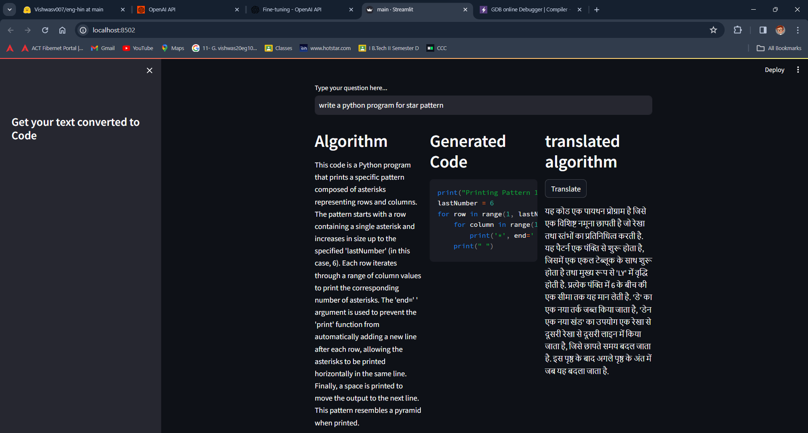
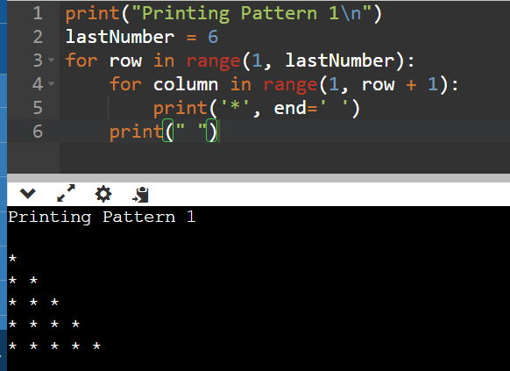
Experiment Screenshots

Slide 11
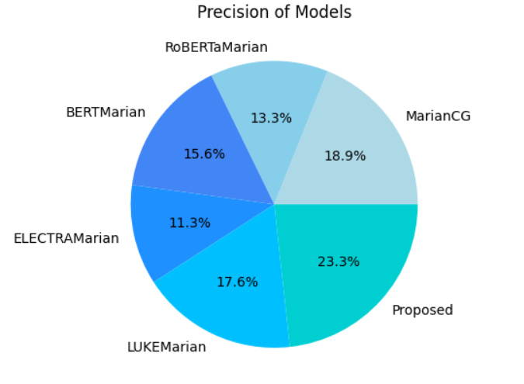
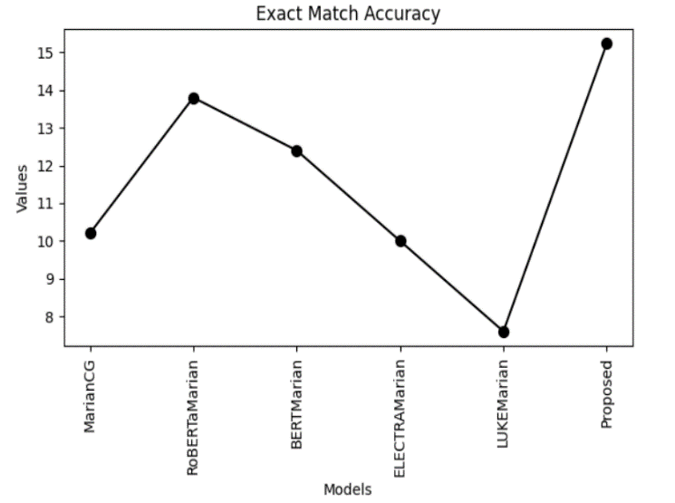
Experiment Results
The above experiment results were tested with CoNaLa dataset
Models | Precision
MarianCG | 0.57
RoBERTaMarian | 0.40
BERTMarian | 0.47
ELECTRAMarian | 0.34
NLI-GSC | 0.53
Proposed | 0.7
Models | Accuracy(%)
MarianCG | 10.2
RoBERTaMarian | 13.8
BERTMarian | 12.4
ELECTRAMarian | 10.0
NLI-GSC | 7.6
Proposed | 15.23

Slide 12
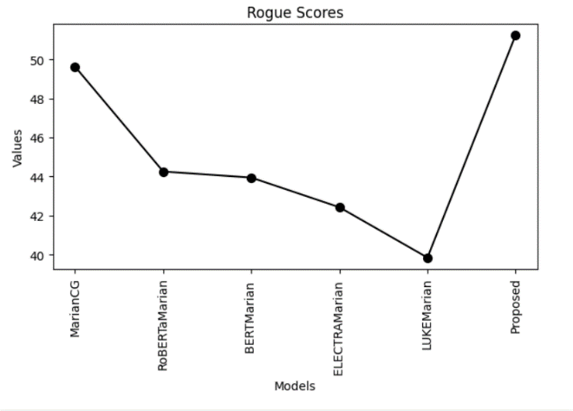
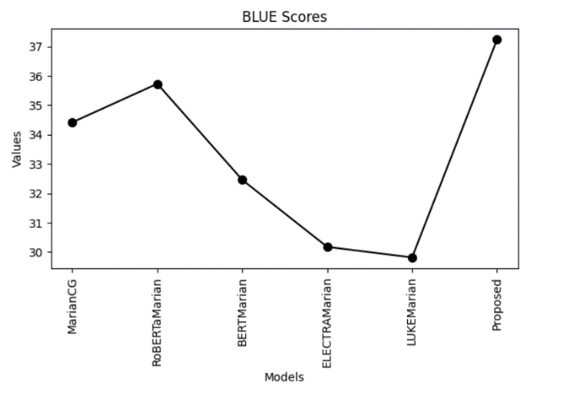
Experiment Results
Models | Rouge Score
MarianCG | 49.62
RoBERTaMarian | 44.25
BERTMarian | 43.94
ELECTRAMarian | 42.42
NLI-GSC | 39.84
Proposed | 51.23
Models | BLUE Score
MarianCG | 34.42
RoBERTaMarian | 35.73
BERTMarian | 32.46
ELECTRAMarian | 30.18
NLI-GSC | 29.82
Proposed | 37.23

Slide 13
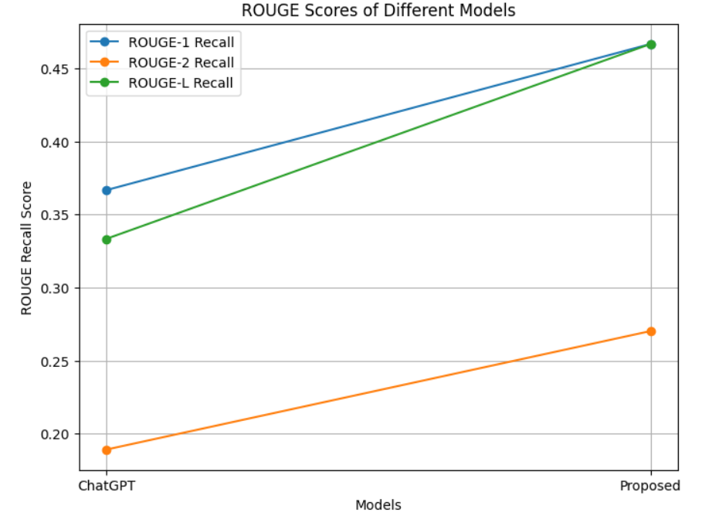
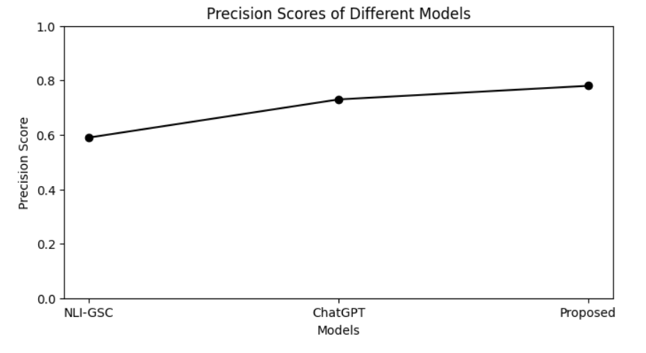
Experiment Results
When seen the above figures it clearly tells that the compared to previous models the proposed method excels in its task.

Slide 14
Finding
The proposed method effectively generated source code as per user’s query.
The proposed method provides correct code as per user’s requirement.
Through fine-tuning, the model generates source codes that are relevant to the user queries
The user interface is quite user friendly and doesn’t need any resources.
All parameters of the proposed model are greater than the existing model, which makes it better.
Our project proposed method output is accurate and satisfying user requirements.

Slide 15
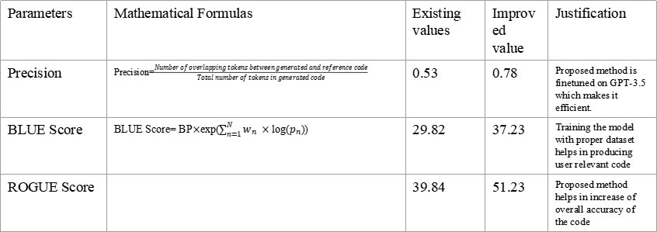
Justification
Parameters | Mathematical Formulas | Existing values | Improved value | Justification
Precision | Precision=$\frac{Number of overlapping tokens between generated and reference code}{Total number of tokens in generated code}$ | 0.53 | 0.78 | Proposed method is finetuned on GPT-3.5 which makes it efficient.
BLUE Score | BLUE Score= BP$×$exp($\sum_{n=1}^{N}{w_{n} ×}$ log($p_{n}$)) | 29.82 | 37.23 | Training the model with proper dataset helps in producing user relevant code
ROGUE Score |  | 39.84 | 51.23 | Proposed method helps in increase of overall accuracy of the code

Slide 16
THANK YOU

