Slide 1
A Seminar on Natural Language to Code: Enhancing Source Code Generation through ChatGPT Integration
Team Details
Shaista Firdous (20EG105442)
M. Sathvika (20EG105428)
K. Shiva Sai(19H61A05L6)
Project Supervisor
Dr. K. Madhuri
Associate Professor

Slide 2
Introduction
NLP stands for Natural Language Processing. It's a field of artificial intelligence that focuses on the interaction between computers and humans using natural language. NLP enables machines to understand, interpret, and generate human language, facilitating communication between computers and people.
Incorporating ChatGPT into source code generation elevates project efficiency by enabling intuitive natural language commands for code creation and refinement.
In this project, we aim to improve source code generation by integrating ChatGPT into the process. By leveraging natural language, our goal is to enhance the efficiency and accuracy of code creation, fostering a more intuitive development experience. This integration seeks to bridge the gap between human-like language understanding and code synthesis, ultimately streamlining the software development workflow.

Slide 3
Benefits:
1)Accessibility
2)Improved development productivity
3)Enhanced collaboration
Applications:
Assistance in Learning Programming: Support beginners in learning programming concepts by translating their natural language queries into code examples, providing a more interactive and accessible learning experience.
Cross-language Code Translation: Enable developers to express logic in one programming language through natural language and have ChatGPT translate it into another language, facilitating multi-language development.

Slide 4
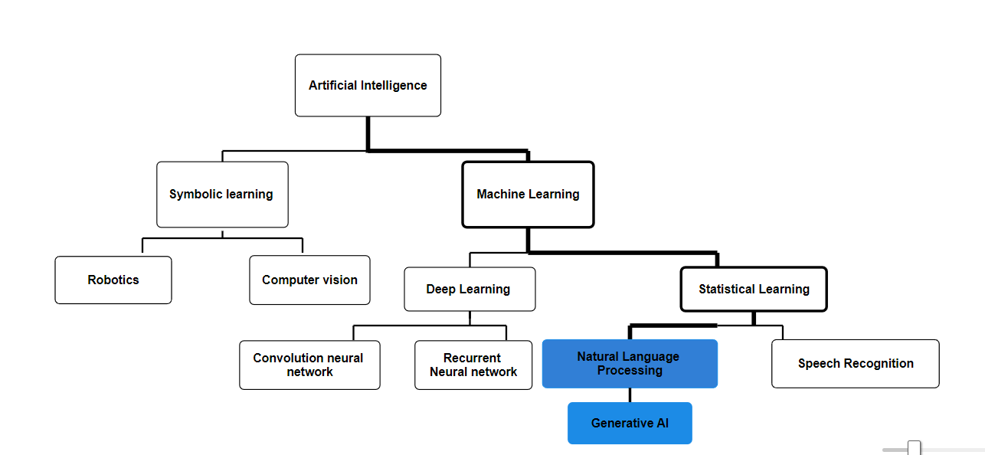
Concept Tree

Slide 5
Literature
S. No | Strategies | Advantages | Disadvantages
1 | NLP based Natural Language Interface | XML-based intermediate representation. Proposed dataset creation from scratch. Natural Language Database Query Interface. | Limited adaptability to diverse languages. Limited coverage of Python constructs, especially loops. Limited coverage of database query complexity.
2 | Rule-Based Approaches | Clear rules for mapping language to code. Explicit control over code generation. | Limited flexibility in handling ambiguous language. Challenges with nuanced or context-dependent code.
3 | Statistical Language Models | Learns language patterns from data. Adaptable to diverse contexts and languages. | May struggle with rare or unseen language patterns. Requires large and diverse training datasets.
4 | Neural Networks (Seq2Seq Models) | Learns implicit language-code mappings. Context-aware, handles longer sequences. | Limited interpretability of model decisions. Resource-intensive training and inference.

Slide 6
SI. No | Strategies | Advantages | Disadvantages
5 | Template-Based Approaches | Provides structured templates for code. Simplicity and ease of understanding. | Limited expressiveness and adaptability. May struggle with complex or diverse language.
6 | Hybrid Approaches (Rule-Based + ML Models) | Combines rule-based clarity with ML flexibility. Adaptable to project-specific needs. | Requires careful integration and tuning. Potential challenges in balancing components.

Slide 7
Literature(cont..) selected strategy:
Author(s) | Method | Advantages | Disadvantages
Aaqib Ahmed R.H. Ansari, Aaqib Ahmed R.H. Ansari | Intermediate Pseudo-Code Representations | Utilizes NLP for pseudocode generation, fostering accessibility for non-programmers. Integrates XML for structured representation and traditional programming for source code conversion. Employs stemming and Viterbi algorithms, enhancing NLP capabilities. Proposes automated dataset creation for self-improvement. | Limited to Java source code generation, potential challenges with ambiguous language, and dependence on predefined structures for dataset creation. The pseudocode to source-code method may introduce complexity. Ambiguity and nuances in natural language pose challenges.
Franks | N gram model | Adaptability: They are adaptable to different languages and coding styles as they learn from the patterns present in the provided training data . Efficiency: N-gram models are computationally efficient and can handle large datasets, making them practical for real-time or near real-time applications | Data Sparsity Issues: With larger values of ‘n’, the amount of training data required for accurate modeling increases exponentially. Overfitting and Noise. Sensitivity: Higher order N-gram models are susceptible to overfitting on specific patterns in the training data, capturing noise or idiosyncrasies that may not generalize well to new inputs.

Slide 8
Raychev | Statistical language translation | Accessibility: It allows developers with varying programming skills to communicate instructions in natural language, making coding more accessible to nonexperts. Rapid Prototyping: Speeds up the prototyping phase by quickly converting natural language descriptions into code. | Ambiguity and Interpretation: Natural language often contains ambiguity and multiple interpretations, leading to potential misunderstandings. Limited Vocabulary and Domain Specific Knowledge: Statistical models may struggle with specialized or domain-specific terminology, resulting in inaccuracies when translating such terms into code.
Bielik | Pos tagging | Improved Parsing: It assists in parsing sentences more effectively, enabling the system to break down complex statements into meaningful segments. Syntax Validation: By identifying parts of speech, the system can validate the syntactic correctness of the provided natural language input, reducing the likelihood of generating code with syntax errors. | Inflexibility with Unconventional Language Structures: It might struggle with unconventional or nonstandard language structures that deviate from typical grammar rule. Contextual Understanding: POS tagging might not capture the full context of a sentence, especially in cases where the meaning of a word or phrase depends heavily on the surrounding context.

Slide 9
Problem Statement
The project presents an NLP-based system limited to Python and C and lacking Python loop support. In response, our project integrates ChatGPT for language-agnostic code generation, refines NLP with stemming algorithms and an XML-based pseudo-code system, and comprehensively covers Python, overcoming the base paper's restrictions( lack of proper dataset for this particular application and conversion of natural language into one specified programming language) for a more versatile solution.
Existing methods:
1)NLP based Natural language interface-Limited adaptability to diverse languages
Limited coverage of Python constructs, especially loops.
2) Statistical language models- Struggle with rare or unseen language patterns. Requires large and diverse training data sets.
3)Template based approaches- Struggle with complex or diverse language limited expressiveness and adaptability.
This project aims to address these challenges by implementing A Natural Language Interface for generating the source through ChatGPT integration. Using ChatGPT to enhance code and improve productivity, accessibility and collaboration.

Slide 10
Problem Illustration
Input Statement | XML Pseudocode Generation | Code Generation
Provide a code to find factorial of a number | <program> <function name="calculate_factorial"> <parameters> <parameter type="int" name="n"/> </parameters> <body> <if condition="n == 0 or n == 1"> <return>1</return> </if> <else> <return>n * calculate_factorial(n-1)</return> </else> </body> </function> <assignment variable="result"> <call function="calculate_factorial"> <argument>5</argument> </call> </assignment> <print> <value>result</value> </print> </program> | def calculate_factorial(n): if n == 0 or n == 1: return 1 else: return n * calculate_factorial(n-1) # User-specified task result = calculate_factorial(5) print(result)

Slide 11
Proposed Method
This method involves enhancing a natural language interface for code generation and integrating ChatGPT without an intermediate pseudocode step to reduce the time taken to generate data and improve the accuracy of the generated code and to enhance system limitations from Python and C to all known coding languages.
Method: Enhanced Context-Aware Code Generation with Integrated ChatGPT
Step 1: Install Python Libraries
Step 2: Add OpenAI API Key
Step 3: Input Processing
Step 4: Dynamic Natural Language Interaction
Step 5: Language-Agnostic Code Generation
Step 6: Continuous Learning and system improvement
Step 7: Real-time Feedback
Step 8: Generated Source Code

Slide 12
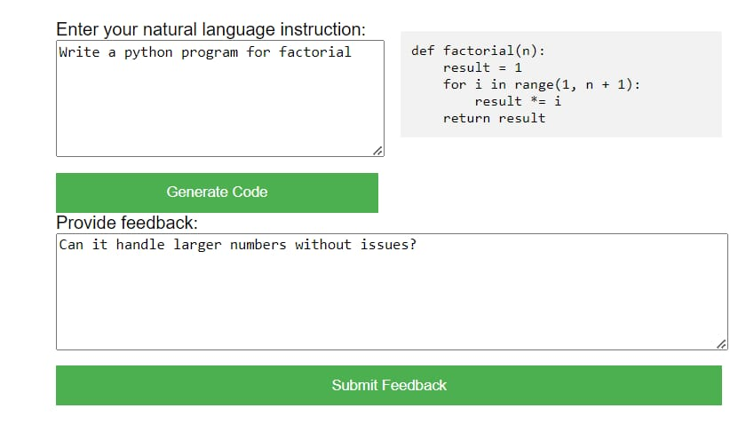
Proposed Method Illustration

Slide 13
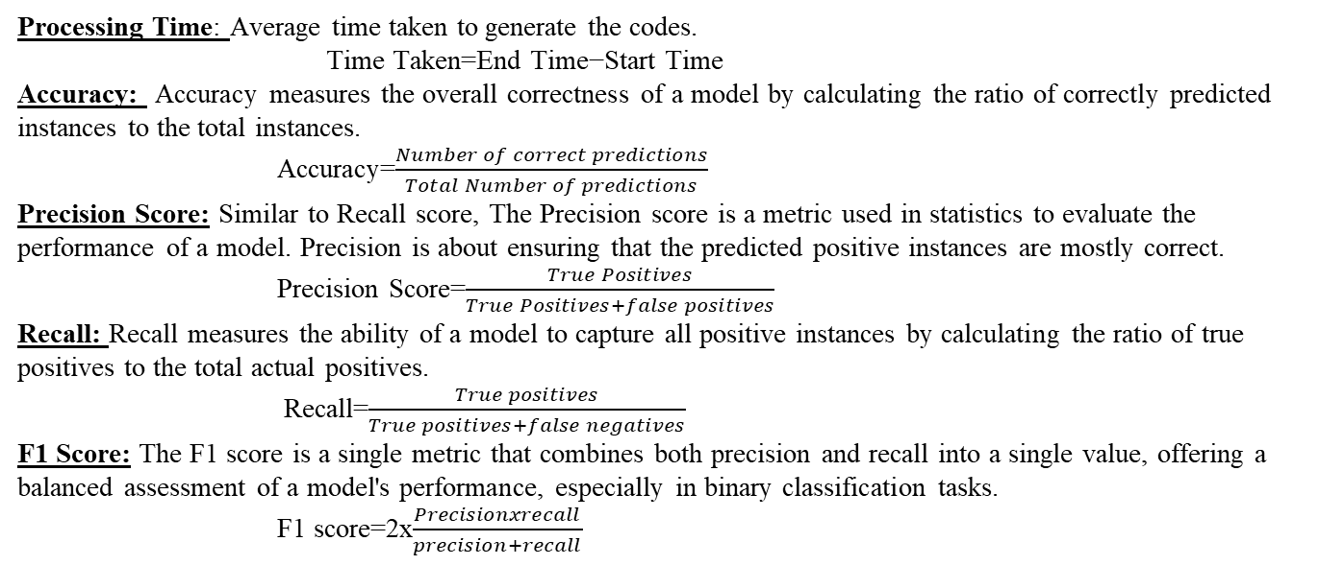
Parameter
Processing Time: Average time taken to generate the codes.
Time Taken=End Time−Start Time
Accuracy: Accuracy measures the overall correctness of a model by calculating the ratio of correctly predicted instances to the total instances.
Accuracy=$\frac{Number of correct predictions}{Total Number of predictions}$
Precision Score: Similar to Recall score, The Precision score is a metric used in statistics to evaluate the performance of a model. Precision is about ensuring that the predicted positive instances are mostly correct.
Precision Score=$\frac{True Positives}{True Positives+false positives}$
Recall: Recall measures the ability of a model to capture all positive instances by calculating the ratio of true positives to the total actual positives.
Recall=$\frac{True positives}{True positives+false negatives}$
F1 Score: The F1 score is a single metric that combines both precision and recall into a single value, offering a balanced assessment of a model's performance, especially in binary classification tasks.
F1 score=2x$\frac{Precisionxrecall}{precision+recall}$

Slide 14
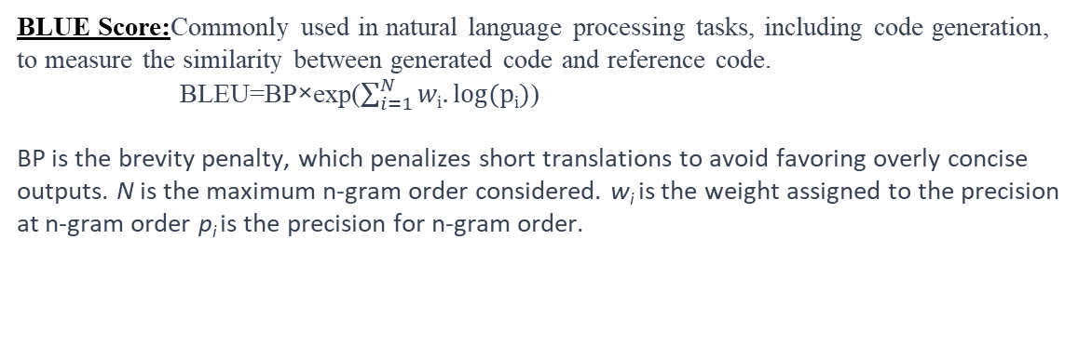
BLUE Score:Commonly used in natural language processing tasks, including code generation, to measure the similarity between generated code and reference code.
BLEU=BP×exp($\sum_{i=1}^{N}{wi.log(pi)}$)
BP is the brevity penalty, which penalizes short translations to avoid favoring overly concise outputs. N is the maximum n-gram order considered. w_{i​} is the weight assigned to the precision at n-gram order p_{i​} is the precision for n-gram order.

Slide 15
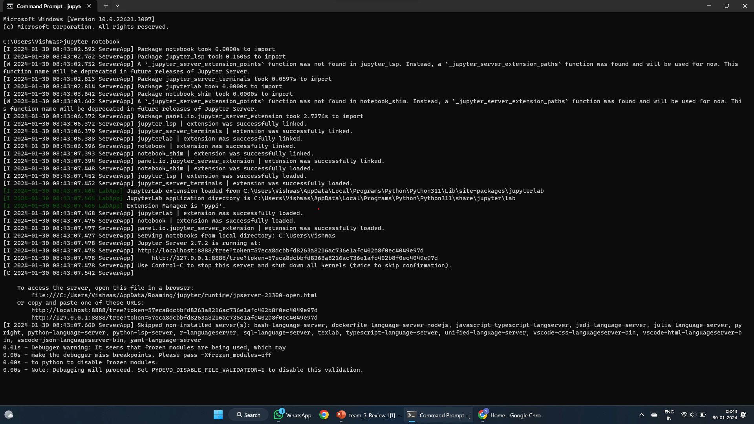
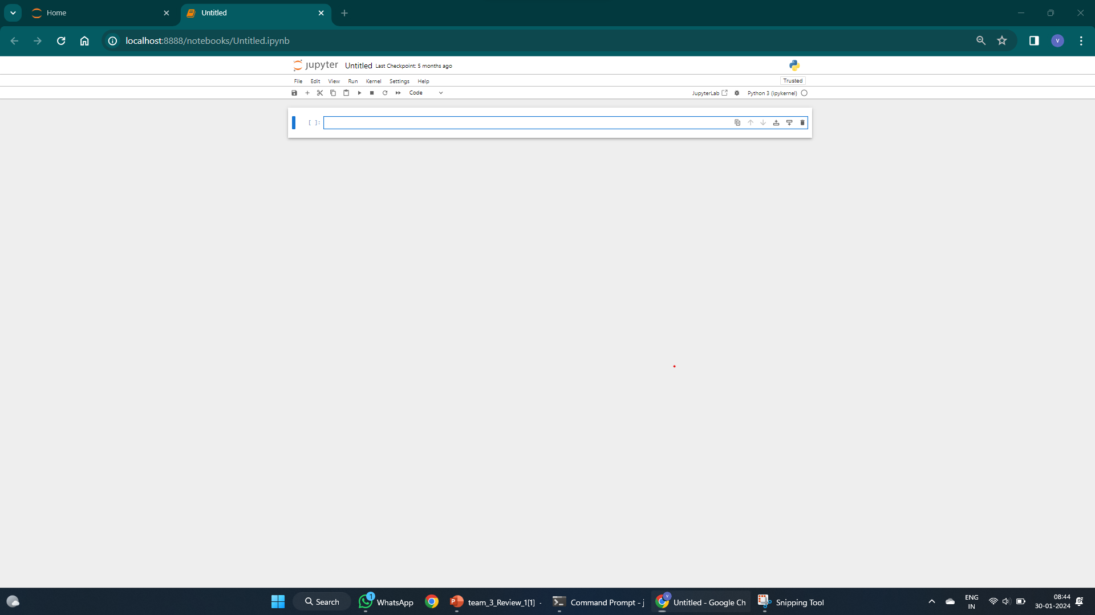
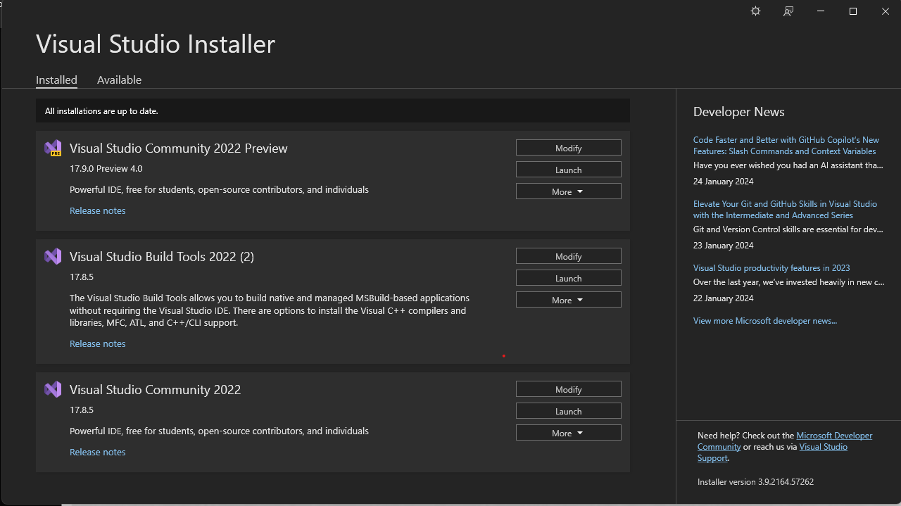
Experiment Environment
Tool: Jupyter Notebook and Visual Studio Code
Language: Python

Slide 16
Project status
S.No | Functionality | Status (Completed /in-progress/Not started)
1. | Natural Language Interface | In progress
2. | ChatGPT Integration | Not started
3. | Code Generation Framework | Not started
4. | Testing Framework | Not started

Slide 17
References
[1] NLI-GSC: A Natural Language Interface for Generating Source Code by Aaqib Ahmed R.H. Ansari, Aaqib Ahmed R.H. Ansari published in International Journal of Advanced Computer Science and Applications (IJACSA) 2022 Volume:13 issue no:842-853.
[2] Amr Ahmed and Greg Hanneman.2005. Syntax-based statistical machine translation: A review Computational Linguistics (2005) .
[3] N. Kushman R. Barzilay “Using Semantic unification to generate regular expressions from natural language,” in Proceedings of the 2013 Conference Of the Northern American Chapter Of the Association for Computational Linguistics: Human Language Technologies, Atlanta, GA, 2013, pp, 826-836.
[4] Y. Oda, S. Sakti, S. Nakamura. 2015, Learning to generate pseudo-code from source code using statistical machine translation (t). In: 30th IEEE/ACM International Conference on Automated Software Engineering (ASE) 2015 , p, 574-584 .

Slide 18
Thank you

Slide 19
Project seminar–I Evaluation
S.No | Rubrics | Marks
1 | Concept Introduction | 4
2 | Literature and Parameter | 5
3 | Problem and Problem Illustration | 8
4 | Proposed Method and Illustration | 8
Total |  | 25

