Slide 1
Customer Churn Segmentation Analysis
Telecom Industry (2025)
Presented by: Shaivik Shende
Date: April 2025

Slide 2
Project Objective
Identify and segment customers at risk of churning using data analytics.
Deliver actionable insights to reduce churn and increase customer retention.
Visualize churn metrics with an interactive Power BI dashboard.

Slide 3
Dataset Information
Source: Kaggle – real-world-churn Dataset
Records: 65,000 telecom customers
Features: Demographics, usage, service satisfaction, app activity, etc.
Tools Used: Python (Pandas, Sklearn), SQL, Power BI

Slide 4
Data Processing Pipeline
SQL: Data aggregation and cleaning
Python:
- Feature engineering & churn label generation
- Model training (Random Forest Classifier)
- Explainability using ELI5
Power BI:
- Customer segmentation
- Churn trend visualization
- App usage by segments

Slide 5
Key Metrics
Total Customers: 65K
Loyal Customers: 96.74%
At Risk Customers: 3.26%
Churn Risk Pool: 40.47K customers

Slide 6
Insights & Interpretation
App Usage Patterns:
- Loyal customers dominate overall app usage.
- “YouTube” & “Other apps” have the highest usage share.
Customer Segmentation:
- Only 3.26% customers are at risk, enabling focused retention strategy.
Churn Risk Level:
- Significant volume at risk, indicating potential revenue loss.

Slide 7
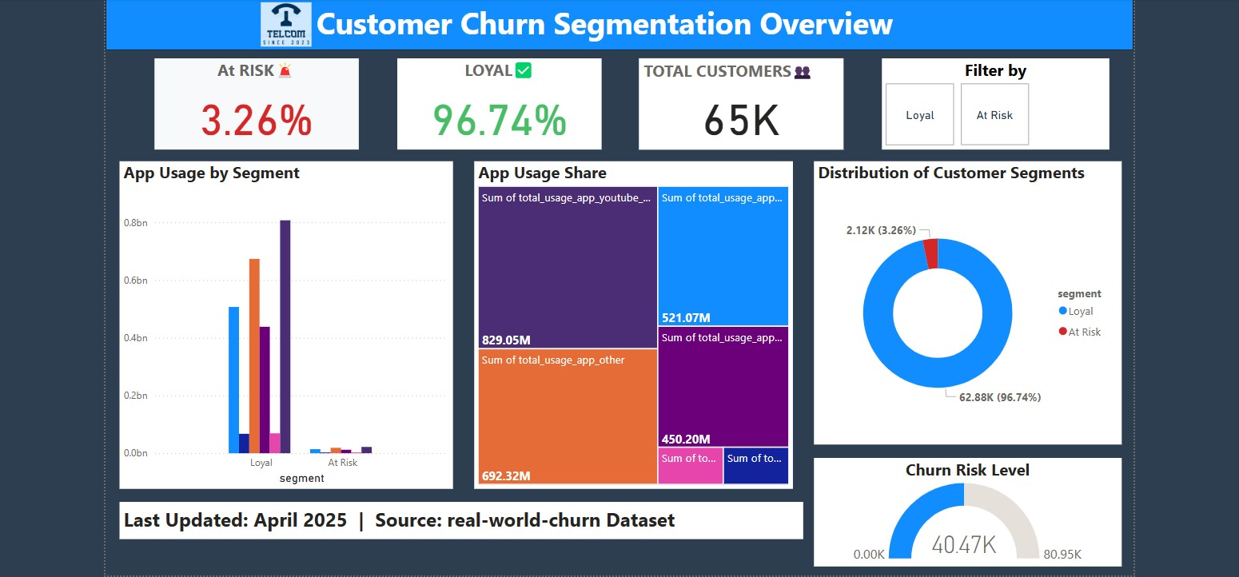
Customer Churn Segmentation Overview Dashboard

Slide 8
Recommendations
Launch retention campaigns targeting the 2.12K at-risk customers.
Incentivize frequent app users with loyalty benefits.
Monitor churn risk metrics monthly via dashboard KPIs.

Slide 9
Tech Stack
SQL: PostgreSQL
Python: Pandas, Scikit-learn, ELI5
Power BI: Visualization and business intelligence
GitHub: Full project repo and documentation

Slide 10
GitHub Repo
Retail Business Sales Analytics on GitHub: https://github.com/Shaivik-ai/DATA_ANALYTICS_PROJECTS

