Slide 1
CAPSTONE PROJECT
NETFLIX
SHAJAD

Slide 2
Table of content
Objective
Data Summary
Data loading and exploration
Data Wrangling
Column wise analysis
Feature engineering
Algorithm that we use
Technique and methods we used
Challenges
Reference
Conclusion

Slide 3
Objective
This dataset consists of tv shows and movies available on Netflix as of 2019. The dataset is collected from Flexable which is a third-party Netflix search engine. In 2018, they released an interesting report which shows that the number of TV shows on Netflix has nearly tripled since 2010. The streaming service’s number of movies has decreased by more than 2,000 titles since 2010, while its number of TV shows has nearly tripled. It will be interesting to explore what all other insights can be obtained from the same dataset. Integrating this dataset with other external datasets such as IMDB ratings, rotten tomatoes can also provide many interesting findings.

Slide 4
Data summary
Show id --> Unique id for every movie/tv show
type --> identifier -A movie or tv show
title --> Title of the movie and tv show
director --> director of the show
cast --> Actors involved
country --> Country of production
Date added --> date it was added at Netflix
Release year --> Actual release year of the show
rating --> TV raring of the show
duration --> Total duration in minutes or no. of the seasons
Listed in --> Genre
description -->The summary description

Slide 5
Data loading
Data loading
Loading the data from google drive and read into notebook
Data exploration
Checking data in different column
Data operations
Cloumns
Numerical columns and the cetagorical columns
Data
Information and data type of columns

Slide 6
Data wrangling
Data wrangling-also called data cleaning, unifying messy and complex data sets to a meaningful format for easy access and analysis. There are various processes designed to transform raw data into more readily used formats.
*It includes following steps:
We create another data frame in dataset.
Creating columns to better understanding.
Remove the columns that used to create the new columns.
Converting columns to proper data type format.
Adding or removing columns for analysis.
We sett the feature name with proper identification for better understanding
We also create a copy of data to avoid the mishapning.
Then we apply the Algorith

Slide 7
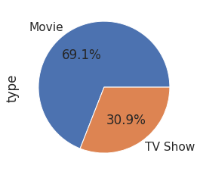
Column wise analysis
In this data there are 69% are movies and 30.9% are tv shows present in this data

Slide 8
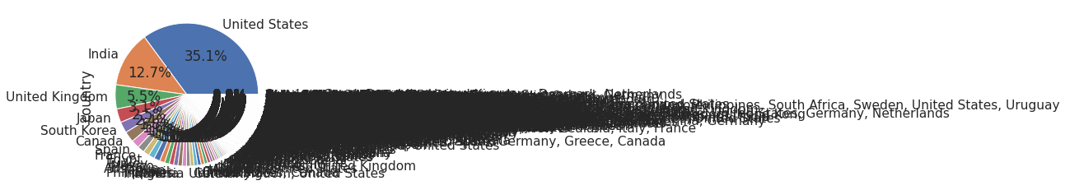
according to this plot
there are 35.1% movies and tv shows are from the United State.
12.7% movies and tv shows are from the India.
5.5% tv shows and movies from the United Kingdom.
3.1% tv shows and movies are from the Japan.
2.5% movies and shows are from the South Korea

Slide 9
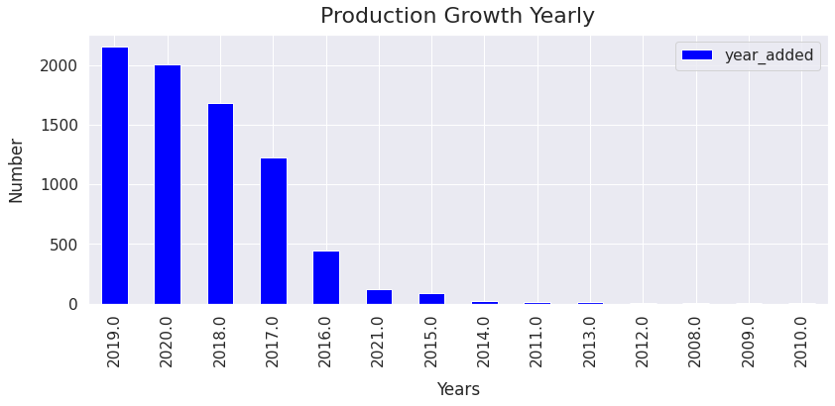
According to this lot we show that more then 2000 movies produce in 2019
2000 movieas and shows produce in 2020
1600 movies and shows produce in 2018 aproximatly.
1200 movies and shows are produce in 2017
less them 500 shows and movies produce per year before 2017

Slide 10
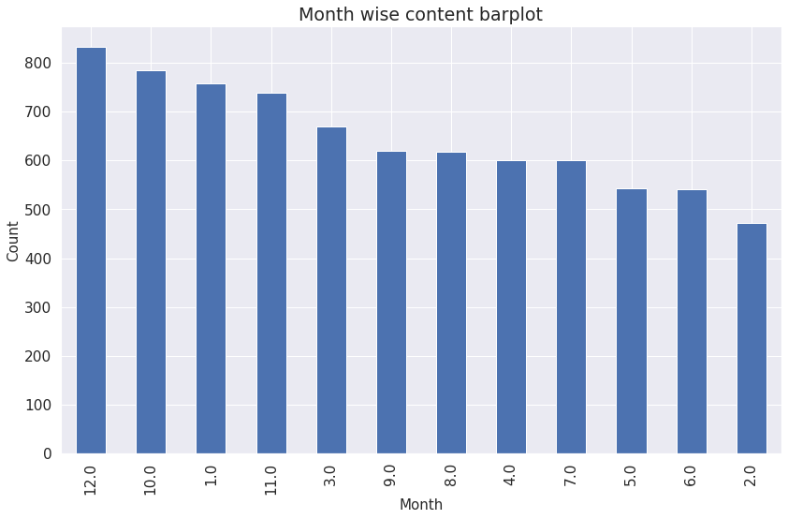
in this plot we show that in December more then 800 movies and shows added on net flix and then November between 750-800 movies and shows are added on Netflix and then January 750 shows and movies are added on January and February is the least movies and shows added month.

Slide 11
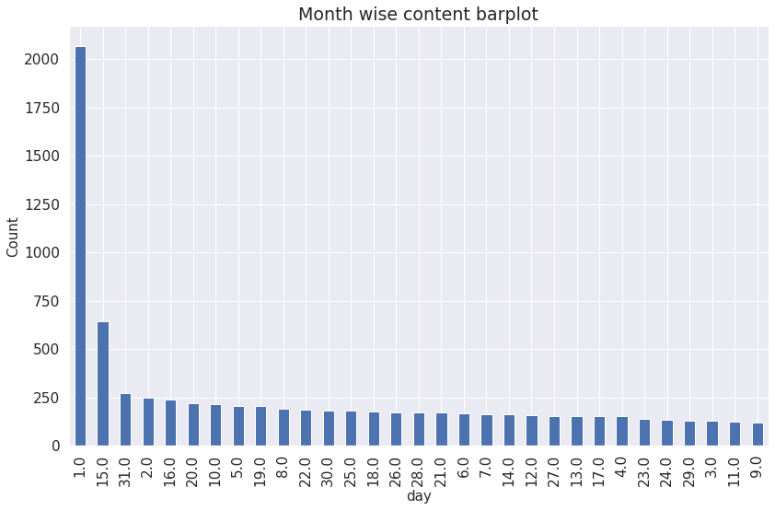
according to this plot 1st days of every month to most movies and shows are added on the Netflix and then the 15th day of month the movies and the shows added on the Netflix between the 650to 700. and then the last day of the month is most released day of Netflix it is between the 200 to 250.

Slide 12
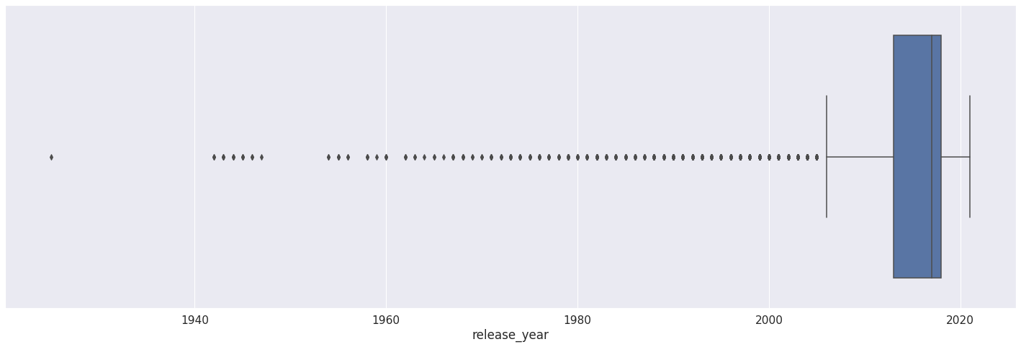
According to this plot we see that after the 2012 to 2021. is founded as outliers and we delete this outliers.

Slide 13
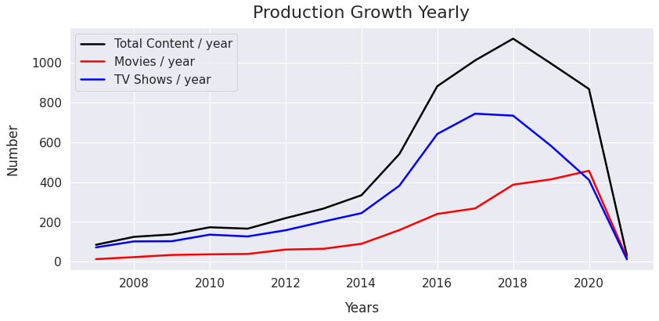
there is an boost coming from 2014 to 2021

Slide 14
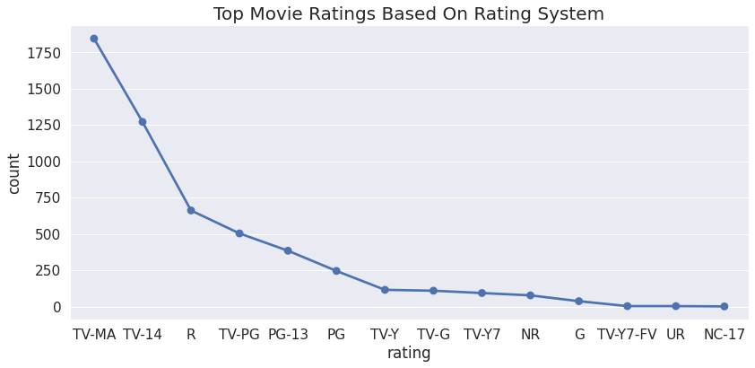
TV-MA (For Mature Audiences)1900 movies come under this rating.
TV-14 ( May be unsuitable for children under 14 ) 1250 movies come under this rating.
TV-PG ( Parental Guidance Suggested ) 500 movies come under this rating.
NR ( Not Rated ) 150 movies come under this rating.

Slide 15
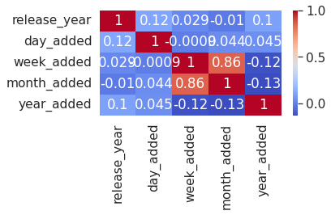
In this correlation heatmap we find that the 86% correlation between the week added and the month added.

Slide 16
Feature Engineering
We convert Male and Female in sex column instaded of 1 and 2.
We make a copy of the data to secure our primary data and to avoid any misshappning
We fill null values with mean and mode.
We delete the duplicate columns.
We drop outliers.
We remove the unnecessary data points.
We add and delete the some columns.
We create the month columns.
We create many data frame in data set.
We remove the stop words.
WE removing Punctuations.
We do text vectorization.

Slide 17
Algorithm that we use
1st we use Hierarchical Clustering
1. Dendrogram
2. Agglomerative Clustering
2nd we use K means clustering
1 Elbow method
2 DBSCAN

Slide 18
Technique and methods we used
1st we decided to drop the columns which have more null values.
Then we remove the stop words and Punctuations from the data set.
And we de text vectorization to the data set.
We use the standard scaler as a scaler.
We use PCA in decomposition.
Clusters that we use in this project is Dendrogram, Agglomerative Clustering, DBSCAN, Elbow method.
In this project we use Hierarchical Clustering, K means clustering.

Slide 19
Challenges
When we start this project the data is very complex and not easy to under stand.
In this project the best part is to plotting the right plot and find the inside information about the features.
After plot the graph we do some feature engineering and make some columns and some colums also delete.
And finally we apply the algorithm on the data

Slide 20
Conclusion
This project is about the Credit card default prediction analysis. When we start this project, it is very difficult to understand and look very complex. In first step we upload the data and then we start to find the duplicate values and nulls values and missing values etc. in this dataset we found the some values are missing in Cast and Directors columns so we decide to remove that colums also in release year there are sum values also missing we fill that values with mean and we also fill the country columns null values with mode in. After completion of 1st step in 2nd step we plot the data in form of graph, pie plot and bar plot and line plot and also box plot, and in box plot we find some outlier so we remove the outliers. And we also find some hidden information by plot the graph. In this dataset there are two types of contents 30.86% is Tv shows and 69.14% is movies includes. We have reached a conclusion from our analysis from the content added over years that Netflix is focusing movies and TV shows (From 2016 data we get to know that Movies is increased by 80% and TV shows is increased by 73% compare). From the dataset insights we can conclude that, most number of TV Shows released in 2017 and for Movies it is 2020. On Netflix USA has the largest number of contents. And most of the countries preferred to produce movies more than TV shows. And then India comers on number 2 hos produce the largest movies and the tv show. Most of the movies are belonging to 3 categories. TOP 3 content categories are, International movies, dramas, comedies. there are 35.1% movies and tv shows are from the United State. 12.7% movies and tv shows are from the India. 5.5% tv shows and movies from the United Kingdom.3.1% tv shows and movies are from the Japan. 2.5% movies and shows are from the South Korea. We also divide the data into month year and the day of month and add that columns into the data frame and we also create some Data frame in our data set. In text analysis (NLP) I used stop words, removed punctuations, stemming & TF-IDF vectorizer and other functions of NLP. Applied different clustering models like K-means, hierarchical, Agglomerative clustering, DBSCAN on data we got the best cluster arrangements. By applying different clustering algorithms to our dataset . we get the optimal number of cluster is equal to 3 .So we decide to take the as no of cluster in this data because it is best no in our conclusion.

Slide 21
Reference
Almabetter
Geeksforgeeks
StackOverflow
Github
Youtube

Slide 22
THANK YOU

