Slide 2
Requested internship
The page shows the information of users who requested for the internships.
It includes :
Name
Email Id
Phone number
Chosen language
College
Qualification
Location

Slide 3
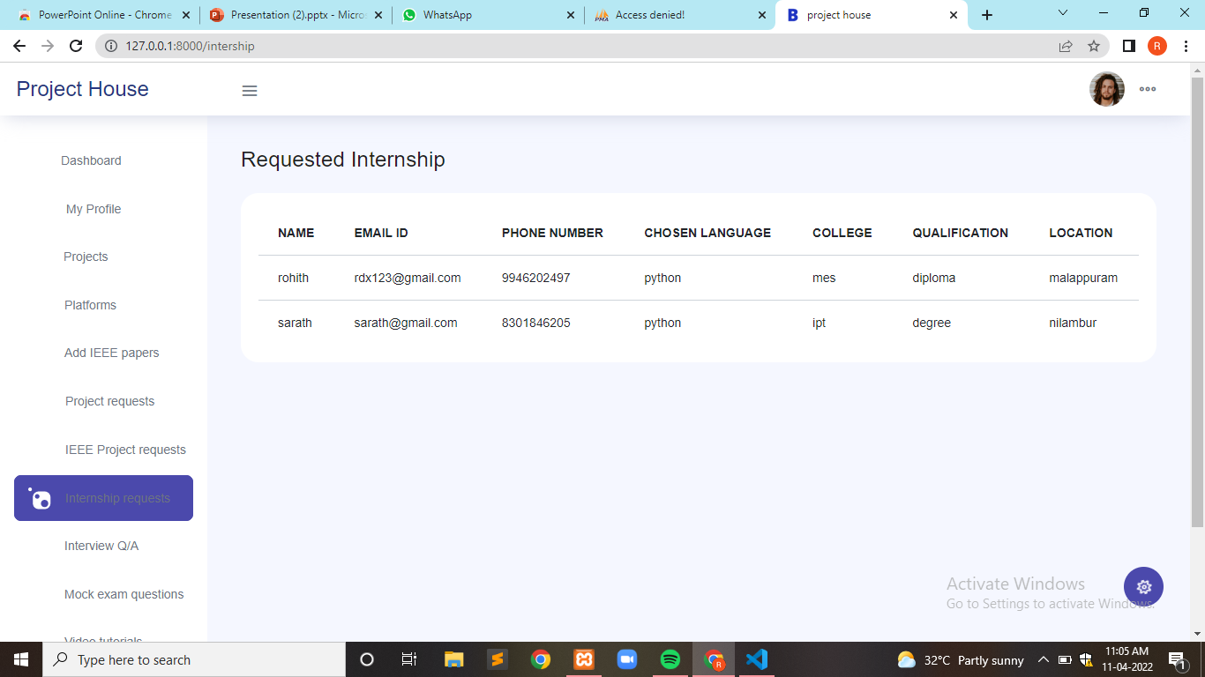

Slide 4
SIGN UP
This page is used to register and store the user information in to the database.
It includes :
Name
Platform
Course
Contact Number
Email id
Password
By Clicking the Signup button it redirects into login page.

Slide 5
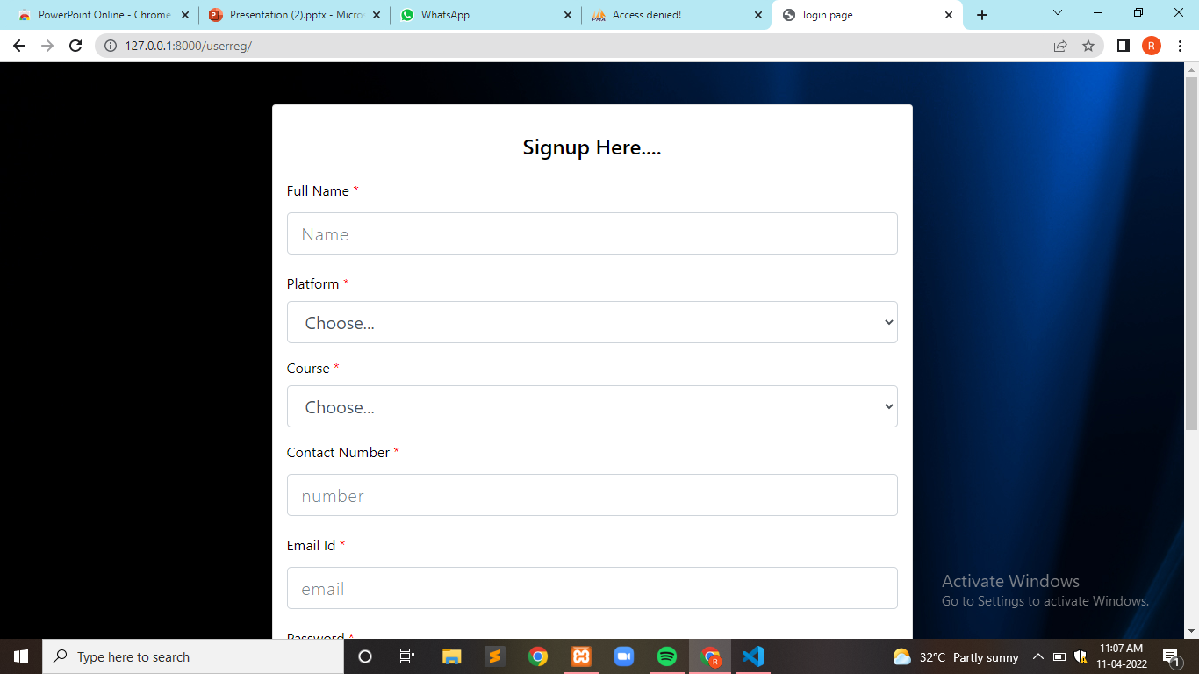

Slide 6
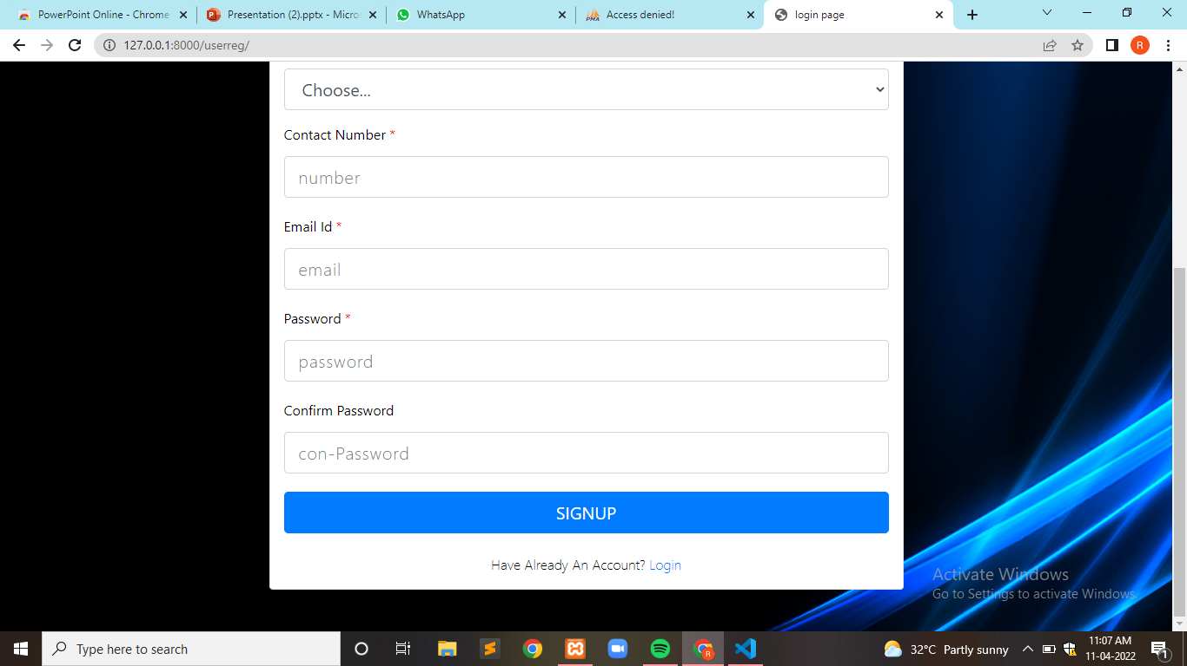

Slide 7
LOGIN
This page is used to login the users through the email and password.
Entering the valid email and password. And clicking the login button it redirect to the user dashboard page.
If entering the incorrect email or password it redirect to the same page.

Slide 8
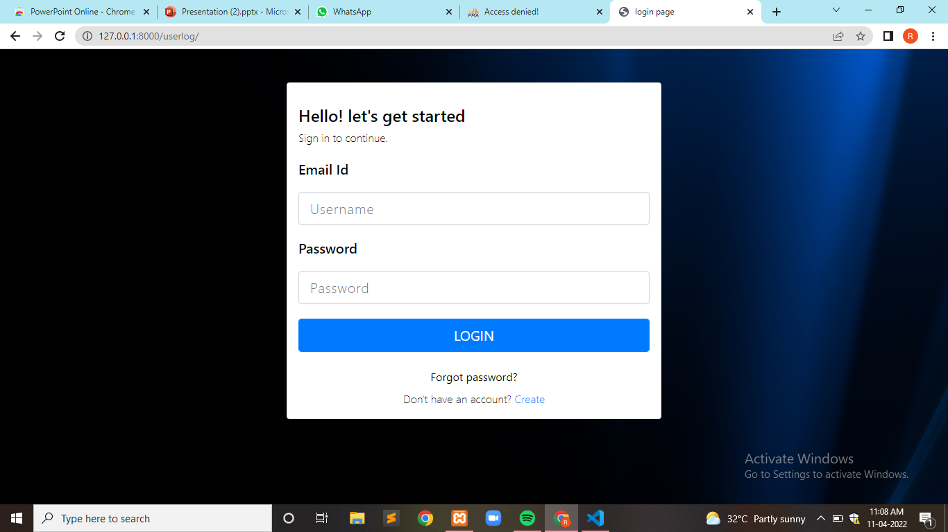

Slide 9
Adding platforms
This page is created to add platforms to the project house by admins
admins can add details about the adding platforms like thumbnail , tutorial video and their descriptions too
It includes :
Platform Name
Upload thumbnail
Platform description
Tutorial description
Upload tutorial video

Slide 10
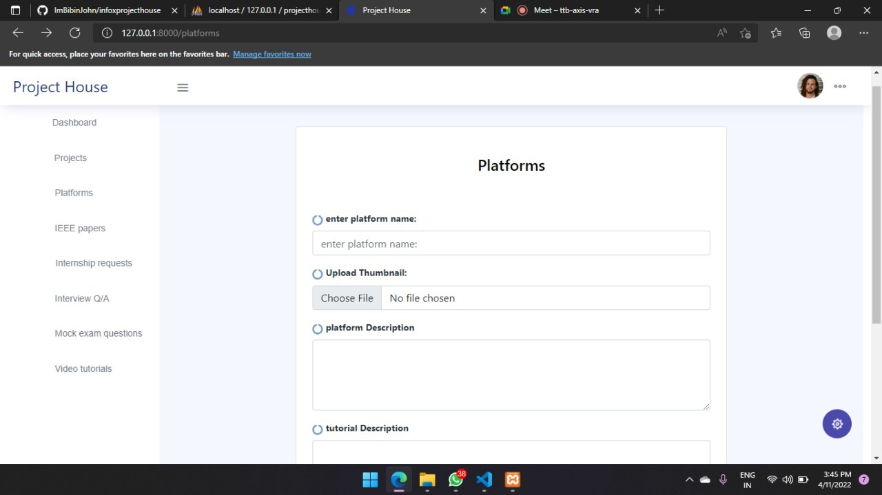

Slide 11
Select platform to view
In this page user can choose a platform and view the platforms, tutorials added by admins
User can view corresponding platform’s tutorial by selecting it

Slide 12
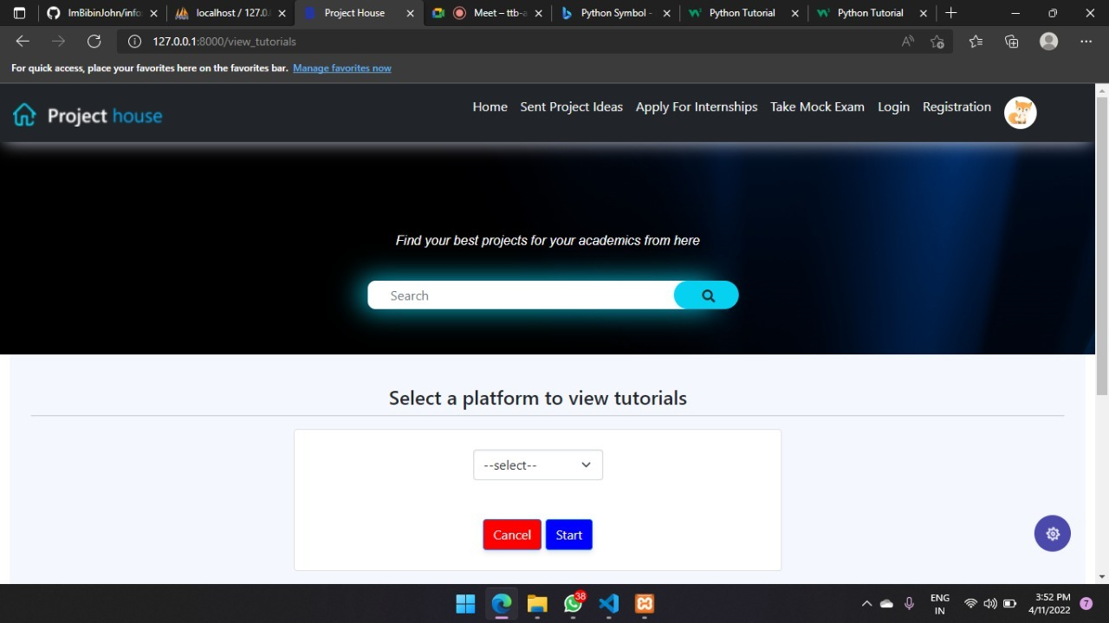

Slide 13
View platforms
In this page user can view , edit and delete the platforms
Also Admin can add new platforms

Slide 14
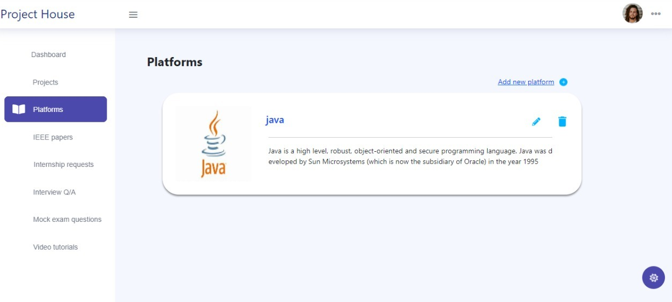

Slide 15
View tutorials
In this page user can view the platforms and their tutorials
They can learn it from the tutorials

Slide 16
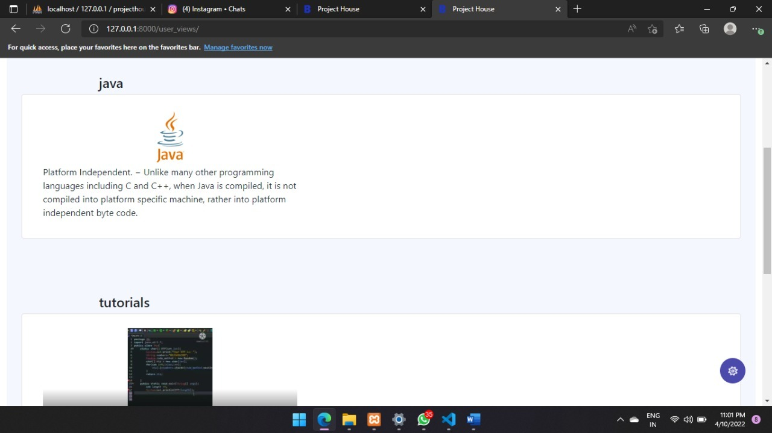

Slide 17
IEEE Papers
Click the side bar project name, and showing three cards
It includes :
View ieee papers
Add new ieee papers
Requested ieee papers

Slide 18
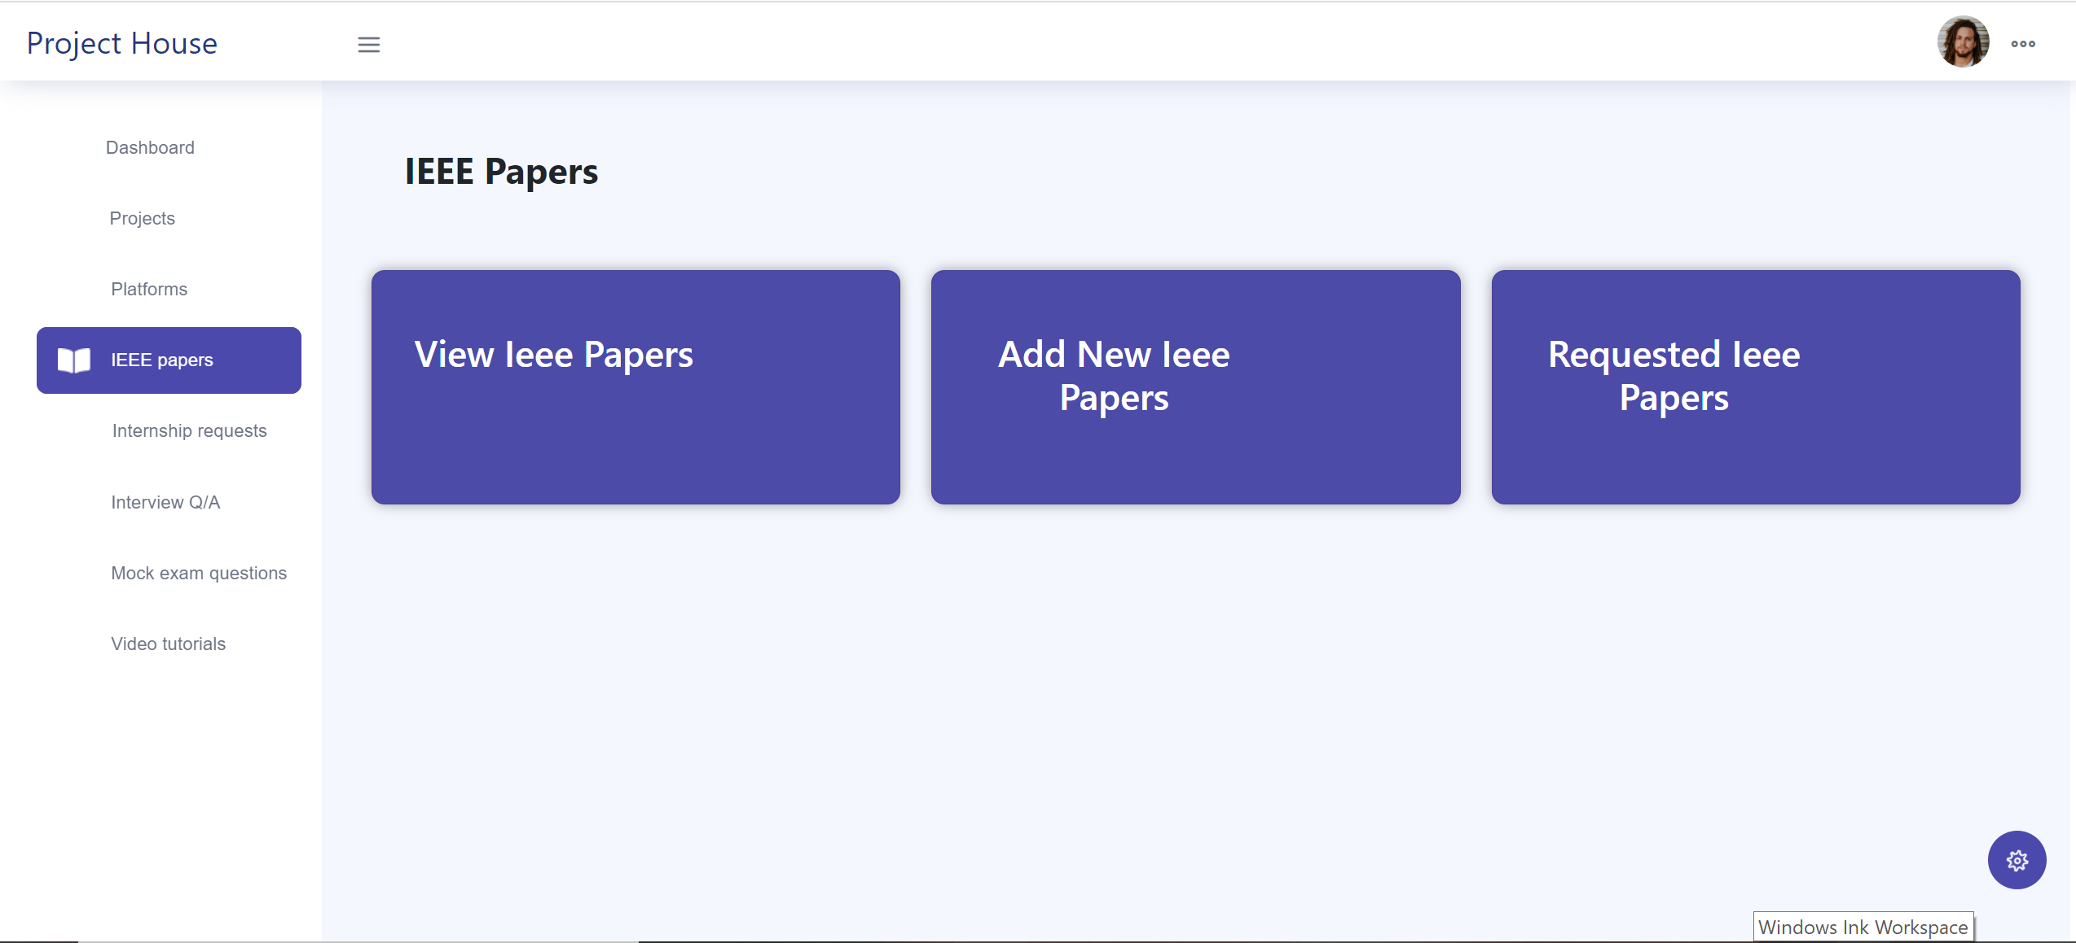

Slide 19
View ieee Papers
Click the view ieee paper card, open to the view paper window.
This page contains two cards in view project page.
First card represent to all platforms
Each platform cards click to the button , showing the second card
Second card represent to projects include platforms.

Slide 20
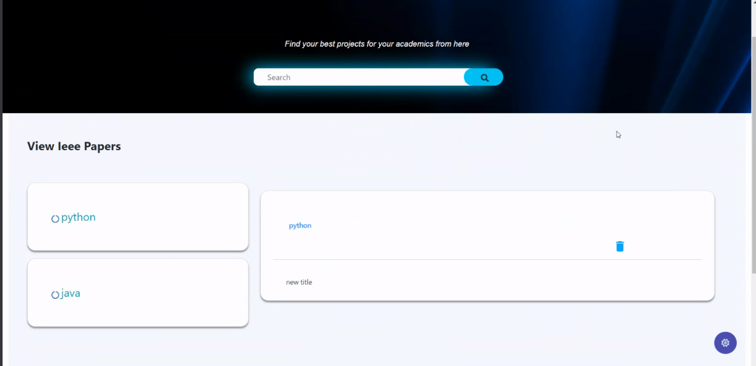

Slide 21
Add new ieee Papers
This page contain add new ieee papers in to the field
Open the page and filling the form will be created ieee paper

Slide 22
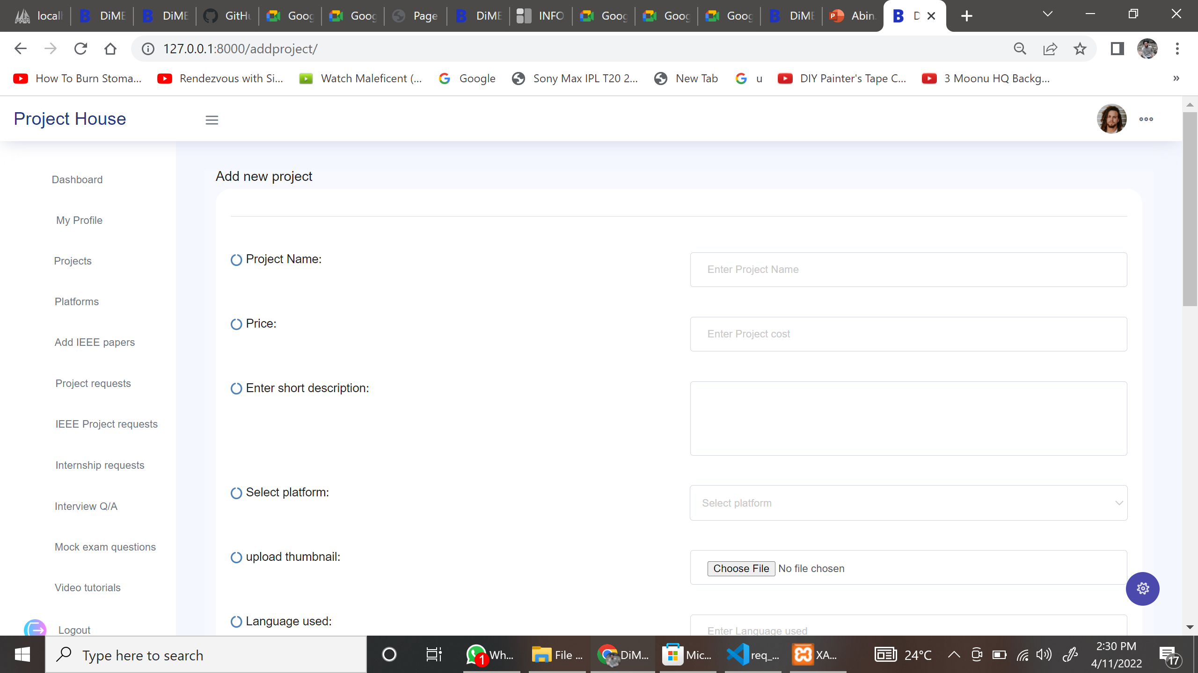

Slide 23
Requested ieee Papers
This page contains
showing to the requested all ieee papers in to this page.

Slide 24
