Slide 1
De-warping Algorithm With Minimum Line Buffer
Presented By
Mohammad Shazzad Hossain

Slide 2
Warping – what and why
What:
Transformation or distortion of an object and its surrounding area in an image.
Why:
3D scene is projected to 2D space, light ray tends to bend, and miss align.
The ratioed distance of the projected point from the image centre is changed.
Creates artificial effect such as magnification, contraction, twisting and colour feeding or spreading.
Increases with the increase in angle of the observable scene which is also known as Field Of View (FOV).
Notes:
Warping is the transformation or distortion of an object and its surrounding area in an image from what that object would look like in the actual scene.
When a 3D scene is projected to 2D space in the image plane light ray tends to bend and miss align.

Slide 3
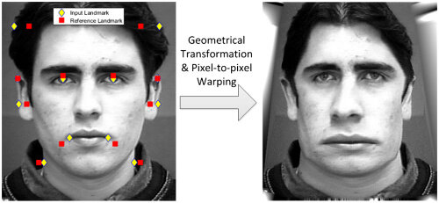
What can happen [1]

Slide 4
Motivation
Frequent use of wide-angle camera with fish-eye lens for capturing wider field of view (FOV).
The wide FOV of these lenses leads to image distortion/warping.
This optical distortion compromises the integrity of visual data.
Adversely impacts distance mapping, object detection, remote sensing, and 3D reconstruction.
Correcting distortion is critical for wide range of application.
Critical for modern day vehicle as they go automounts.

Slide 5
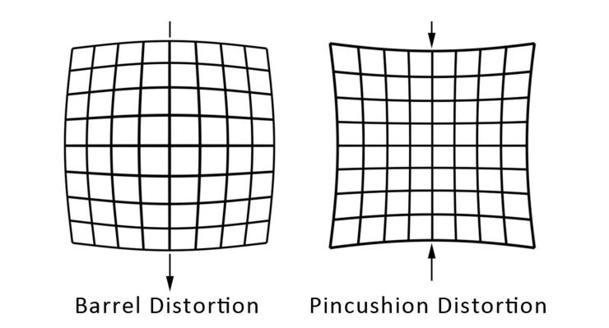
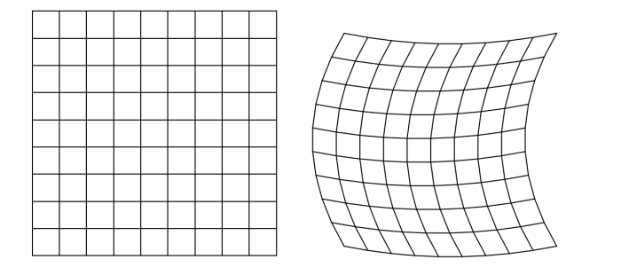
Different Types of Distortion
Radial Distortion – Most common form of distortion
Displacement of image point along radial axis.
Most common form of distortion in wide angle camera.
Tangential Distortion
– Miss alignment of Camera lens and image sensor
Chromatic Aberration
Falling to converge all the colours of spectrum to a single point.
Other Distortions
Astigmatism, Keystoning, Field Curvature etc.

Slide 6
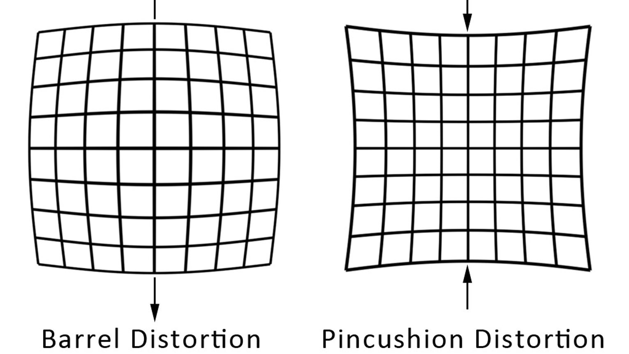
Types of Radial Distortion
Barrel Distortion
Image magnification decreases with increasing distance form optical center.
Gives rise to a barrel like shape.
Most common and dominant form of radial distortion
Pincushion Distortion
Image magnification Increase with increasing distance form optical center.
Gives rise to a pincushion like effect.
Most common and dominant form of radial distortion

Slide 7
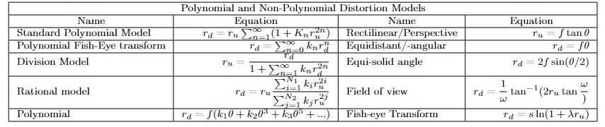
Different Distortion Models
Polynomial Models – uses polynomial equation to stablish relation between undistorted and distorted radial distance (r_{u} and r_{d}).
Standard Polynomial Model
Division Model
Polynomial Fish-eye Transform Model
Non-Polynomial Models – stablishes a relationship between radial distance (r_{d},r_{u}) and incident angle θ.
Perspective Model
Fish-eye Transform
FOV Model

Slide 8
Radial Distortion Correction
Following methods commonly practiced for distortion correction
Back mapping
Using invers distortion model.
Reliable and commonly used method.
Back Mapping With Bilinear Interpolation –
To reduce the spread of pixel due to back mapping.
Deep Learning
Brings divers distortion model to a unified system
Does not depend on any specific model.
Sometimes restricted to certain type of distortion.

Slide 9
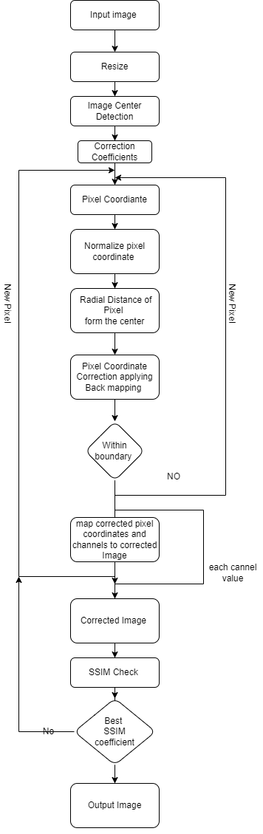
Developed Algorithm
The algorithm utilizes back mapping method and has been developed considering the following
The distortion coefficient of the camera is known before hand
Distortion coefficient and correction coefficient might not be the same.
During correction of barrel distortion, higher order coefficient which represents pincushion distortion might also be used.

Slide 10
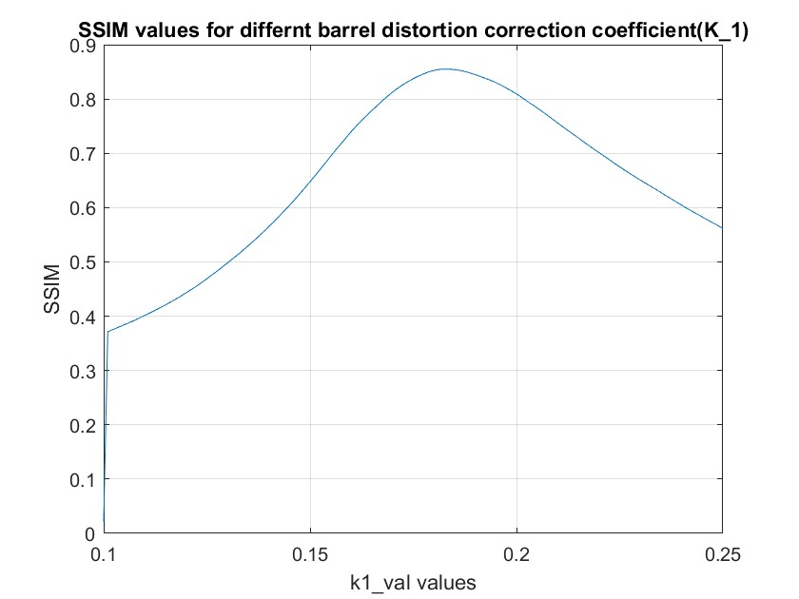
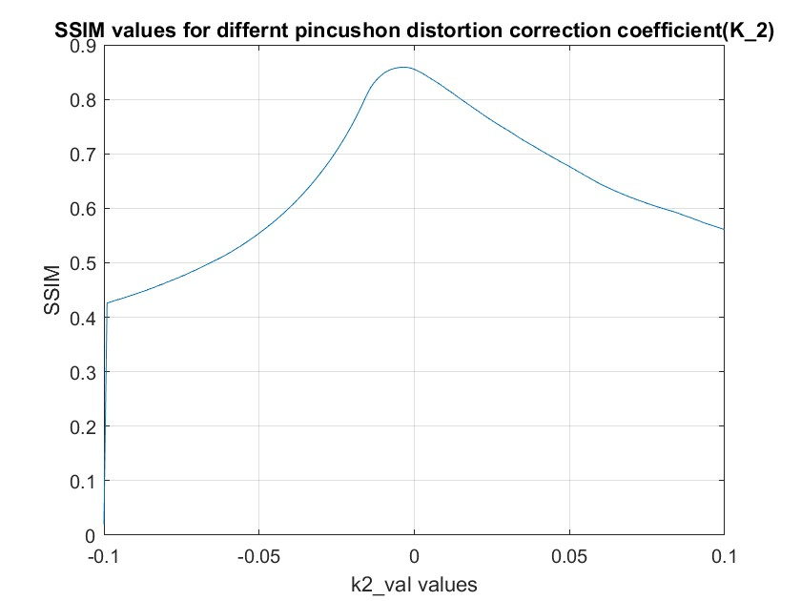
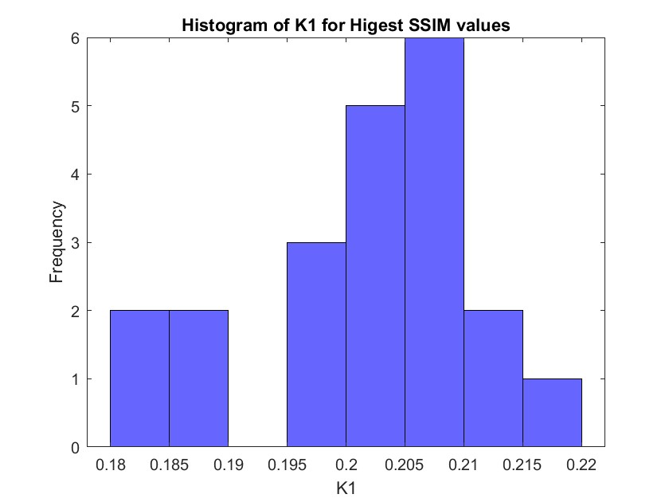
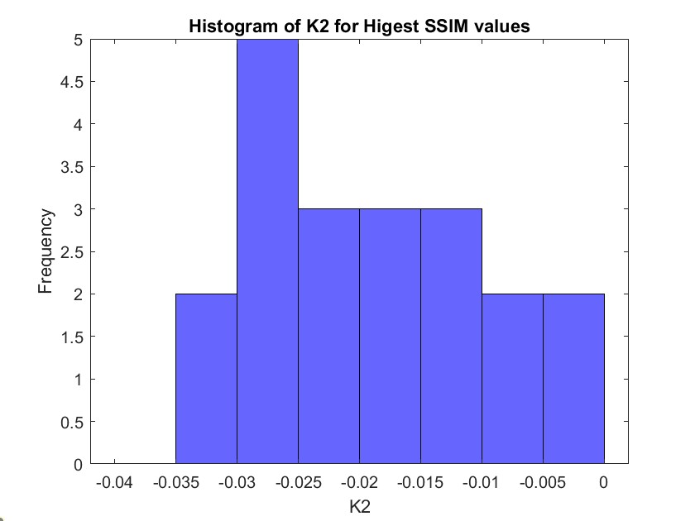
Coefficients Value Selection

Slide 11
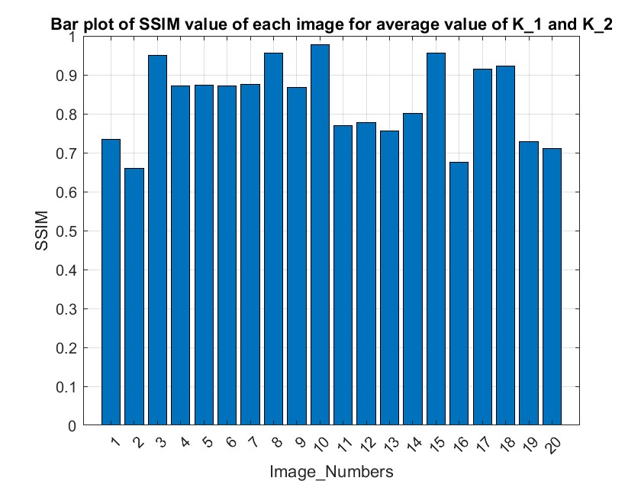
Test results with different images.

Slide 12
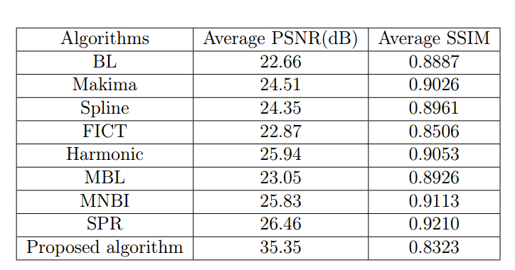
Comparison of Results with existing Algorithm.
Bilinear Interpolation (BL), Makima interpolation (Makima), Spline interpolation (Spline), Fast image inpainting using coherence transport (FICT), Harmonic
interpolation (Harmonic), Modified bilinear interpolation (MBL), Multiple nearest neighbor based interpolation (MNBI), and Sub-pixel relocation (SPR)

Slide 13
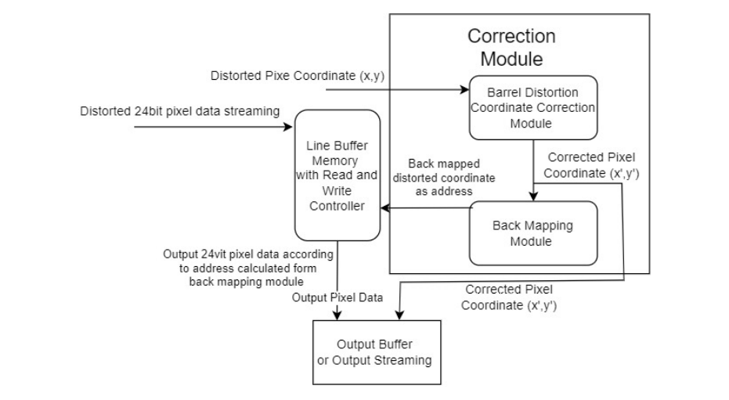
Hardware Design for Implementation
System level Micro- Architecture

Slide 14
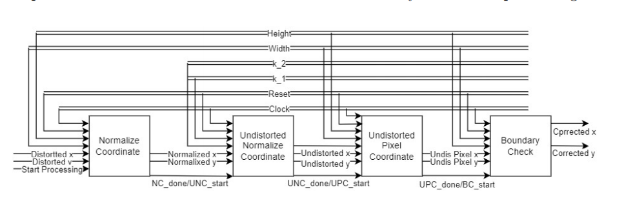
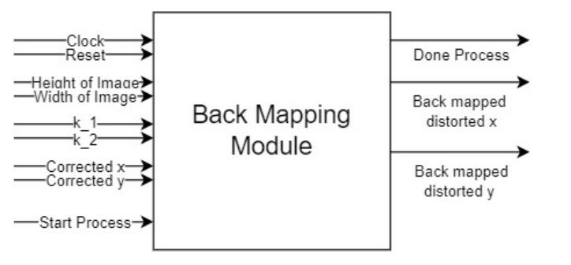
Correction Module

Slide 15
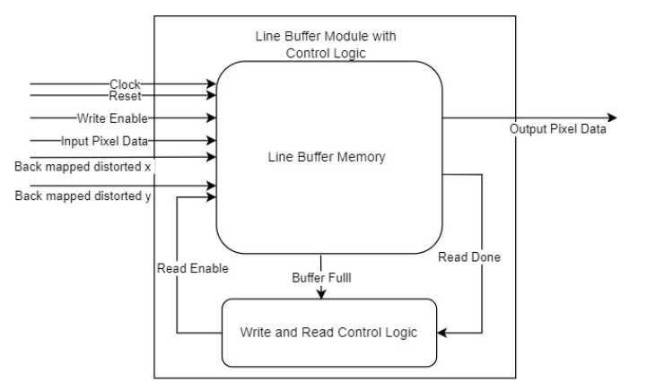
Line buffer Module

Slide 16
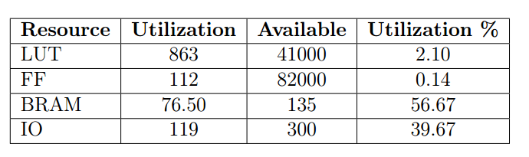
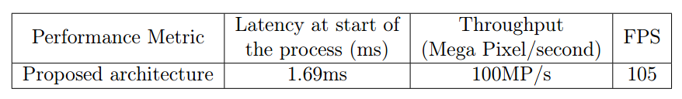
Results of Hardware Realization

Slide 17
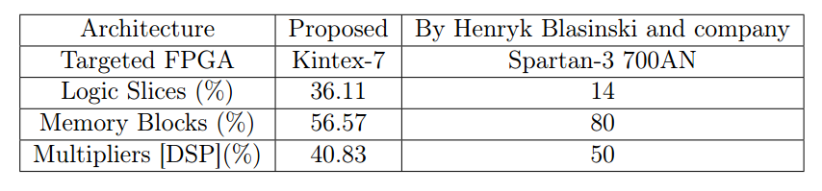
Comparison of resource utilization with existing work.

Slide 18
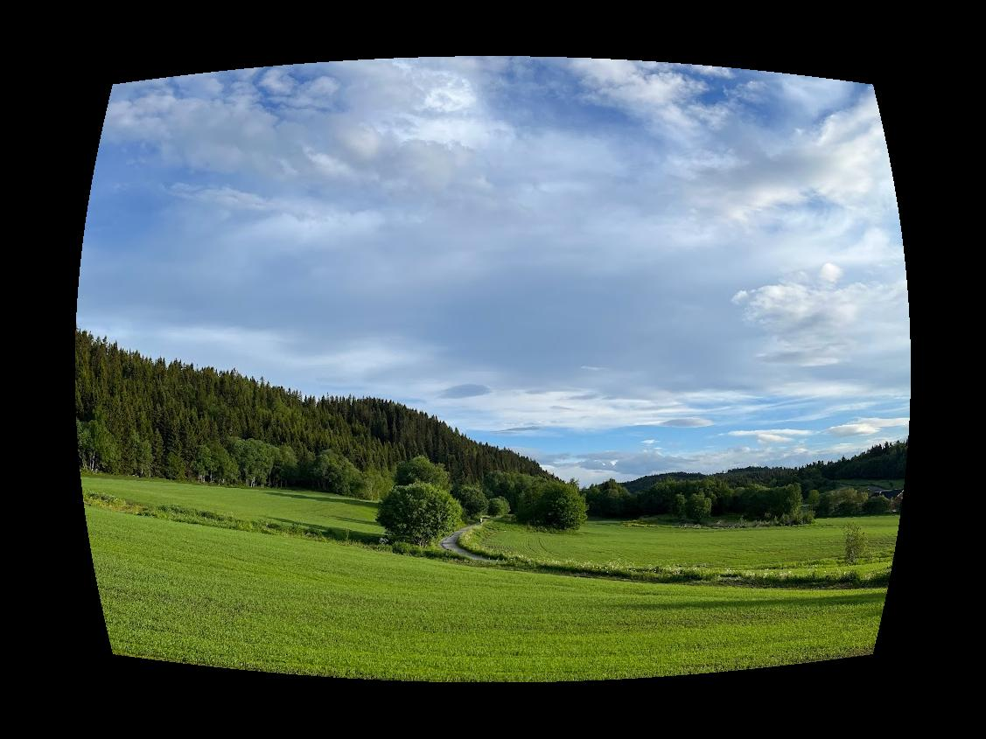

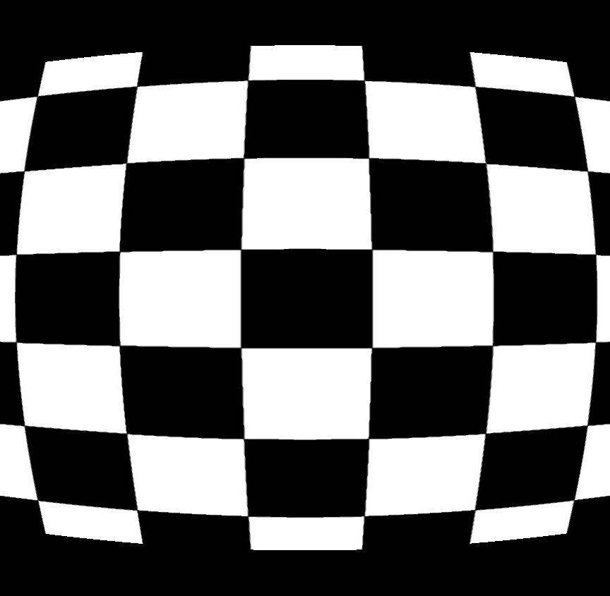
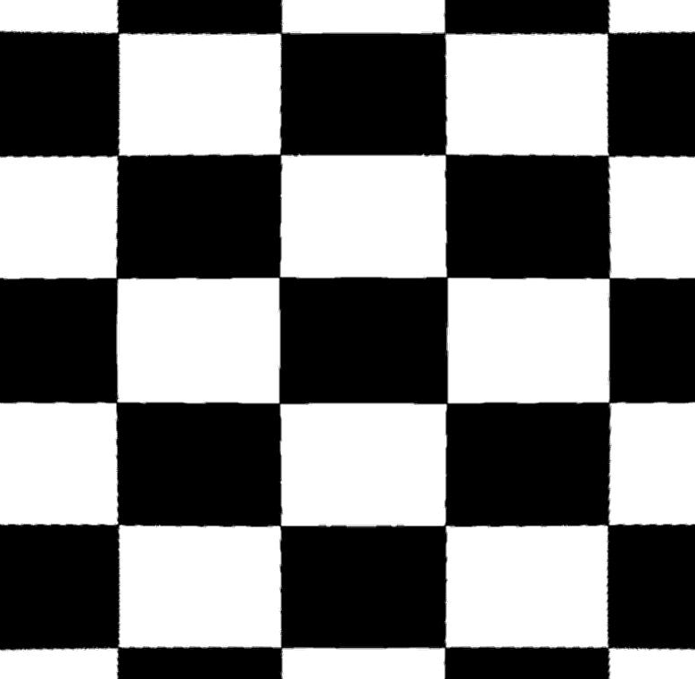
Barrel Distortion Corrected
Distorted Image
Corrected Image

Slide 19
References
1 H. Mohmmadzade, A. Sayyafan and B. Ghojogh “Pixel-Level Alignment of Facial Images for High Accuracy Recognition Using Ensemble of Patches” June 2018, Journal of the Optical Society of America A 35(7), DOI: 10.1364/JOSAA.35.001149
2. Jinlong Fan et al. “Wide-Angle Image Rectification: A Survey.” In: Inter- national Journal of Computer Vision (130 Jan. 2022), pp. 747–776. doi: https://doi.org/10.1007/s11263-021-01562-9.
3. C. Hughes1 M. Glavin1 E. Jones1 P. Denny. “Wide-angle camera technology for automotive applications: A review ”. In: IEEE Xplore (July 2008). doi: 10.1049/cp:20080656.
4. Peter Sturm et al. “Camera Models and Fundamental Concepts Used in Geo- metric Computer Vision.” In: Foundations and Trends in Computer Graph- ics and Vision 6(1-2) (2011), pp. 1–181. doi: https://doi.org/10.1561/ 0600000023.
5. Reg G. Willson. “Modeling and Calibration of Automated Zoom Lenses.” PhD thesis. Carnegie Mellon University, 1994
6. A. Prati R. Cucchiara C. Grana and R. Vezzani. “A Hough transform-based method for radial lens distortion correction”. In: 12th International Confer- ence on Image Analysis and Processing, 2003.Proceedings. (Sept. 2003). doi: 10.1109/ICIAP.2003.1234047.
7.Xianghua Ying et al. “Imposing Differential Constraints on Radial Distortion Correction”. In: Computer Vision – ACCV 2014 9003 (Apr. 2015), pp. 384– 398. doi: https://doi.org/10.1007/978-3-319-16865-4_25.
8. H. Blasinski, Wei Hai, and F. Lohier. “FPGA Architecture for Real-Time Barrel Distortion Correction of Colour Images”. In: 2011 IEEE International Conference on Multimedia and Expo, Barcelona, Spain (2011), pp. 1–6. doi:10.1109/ICME.2011.6011854.

