Slide 1

Mocking
In main roles: Moq, Nsubstitute, FakeItEasy, RhinoMocks and Julia Roberts

Slide 2
The importance and purpose of unit testing
Ensure code correctness
Documentation
Design Aid
Refactoring Support
Integration Ease
QA

Slide 3

Concepts of Mocking
Test double, stub

Slide 4

Concepts of Mocking
Fake
Spy

Slide 5

Moq

Slide 6
Key features
Uses expression trees and linq
Strong-Typed
IntelliSense support
EZ to master
No need to read documentation (as authors claim)
Can mock classes and interfaces

Slide 7

NSubstitute

Slide 8
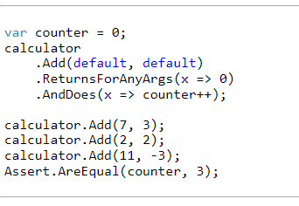
Callbacks

Slide 9
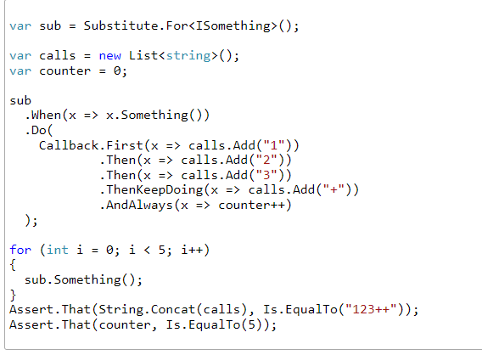
Callback Builder

Slide 10
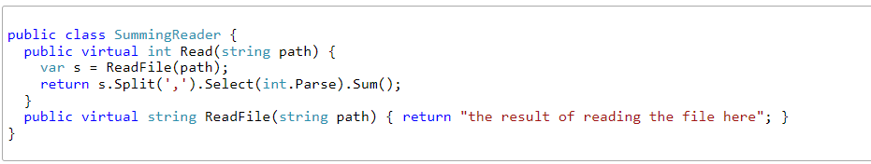
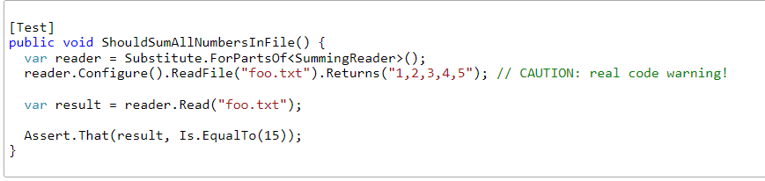
Partial Stub

Slide 11

FakeItEasy

Slide 12
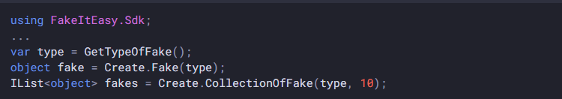
Flexible

Slide 13
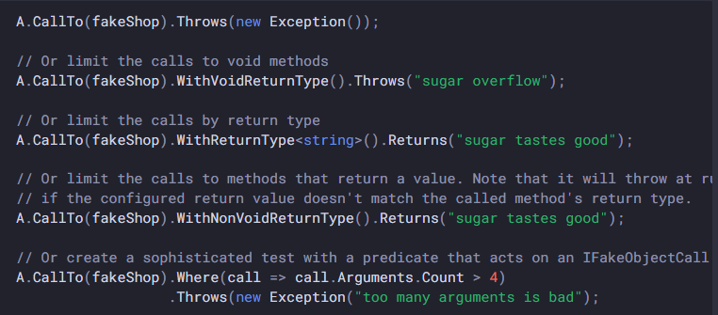
Specifying call to any method

Slide 14
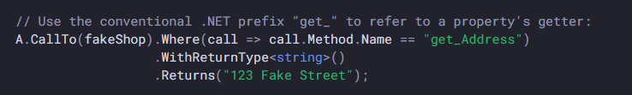
Setup protected properties

Slide 15

Strict mock, will throw if called unconfigured members

Slide 16

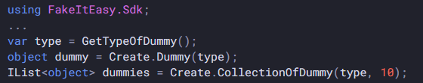
Dummies

Slide 17
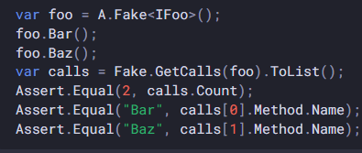
Advanced usage

Slide 18
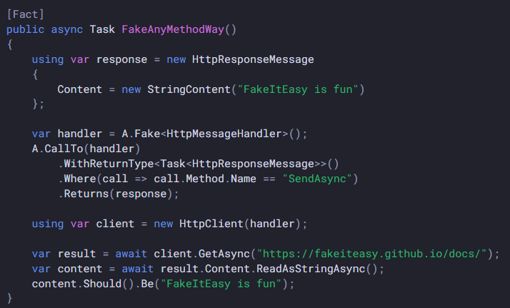
Built in HttpClient mock

Slide 19

Rhino Mocks

Slide 20
Name | Mocks | Dummies | Custom Matchers | Advanced api | AutoMock | Supp | Fluent | Docs
Moq | + | - | + | - | +(e) | + | 3 | 0
Nsubstitute | + | - | + | - | +(i) | + | 3 | 3
FakeItEasy | + | + | + | + | +(e) | + | 4 | 4
RhinoMocks | - | - | - | + | +(e) | - | 0 | 1

Slide 21

The End
"The only way to do great work is to love what you do." - Steve Jobs

