Slide 1
Aging, but not amnestic mild cognitive impairment, reshapes the infra-slow rhythm of sleep spindle power
Shaked Aglamaz
Supervised by Prof. Yuval Nir
Sagol School of Neuroscience, Tel Aviv University
M.Sc. thesis defense · [defense date]
Notes:
Placeholder date on the title slide: replace with the real defense date. Open by naming the object of the talk: a rhythm inside N2 sleep, about one cycle every 50 seconds, and the question of what aging and amnestic MCI do to it.

Slide 2
What this talk covers
The rhythm
Spindles come in trains about every 50 s: an infra-slow fluctuation of sigma power (ISFS)
What we measured
256-channel EEG, full nights, 104 participants: peak frequency, bandwidth, strength (AUC)
What changed with age
Faster rhythm, and the central-parietal hotspot of strength loses its focus
What aMCI added
Nothing detectable beyond age, and nothing that tracks cognitive score
Shaked Aglamaz · ISFS in aging and aMCI
2
Notes:
One sentence per box, then move on. Do not read the boxes out. Flag that the aMCI null is a result, not a missing result: it is what makes the aging interpretation clean.

Slide 3
Background
N2 sleep, spindles, and the infra-slow rhythm that organizes them

Slide 4
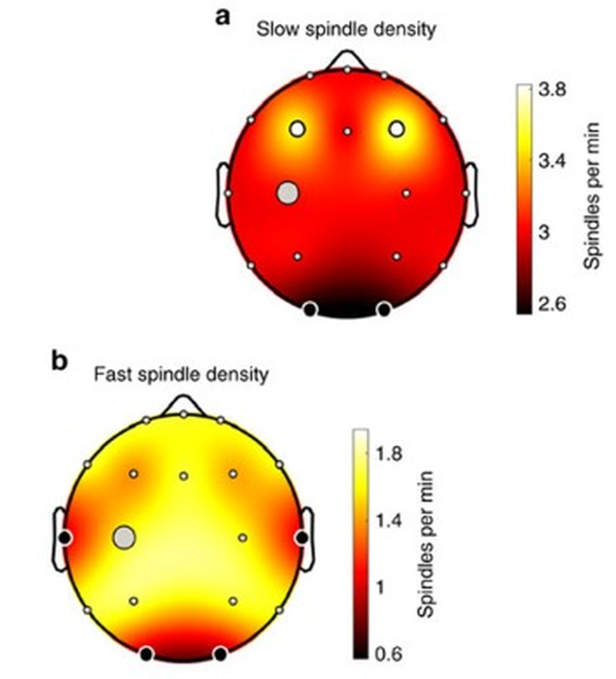
Sleep spindles
thalamo-cortical bursts, 11 to 16 Hz
slow: frontal · fast: central-parietal
tied to consolidation and to sensory disconnection
Purcell et al. 2017, n = 11,630
Shaked Aglamaz · ISFS in aging and aMCI
4
Notes:
Start here rather than at what N2 is: everyone in the room scores sleep. Spindles come from thalamic reticular and thalamocortical interaction, they define N2, and they are tied to plasticity, overnight consolidation and sensory disconnection. This talk is about the fast subtype, because that is where the infra-slow rhythm is most pronounced. Purcell is the largest spindle dataset there is, 11,630 individuals aged 4 to 97; the topography panel comes from its paediatric subsample with 18 electrodes, and the slow-frontal / fast-central pattern is the standard adult one too (Molle 2011). Right panel: density falls and the fast peak flattens with each decade past about 40.

Slide 5
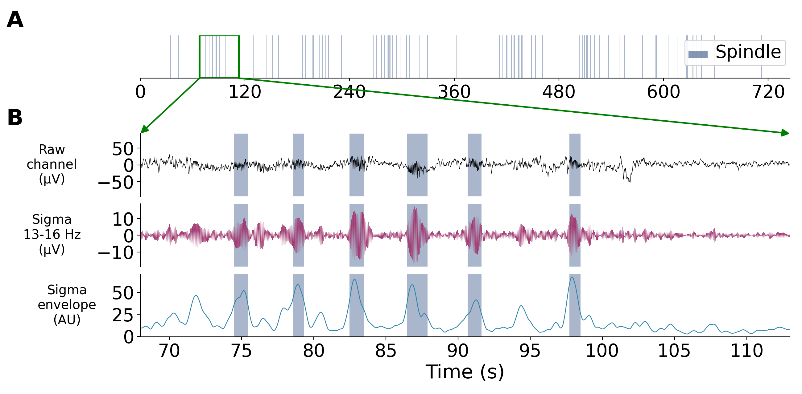
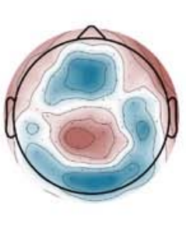
Spindles appear in a rhythm
one bar = one detected spindle
trains recur every ~50 s (~0.02 Hz)
fast sigma, central-parietal
ISFS strength in young adults (Dimitriades et al. 2024)
ISFS = ISO
Shaked Aglamaz · ISFS in aging and aMCI
5
Notes:
Talk over the top figure instead of reading it: each bar is one detected spindle in one channel, the green window is opened out below, and the three traces are the raw channel, the 13 to 16 Hz sigma, and the sigma amplitude envelope. What fluctuates is that envelope. The Lazar panel is the human characterization: the infra-slow modulation is confined to the fast sigma band and to central-parietal and occipital electrodes, exactly where fast spindles are largest. On the naming, say once that the same phenomenon is published as an infra-slow fluctuation of sigma power (ISFS) and as an infra-slow oscillation (ISO). The rate depends on what is measured: sigma power puts it near 0.01 Hz, spindle events near 0.02 Hz (Lazar 2019; Lecci 2017).

Slide 6
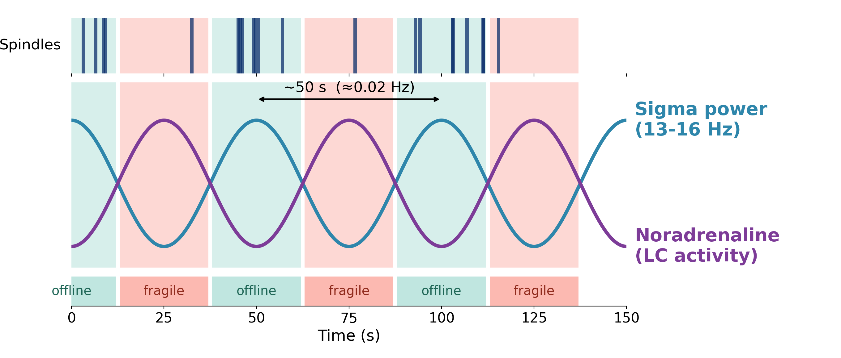
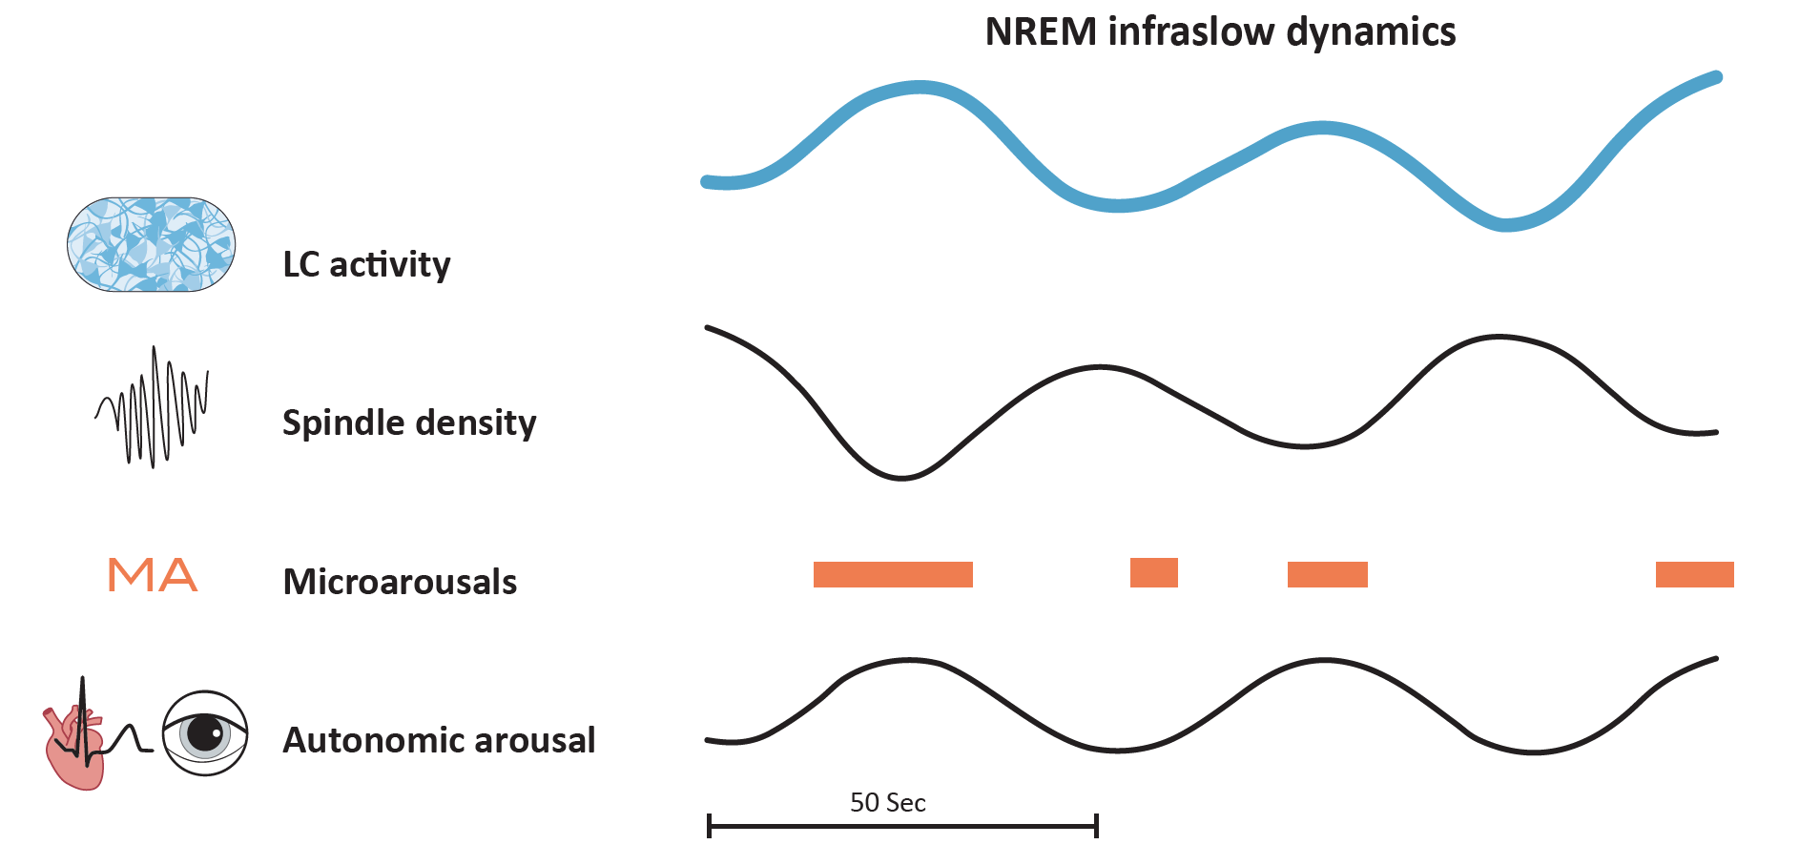
Two substates, paced by the locus coeruleus
our schematic of the published account
the same cycle from rodent work (Nir et al., review)
offline: spindle trains, sensory gating
fragile: micro-arousals
noradrenaline in anti-phase with sigma
Shaked Aglamaz · ISFS in aging and aMCI
6
Notes:
Top: our schematic of the published account, not our data. Bottom: the same cycle as it is described from rodent work, with LC activity, spindle density, micro-arousals and autonomic arousal aligned on it. In rodents the LC sets the phase; thalamic noradrenaline suppresses spindle generation, so LC peaks mark micro-arousals and LC troughs the spindle trains (Lecci 2017; Osorio-Forero 2021, 2025). Acetylcholine, serotonin and dopamine run on the same cycle, and silencing the LC abolishes the noradrenergic oscillation (Kjaerby 2022, 2026). Lecci also showed the phase gates arousability: mice wake to a tone on the declining sigma phase and sleep through it on the rising phase. The bottom panel is from Yuval's own unpublished review, so clear it with him; the published alternative already in the assets folder is the mouse and human spectra from Lecci 2017.

Slide 7
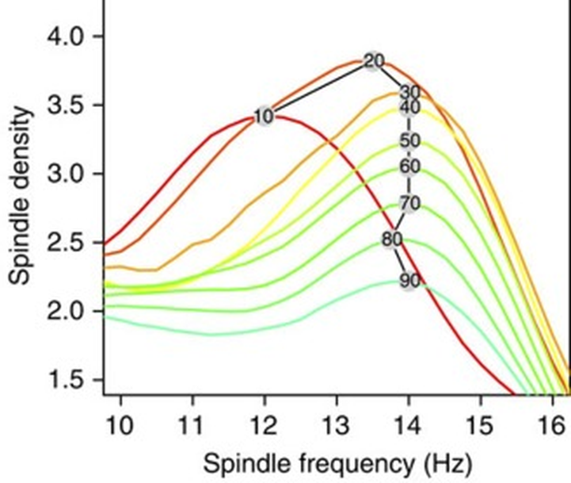
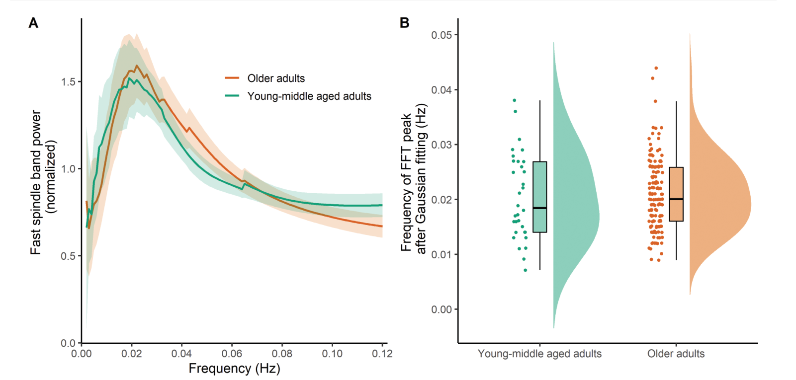
What aging does to spindles, and to the rhythm
the rhythm is present in older adults; at C3/C4 its peak frequency does not differ (Champetier et al. 2023)
fewer spindles with age (Purcell et al. 2017)
spindles: fewer, less clustered
parietal fast-spindle deficit in aMCI and AD (Gorgoni 2016)
the rhythm: two electrodes, one null, no topography
Shaked Aglamaz · ISFS in aging and aMCI
7
Notes:
This slide positions the thesis, so be precise. Aging: spindle density falls, slow-wave to spindle coupling loosens, and the temporal clustering of spindles breaks down (Mander 2017; Helfrich 2018; Champetier 2023). Champetier came closest to our question: 32 young-middle aged adults, 20 to 52 years, against 147 cognitively unimpaired older adults, fast-spindle power at C3 and C4 only, FFT and a Gaussian fit, peak 0.021 versus 0.022 Hz, no group difference (F(1,175) = 0.164, p = .69). They also showed the proportion of clustered fast spindles falls with age. So what was open was not whether the rhythm survives into old age, but its whole-scalp parameters and its topography, against a genuinely young reference group, and whether aMCI adds anything. Expect to be asked why our peak-frequency result is positive where theirs is null, and answer with the age contrast (their younger group averages 34.5 years and reaches 52, ours averages 27.1), with two central electrodes versus 176, and with the direction: their means differ the same way ours do.

Slide 8
Amnestic MCI
Cognitive complaint plus objective impairment, daily function preserved
Amnestic subtype: memory impaired, closest to Alzheimer's disease
Enriched for Alzheimer's pathology, not equivalent to it
NREM sleep features proposed as early markers
Shaked Aglamaz · ISFS in aging and aMCI
8
Notes:
Petersen 1999 and Albert 2011 for the criteria: the syndrome is diagnosed first and its cause judged separately, so a group defined on cognitive grounds is aetiologically mixed. Most people with MCI never progress (Mitchell 2009) and about a quarter of amnestic cases revert to normal cognition (Malek-Ahmadi 2016). Candidate NREM markers: Taillard 2019, Liu 2020, and the parietal fast-spindle deficit of Gorgoni 2016. How to read a null here belongs in the discussion, so do not pre-empt it.

Slide 9
Open questions
Aim 1
Does the ISFS change with healthy aging, in its parameters and in its topography?
Aim 2
Does amnestic MCI add anything beyond age?
Approach
256-channel EEG, three groups: whole scalp, channel by channel, and an a-priori ROI
Shaked Aglamaz · ISFS in aging and aMCI
9
Notes:
Hypotheses as they were stated: an age effect on the parameters and on the topography, and, if the ISFS indexes early neurodegeneration, a further change in aMCI. What was missing: whole-scalp parameters and topography in older adults, a young reference group recorded the same way, and any data at all in aMCI. Grollero et al. (2026) measured the same features in diagnosed Alzheimer's disease concurrently with this work: convergent, not the motivation, and it returns in the discussion.

Slide 10
Methods
From a full night of 256-channel EEG to three numbers per channel

Slide 11
Cohort: 104 participants, two sites
Group | n (Tel Aviv / Sydney) | Age (years) | MoCA
Young | 35 (35 / 0) | 27.1 ± 4.3 | not assessed
Elderly | 39 (30 / 9) | 66.5 ± 9.7 | 27.2 ± 2.6 (n = 30)
aMCI | 30 (14 / 16) | 67.8 ± 9.1 | 21.5 ± 4.3 (n = 14)
Identical EEG setup and identical scoring at both sites: TASMC Tel Aviv, and the CIRUS Centre, Woolcock Institute, Sydney
The two older groups are matched in age (p = 0.57) and differ in MoCA as expected (p < 0.001)
Shaked Aglamaz · ISFS in aging and aMCI
11
Notes:
aMCI patients in Tel Aviv came through the Memory and Attention Disorders Center and were diagnosed clinically at the Cognitive Neurology Unit; patients already diagnosed with Alzheimer's disease were not included. Moderate or severe apnea was excluded, so every older participant has an AHI of 15 or below. MoCA was collected in Tel Aviv only, which is why the MoCA analysis has n = 44 rather than 69. Age: Welch t = -0.56, p = 0.57; MoCA: Mann-Whitney U = 375.5, p < 0.001.

Slide 12
Recording and scoring
256-channel EGI system, Cz reference, digitized at 1000 Hz, impedances below 50 kOhm
Full-night PSG: EEG with EOG and submental EMG
Scored in 30 s epochs by AASM criteria (Visbrain within SleepEEGpy), on frontal, central and occipital derivations against contralateral mastoids
Verified against the Pz spectrogram with the hypnogram overlaid
Face, neck and ear electrodes dropped: 176 channels enter the analysis
The ISFS analysis is restricted to N2 sleep
Shaked Aglamaz · ISFS in aging and aMCI
12
Notes:
Same protocol at both sites, which is what makes pooling defensible. The excluded electrodes are the ones not over the scalp and most prone to muscle and movement artifact.

Slide 13
Preprocessing and artifact rejection
Resample
250 Hz
›
Notch
50, 100 Hz
›
Band-pass
0.1 to 40 Hz
›
Reject bad
channels, epochs
›
Average reference
(good channels)
›
Interpolate
bad channels
Semi-automatic rejection, every recording inspected visually over its full duration
Bad channels: 6.3 %, 1.4 %, 3.4 % of channels (young, elderly, aMCI)
N2 time rejected as artifactual: 4.1 %, 3.3 %, 1.8 %
The reference is computed over good channels only, so a bad channel never enters it; interpolation comes afterwards
Shaked Aglamaz · ISFS in aging and aMCI
13
Notes:
Technical exclusions applied on top of the diagnostic criteria: more than 20 % of electrodes bad, more than 30 % of N2 artifactual, fewer than three clean bouts, or total sleep time under 210 min. The 210 min floor means each analyzed night holds more than two full NREM-REM cycles, so N2 is sampled across the night and not only from its first hours. Backup slide B3 has the exclusion counts.

Slide 14
Clean N2 bouts: the unit of analysis
Everything not scored as N2 is discarded
Each N2 period is split around every overlapping artifact annotation
Segments of at least 300 s are kept; each bout is analyzed independently
300 s is the floor because the lowest frequency of interest, 0.0075 Hz, has a period of about 133 s, so a bout must hold two full cycles
At least three clean bouts were required per participant
Across the cohort: 1023 clean bouts, on average 9.8 per participant (range 3 to 21)
Shaked Aglamaz · ISFS in aging and aMCI
14
Notes:
Splitting around artifacts rather than rejecting whole N2 periods is what preserves usable data. The three-bout minimum is an inclusion criterion, and it excluded nine recordings across the three groups.

Slide 15
From the EEG to the sigma envelope
A) Spindles over one 745 s N2 bout. B) The 45 s window opened out: raw channel, 13 to 16 Hz sigma, and the sigma amplitude envelope, with detected spindles shaded.
Shaked Aglamaz · ISFS in aging and aMCI
15
Notes:
One example participant and channel. The envelope comes from a Gabor-Morlet wavelet transform, 13 to 16 Hz in 0.2 Hz steps, 4 cycles wide, implemented as convolution in the frequency domain. Then, for each bout: subtract the mean of the envelope so its constant offset does not dominate the 0 Hz bin, Fourier transform, take the squared magnitude, put it on a frequency axis common to all bouts, and divide by its own mean power so channels and bouts of different signal strength are comparable.

Slide 16
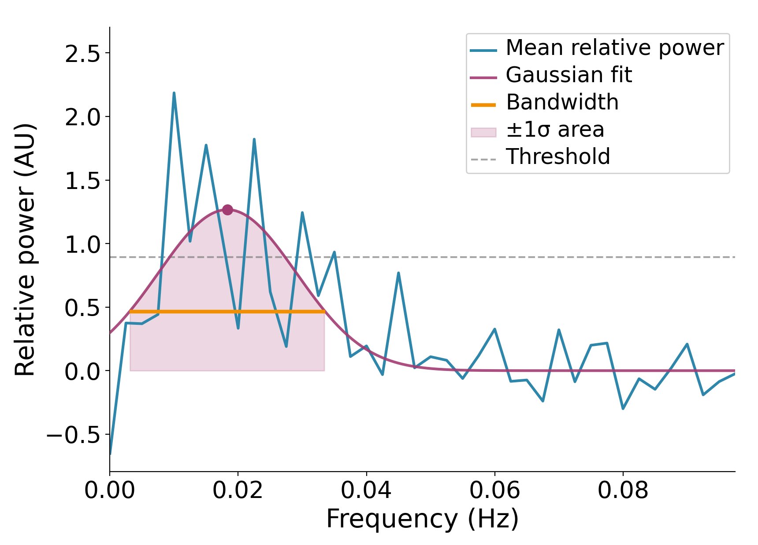
Three parameters per channel
envelope > FFT > Gaussian fit
Peak frequency: how fast
Bandwidth: how sharply defined
AUC: how strong
Baseline from 0.06 to 0.10 Hz subtracted first
Accepted if: peak > 1.5 SD, peak inside 0.0075 to 0.04 Hz, area > 0
Failures left missing, not zero
Shaked Aglamaz · ISFS in aging and aMCI
16
Notes:
The parameterization is Dimitriades et al. (2024), adapted from their 128-channel montage to ours; they followed the ISFS across development and linked these three measures to arousal and memory reactivation. Point at the curve while naming the parameters: the peak, the width of the orange band, the area of the shaded band. Normalized bout spectra are averaged within each channel before the fit. Why the baseline matters: broadband noise puts a channel-specific offset under the peak, which would inflate any peak measured on top of it, and the 0.06 to 0.10 Hz range contains no ISFS signal, so it estimates that offset cleanly. The acceptance rule is the reference pipeline's plus the positive-area gate, which rejects degenerate fits. Leaving failures missing rather than zero matters: a zero would be a measurement, a missing value is the absence of one.

Slide 17
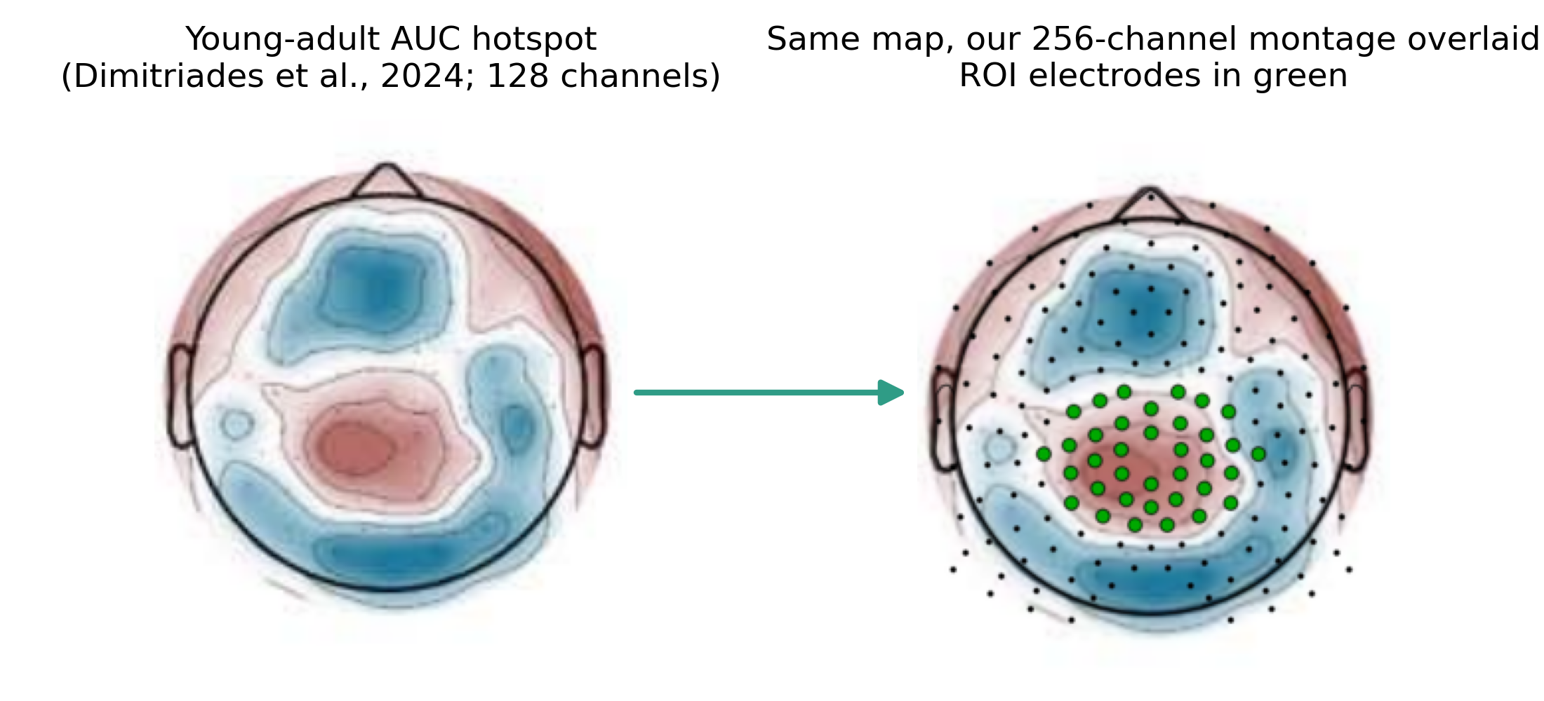
The region of interest was defined a priori
Taken from the young-adult AUC hotspot of Dimitriades et al. (2024) and mapped onto the 256-channel montage. Fixed before any group comparison, and identical for every participant.
Shaked Aglamaz · ISFS in aging and aMCI
17
Notes:
Say the ROI, or the central-parietal ROI, and nothing else: the internal variant labels are not for the audience. It is used for the AUC comparison and appears as green dots on the topography slides. Because it was fixed in advance, the ROI test is confirmatory while the cluster test is exploratory over the whole scalp.

Slide 18
Statistics at three levels of spatial detail
Whole scalp: one value per participant, the mean over channels with an accepted fit
One-way ANOVA with eta squared where normality and variance homogeneity held, Kruskal-Wallis otherwise; Tukey HSD post-hoc when the omnibus test was significant
Topography: cluster-based permutation test (F statistic, 5000 permutations, EGI-256 adjacency), Tukey-Kramer post-hoc at each electrode of a significant cluster
ROI: per-channel values normalized by the participant's whole-scalp mean first, and only then restricted to the ROI
Where the amount of analyzed N2 sleep could matter, it was entered as a covariate (ANCOVA)
Shaked Aglamaz · ISFS in aging and aMCI
18
Notes:
Whole-scalp AUC failed the normality check, so that one parameter is tested non-parametrically. The order of normalization matters: normalizing inside the ROI would force its mean to 1 by construction, which is why it is done over all channels first. Cluster-forming threshold at the p = 0.05 F-critical value, one-tailed.

Slide 19
Results
Young 35 · Elderly 39 · aMCI 30

Slide 20
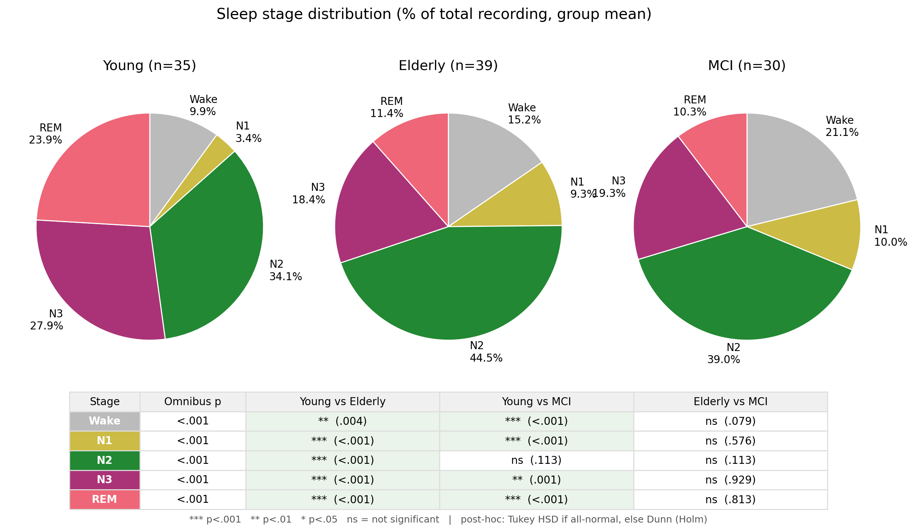
Sleep changes with age, but N2 stays plentiful
Less N3 and less REM sleep in both older groups (both p < 0.001), while N2, the stage the ISFS lives in, remains the largest stage in all three groups.
Shaked Aglamaz · ISFS in aging and aMCI
20
Notes:
N3: ANOVA F = 10.85, p = 0.0001. REM: F = 36.70, p < 0.0001. Both are driven by young versus each older group, with elderly and aMCI indistinguishable. N2 is 34.1 %, 44.5 % and 39.0 % of recording time. This is the normative aging pattern, which is the point: it is the baseline against which any aMCI effect has to show itself.

Slide 21
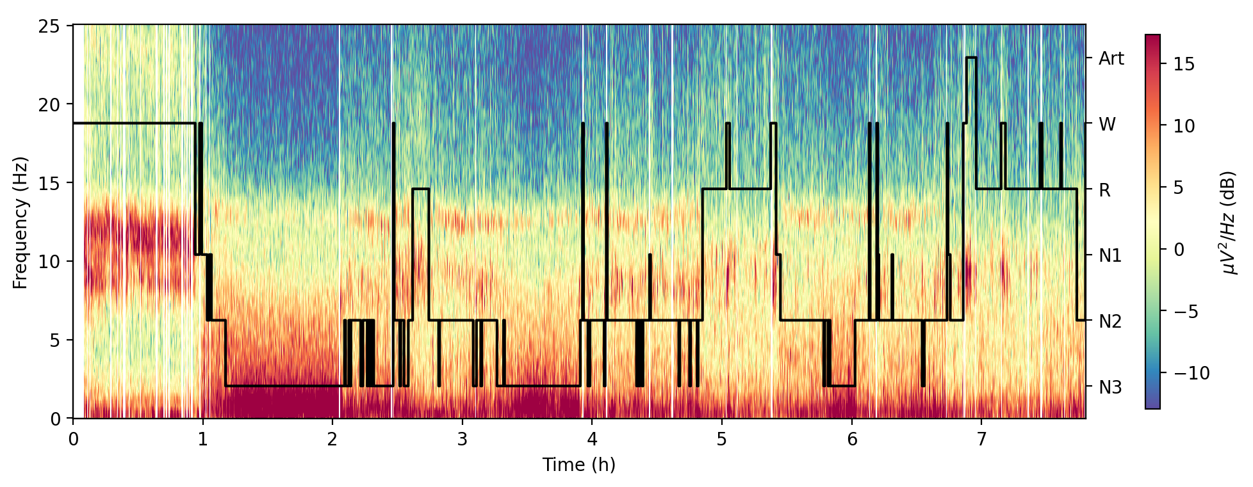
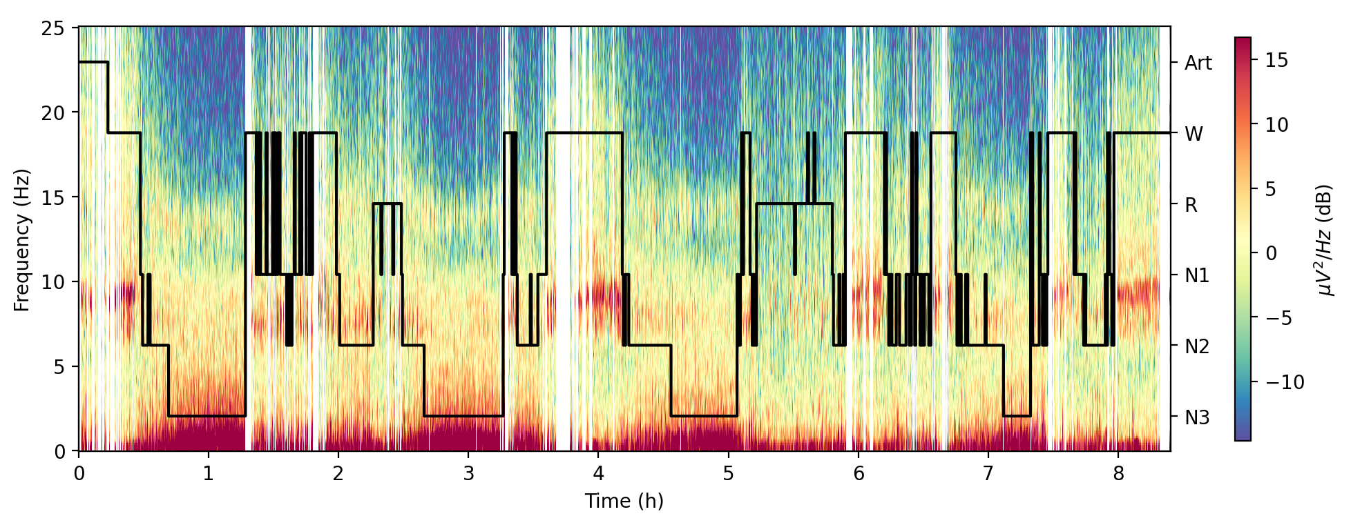
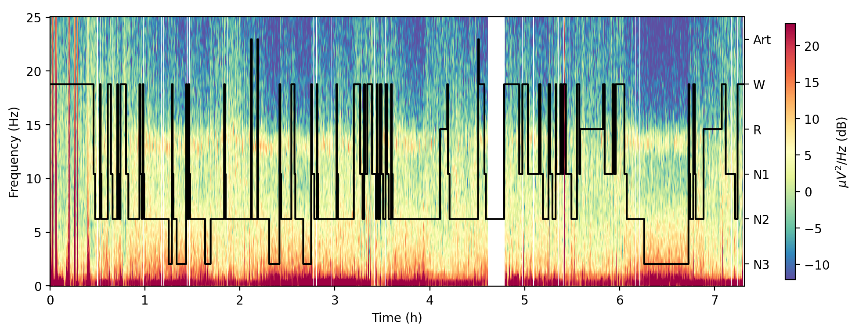
One whole night per group
Young
Elderly
aMCI
Shaked Aglamaz · ISFS in aging and aMCI
21
Notes:
Hypnogram over the spectrogram of one electrode, one representative participant per group. Subject codes are cropped on purpose: two of the codes are misleading about group membership. Point out the fragmentation and the loss of deep sleep in the two older nights, then move on: the group statistics are on the next slide.

Slide 22
Sleep architecture and continuity
The normative aging pattern, and on every measure elderly and aMCI are statistically indistinguishable (all p >= 0.11).
 | Young | Elderly | aMCI | omnibus p
Wake (%) | 9.9 ± 6.6 | 15.2 ± 7.5 | 21.1 ± 11.8 | < 0.0001
N1 (%) | 3.4 ± 2.5 | 9.3 ± 6.2 | 10.0 ± 5.6 | < 0.0001
N2 (%) | 34.1 ± 13.2 | 44.5 ± 11.7 | 39.0 ± 12.3 | 0.0009
N3 (%) | 27.9 ± 8.7 | 18.4 ± 9.7 | 19.3 ± 9.9 | 0.0001
REM (%) | 23.9 ± 10.4 | 11.4 ± 5.0 | 10.3 ± 5.2 | < 0.0001
WASO (min) | 23.2 ± 19.6 | 51.9 ± 30.0 | 71.0 ± 46.3 | < 0.0001
Sleep efficiency (%) | 89.2 ± 6.7 | 83.6 ± 8.5 | 78.6 ± 11.7 | 0.0001
Shaked Aglamaz · ISFS in aging and aMCI
22
Notes:
Percentages are of total recording time; mean ± SD. Sleep onset latency did not differ across groups (17.4, 15.6, 19.9 min; p = 0.38) and REM latency did (92.8, 125.4, 130.3 min; p = 0.005). Effect sizes: WASO eta squared 0.291, sleep efficiency 0.170. The full 14-row table with tests and post-hoc columns is backup slide B2.

Slide 23
Is the N2 that entered the analysis comparable?
 | Young | Elderly | aMCI | omnibus p
N2 bouts (n) | 7.7 ± 3.8 | 11.0 ± 4.2 | 10.8 ± 4.7 | 0.0013
Mean bout length (s) | 629 ± 175 | 561 ± 109 | 501 ± 77 | 0.0022
Analyzed N2 (min) | 80.7 ± 44.2 | 106.0 ± 50.1 | 90.8 ± 39.9 | 0.081
Share of N2 kept (%) | 51.9 ± 15.9 | 52.3 ± 17.4 | 51.5 ± 15.5 | 0.98
The share of each participant's N2 that survived cleaning is identical across groups
The imbalance that does exist runs opposite to the effects: young adults contributed the least analyzed N2, yet show the strongest hotspot
With analyzed N2 duration as a covariate, the peak-frequency effect holds (p = 0.0034) and the covariate explains none of its variance (p = 0.94)
Shaked Aglamaz · ISFS in aging and aMCI
23
Notes:
Raise this before showing any ISFS result: it is the first thing an examiner asks. Total analyzed N2 does not differ significantly (Kruskal-Wallis p = 0.081). Bandwidth is the one parameter that does track this, and it gets its own slide. Full ANCOVA output is backup slide B4.

Slide 24
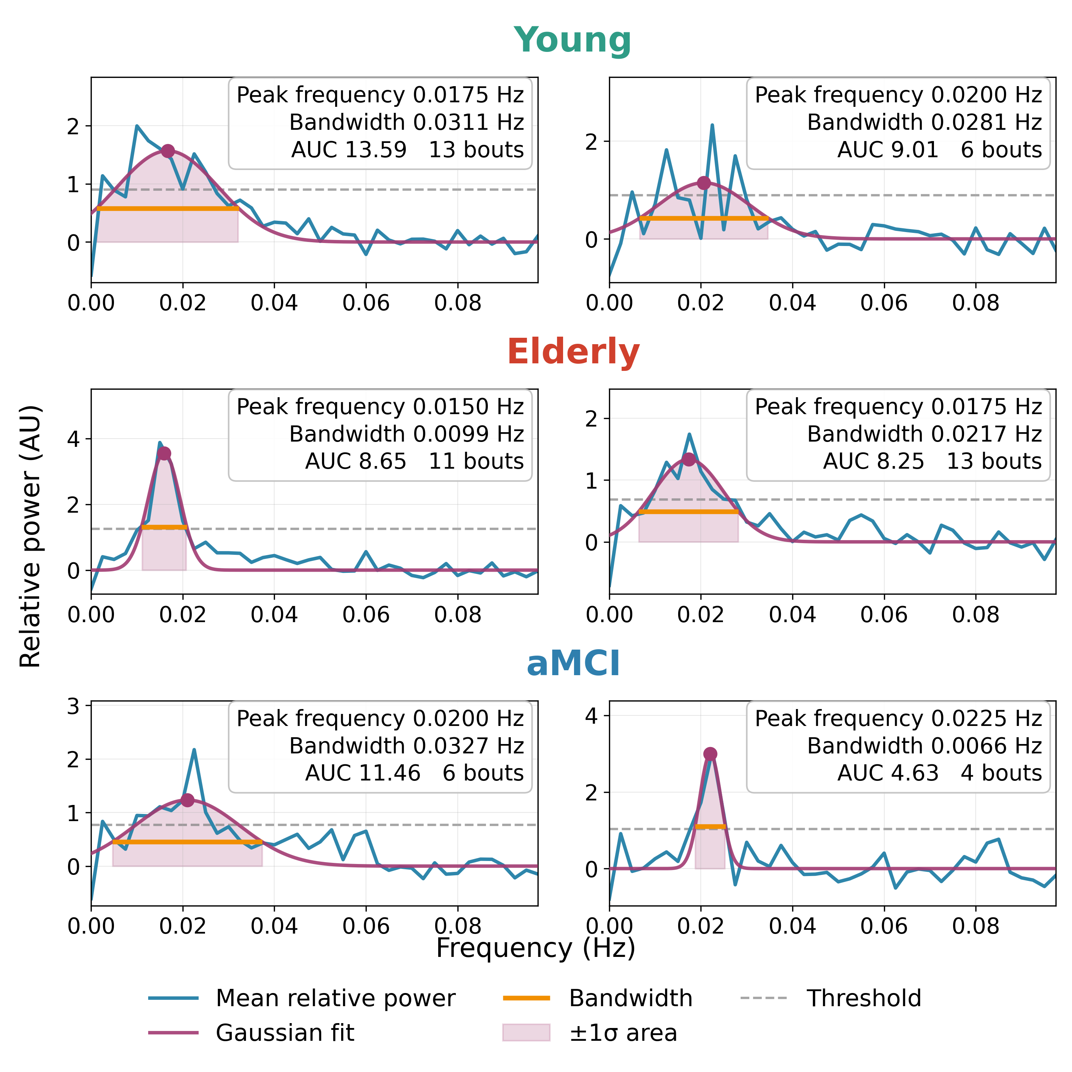
The ISFS is present in nearly every channel
A valid fit in 80.8 % of channels overall: 74.5 % in young adults, 85.6 % in elderly, 82.0 % in aMCI. Two example channels per group.
Shaked Aglamaz · ISFS in aging and aMCI
24
Notes:
This is what the group averages rest on: well-formed single-participant spectra, not an average that only looks clean once pooled. Each panel is one channel of one participant, with its own vertical scale, drawn with the same conventions as the methods figure. If asked what a failed fit means: no peak clearing the threshold inside the ISFS band, so no ISFS measurable at that channel, left missing rather than zero.

Slide 25
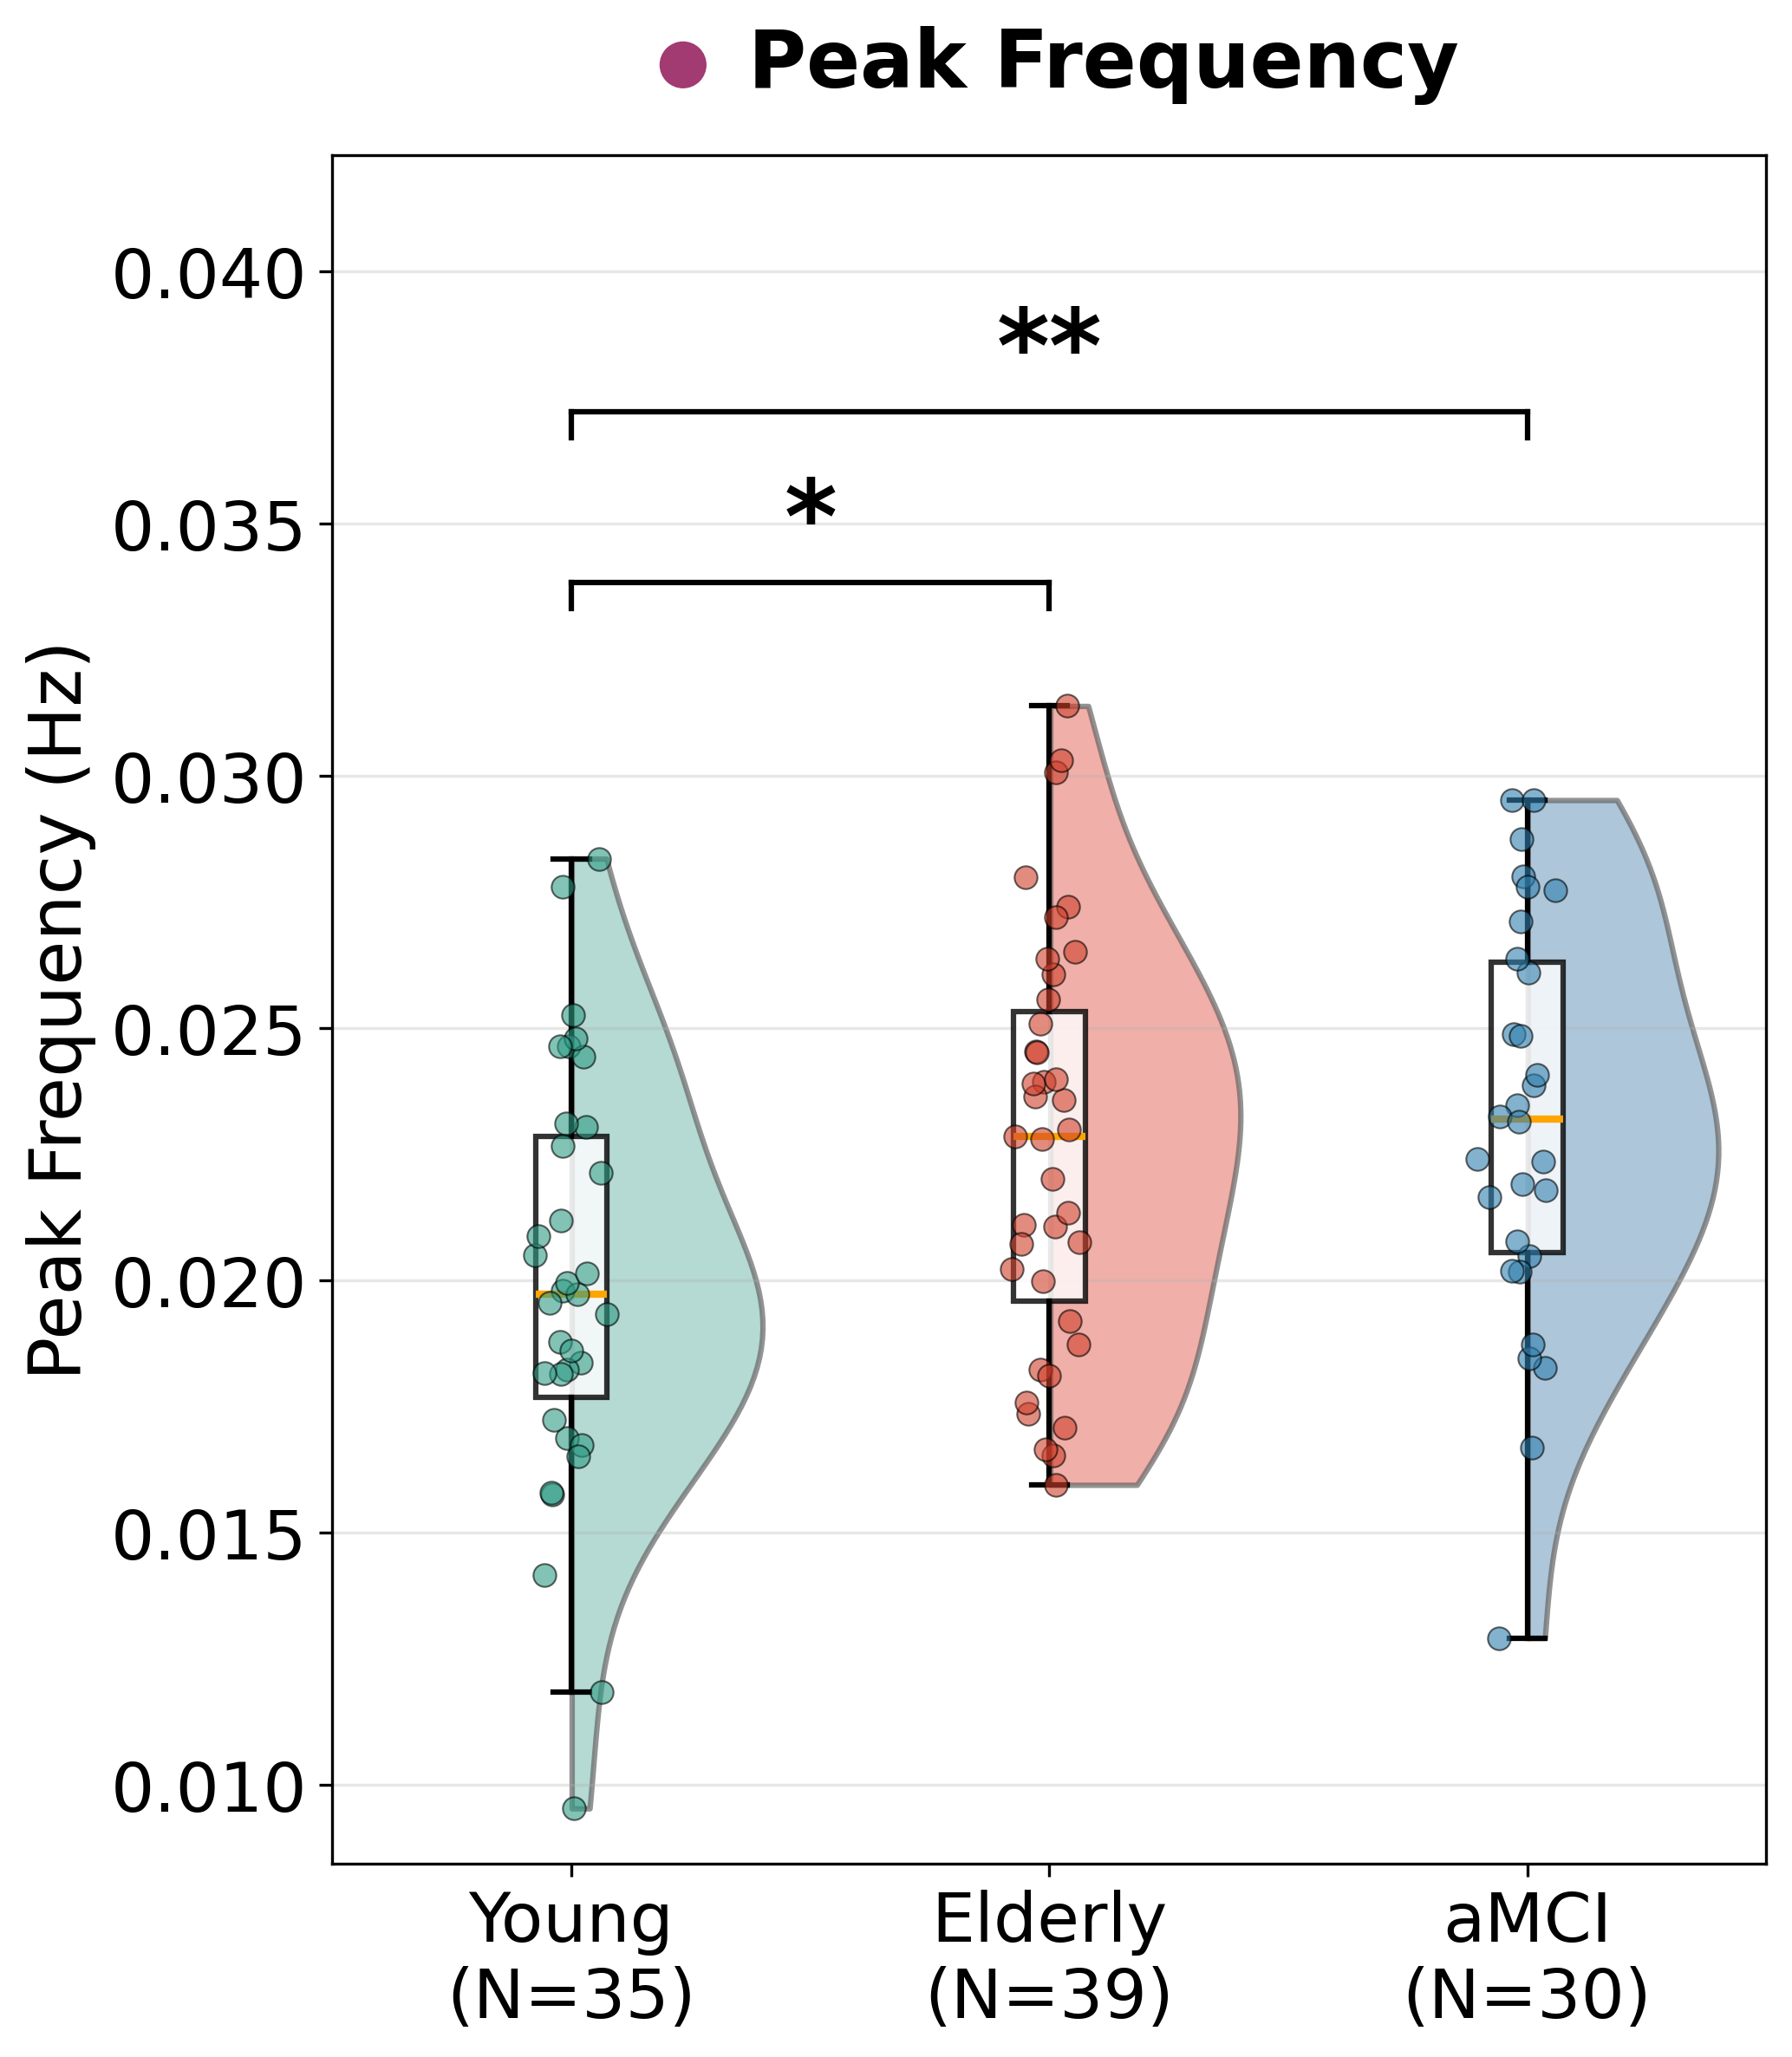
The rhythm runs faster in both older groups
Young 0.0199, Elderly 0.0226, aMCI 0.0232 Hz. One-way ANOVA p = 0.0026, eta squared 0.111.
Young < Elderly = aMCI
Post-hoc: young vs elderly p = 0.013, young vs aMCI p = 0.005
Elderly vs aMCI: p = 0.86
Across all 104 participants the peak sits at 0.0219 Hz on average (range 0.0095 to 0.0314), where the literature puts it
Each dot is one participant's mean over the fitted electrodes
Shaked Aglamaz · ISFS in aging and aMCI
25
Notes:
Headline temporal result. The effect survives the N2-duration covariate (ANCOVA p = 0.0034, partial eta squared 0.108) with both pairwise contrasts surviving Holm correction. If asked how big it is: about a 15 % higher rate, or a cycle roughly 7 s shorter.

Slide 26
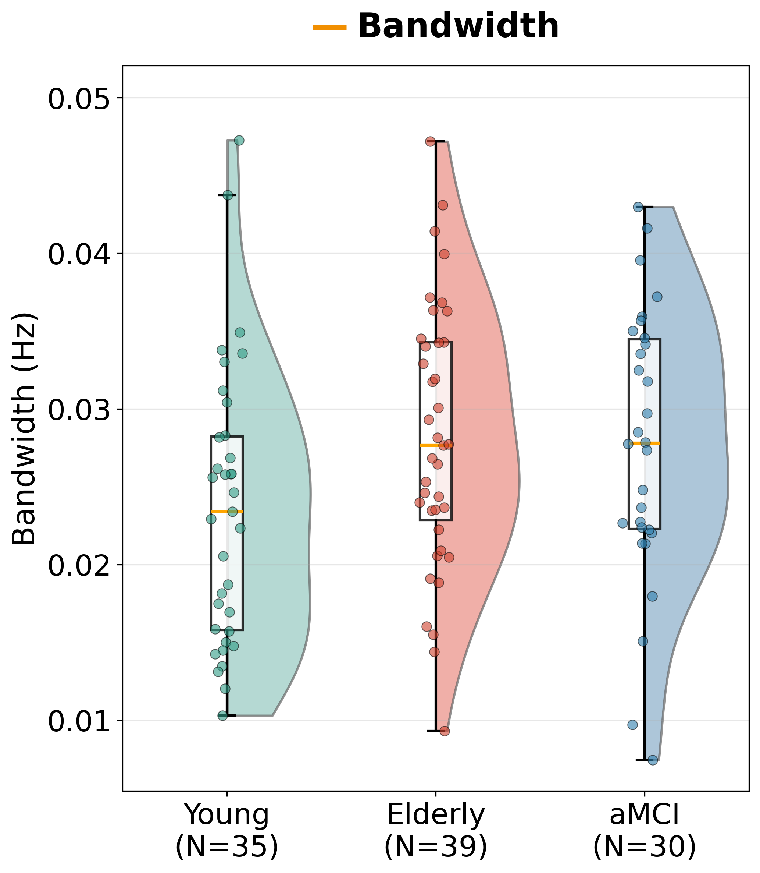
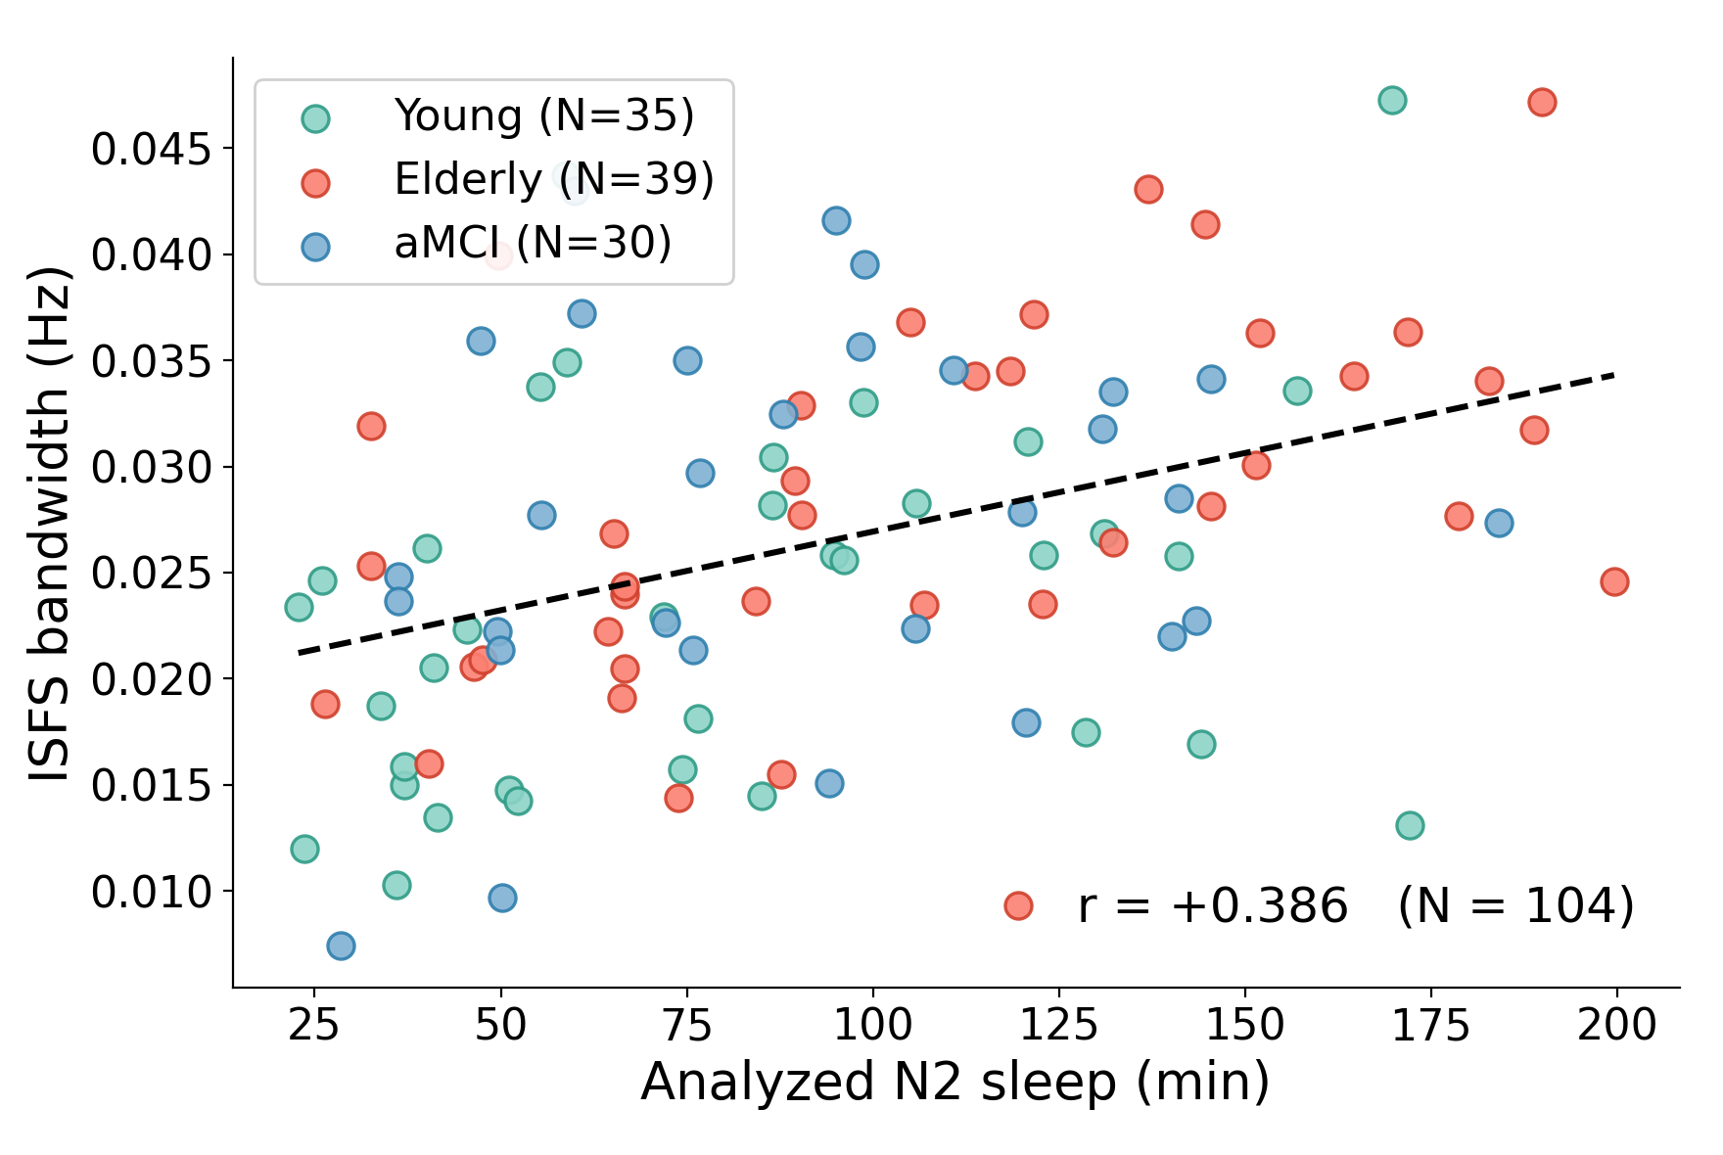
Bandwidth: no group effect, and it tracks analyzed N2
0.0236, 0.0281, 0.0276 Hz, ANOVA p = 0.061, not significant. Bandwidth correlates with how much N2 sleep a participant contributed (r = 0.386), and with duration as a covariate the group difference weakens to p = 0.206.
Shaked Aglamaz · ISFS in aging and aMCI
26
Notes:
The covariate is the stronger predictor: F = 14.73, p = 0.0002, partial eta squared 0.128, against group's 0.031. So this is not interpretable as an effect of age, and the thesis does not call it a trend. Say why being explicit here is a strength: the same covariate analysis is what makes the peak-frequency result credible, because there it changed nothing.

Slide 27
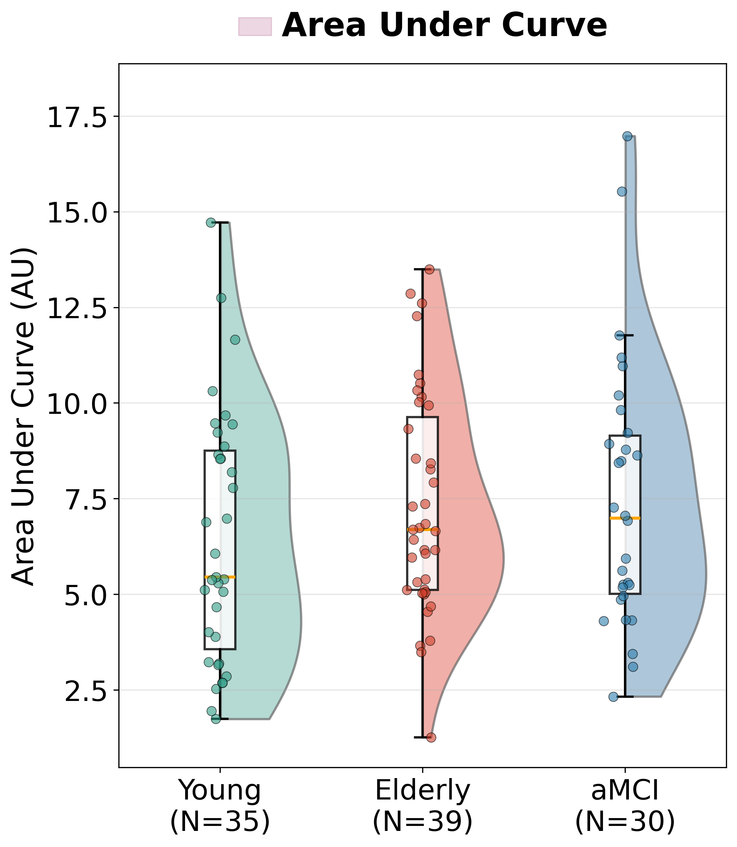
Overall strength, averaged over the scalp, is unchanged
AUC 6.46, 7.31, 7.48. Kruskal-Wallis p = 0.38.
No group difference in ISFS strength when every channel is averaged together
Tested non-parametrically because AUC failed the normality check
Averaging over the whole scalp can hide a regional effect, which is exactly what happens next
Shaked Aglamaz · ISFS in aging and aMCI
27
Notes:
Deliberate setup for the topography slides. If the talk is running long, this slide and the next can be merged, but do not skip the point: the null at whole-scalp level is what makes the focal result interesting rather than just a global decline.

Slide 28
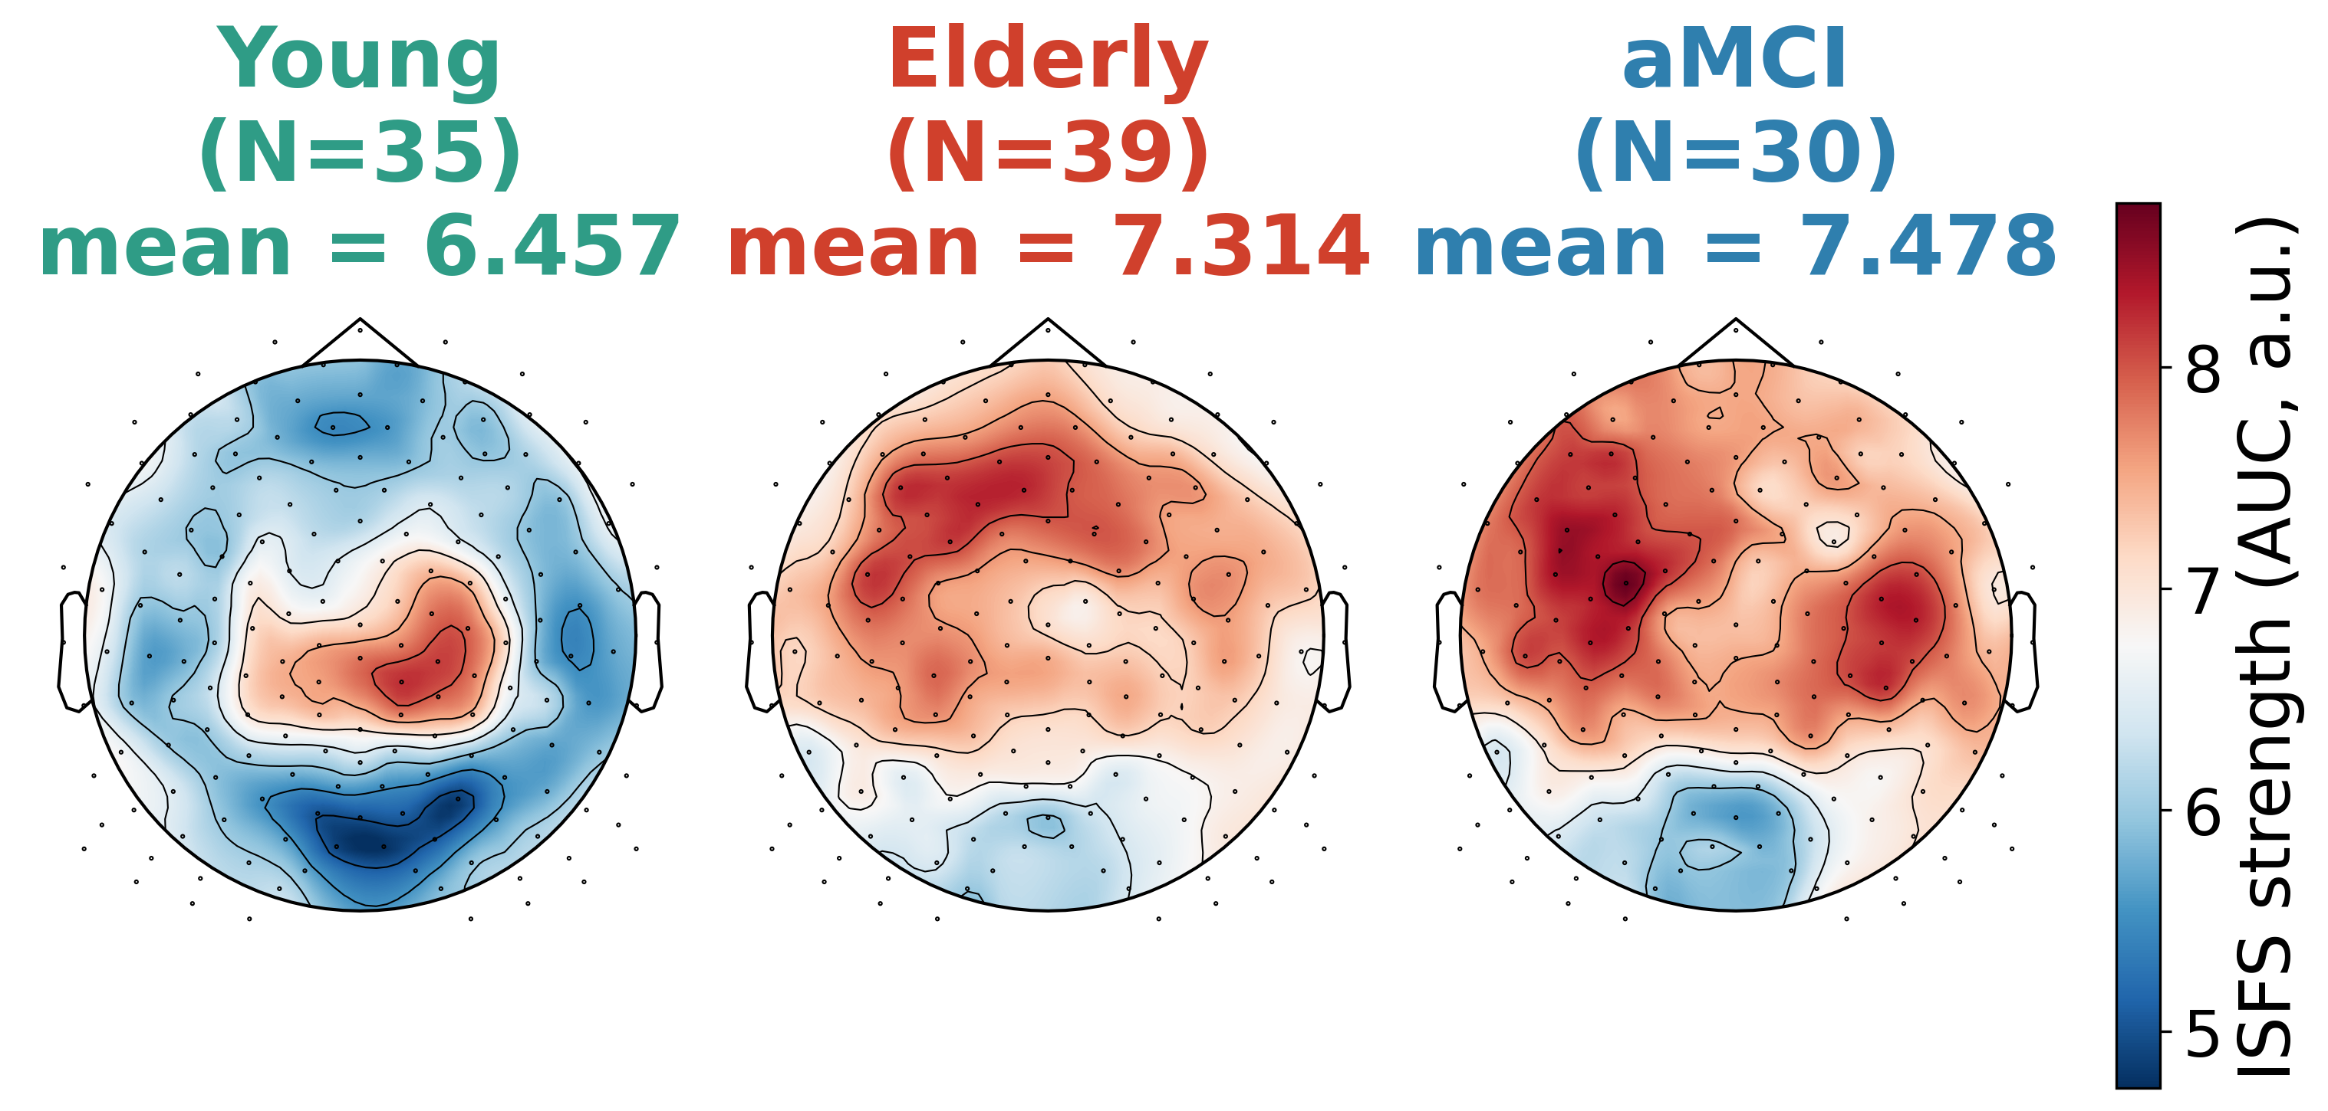
Where the strength sits: the young-adult hotspot
Young adults concentrate ISFS strength over central-parietal electrodes. In both older groups the hotspot is less focal and more diffuse.
Shaked Aglamaz · ISFS in aging and aMCI
28
Notes:
Raw per-group maps; the number above each map is the mean of the per-participant means. Worth saying out loud: the young-adult topography reproduces Dimitriades 2024 and Lazar 2019 in an independent cohort, which is a validation of the whole pipeline before any group claim is made.

Slide 29
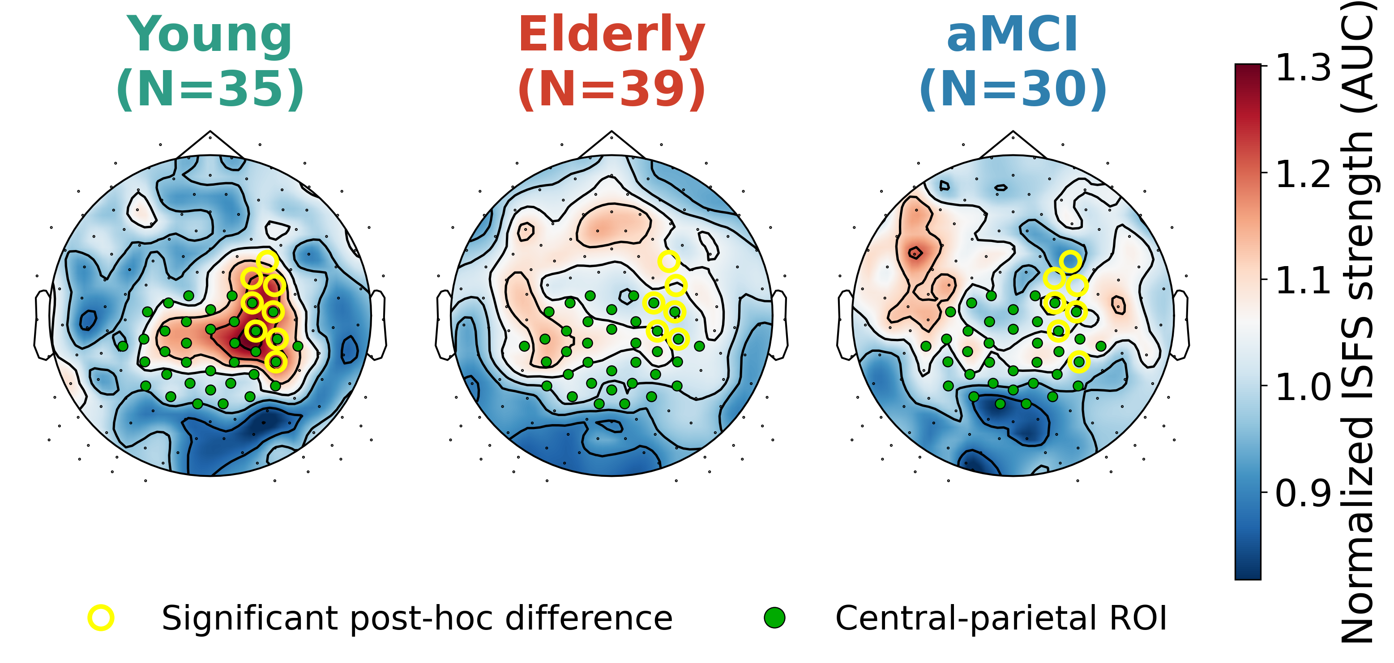
One significant central-parietal cluster
Cluster-based permutation test: p = 0.023, 9 electrodes, lower AUC in both older groups. Yellow rings mark significant post-hoc electrodes, green dots the pre-defined ROI.
Shaked Aglamaz · ISFS in aging and aMCI
29
Notes:
Electrodes E130, E143, E144, E153, E154, E155, E184, E185, E197 (mean F = 5.15, max F = 10.62). Post-hoc: young vs elderly significant at 5 of 9, young vs aMCI at 7 of 9, elderly vs aMCI at 1 (E197). These maps are per-participant normalized, so the result is about where a participant's strength is concentrated, not about the overall level, which did not differ. Headline spatial result. Backup slide B5 has the electrode lists.

Slide 30
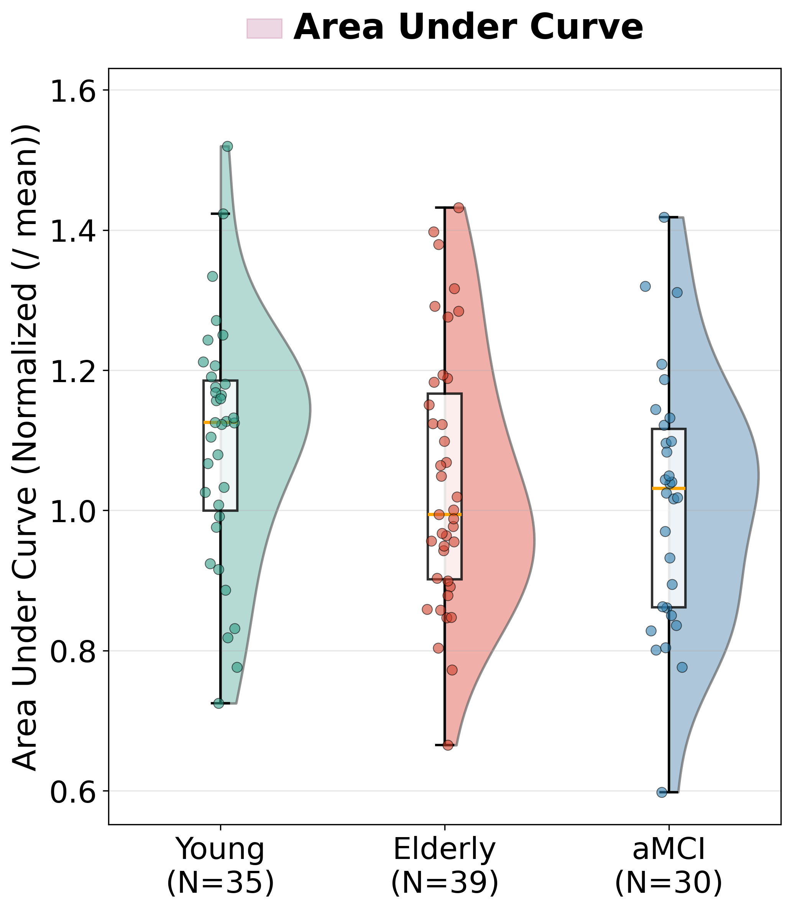
Averaging over the whole ROI dilutes the effect
Same order as the topography (1.099, 1.040, 1.012) but the three-group comparison is not significant: ANOVA p = 0.143.
The cluster is 9 electrodes; the ROI is 36
Averaging over the whole region mixes the affected electrodes with unaffected neighbours
This is a null, and it is reported as one; a larger sample may resolve whether the ROI effect is genuine
Shaked Aglamaz · ISFS in aging and aMCI
30
Notes:
Do not present this as support for the cluster result. The honest reading is that the a-priori ROI, taken from young adults, is larger than the region that actually changes with age. Values are per-participant normalized, so 1.10 means 10 % above that participant's own whole-scalp mean.

Slide 31
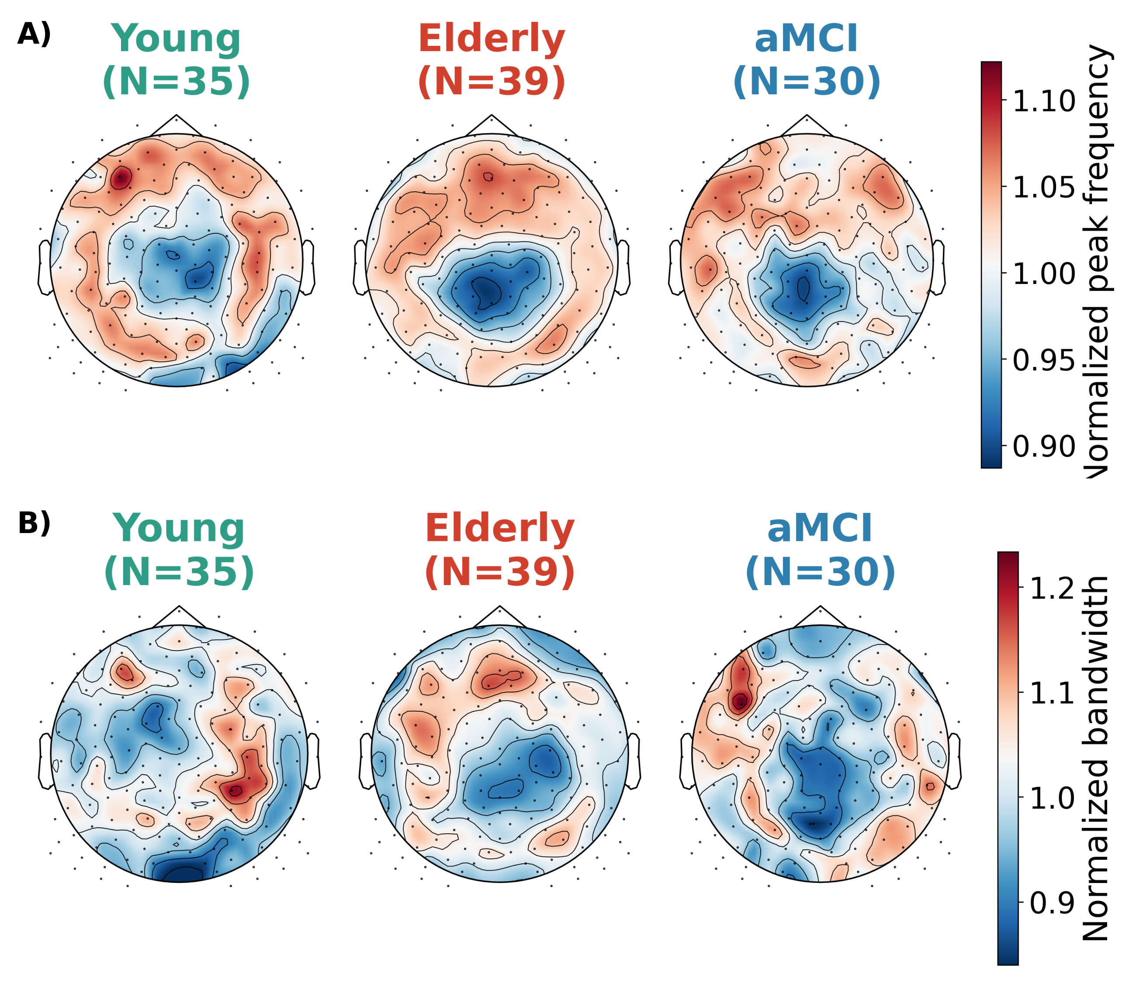
The temporal changes are diffuse, not regional
Neither peak frequency (A) nor bandwidth (B) produced a significant cluster anywhere on the scalp.
Shaked Aglamaz · ISFS in aging and aMCI
31
Notes:
In young adults peak frequency shows a frontal emphasis that flattens in the older groups, and bandwidth has no consistent spatial pattern at all. The interpretation to offer: peak frequency changes everywhere rather than anywhere in particular, which is what a change in the pacemaker rather than in a cortical generator would look like.

Slide 32
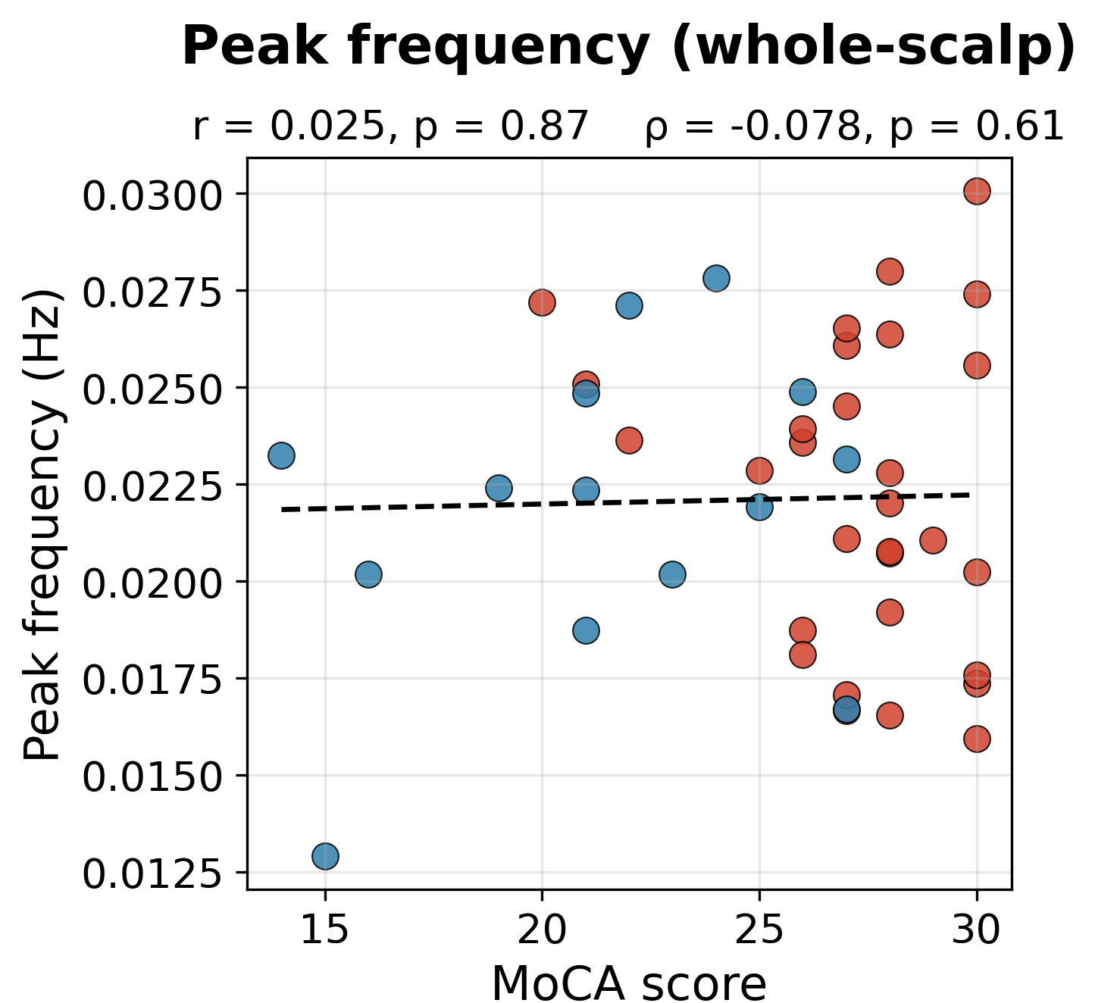
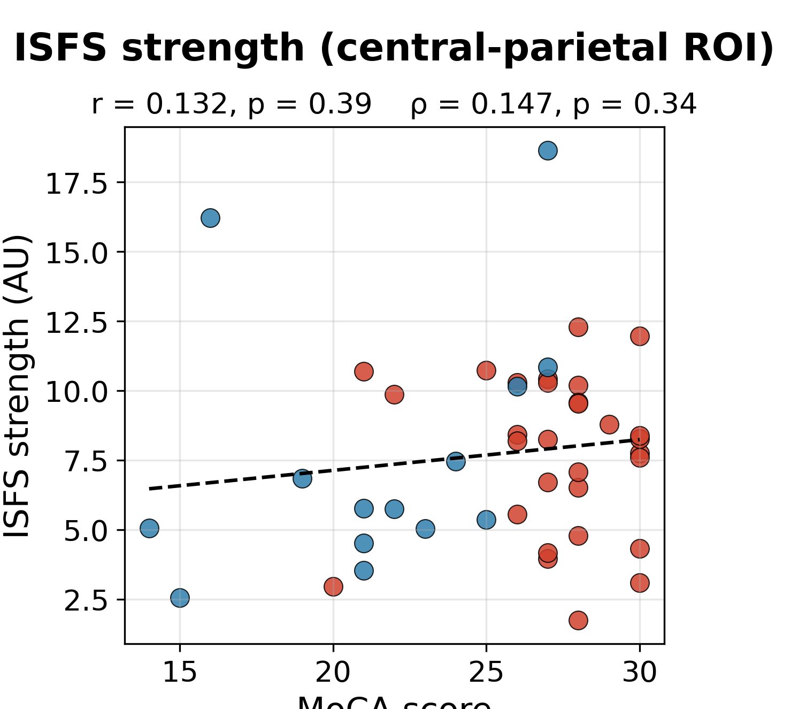
No association with cognitive score
Pooled elderly and aMCI, n = 44: no ISFS measure tracks the MoCA (all |r| <= 0.15, all p >= 0.34, Pearson and Spearman). Elderly in red, aMCI in blue.
Shaked Aglamaz · ISFS in aging and aMCI
32
Notes:
All four scalars were tested; two are shown, the other two behave the same way. Say the limitation before an examiner does: MoCA was collected in Tel Aviv only, so this analysis has n = 44 out of 69 older participants and is the least powered in the thesis.

Slide 33
Discussion
What changed, what did not, and what would explain it

Slide 34
What changed, and what did not
Bandwidth is not part of the story: what difference there was tracked how much N2 sleep we analyzed.
Faster
Peak frequency higher in both older groups (p = 0.0026), everywhere on the scalp
Less focal
The central-parietal hotspot of strength flattens (cluster p = 0.023) while overall strength is preserved
aMCI = Elderly
No difference on any measure, and no correlation with cognitive score
Shaked Aglamaz · ISFS in aging and aMCI
34
Notes:
Say the summary in three sentences and resist elaborating: the next four slides do the elaborating. The framing of the whole thesis is in the title: aging, not amnestic MCI.

Slide 35
A loss of temporal and spatial precision
In young adults the ISFS is strongest in fast spindles and over centro-parieto-occipital cortex (Molle 2011; Lazar 2019), and our young-adult hotspot reproduces that
With age the rhythm that organizes spindle trains speeds up, and its energy is no longer concentrated where fast-spindle generators are densest
AUC at an electrode reflects how deeply spindle amplitude rises and falls there, not how many spindles occur
So what was lost is regional focus, not overall strength: a drive that has become less precise rather than weaker
An infra-slow rhythm contributes to, but does not dominate, spindle timing (Chen 2025), so this is not direct evidence that spindle generation has degraded
Shaked Aglamaz · ISFS in aging and aMCI
35
Notes:
The last bullet is the careful reading, and it is the one to volunteer rather than defend: safer to read the effect as a change in where the rhythm is expressed than as evidence about the spindle generators themselves. The peak-frequency map blurs in the same direction without reaching significance.

Slide 36
A noradrenergic account, and its limits
In rodents the LC does not merely accompany the rhythm, it sets its phase; noradrenaline in thalamus, basal forebrain and brainstem rises and falls on the same 50 s cycle
That structure ages badly: the earliest abnormal tau appears in the LC (Braak 2011), and it loses proportionally more neurons in Alzheimer's disease than the nucleus basalis or the substantia nigra (Zarow 2003)
In living humans, LC integrity tracks memory and sleep regulation in older adults, and an LC abnormality in aMCI separates those who progress to dementia from those who do not
A whole-scalp frequency effect fits a change in the pacemaker better than a change in the cortex where spindles appear
Not shown here: neither noradrenergic nor thalamic activity was measured. What our data can do is test the account's prediction
Shaked Aglamaz · ISFS in aging and aMCI
36
Notes:
Lecci 2017, Osorio-Forero 2021 and 2025, Kjaerby 2022 and 2026; Braak 2011, Zarow 2003, Dahl 2019, Van Egroo 2022, Galgani 2023, Luthi 2025. The prediction our data does test: a mechanism anchored in a structure that degenerates early and in the general population, not only in patients, predicts a change complete in healthy older adults and no further advanced in aMCI. That is the pattern we found.

Slide 37
No evidence for an effect of amnestic MCI beyond age
The two groups were age-matched and differed in cognitive score, yet were indistinguishable on every ISFS measure
Reading one: the change is already well advanced in healthy older adults, and the transition to aMCI does not measurably accelerate it
Reading two: the rhythm changes before cognition does, in which case a group defined by cognitive score cannot separate
Dilution: aMCI is aetiologically mixed, so an Alzheimer's-specific effect would be diluted by the patients who do not have that pathology
A contrast worth noting: in an overlapping cohort, slow-wave synchrony does track impairment (Sharon 2025), and the cyclic alternating pattern is reduced in MCI and predicts incident dementia
Shaked Aglamaz · ISFS in aging and aMCI
37
Notes:
Grollero 2026 found reduced peak amplitude in clinically diagnosed Alzheimer's disease, a parameter we did not measure, in a group defined by diagnosis rather than by cognitive complaint. So our null says the rhythm does not track an aMCI diagnosis; it does not say the rhythm is preserved in early Alzheimer's disease. Two measures of the same nights behaving differently is informative about what each one indexes.

Slide 38
The ISFS in other populations, and why comparison is hard
Reduced central-parietal strength in childhood- and early-onset schizophrenia, uncorrelated with clinical characteristics (Dimitriades 2025): structurally the same result as ours, in a different condition and a much younger sample
Elevated infra-slow sigma power in myalgic encephalomyelitis and chronic fatigue syndrome (Sun 2026)
Already measurable in children aged one to five, with no difference between autistic and typically developing children (Liu 2026)
But the rhythm is not measured the same way: a Gaussian fit to the envelope spectrum (ours) or relative band power in a fixed window, which yields no frequency or bandwidth at all
Even strength is three different quantities across studies: area of the fitted peak, amplitude of the fitted peak, or relative band power
Shaked Aglamaz · ISFS in aging and aMCI
38
Notes:
So the opposite directions, reduced in schizophrenia and in aging but elevated in chronic fatigue, cannot yet be read as a contradiction. If the rhythm indexes how deeply arousal is modulated across the night, deviation in either direction may be what matters, which is what an inverted-U on noradrenergic fluctuation amplitude would predict (Luthi 2025). Two of our three measures have essentially no comparison literature outside the approach they come from.

Slide 39
Limitations
Modest samples, two recording sites, and patients recruited through memory clinics rather than assembled as a uniform research cohort
Patients reach a clinic at different points in their illness, so an effect confined to more advanced patients could have been missed
The ROI reduction fell short of significance (p = 0.143) and would benefit from a larger sample
Cognitive scores were available for only part of the older sample (n = 44)
Cross-sectional: individual trajectories, and which patients progress, cannot be identified from these data
Shaked Aglamaz · ISFS in aging and aMCI
39
Notes:
Volunteer these rather than waiting to be asked. The Sydney recruitment and diagnostic route are not documented in the same detail as the Tel Aviv one, which is a real gap in the methods and is stated as such in the thesis.

Slide 40
Future directions
Longitudinal recordings: does ISFS topography predict conversion, or track decline within individuals?
Coupling: sleep is built from nested rhythms, and the timing of spindles relative to the slow oscillation predicts overnight retention and loosens with age (Helfrich 2018)
So ask what the ISFS is coupled to: the slow oscillations inside its windows, and the infra-slow haemodynamic fluctuations that share its timescale
The LC cannot be recorded in a sleeping human, so the origin of the human rhythm will stay inferred; converging indirect evidence is the route
Shaked Aglamaz · ISFS in aging and aMCI
40
Notes:
Keep this short. If asked what the single most informative next experiment would be: repeated overnight recordings years apart in the same older and aMCI participants, because only a within-subject design separates aging trajectories from cross-sectional differences.

Slide 41
Conclusion
The infra-slow sigma rhythm of N2 sleep is a sensitive marker of how healthy aging reshapes the spindle infrastructure of sleep: it becomes faster and loses its central-parietal focus.
It did not distinguish patients with amnestic MCI from healthy older adults of the same age.
Shaked Aglamaz · ISFS in aging and aMCI
41
Notes:
Land on the two sentences and stop. Then the acknowledgements slide, then invite questions.

Slide 42
Acknowledgements
Prof. Yuval Nir, for the guidance and the standards
Noa Bregman, and Rivi Tauman and Jenny Zitser, for the clinical and sleep-medicine side
Maria E. Dimitriades, whose analysis pipeline this work is built on
Angela D'Rozario and Rick Wassing, for the recordings at the CIRUS Centre in Sydney
Rotem Falach and Flavio Schmidig, who taught me EEG analysis, and the whole Nir lab
The participants and their families
Shaked Aglamaz · ISFS in aging and aMCI
42
Notes:
Thank you. Questions.

Slide 43
Backup slides
Referenced by number from the notes of the slide each one defends

Slide 44
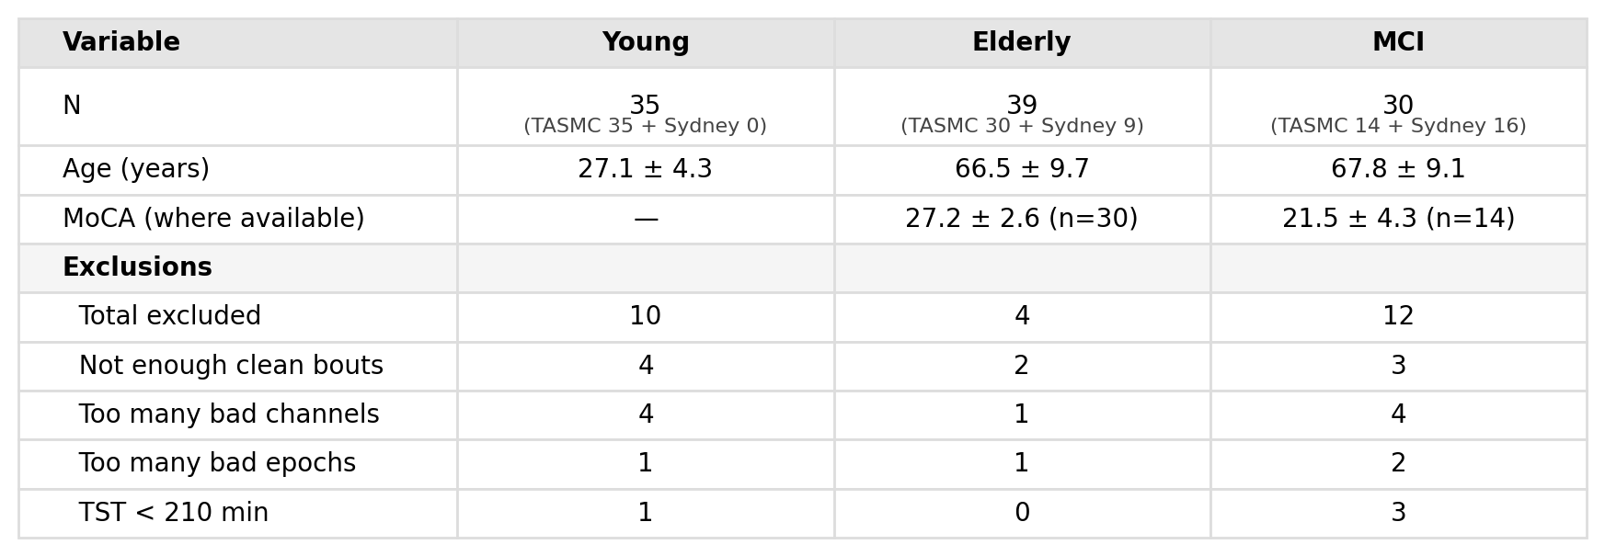
B1. Full demographics and data quality
Sample sizes, age, MoCA, bad channels and bad N2 epochs per group, with exclusion counts.
Shaked Aglamaz · ISFS in aging and aMCI
44
Notes:
Bad channels 6.3 %, 1.4 %, 3.4 %; bad N2 epochs 4.1 %, 3.3 %, 1.8 %. The header of this rendering still says MCI rather than aMCI; the thesis table is a native table that reads aMCI.

Slide 45
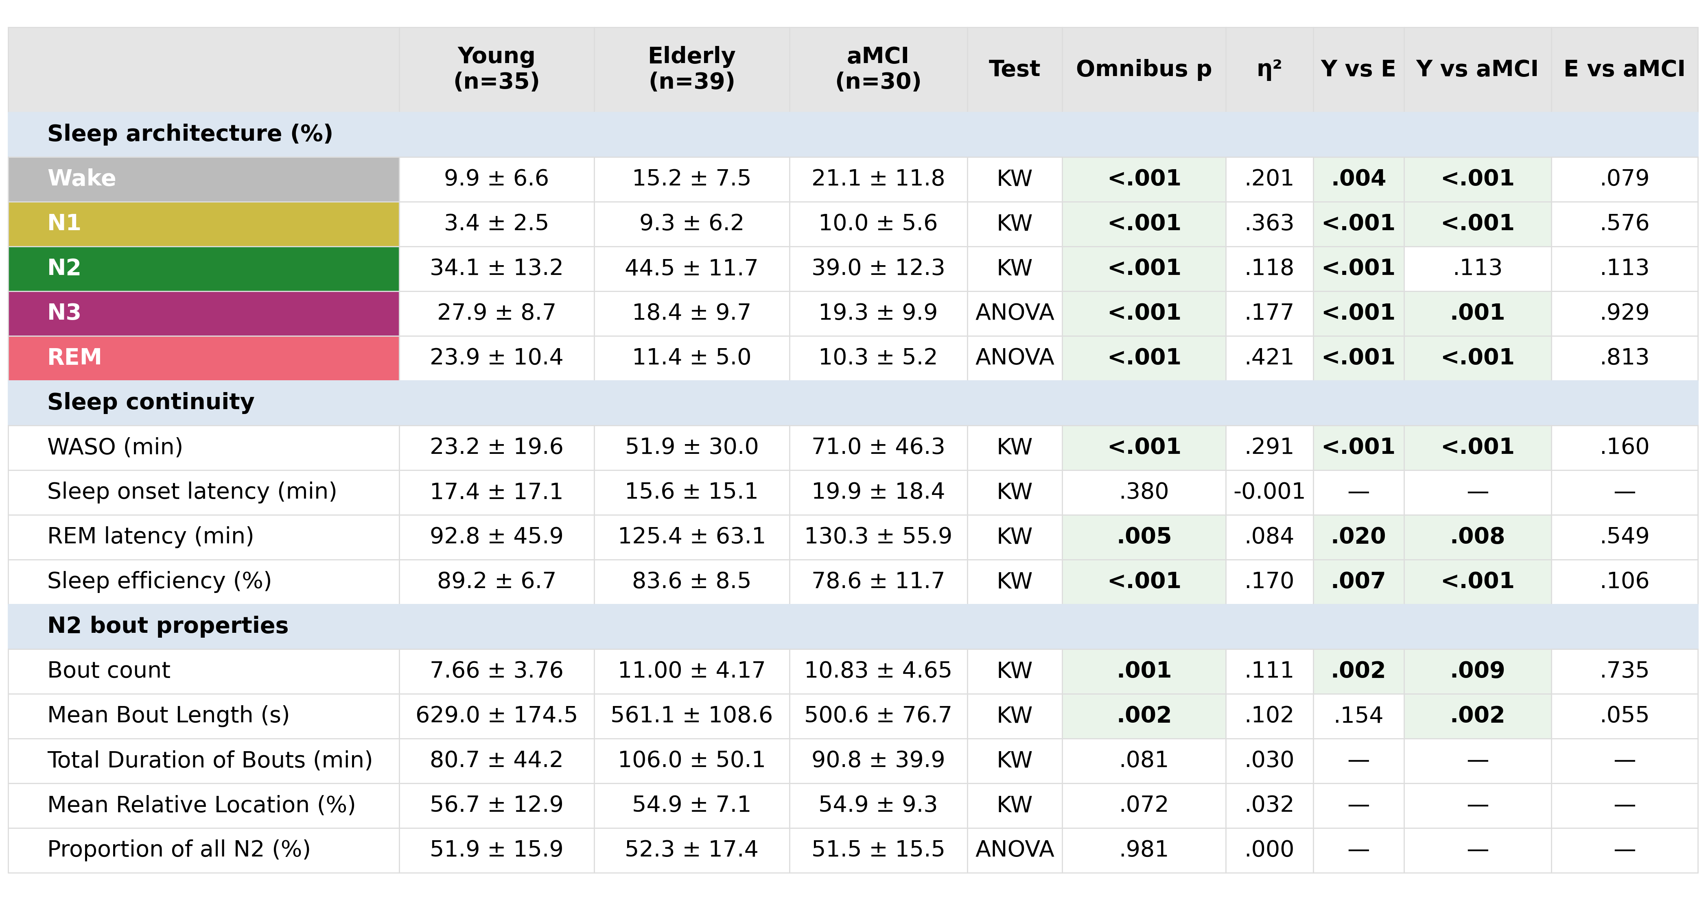
B2. Full sleep table, with tests and effect sizes
Sleep architecture, sleep continuity and N2 bout properties, with the omnibus test, eta squared and post-hoc p values for every row.
Shaked Aglamaz · ISFS in aging and aMCI
45
Notes:
Dashes mark comparisons that were not run because the omnibus test was not significant. Bold marks p < 0.05.

Slide 46
B3. Exclusions: 26 recordings
Analyzed: 35, 39 and 30 recordings. Patients who had progressed to a clinical diagnosis of Alzheimer's disease were not included in the analysis at all, and are not counted here.
Reason | Young | Elderly | aMCI
Fewer than 3 clean N2 bouts | 4 | 2 | 3
Too many bad channels | 4 | 1 | 4
Too many bad N2 epochs | 1 | 1 | 2
Total sleep time under 210 min | 1 | 0 | 3
Total excluded | 10 | 4 | 12
Shaked Aglamaz · ISFS in aging and aMCI
46
Notes:
The criteria are stated in the methods: more than 20 % of electrodes bad, more than 30 % of N2 artifactual, fewer than three clean bouts, or total sleep time under 210 min.

Slide 47
B4. ANCOVA with analyzed N2 duration as covariate
Parameter | unadjusted p | group p | covariate p | verdict
Peak frequency | 0.0026 | 0.0034 | 0.94 | group effect survives
Bandwidth | 0.061 | 0.206 | 0.0002 | duration, not group
AUC (whole scalp) | 0.38 | 0.45 | 0.49 | no effect either way
Covariate mean-centred at the cohort grand mean of 93.1 min; N = 104, residual df = 100
Peak frequency: partial eta squared 0.108 for group, 0.0001 for the covariate; adjusted means identical to raw means
Bandwidth: partial eta squared 0.128 for the covariate against 0.031 for group
Homogeneity of regression slopes held for all three parameters (p >= 0.11)
Shaked Aglamaz · ISFS in aging and aMCI
47
Notes:
AUC failed the per-group normality check in the main analysis, so Kruskal-Wallis remains its primary test and the ANCOVA row is a covariate-adjusted supplement. Source: three_group_ancova_statistics.txt.

Slide 48
B5. The cluster, electrode by electrode
Mean F = 5.15, max F = 10.62 across the cluster. Post-hoc tests are Tukey-Kramer at each cluster electrode.
 | n | electrodes
Cluster (F test), p = 0.023 | 9 | E130, E143, E144, E153, E154, E155, E184, E185, E197
Young vs Elderly | 5 | E143, E144, E154, E155, E184
Young vs aMCI | 7 | E143, E144, E153, E155, E184, E185, E197
Elderly vs aMCI | 1 | E197
Shaked Aglamaz · ISFS in aging and aMCI
48
Notes:
12 candidate clusters were formed, one survived. The direction is lower AUC in both older groups than in young adults. Across re-runs on slightly different cohorts the cluster stays central-parietal and keeps its direction; the electrode count moves by one or two.

Slide 49
B6. Bandwidth against analyzed N2 duration
r = +0.386 across all 104 participants. This is why the bandwidth difference is not read as an effect of age.
Shaked Aglamaz · ISFS in aging and aMCI
49
Notes:
A longer recording gives more bouts and a more finely resolved spectrum, which plausibly broadens the fitted peak. Whatever the mechanism, duration is the stronger predictor and it is not balanced across groups.

Slide 50
B7. Feature extraction, in detail
Gabor-Morlet wavelets, 13.0 to 16.0 Hz in 0.2 Hz steps, fixed width of 4 cycles, applied as frequency-domain convolution via FFT
Envelope = mean magnitude of the complex coefficients across those wavelet frequencies
Per bout: subtract the envelope mean, FFT, take the squared magnitude, resample onto a common frequency axis, divide by the bout's own mean power
If the spectral maximum fell in the lowest bins (0 to 0.006 Hz), those bins were discarded as residual drift
Baseline subtracted from the channel-mean spectrum, estimated over 0.06 to 0.10 Hz
Gaussian a·exp(-((f-b)/c)^2) by nonlinear least squares; bandwidth is the width of b ± |c|, AUC the integral over that band
Shaked Aglamaz · ISFS in aging and aMCI
50
Notes:
If asked what differs from the reference implementation: the positive-area gate on the fit, which rejects degenerate solutions, and the montage adaptation from 128 to 256 channels. If asked about the absolute-value on c: the fit can return a negative width parameter, which is the same Gaussian, so its magnitude is what enters the bandwidth.

Slide 51
B8. Detection rates, and what a failed fit means
Valid Gaussian fit in 80.8 % of channels overall: 74.5 % young, 85.6 % elderly, 82.0 % aMCI
1023 clean N2 bouts entered the analysis, on average 9.8 per participant
A failure means no peak clearing 1.5 SD inside 0.0075 to 0.04 Hz, or a non-positive integrated area
Failed channels are left missing, so they neither raise nor lower a participant's mean
The reference study reports comparable rates on its own criteria; the numbers are not directly comparable because our acceptance rule is slightly stricter
Shaked Aglamaz · ISFS in aging and aMCI
51
Notes:
Young adults have the lowest detection rate and the strongest hotspot, which rules out a story in which the group differences are driven by how often the fit succeeds. If pressed on why young adults fit less often: they also contributed the least analyzed N2 sleep.

Slide 52
B9. Was the aMCI group too heterogeneous?
A sensitivity analysis restricting the patient group to purely amnestic cases was run, and then rejected: the full aMCI group (n = 30) is what the thesis reports
In that run the focal central-parietal AUC cluster survived, the young-versus-patient peak-frequency contrast lost significance at the reduced sample size, and the MoCA nulls were unchanged
It was run on the pre-final cohort, so its p values are not the numbers of record
Reported instead in the discussion as a limitation: a mixed group dilutes any disease-specific effect
Shaked Aglamaz · ISFS in aging and aMCI
52
Notes:
Outputs are kept under results/no_naMCI. The reason for rejecting the sensitivity run was that it traded a defensible full sample for a smaller one without changing the conclusion, and the exclusion criteria were already fixed. Do not quote its p values as results.

Slide 53
B10. Alongside Grollero et al. (2026)
 | This thesis | Grollero et al. 2026
Sample | 39 elderly, 30 aMCI, 35 young | 10 Alzheimer's disease, 20 age-matched controls
Recording | In-lab 256-channel EEG | Home EEG
Strength measure | Area under the fitted peak (AUC) | Amplitude of the fitted peak
Frequency | Faster with age, no clinical difference | No clinical difference
Strength | Central-parietal focus lost with age | Reduced in AD, tracks plasma amyloid
Group definition | Clinical aMCI, mixed aetiology | Confirmed Alzheimer's disease
Shaked Aglamaz · ISFS in aging and aMCI
53
Notes:
Concurrent work, not the motivation for this thesis. The two studies agree on frequency, which distinguished neither clinical contrast, and are broadly consistent on a weakening of the rhythm over central regions. They diverge on whether cognitive impairment leaves a mark beyond age, and the two strength measures are not the same quantity, so the divergence is not a direct contradiction.

Slide 54
B11. Where the hypnograms and annotations come from
Sleep stages and artifact marks are read from each recording's cleaned annotation file, which is the file the analysis itself used
Two independent labels can coincide: an unscored epoch from the scorer, and an amplifier or acquisition gap
Both are excluded from the numerator and the denominator of total sleep time and wake after sleep onset, so neither inflates the other
Stage labels appear in two dialects across files and are normalized before any counting
Shaked Aglamaz · ISFS in aging and aMCI
54
Notes:
This is the answer to any question about how sleep-architecture percentages were computed and why they do not match a naive count of scored epochs. The full note is in the repository.

