Slide 1
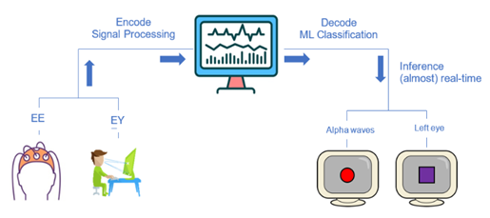
EEG and Eye-Tracker real-time BCI
Shaked Aglamaz and Maya Adar
Computational Clinical Psychology Shahar Lab

Slide 2
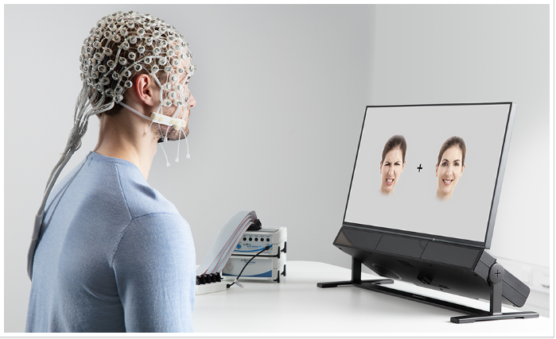
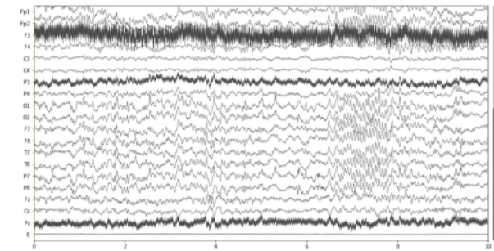

Research Problem: Neural Decoding
Predict Stimuli from eye tracker data/neural activity
Prediction
Notes:
Our main goal is to build a decoder that will receive EEG data and Eye-tracker data, and will predict the stimulus and the location the subject is looking at.
In Nitzan Shahars lab

Slide 3
Project desired outcome
Notes:
In Nitzan Shahars lab they want to run experiments with EEG and Eye-tracker, measuring the subjects behavior through the experiment.
In our project we first need to Encode the data from the EEG and Eye-tracker and calibrate the system.
Then we will build a classifier based on short experiments we will conduct.
Finally we would like to make a classifier for the use of the lab research, that may also be used in real time.

Slide 4
First Milestone – System Calibration
Colleting, preprocessing and labeling the time series data from Eye-Tracker and EEG.
Calibration of data stream of computer’s triggers and EEG data.
Analyzing the latency between sending the trigger and recording the input.
When recording one channel in EEG
When recording multiple channels in EEG

Slide 5
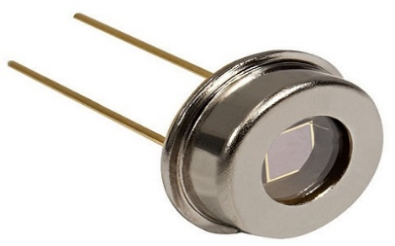
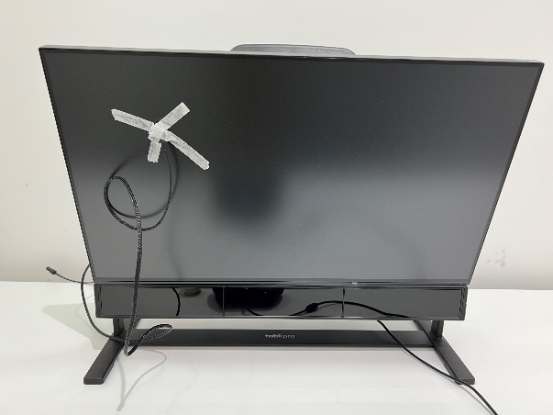
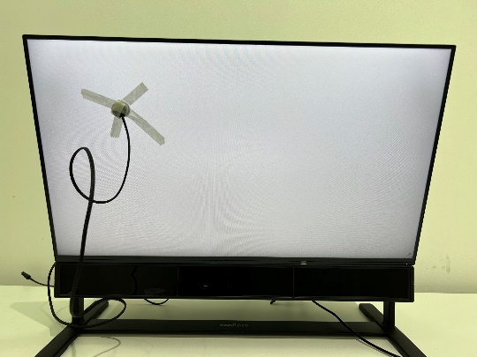
How did we do that?
Created an experiment to find the latency between one computer sending a trigger and another computer recording the input.
Trigger
Notes:
After we collected some data and understood how to analyze it, we made a short experiment to calculate the average latency of the system.
First we taped a diode on the computer screen.
We wrote a simple function in python that sends a trigger through the EEG, and then turns the screen white for 200 ms many times.
Then we recorded the data from the EEG on another computer and measured the latency between the time the trigger was sent and the time the diode recorded a significant change in brightness.

Slide 6
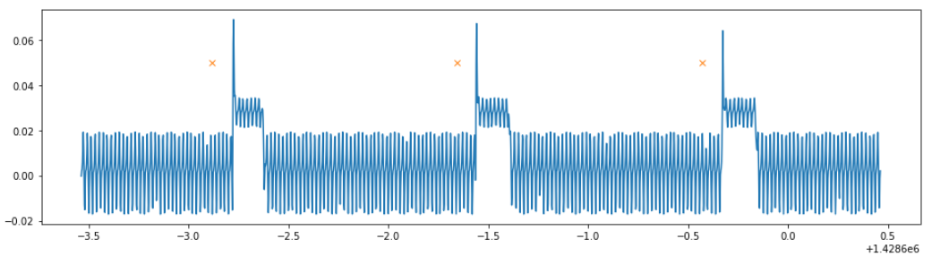

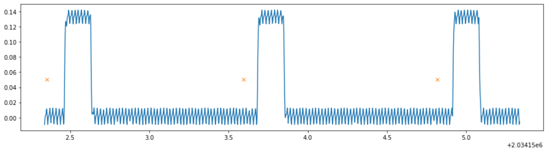
Results
1 channel: diode and triggers
Multiple channels: 64 EEG, diode and triggers

Slide 7
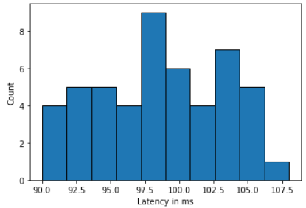
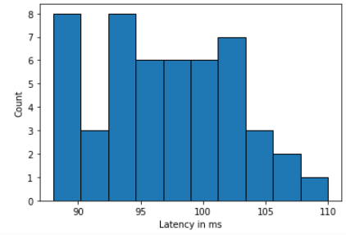
LSL – 1 channel (sec) Mean - 0.09860060114413499 Std - 0.00504769104282308 Min - 0.08999949786812067 Max - 0.10799934365786612 | LSL – multiple channels (sec) Mean - 0.09708211606368422 Std - 0.005203206640665435 Min - 0.08799811289645731 Max - 0.11000888398848474
Notes:
As we can see the average latency is 100 ms. It should be considered when changing the stimulus on the screen based on the data recorded in real time.

Slide 8


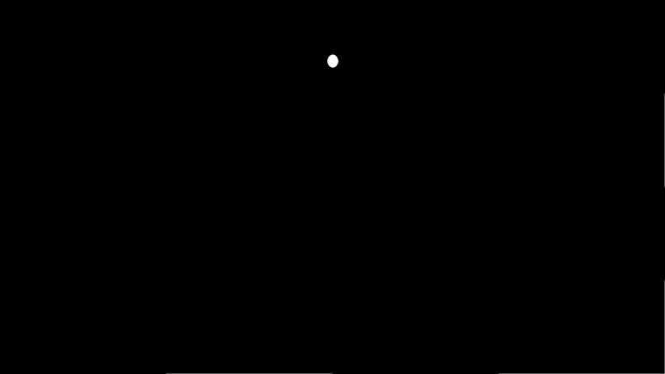
Next Step
Conducting an experiment to train the classifier.
Notes:
In this experiment we will show a white dot on a black screen in different locations.
Then we will use the data from the eye-tracker to train a classifier.

Slide 9


Next Step
Decoding EEG data

