Slide 1
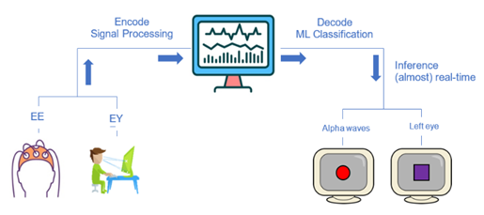
EEG and Eye-Tracker real-time BCI
Shaked Aglamaz and Maya Adar
Computational Clinical Psychology Shahar Lab

Slide 2
First Milestone – System Calibration
Colleting, preprocessing and labeling the time series data from Eye-Tracker and EEG.
Calibration of data stream of computer’s triggers and EEG data.
Analyzing the latency between sending the trigger and recording the input.
When recording one channel in EEG
When recording multiple channels in EEG

Slide 3
How did we do that?
Studied the data from the Eye-Tracker and EEG
- Data Structure
- Python Packages
- Recording and analyzing offline
Created an experiment to find the latency between one computer sending a trigger and another computer recording the input.

Slide 4
The experiment – First step
We wrote a short python function that presents a white screen for 0.1 sec (between black screen)
Before presenting the white screen, the function sends a trigger to a specific channel of the EEG.

Slide 5
The experiment – Second step
We taped a diode on the screen that records the brightness through another channel of the EEG.
Another Computer receives the EEG data stream.
When the trigger was sent from the first computer
When the diode showed a peak in brightness
Calculating the latency in four conditions
One EEG channel (diode) | Multiple EEG channels (diode + electrodes)
LSL recorder (xdf file) | EEGO recorder (edf file)

Slide 6
Results

Slide 7
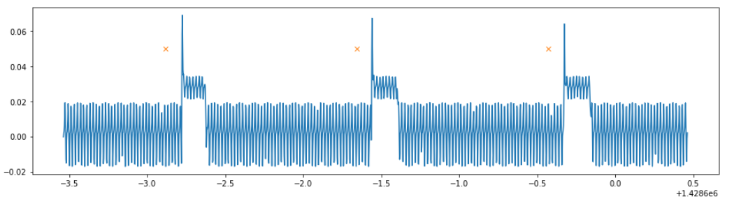

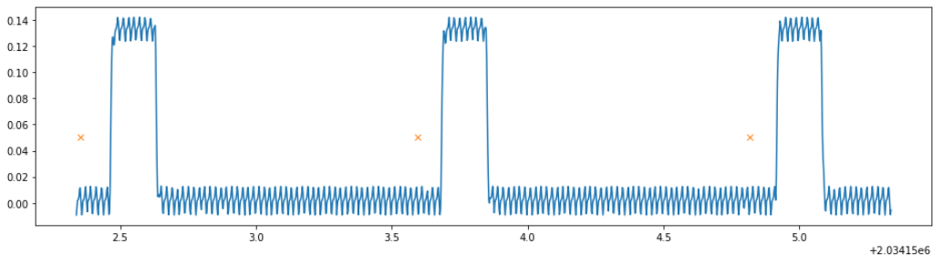
LSL RECORDER
2 channels: diode and triggers
Multiple channels: 64 EEG, diode and triggers

Slide 8
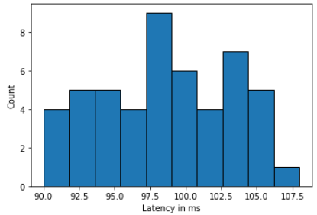
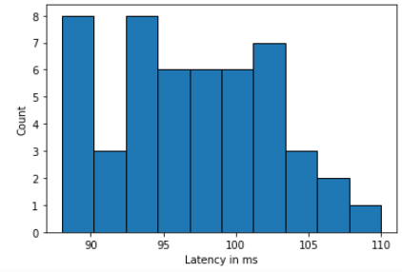
LSL – 2 channels (sec) Mean - 0.09860060114413499 Std - 0.00504769104282308 Min - 0.08999949786812067 Max - 0.10799934365786612 | LSL – multiple channels (sec) Mean - 0.09708211606368422 Std - 0.005203206640665435 Min - 0.08799811289645731 Max - 0.11000888398848474

Slide 9
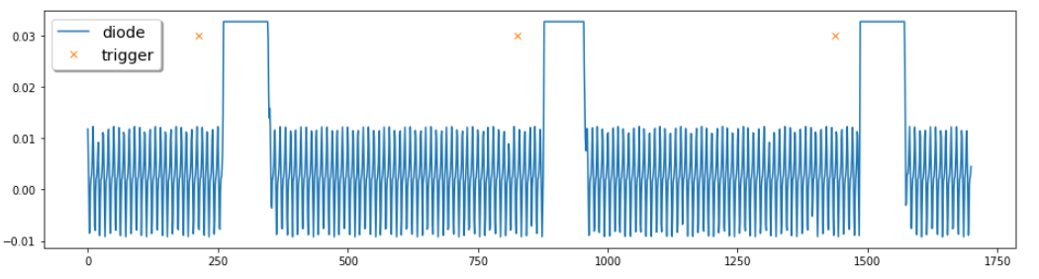
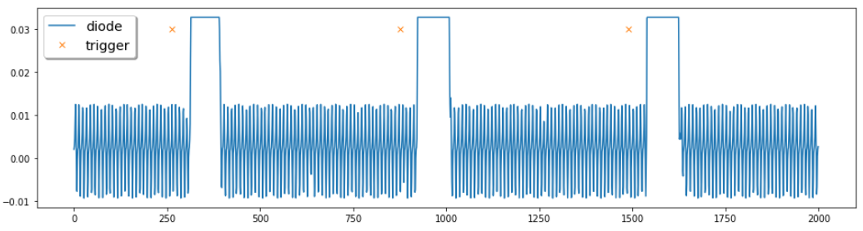
EEGO RECORDER
1 channel: diode and triggers
Multiple channels: 64 EEG, diode and triggers

Slide 10
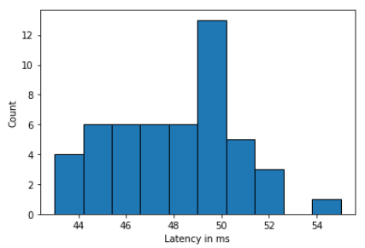
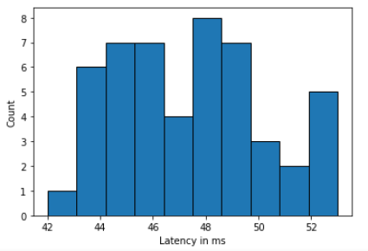
EEGO – 1 channel (sec) Mean - 0.04741999999999999 Std - 0.0025929905514675525 Min - 0.042 Max - 0.053 | EEGO – multiple channels (sec) Mean - 0.04798 Std - 0.002603766502588126 Min - 0.043 Max - 0.055

