Slide 1
INVESTMENT ASSIGNMENT SUBMISSION
Name: Shakeeb Ahamed Pasha

Slide 2
Abstract
Spark Funds, an asset management company wants to make decision about investment.
The company intends to select the best sector, countries and suitable investment type for their investments.
The main constraints for the investment are
Investment in the range 5-15million USD per round of investment.
Investment sector and country to be identified where most of the investments are made.
Only English –speaking countries to be considered for investment.

Slide 3
Approach
Data acquisition
We have taken the data from crunchbase.com in the form of companies db(companies details), rounds2 db(funding type and amount) and mapping csv(map categories to 8 top level sectors and other category).
Data preparation and clean-up
Create a master data frame with merge of companies and rounds2 db on “company_permalink”.
Clean up the missing values in master df by following approach
raised_amount_usd – fill with median values – as the column has outliers
Country code and Categories – fill the mode values
Clean up the outliers in raised_amount_usd for each funding type by dropping values above 95 percentile.
Analysis
Investment type analysis
Country analysis
Sector analysis
Decision making
Arrive at a suitable investment option for the company.

Slide 4
Investment Type Analysis
Objective of the company is to invest in the range 5-15 million USD per round.
Average funding across the types – venture, seed, angel and private equity
Pick the average funding as the most representative value and which falls in the range 5-15million USD

Slide 5
Country Analysis
Objective is to pick the country which is most funded.
The country selected should be English speaking.
Prepare a list of top 9 countries in order of total investments received.
Out of the top 9 list, pick the top 3 countries where English is an official language.

Slide 6
Sector Analysis
Objective is to find the most heavily invested sector for the selected funding type and countries.
Prepare a column representing the primary sector of a particular company.
Using mapping csv, prepare a column representing the main sector out of the 8 sectors for each company.
For each of the three countries selected, pick the sectors receiving highest funding of type selected from investment type analysis and investments in the range of 5-15million USD.

Slide 7
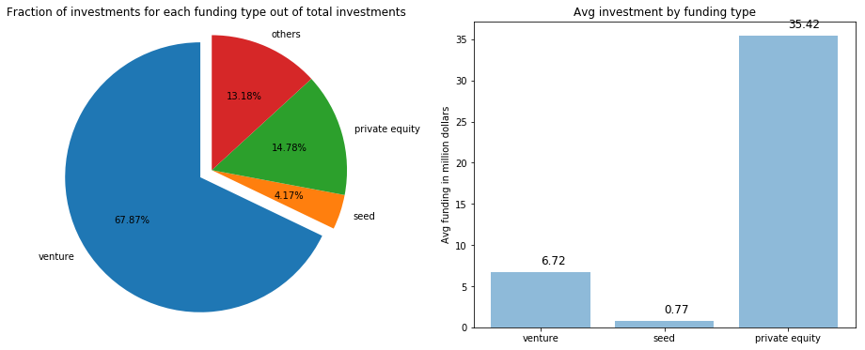
Results – Investment Type
From the analysis – Venture funding is most suitable, as its average funding is in the range 5-15million USD.
And it is also the most representative investment type with 67.87% funding out of total investments.

Slide 8
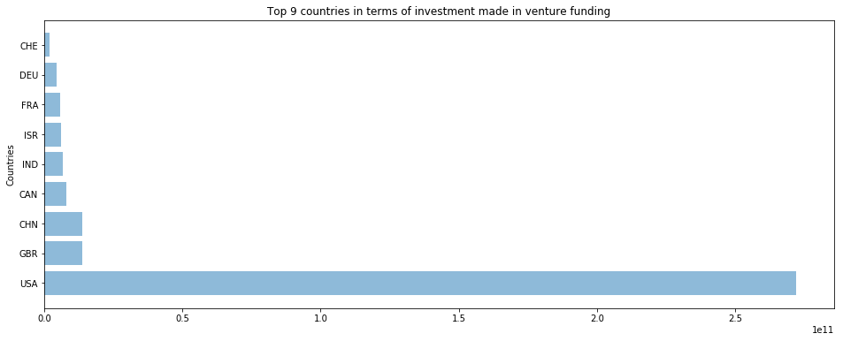
Results – Country
From the analysis – USA, GBR and CAN are the most suitable English speaking countries as represented
by the total investments received in venture funding in these countries.

Slide 9
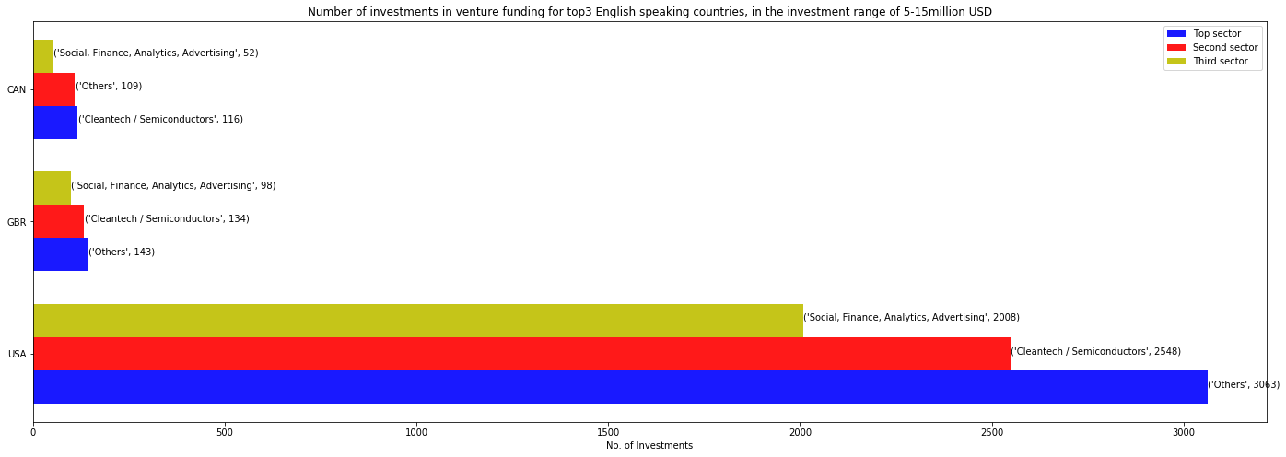
Results - Sector
From the analysis – following are the top 3 sectors in the top 3 suitable countries
for the relevant venture funding in the range of 5-15million USD.

Slide 10
Conclusion
From the analysis and the ensuing results, it is clear that -
Venture funding is the most suitable investment type.
USA, GBR and CAN are the most suitable countries to invest.
And the top 3 sectors in each of these countries to invest in are
USA – Others, Cleantech/Semiconductors, Social Finance Analytics Advertisements
GBR – Others, Cleantech/Semiconductors, Social Finance Analytics Advertisements
CAN – Cleantech/Semiconductors, Others , Social Finance Analytics Advertisements

