Slide 1
Integration Hub Design
Submitted by Shakkeeb

Slide 2
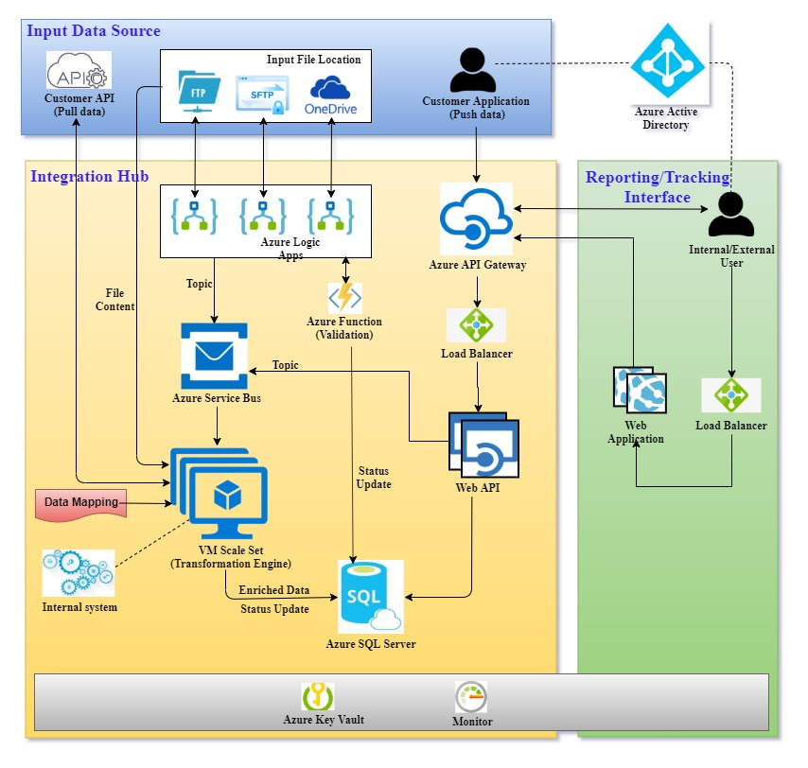
Solution
Architecture

Slide 3
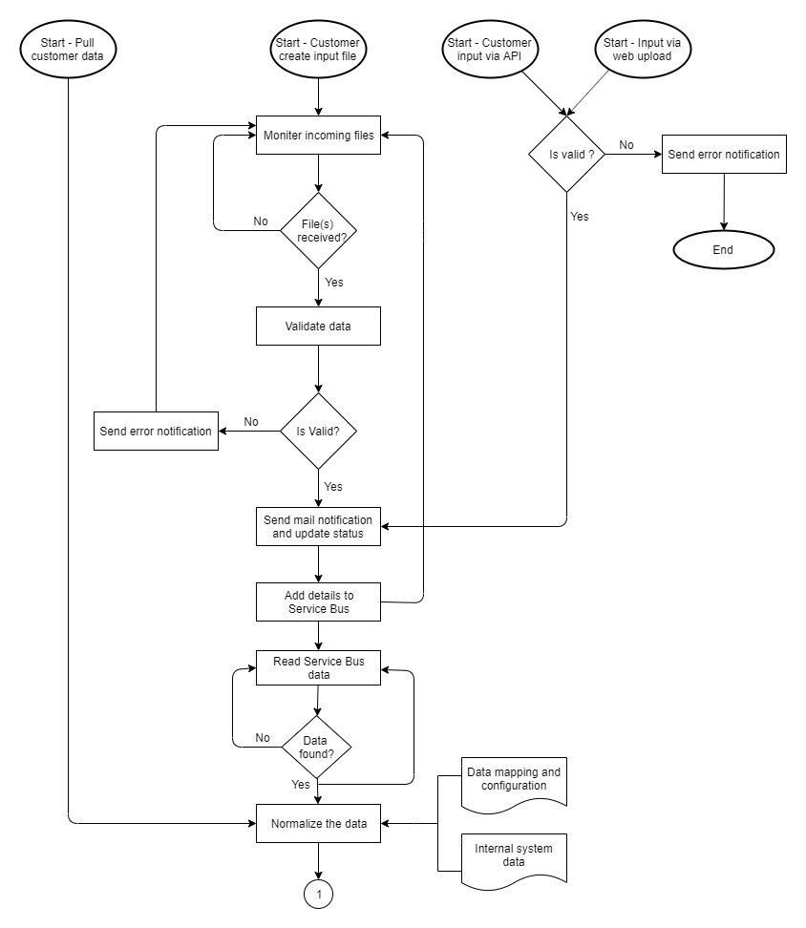
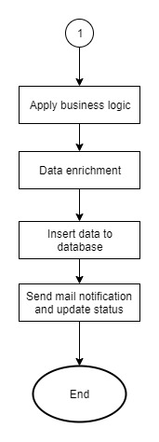
Process
Flow

Slide 4
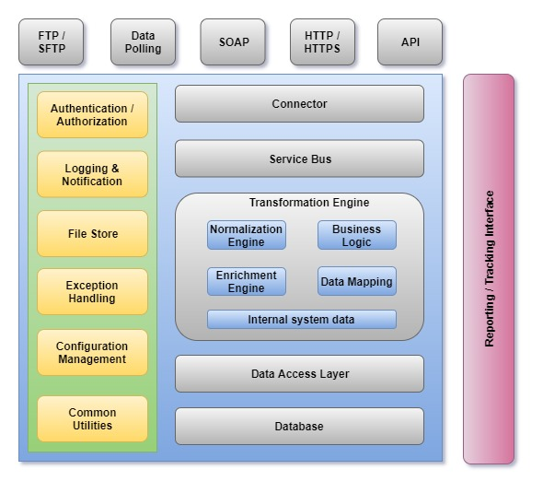
Integration
Architecture

