Slide 1
Non Primitive datatypes
Introduction to Python

Slide 2
Objectives
DAY 2
• Describe the difference between primitive and non-primitive data structures
• Perform data handling with Python lists by Storing, accessing and manipulating information in a list structure.
• Perform data handling with Python dictionaries by Storing, accessing and manipulating information in a dictionary structure.
• Demonstrate the ability to data from external sources into Python environment
• Compare and contrast use cases for lists and dictionaries in python

Slide 3
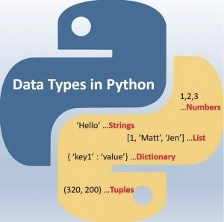
Data Types in python

Slide 4
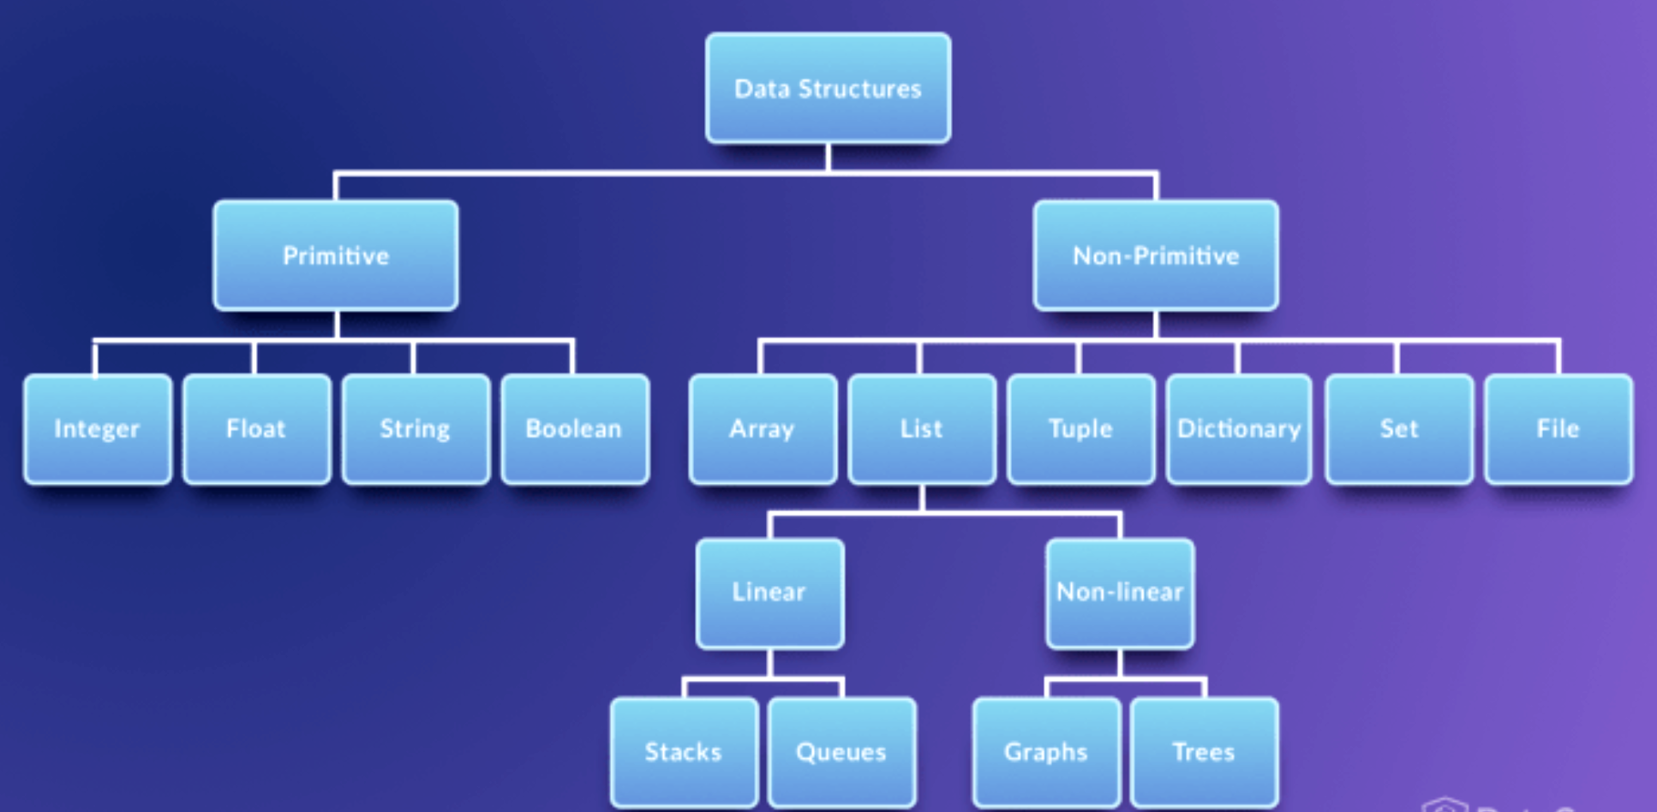
Primitive and non primitive data types

Slide 5

Primitive data types
Primitive data are only single values, they have not special capabilities.
The examples of Primitive data types are given int, float, string, boolean etc.
The integer reals, logic data character data pointer and reference are primitive data structures data structure that normally are directly operated upon by machine level instructions are known as primitive structure and data type.
Primitive data types
A primitive data type is one that fits the base architecture of the underlying computer such as int, float, and pointer, and all of the variations, thereof such as char short long unsigned float double and etc, are primitive data type.
Primitive data are only single values, they have not special capabilities.
The examples of Primitive data types are given int, float, string, boolean etc.
The integer reals, logic data character data pointer and reference are primitive data structures data structure that normally are directly operated upon by machine level instructions are known as primitive structure and data type.

Slide 6
Non Primitive data types
Primitive data are only single values, they have not special capabilities.
The examples of Primitive data types are given int, float, string, boolean etc.
The integer reals, logic data character data pointer and reference are primitive data structures data structure that normally are directly operated upon by machine level instructions are known as primitive structure and data type.
Data types built on top of primitive data types for advanced computation, such as an array structure or class is known as the non-primitive data type.
These data type that are derived from primary data types
The non-primitive data types are used to store the group of values.
Examples of non-primitive data type.
Array, lists, dictionaries, sets, stacks, queue etc.
(further details here)
https://www.datacamp.com/community/tutorials/data-structures-python
https://code.tutsplus.com/articles/advanced-python-data-structures--net-32748

Slide 7
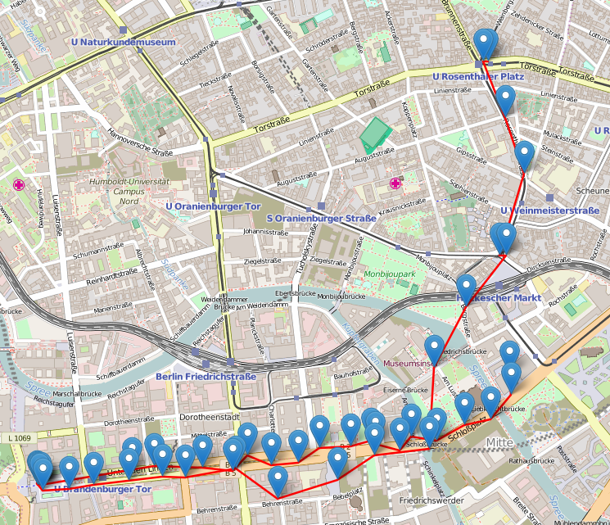
foLIUM
Create geographical visualisations
Choropleth maps (binding data to maps)
Adding markers on maps
Works with OpenStreetMap, Mapbox, Stamen APIs
Interactivity (Zoom in and out)

Slide 8

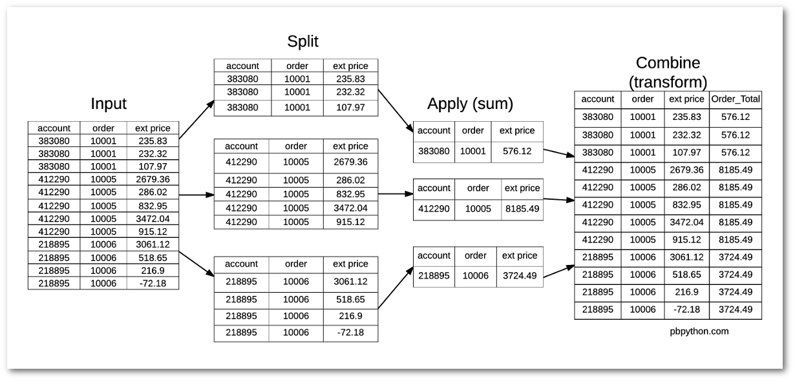
PANDAS

