Slide 1
Basics
Introduction:
How Tableau reads the data ?
Why Tableau ?
Connect with different types of data.
Live Vs Extract
Data types.
View data/ hide unhide columns
Column formatting – Rename, copy, split and custom split
Sorting – Columns, Records and Tables.
BI Tool to build interactive reports/dashboards and visualize data.
Types of products – Tableau desktop, Tableau online, Tableau server, Tableau reader, Tableau public

Slide 2
WORKSHEET INTERFACE
Sorting in worksheet
Quick sort
Sorting by pills
Sorting by tool bar
Sorting by shortcut methods
Clear sort.
Dimensions
Measures
Marks card
Filters card
Column, Row shelves
Show me graph
Colour of Discrete and Continuous pills.
Measure Names and Measure values
Drill down and Hierarchies

Slide 3
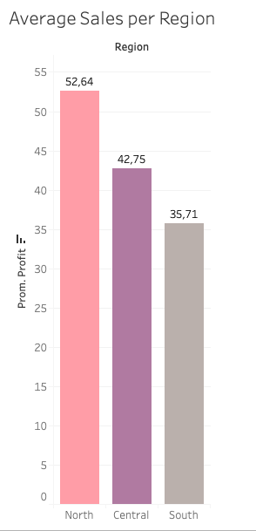
CD-Discount Challenges
Which region has the highest average Profit?
Create a bar chart to answer the above question
Can you also label the bars to show their average profit and colour them by region?

Slide 4
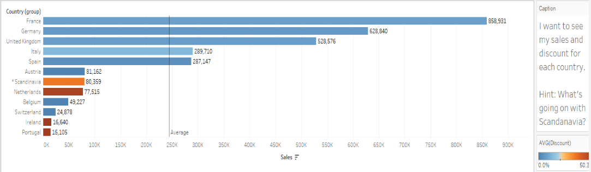
CD-Discount Challenges
Recreate the below view.

Slide 5
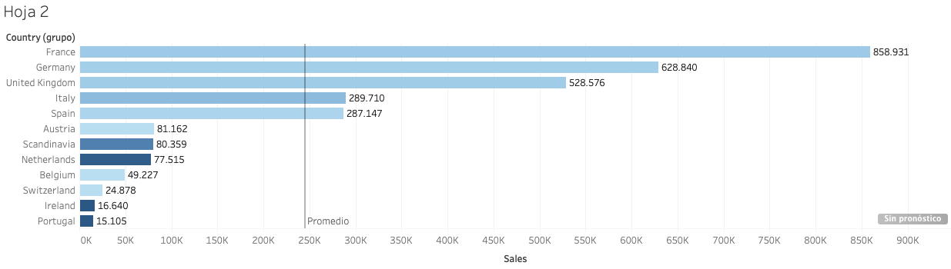

Slide 6
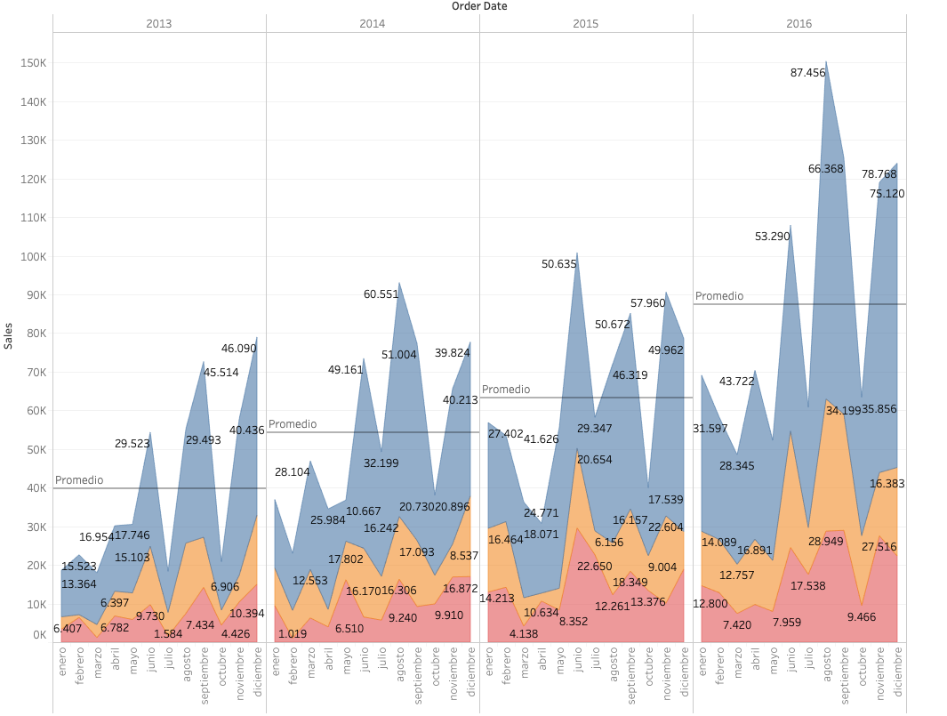
CD-Discount Challenges
Show sales per month on a continuous axis.
Can you calculate the running total of these sales?
Can you show a different line for each region?
How about changing this to an area chart instead of a line?

Slide 7
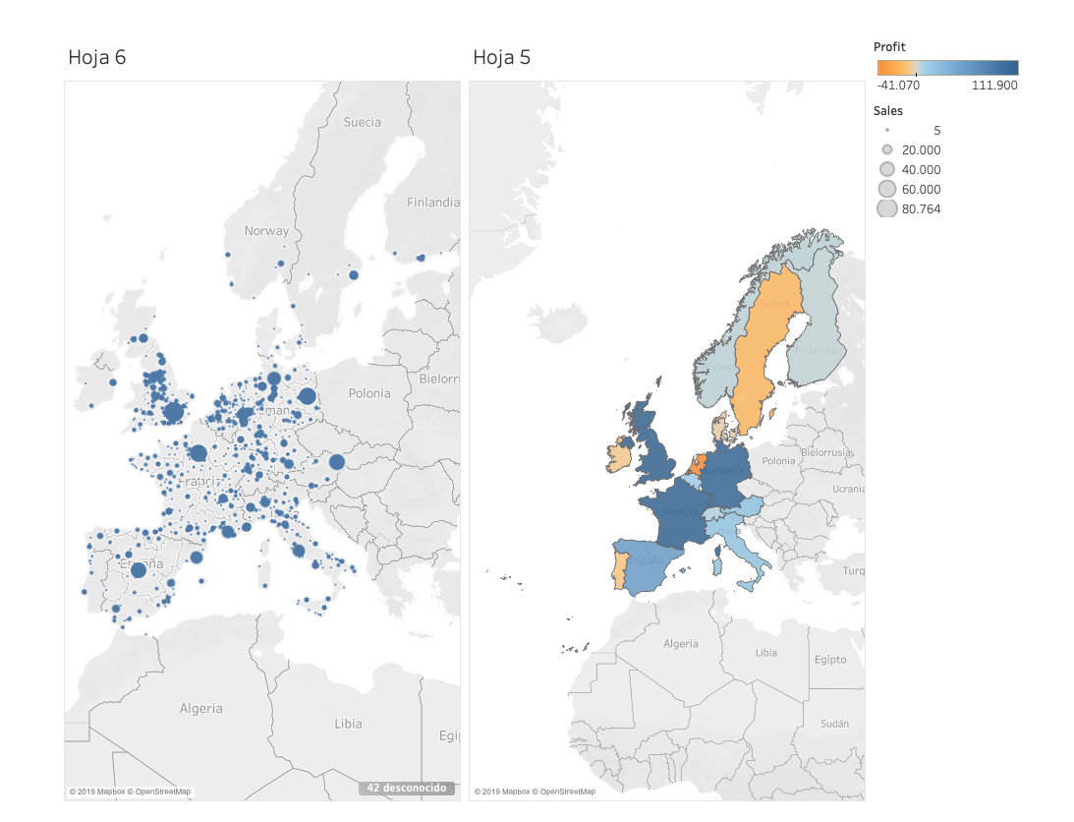
CD-Discount Challenges
Can you represent total sales per city on a map?
Can you represent total profit per country on a filled map?
Both together?

