Slide 1
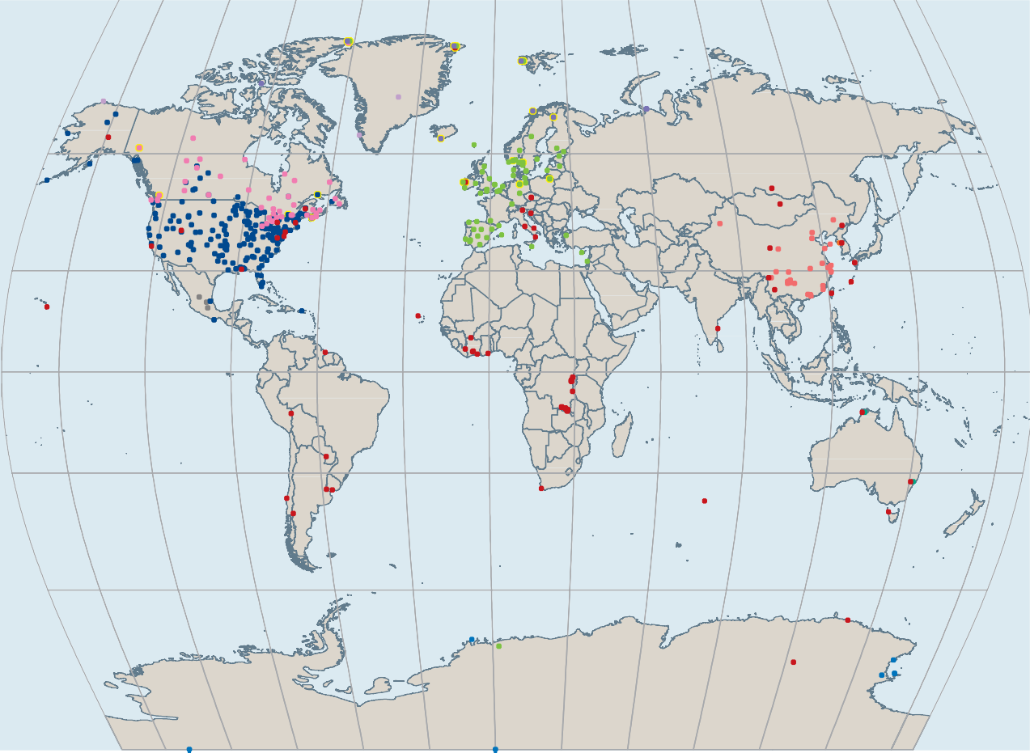
International networks
National networks
Australia China
Republic of Korea
AMAP EMEP GMOS
MDN (Canada and United States)
Long-term air monitoring (>10-year time-series)
Canada Japan Mexico
Antarctic Other

