Slide 1
Stock Portfolio Management
BY: Xinyuan Liu, Matthew Bellio and Josh Hall

Slide 2
Agenda:
Background
Data
Stock Movement
Correlated Stock Movement
Portfolio Management
Median US income & low savings rate
College Degree & moderate savings rate
Future Improvements
Conclusion

Slide 3
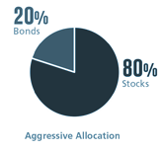

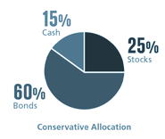
Background
Portfolio management involves building and overseeing a selection of investments that will meet a long term financial goal and risk tolerance for an individual*
A typical portfolio is made up of an allocation of assets to match a given amount of risk
Our assets will only be stocks as our project is composed of 2 parts:
Stock price prediction for a basket of stocks
Portfolio management given that basket
Our goal is to show how much one needs to save to retire the way they want
* https://www.investopedia.com/terms/p/portfoliomanagement.asp#:~:text=Portfolio%20management%20involves%20building%20and,to%20beat%20the%20broader%20market.
Notes:
Assets are usually some combination of stocks, bonds, and cash like investments
Baskets in our project consist of XXX stocks
Under a certain set of assumptions which we will talk about later

Slide 4
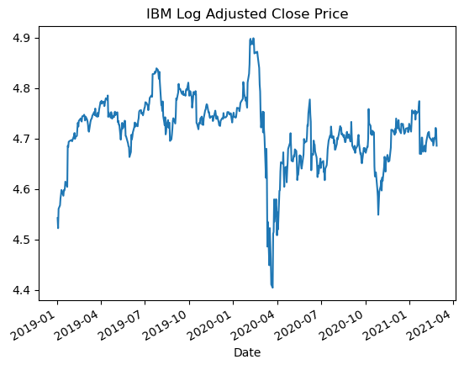
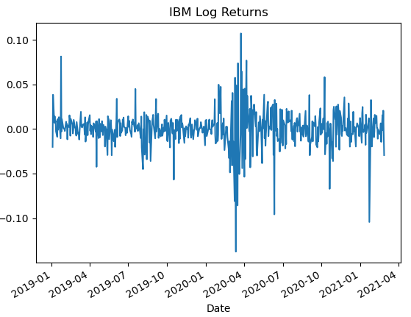
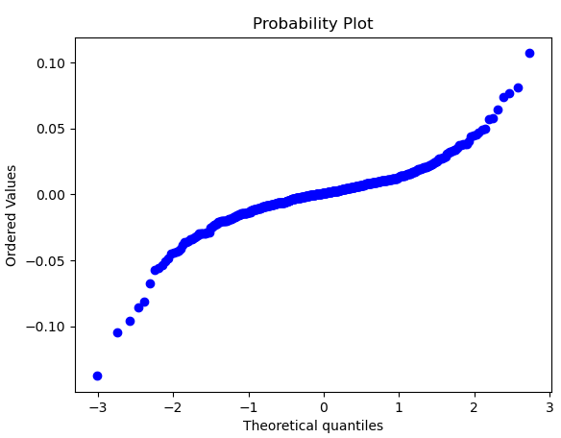
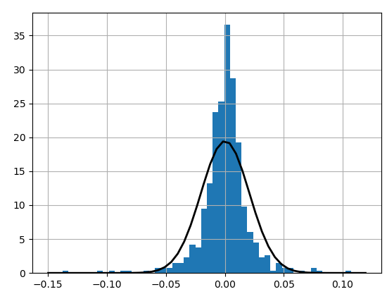
Data
Data was obtained using Yahoo’s publicly available API
The log adjusted close price was used to derive the log returns
The following plots were created for exploration of each stock
Data was split into a train/test set to validate our stock price prediction portion of the code
Latest data always considered the test set

Slide 5
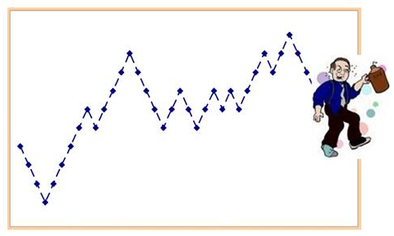
Stock Movement
The mathematician Bachelier (1900) was one of the to discover that most asset returns tend to follow a random walk*
Random walk theory assumes that past movement or trend of a stock price or market cannot be used to predict its future movement**
Efficient market hypothesis states that all information that could be used to predict a stocks performance is already built into the current stock price***
* Black Swans & Value At Risk
** https://www.investopedia.com/terms/r/randomwalktheory.asp
*** https://www.investopedia.com/ask/answers/05/marketefficiency.asp
Notes:
Common analogy for a random walk is that of a drunkard who staggers randomly to the left or right as he tries to go forward and the path he traces is a random walk (https://people.duke.edu/~rnau/411rand.htm)

Slide 6
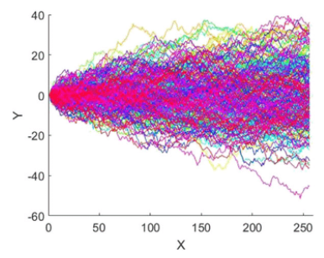


Brownian Motion
This random walk process is characterized by Brownian Motion
More generally, Brownian Motion describes any physical phenomena where some quantity is constantly undergoing small, random fluctuations*
When applied to stocks, it is composed of two major components**:
The complete formula is**:
* https://www.britannica.com/science/Brownian-motion
** https://medium.com/analytics-vidhya/monte-carlo-simulations-for-predicting-stock-prices-python-a64f53585662
Notes:
Brownian motion movement of 256 particles for t = 1 s (https://www.researchgate.net/figure/Brownian-motion-movement-of-256-particles-for-t-1-s-a-Surface-plot-of-Brownian_fig1_336934500)

Slide 7
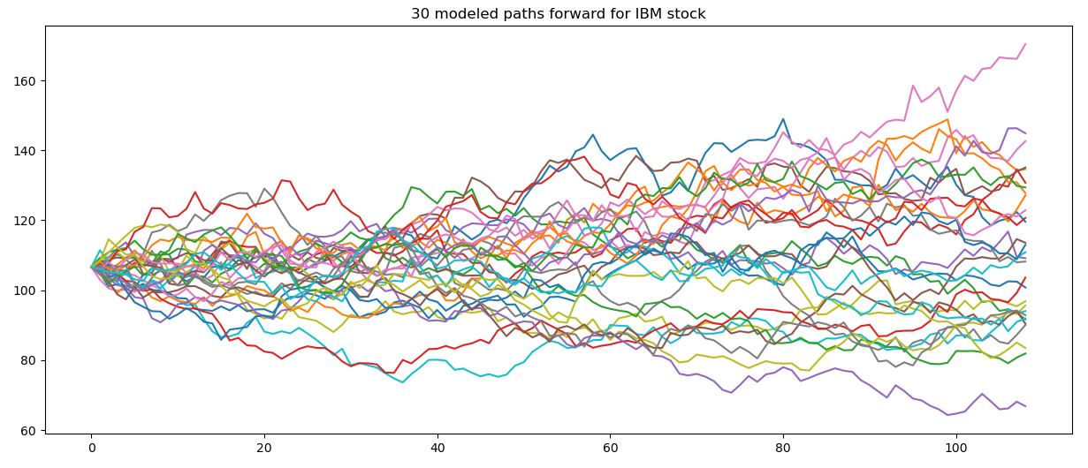
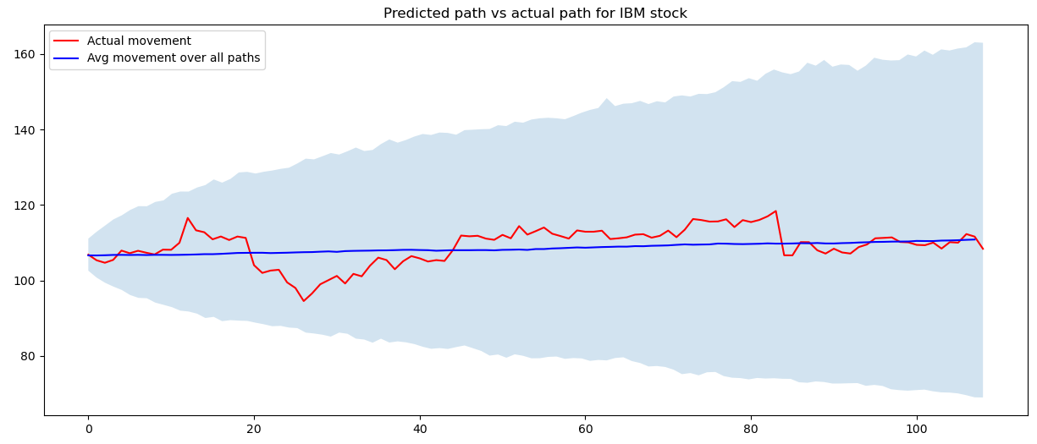
Single Stock Results
Using Brownian Motion we can predict a single path forward for a stock
Wrapping that in a Monte Carlo simulation and we can predict multiple paths forward
Using the training set to obtain the mean and sigma values, we plotted the mean and 95% confidence interval values for each day in the test set along with the actual value
Notes:
Looking at 30 arbitrary paths, it does look a lot like that of a particle from the following slide
XXXX trials were run to obtain the lower chart and the x axis shows how many days out the stock price was predicted

Slide 8
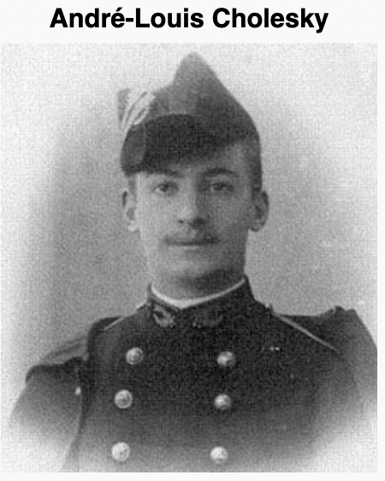
Cholesky
The Cholesky decomposition or Cholesky factorization is a decomposition of a positive-definite matrix into the product of a lower triangular matrix and its conjugate transpose, which is useful for efficient numerical solutions
Cholesky decomposition may be used for multi-asset baskets. The resulting lower triangular matrix is multiplied with a vector of random numbers to obtain a vector of correlated epsilon values.
In this project, we use Cholesky decomposition to decompose the covariance matrix, and multiply it to the normally distributed random matrix, then we plug that to the Brownian Motion equation to get the Monte Carlo stock price for assets.

Slide 9
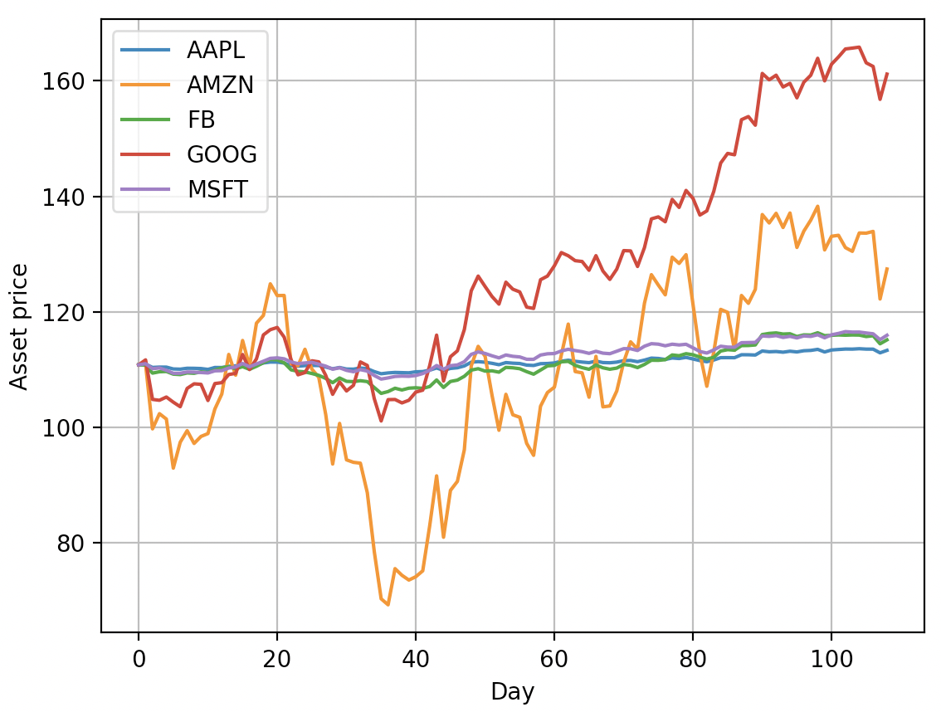
Results cont.
We applied the Cholesky decomposition to Brownian Motion into five stocks, namely AAPL, AMZN, FB, GOOG, and MSFT.
The paths of the five positively correlated stocks behave in a similar pattern.
NOTE: The stocks start at the same price just for the sake of comparison, so you see the volatility of AMZN and GOOG are large due to the fact that the real base prices are relatively low.

Slide 10
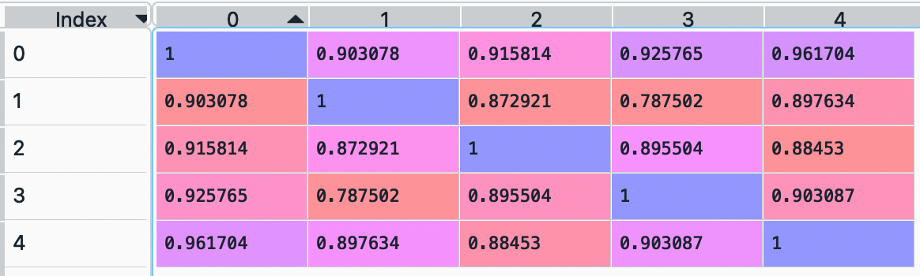
More details of Cholesky - Correlation matrix
The matrix is extracted from real stock prices data
You notice that the correlations are all positive, so the plot in previous slide are all positively correlated.
After that, we decomposite using R = np.linalg.cholesky().

Slide 11
Cont.
Then we get the epsilon array by epsilon_array = np.inner(random_array,R)
Finally plug into the equation: S * exp((r - 0.5 * v**2) * dt + v * sqrt(dt) * epsilon)
Summary
The high correlations are reflected in the simulated price paths. After normalizing the initial price levels (so we set out from the same starting point), we observe a general tendency for asset prices to move into the same direction.

Slide 12

Portfolio Management
Goals
Show what your savings rate needs to be at certain points in your life to retire how you want.
Use different portfolio types to show the speed at which you might be able to retire.
Give examples of different situations to show retirement is obtainable within reasonable amounts of time.

Slide 13
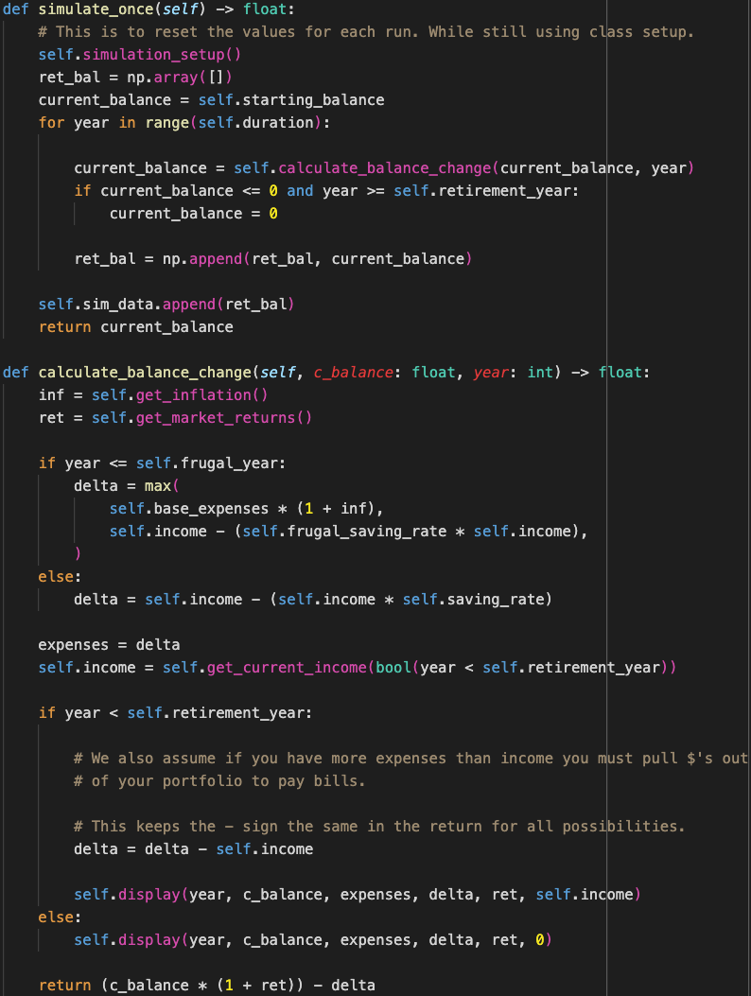
Portfolio Simulate Once
The base simulate once is very similar to the retirement planner that we created in the homework.
Instead of using a generic 6% return with 8% standard deviation we simulated the given portfolio with equal weights in each ticker to find our returns.
Then we added extra inputs to round out a more realistic simulation

Slide 14
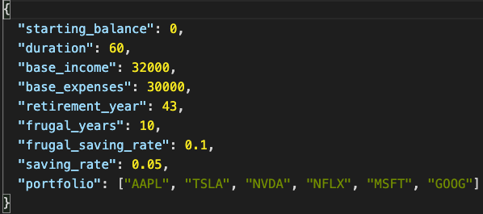
Inputs for Portfolio Simulation
We started with the base income and expenses
The expansions that we made were
Savings rate
Ability to get raises each year (random)
Ability to change your savings rate based on your point of life in the simulation
Ability to start in debt before starting to invest in the market

Slide 15
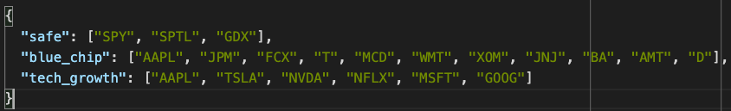
Bringing it together
Not only does each simulation get to use random values for inflation, raises and expenses.
Each simulation also starts with a new market simulation.
The benefits of this approach are:
We do not assume that the market will be the same in each simulation
Therefore the mean and standard deviation of returns we start with for each simulation is different
We are still drawing a random distribution for a given year in the simulation
This gives us the ability to cover the most possible outcomes and therefore giving a better prediction
The cons of this approach are:
It takes a long time to run
Possible that the mean and std are very close across simulations and therefore is not adding much

Slide 16
Portfolio Options
Chose to run 3 different portfolio options for each of our scenarios.
You can run billions of different combinations of tickers and they each will give you slightly different results but these are a few common approaches that do not take a ton of research to get started.

Slide 17
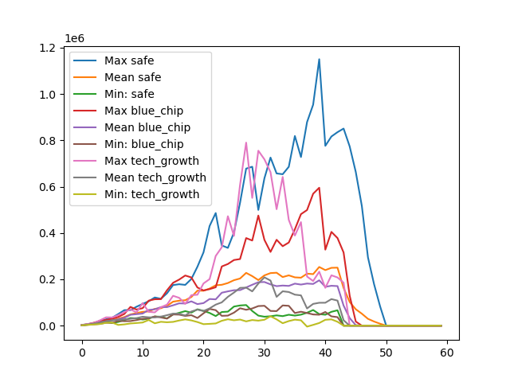
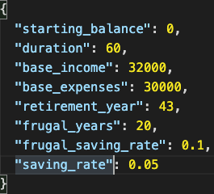
Results
First we have a few standard values to show the base results. The ones here are for someone with the median income in the US and a low savings rate.

Slide 18
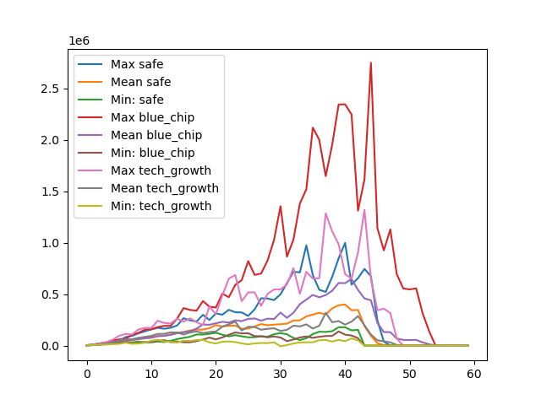
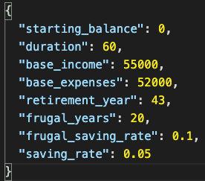
Results cont.
The second set of results here are for someone with a college degree and a low savings rate.

Slide 19
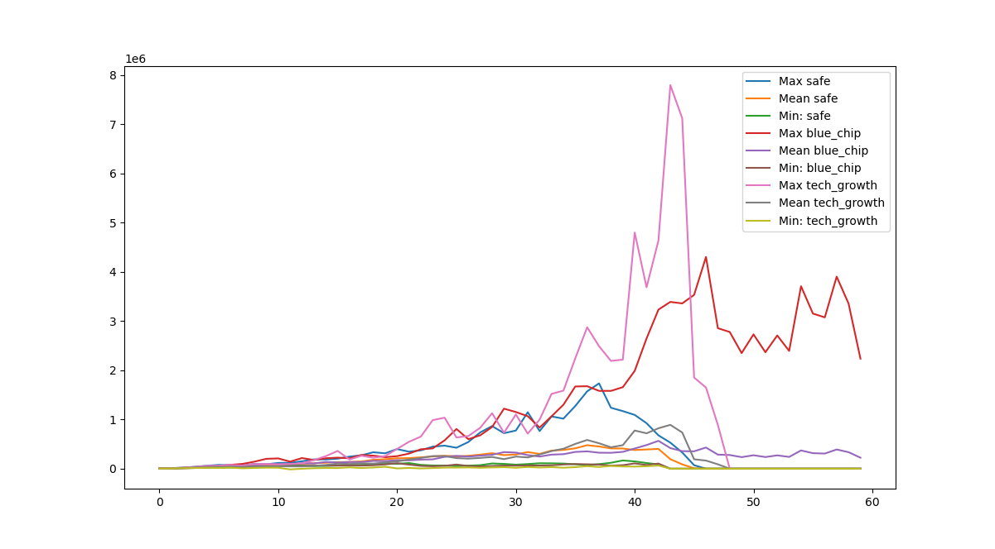
Comparison of Different Plans
Here we show a comparison of how important savings rate is in reaching portfolio goals. This is intended to show the power of compound interest. As you can see income level helps to a point but the main driver of a portfolio is the savings rate.

Slide 20
Improvements / Expansions
Ability to have multiple income streams and some variability in them
Ability to have certain expenses like a mortgage that eventually ends and your net worth is growing with the value of a home or asset.
Breaking down into different types of accounts (401K, Investment, Real Estate etc)
Control the raises and income in a more meaningful and realistic way.

