Slide 1

Objective: Predicting Customer Churn
Business Objective: Minimize customer churn by proactively identifying high-risk customers and implementing targeted retention interventions.
Analytical Objective: Develop a predictive model for churn (binary classification: Churned vs. Stayed) using customer behavioral and transactional data.
Strategic Value: Retaining existing customers is significantly more cost-efficient than acquiring new ones; leveraging predictive insights enables data-driven retention strategies, improves ROI, and strengthens customer lifetime value.

Slide 2
Data & Modeling Overview
Dataset: Customer transactional and behavioral data (7,000+ customers).
Features Used: Tenure in months, monthly spend, total charges, referrals, demographics, service types, payment methods, etc.
Preprocessing:
Handled missing values
Encoded categorical variables
Scaled/normalized numeric features where needed
Train/Test Split: 70% training, 30% testing.
Class Imbalance Handling: Weighted models to account for fewer churners.
Models Trained: Logistic Regression, Random Forest, Gradient Boosting (XGBoost).

Slide 3
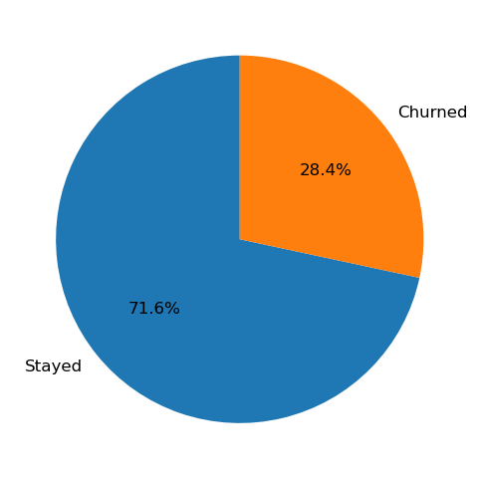
Customer Churn Distribution
Total Customers Analyzed: 1,977 (Churners + Non-Churners).
Churn Rate: 561 customers (28%) left AllLife.
Non-Churned Customers: 1,416 customers (72%) remained.
Class Imbalance: Majority are non-churners, fewer churners.
Implication: Imbalance dataset applied scale_pos_weight to improve model performance.
Key Takeaway: Roughly 3 out of 10 customers leave churn is a significant business risk that can not be ignored.

Slide 4
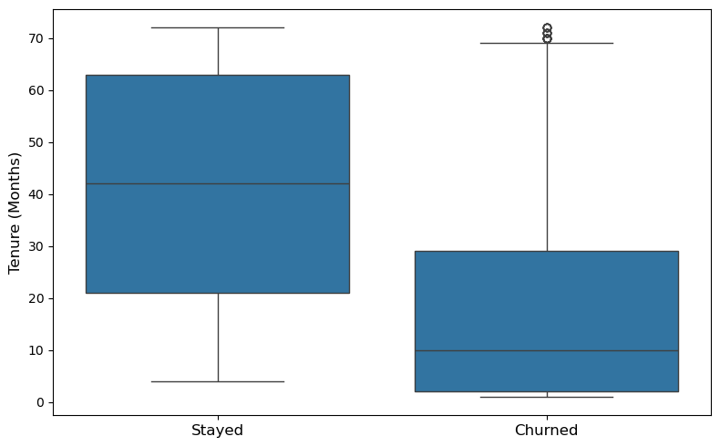
Impact of Tenure on Customer Churn
Stayed customers: Median tenure ~42 months; most remain 20-65 months.
Churned customers: Median tenure ~10 months; majority leave in the first 1-2 years.
Critical window: First 12 months are the highest-risk period.
Key Takeaway: Tenure is a strong predictor of churn.
Business action: Focus retention campaigns on early-tenure customers (onboarding, discounts, offers, loyalty rewards).

Slide 5
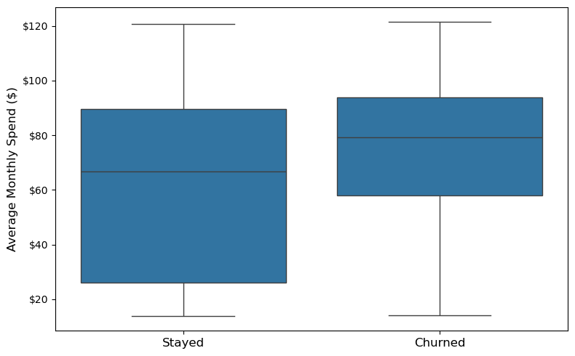
Impact of Monthly Spend on Customer Churn
Stayed Customers: Median monthly spend ~$65; most spend between $25–$90.
Churned Customers: Median monthly spend ~$80; very high spenders ($60+) are most likely to leave.
Critical Insights: Higher monthly spend higher likelihood of churn.
Key Takeaway: Monthly spend is a strong predictor for churn.
Business action: Focus retention efforts on high-spending, early-tenure customers (personalized offers, loyalty rewards, VIP supports).

Slide 6
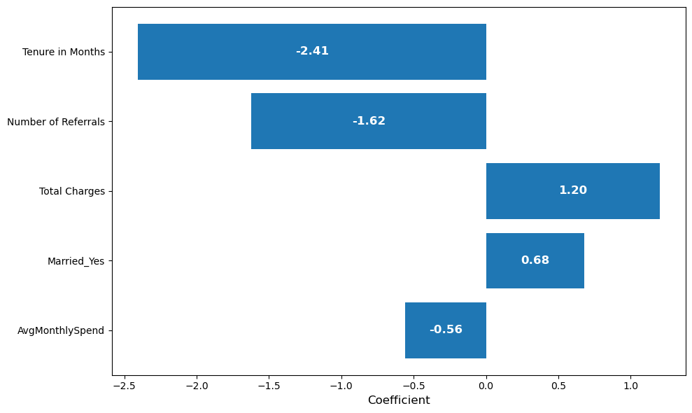
Top Predictors of Churn - Logistic Regression Model
Tenure: Longer-tenure customers are much less likely to churn.
Number of Referrals: Customers who provide more referrals have lower churn risk.
Total Charges: High total charges strongly increases the likelihood of churn.
Other Key Drivers: Features with positive coefficients indicate higher churn risk; negative coefficients indicate retention factors.
Critical Insights: Both usage patterns and financial metrics significantly impact churn probability.
Key Takeaway: Logistic regression quantifies which features most influence churn, helping target high-risk customers for retention offers.

Slide 7
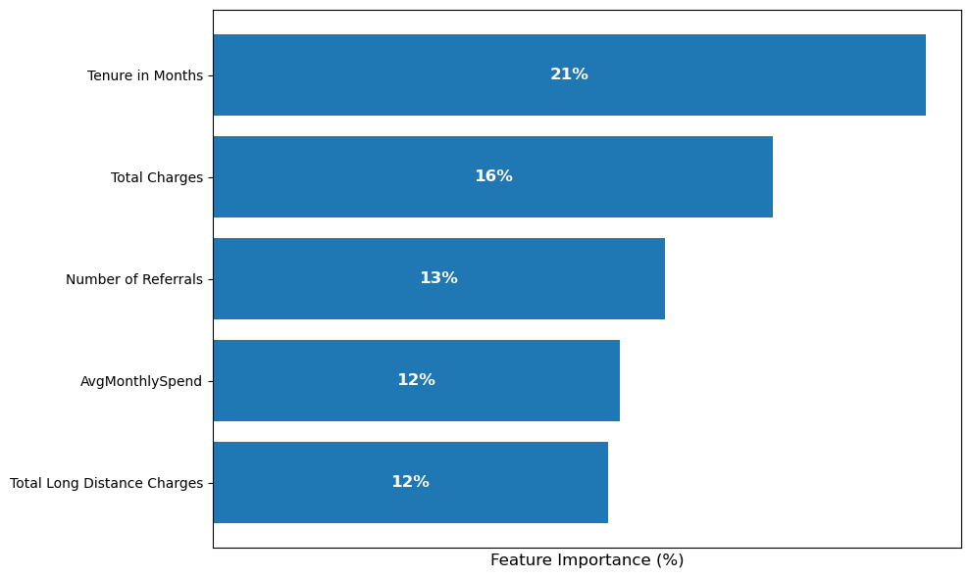
Key Drivers of Churn - Random Forest Model
Tenure in Months (21%): Shorter-tenure customers are much more likely to churn.
Total Charges (16%): Customer with high total spend show higher churn risk.
Number of Referrals (13%): Referrals strongly reduce churn risk.
Average Monthly Spend (12%): High monthly bills increase churn likelihood.
Key Takeaway: Retention strategies should focus on new, high-spending customers who are not yet engaged enough (e.g., no referrals).

Slide 8
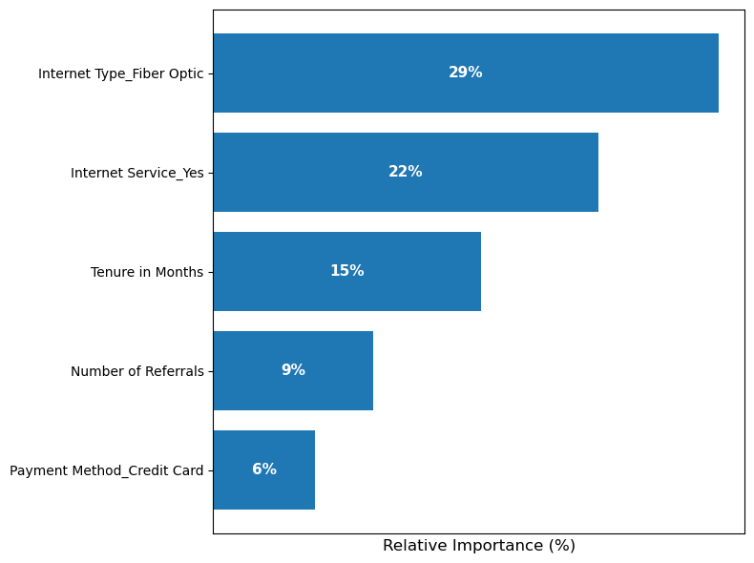
Top Predictors of Churn – Gradient Boosting
Top Drivers: Fiber Optic internet (29%), Internet Service (22%), and Tenure (15%) are the strongest predictors of churn.
Tenure Effect: Newer customers are more likely to churn.
Internet Plan Impact: High-end internet plans (Fiber Optic) have higher churn probability.
Key Insight: Both service type and customer behavior drive churn risk.
Key Takeaway: Retention efforts should target new, high-spending, or Fiber Optic customers.

Slide 9
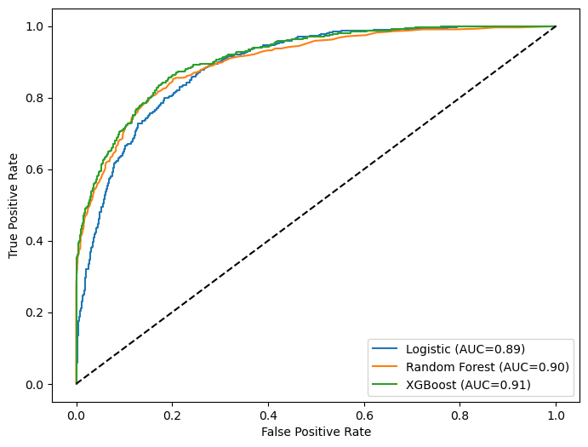
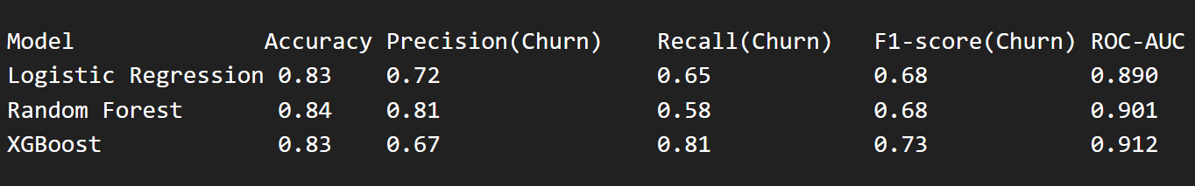
Model Performance Comparison (ROC Curves)
Logistic Regression: Interpretable, decent overall performance; balanced metrics.
Random Forest: Higher precision (fewer false positives) but lower recall (misses some churners).
XGBoost: Best recall (0.81) and highest ROC-AUC (0.912), most effective at identifying churners.
Business Implication: XGBoost is recommended for retention campaigns targeting high-risk customers.
Key Insight: Model choice depends on business goals here, catching as many churners as possible is most important.

Slide 10
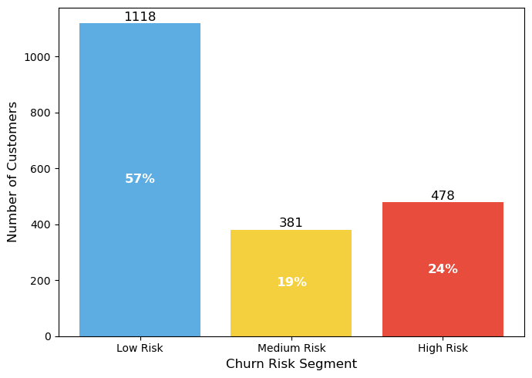
Customer Churn Risk Segmentation
Low Risk: 57% of customers – unlikely to churn soon.
Medium Risk: 19% of customers – moderate probability of churn.
High Risk: 24% of customers – highest likelihood to churn; priority for retention campaigns.
Insight: Churn probability is evenly distributed across segments, highlighting the need for targeted retention strategies.
Actionable Takeaway: Focus personalized offers, loyalty incentives, and proactive engagement on high-risk customers to reduce overall churn.
Model Choice: XGBoost provides reliable predicted probabilities for segmentation, enabling effective prioritization.

Slide 11
Improving Model Accuracy & Impact
Retraining: update model periodically with new customer data to capture changing behaviors.
Feature engineering: create derived features (e.g., usage trends, customer lifetime value, product interactions).
Hyperparameter tuning: optimize XGBoost parameters for better recall and precision (like max_depth, learning_rate, n_estimators, scale_pos_weight).
Additional data sources: incorporate external demographic, behavioral, or social data.
Performance monitoring: track KPIs like churn rate reduction, retention ROI, and prediction accuracy over time.

Slide 12
🎯 Recommended Retention Strategy
Prioritize high-risk customers with personalized retention campaigns/offers.
Engage medium-risk customers to prevent escalation.
Maintain satisfaction for low-risk customers to prevent future churn.
Leverage key drivers (tenure in months, total charges, referrals, monthly spend) to design customized interventions.
Optimize marketing resources by focusing efforts where churn likelihood is highest.

Slide 13
Key Takeaways & Next Steps
XGBoost is the most effective model for identifying churners.
Top predictors: Tenure in months, total charges, referrals, monthly spend.
Risk segmentation allows prioritization of retention resources.
Continuous improvement: Retrain model with new data and monitor performance.
Next Steps: Integrate into marketing workflow, track KPIs, refine strategies based on results.

Slide 14
THANK YOU!

