Slide 1
Genesis Point
Collection of limitless creations

Slide 2
A wrong design and faulty wire can be dire
A well-designed electrical system can prevent hazards, but regular maintenance and testing are also crucial to ensure safe operation. It's important to consider the needs of the people using the system, and ensure that it's properly designed.
Genesis Point

Slide 3
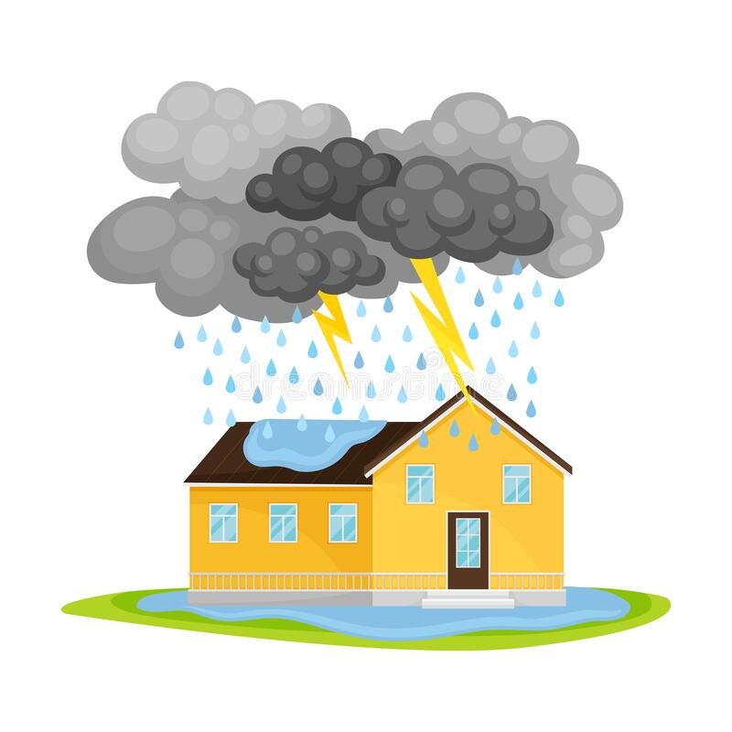
Design Process
Power Calculation
Lightning Protection
Floor Planning
Conduit

Slide 4
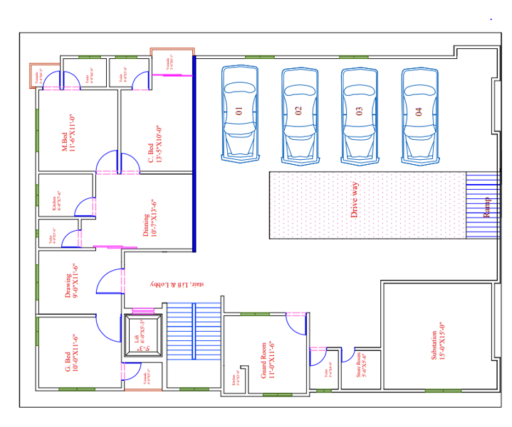
Ground Floor

Slide 5
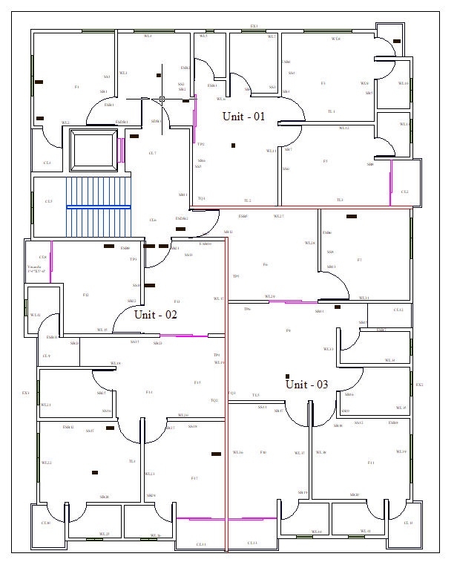
First Floor

Slide 6
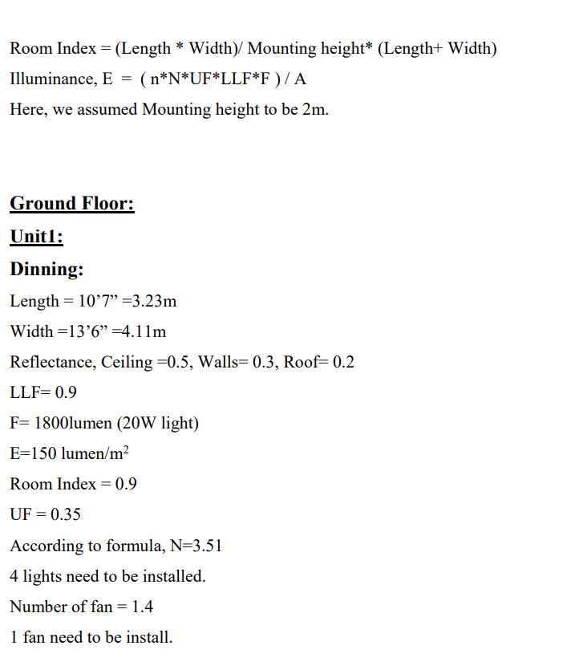
Sample Calculation

Slide 7
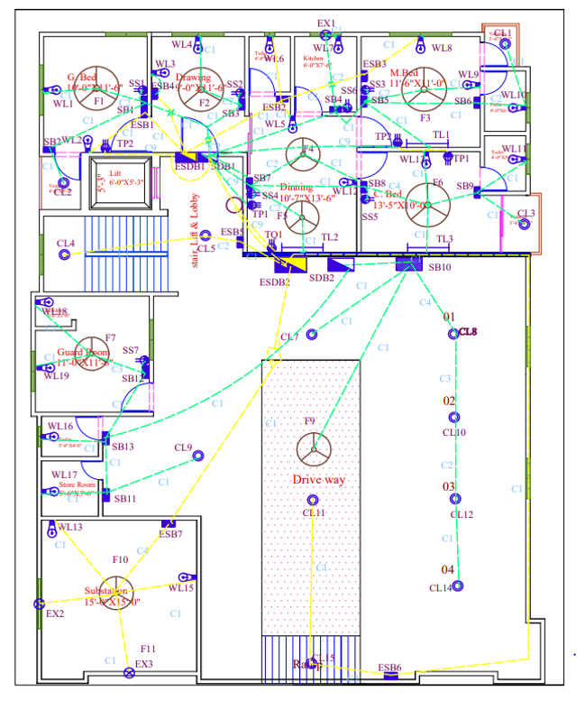

Slide 8
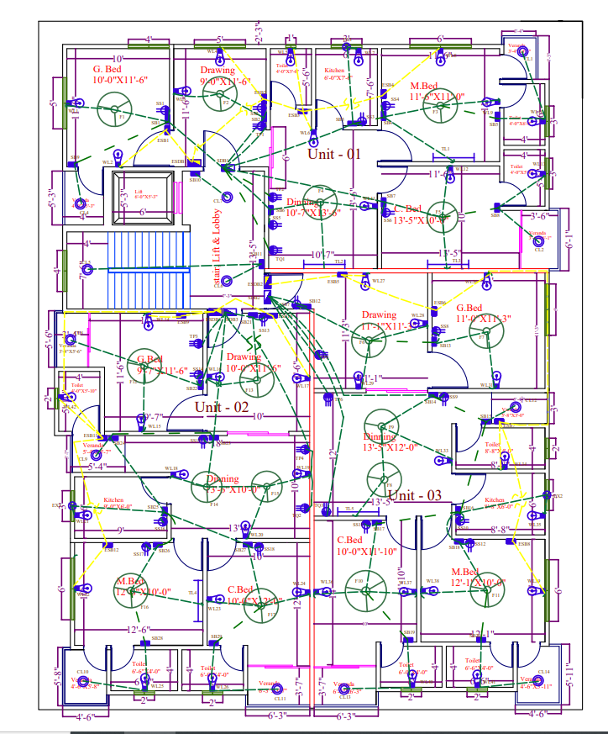
Conduit

Slide 9
Conduit Legend
C | Cross section | Current Rating
C1 | 2 x 1.5 mm2 | 5A
C2 | 4 x 1.5 mm2 | 5A
C3 | 6 x 1.5 mm2 | 5A
C4 | 8 x 1.5 mm2 | 5A
C5 | 2 x 2.5 mm2 | 10A
C9 | 2 x 4 mm2 | 15A

Slide 10
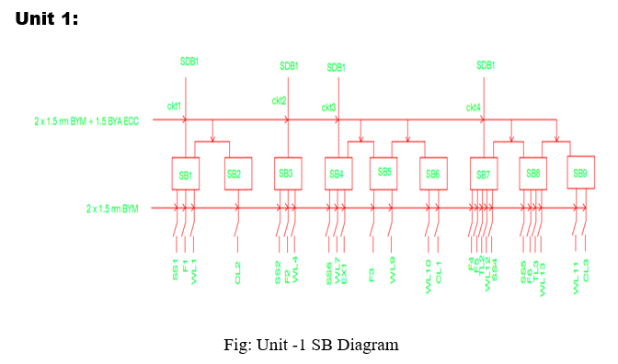
Switchboard Diagram Ground Floor

Slide 11
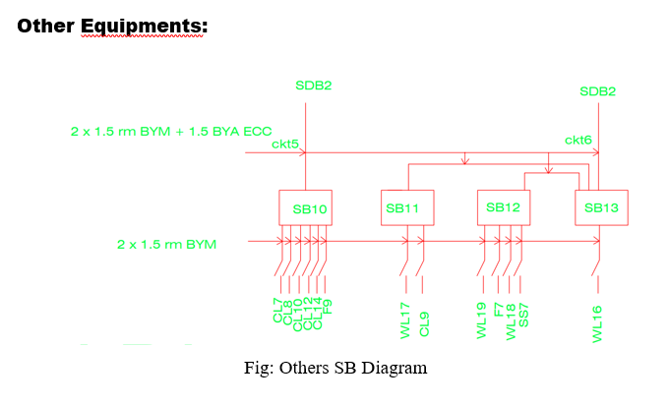
Ground Floor

Slide 12
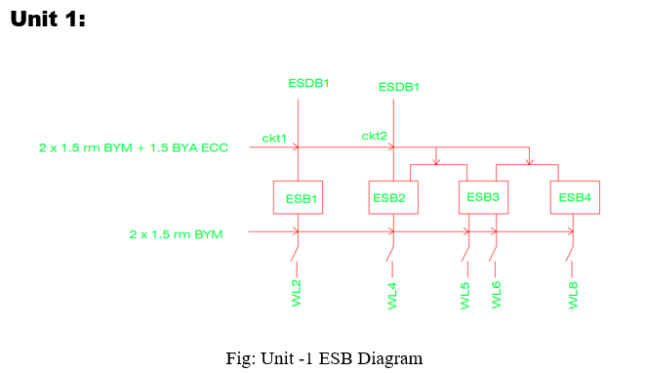
Emergency Switchboard Diagram

Slide 13
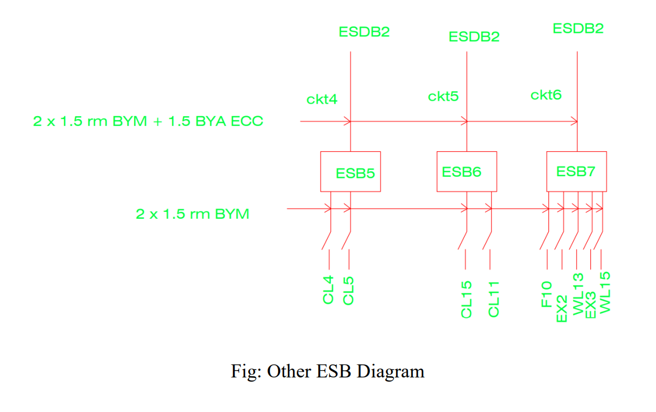
Others Emergency Switchboard diagram of ground floor

Slide 14
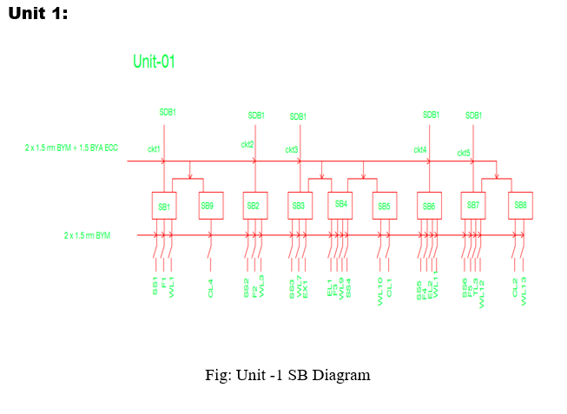
Switchboard diagram for first floor

Slide 15
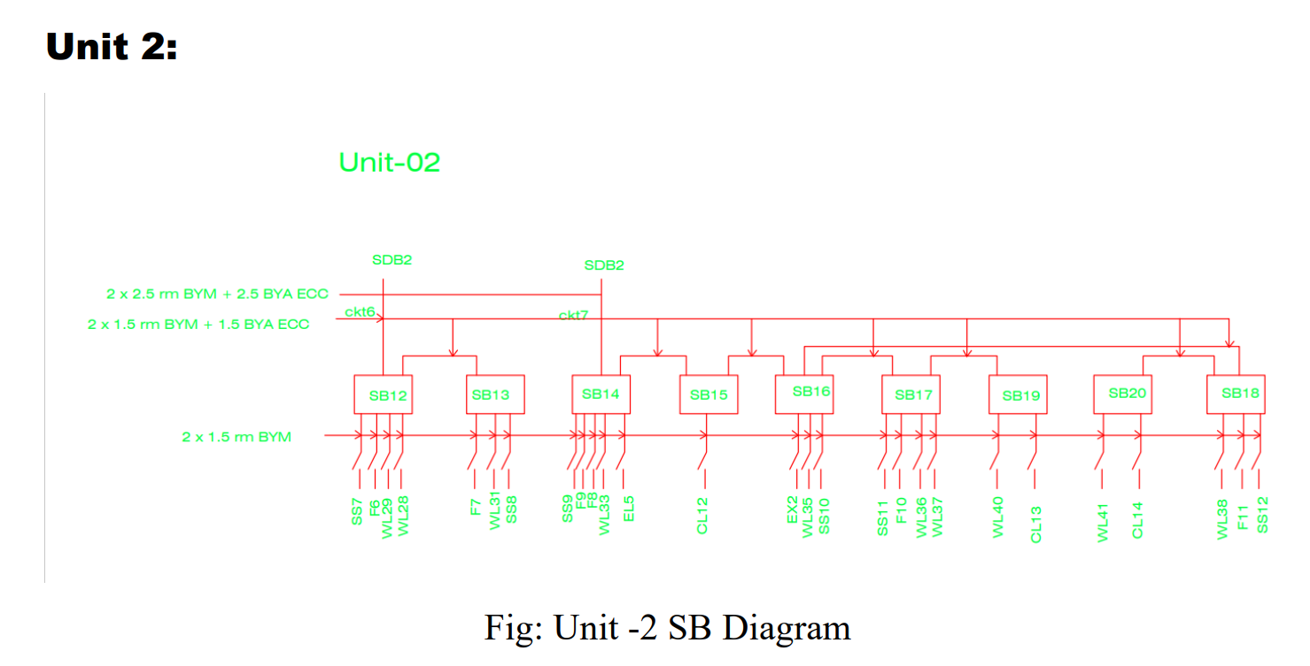
Switchboard Diagram First Floor

Slide 16
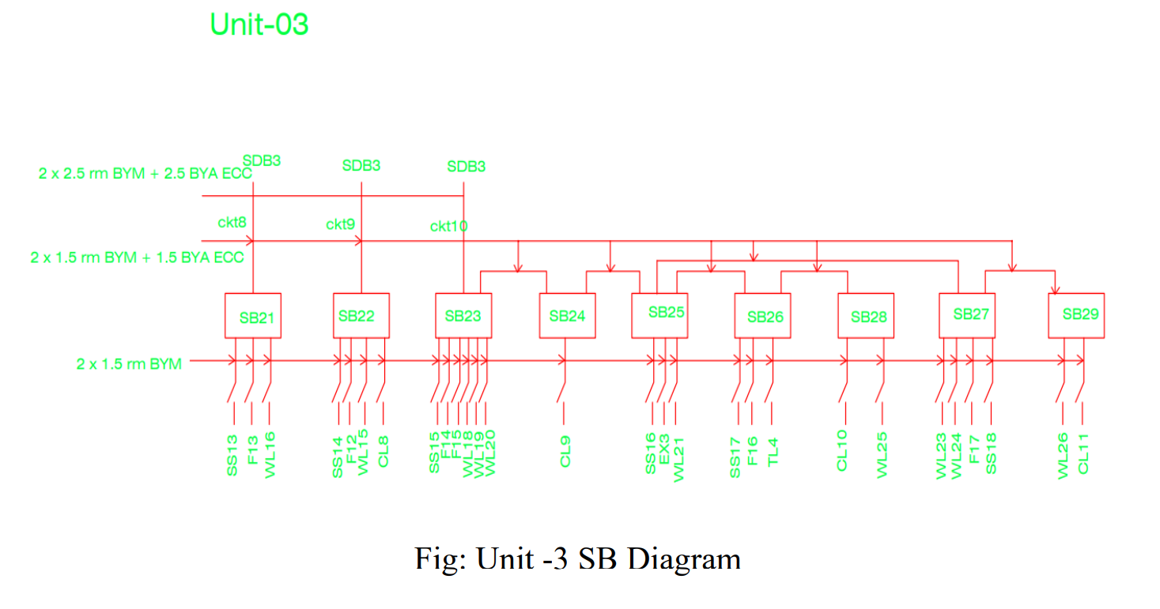
Switchboard Diagram First Floor

Slide 17
Emergency Switchboard Diagram of First floor

Slide 18
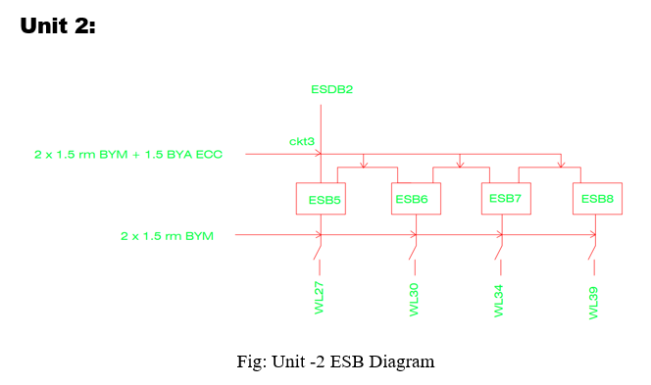
Emergency Switchboard Diagram first floor

Slide 19
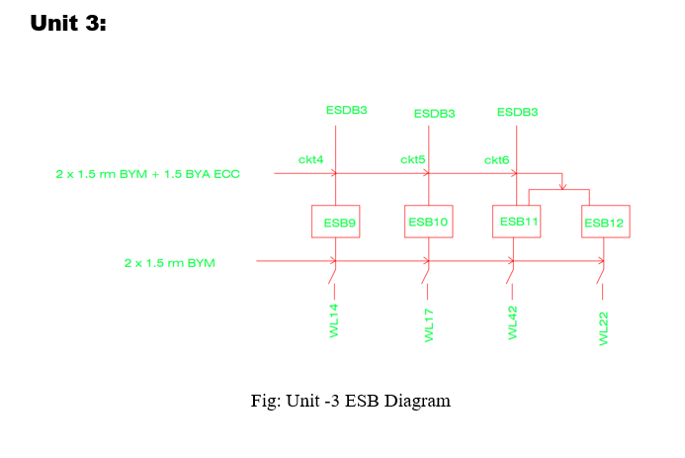
Emergency Switchboard Diagram first floor

Slide 20
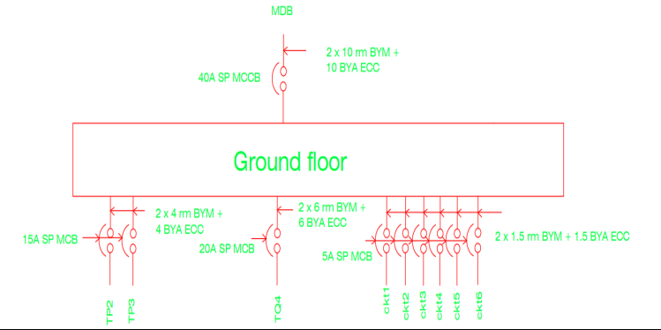
SDB to MDB Diagram for ground floor

Slide 21
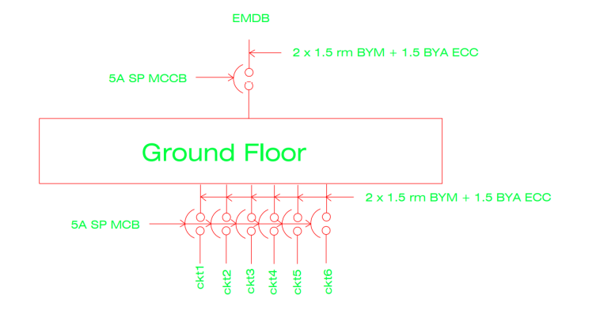
Emergency Main Distribution board Diagram of Ground floor

Slide 22
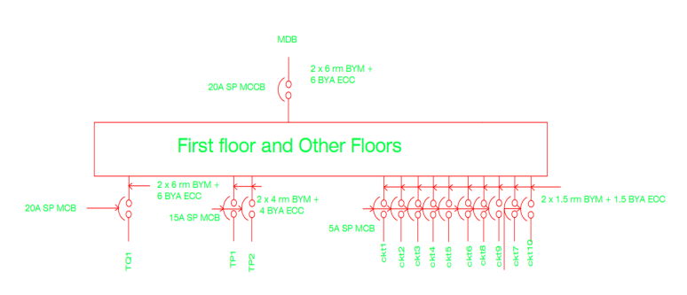
SDB to MDB diagram for first floor

Slide 23
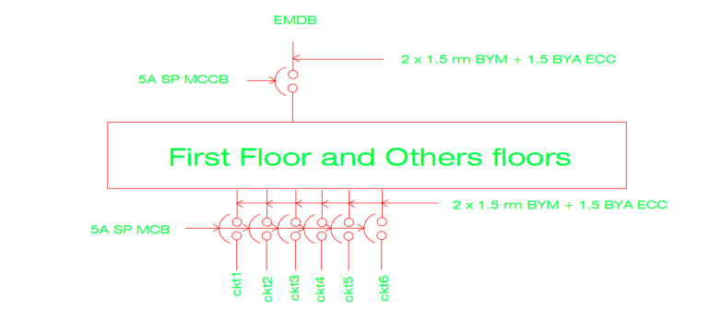
Emergency Main Distribution board Diagram of First floor

Slide 24
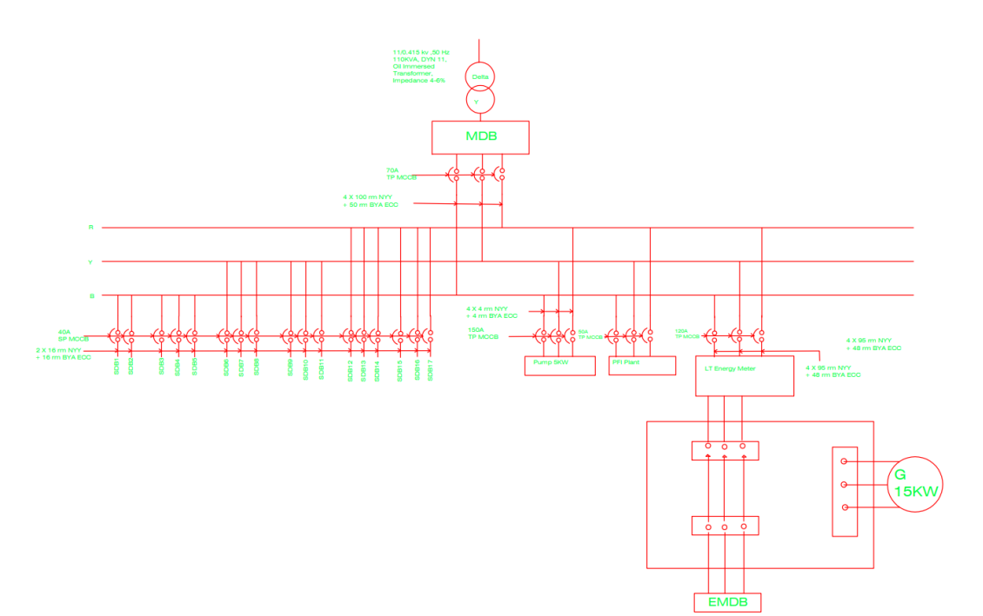
Main Distribution Board (MDB) Diagram

Slide 25
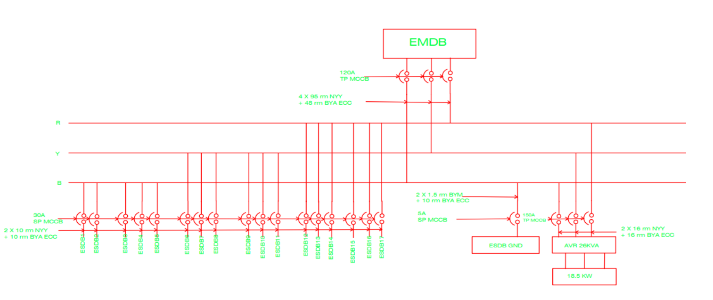
Emergency Main Distribution Board (EMDB) Diagram

Slide 26
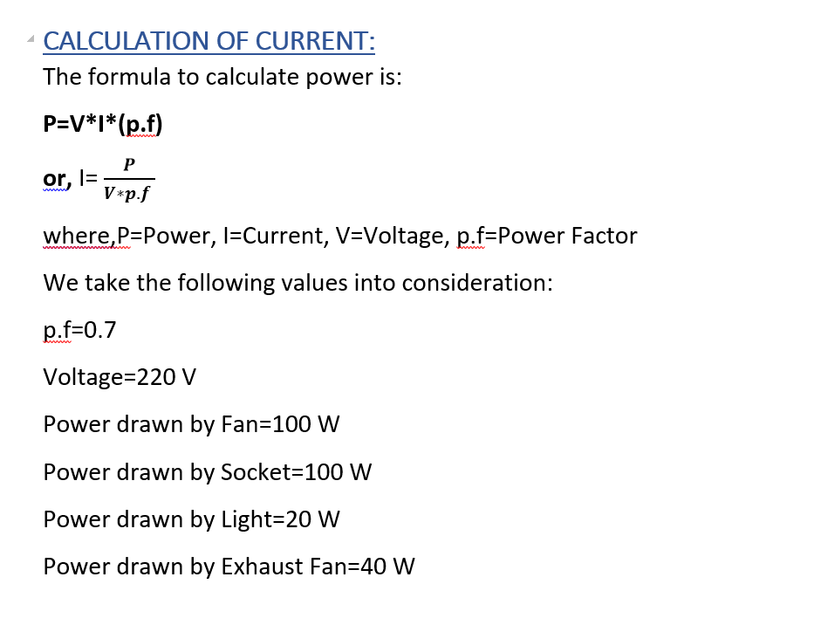
Power Calculation

Slide 27
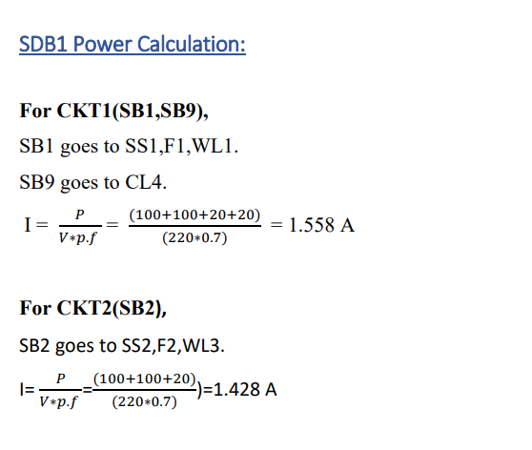

Slide 28
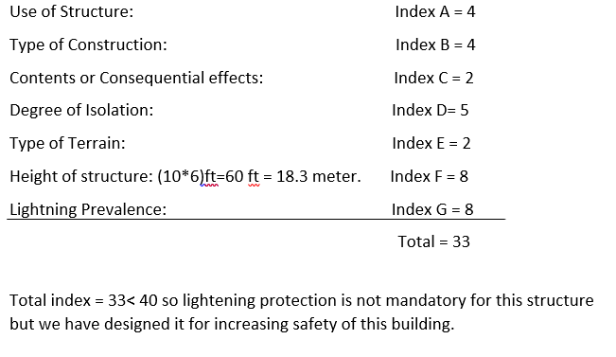

Lightening Protection Index Summary

Slide 29
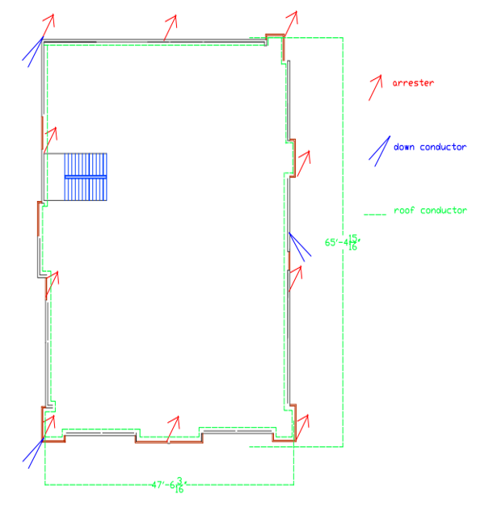
Lightning Protection

Slide 30
Thank You

