Slide 1
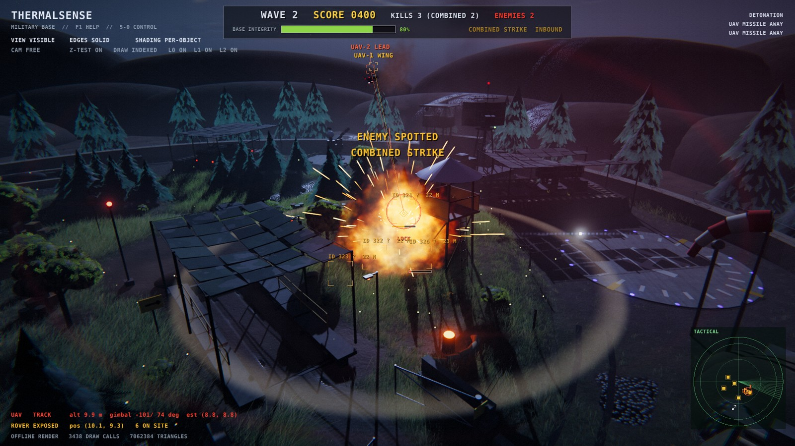
ThermalSense
Autonomous UAV Patrol of a Military Base
Md. Shakhoyat Rahman Shujon | Roll 2107104
Computer Graphics Lab | C++17, OpenGL 3.3 (+ 4.3 compute for ray tracing) | v7
Notes:
Good morning. This is ThermalSense, my computer graphics lab project: autonomous drones defending a hidden army base, now a playable game. Everything you will see, the camp, the soldiers, the vehicles and the rover intruders, is built only from cube, sphere and cylinder primitives. No model files, no textures. Version seven adds a day and night cycle, first person play, real ray tracing and a frame explorer. I end with the demonstration video.

Slide 2
THERMALSENSE
Outline
Foundations (v1-v5)
v6: a living base
v7: play, rays, frames
3
Goal and history
9
Day and night cycle
13
Game camera, possession
4
Building with primitives
10
Soldiers and IK gait
14
Whitted, path, light tracing
5
Camp and bunker
11
Random rover routes
15
BVH and SAH
6
Controllable objects
12
Vision under noise
16
Ray-tree debugger
7
Rendering pipeline
17
Ray tracing timings
8
Autonomy, game loop
18
Frame Explorer: 16 stages
19
Colour interpolation
20
Reflection: SSR vs RT
21
Results
22
Demo video
Notes:
Here is the outline in three parts. First the foundations from versions one to five: the goal, how every object is assembled from primitives, the camp and bunker, the controllable vehicles, the rendering pipeline and the autonomous game loop. Second, version six makes the base live: a day and night cycle, eight soldiers, random rover routes and vision under sensor noise. Third, version seven: playing from any point of view, ray tracing and the Frame Explorer.

Slide 3
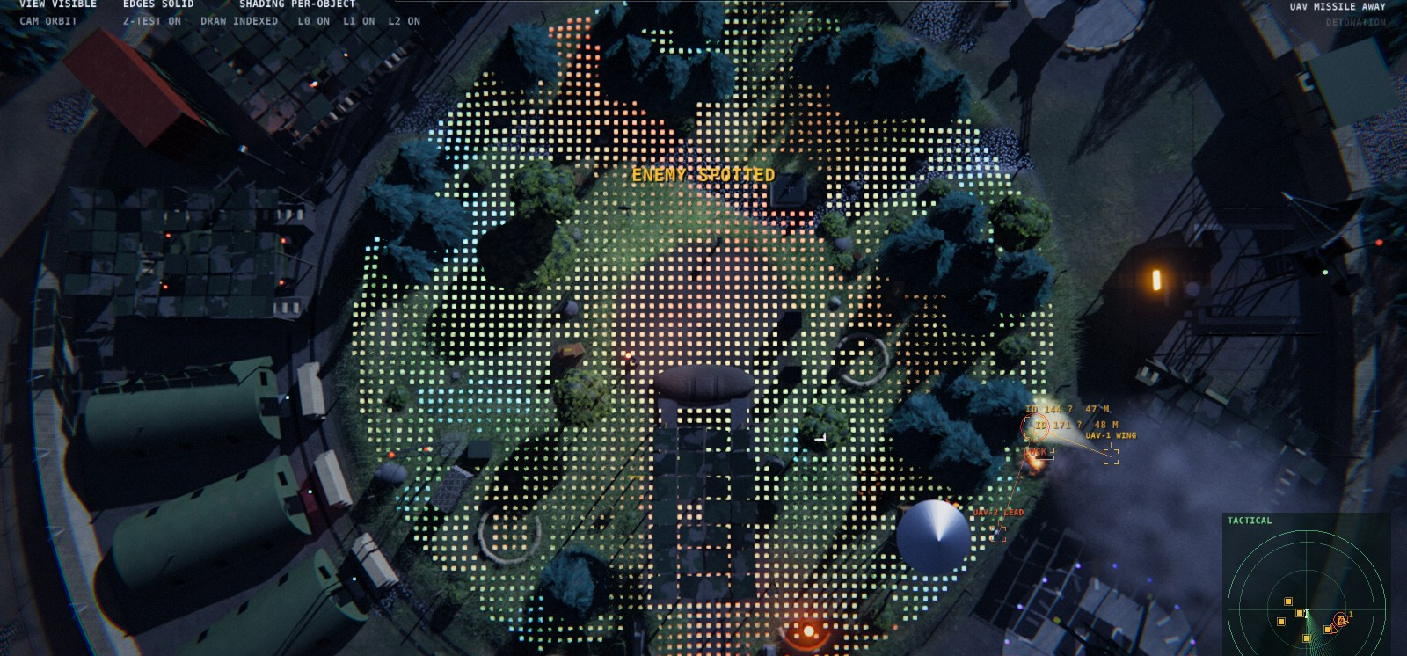
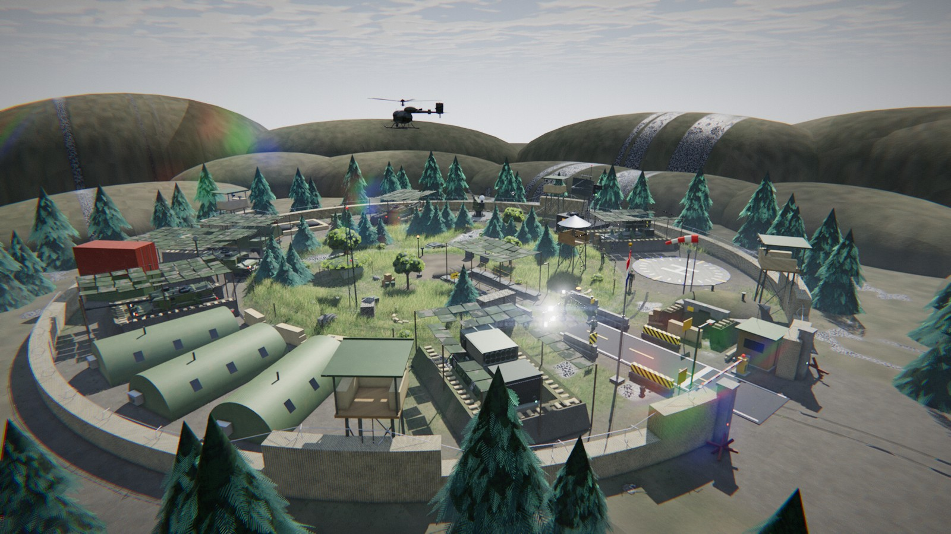
3 | GOAL
Goal and requirements history
Lab sheet
Proposal
v2
v3
v4
v5
v6
v7
Unit cube, sphere, cylinder; M = T·R·S; VAO/VBO/EBO
Flat / Gouraud / Phong, 3 lights, Z-buffer, thermal map
PBR, shadows, SSAO, fog; thermal tracker; MicroMouse rover
RTX 4070 EPIC preset, first-person FLIR, TAA, SSR
Military base, walkable bunker, controllable vehicles
Night Watch: 2 UAVs, CV tracker, waves, score, sound
Day/night cycle, 8 soldiers, random routes, sensor noise
First person anywhere, ray tracing, Frame Explorer
v5: top-down plan, night
v6: the same camp by day
Notes:
The goal: drones that find and track intruders using only their own thermal cameras, in a believable base built entirely from primitives. The requirements grew in stages: the lab sheet gave canonical primitives and M equals T R S, the proposal added shading and the Z-buffer, version two PBR and tracking, three the RTX pipeline, four the base and bunker, five the game. Six adds day and night, seven play, ray tracing and the explorer.

Slide 4
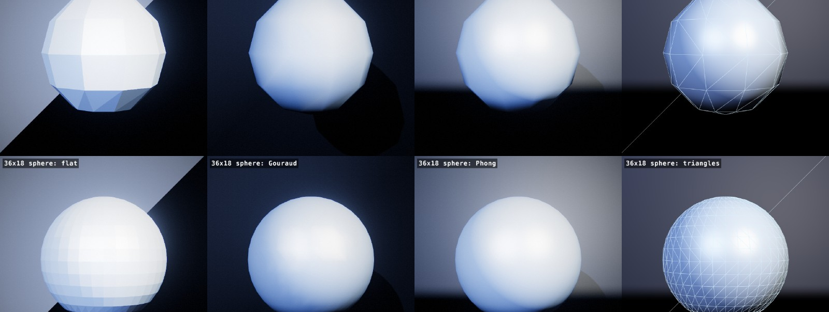
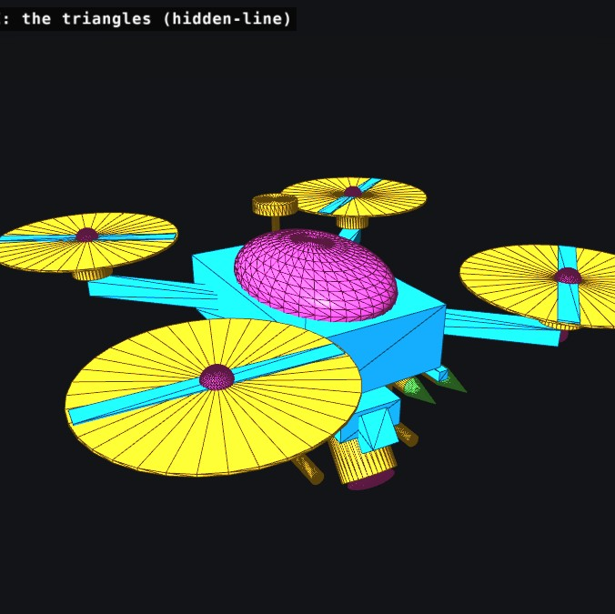
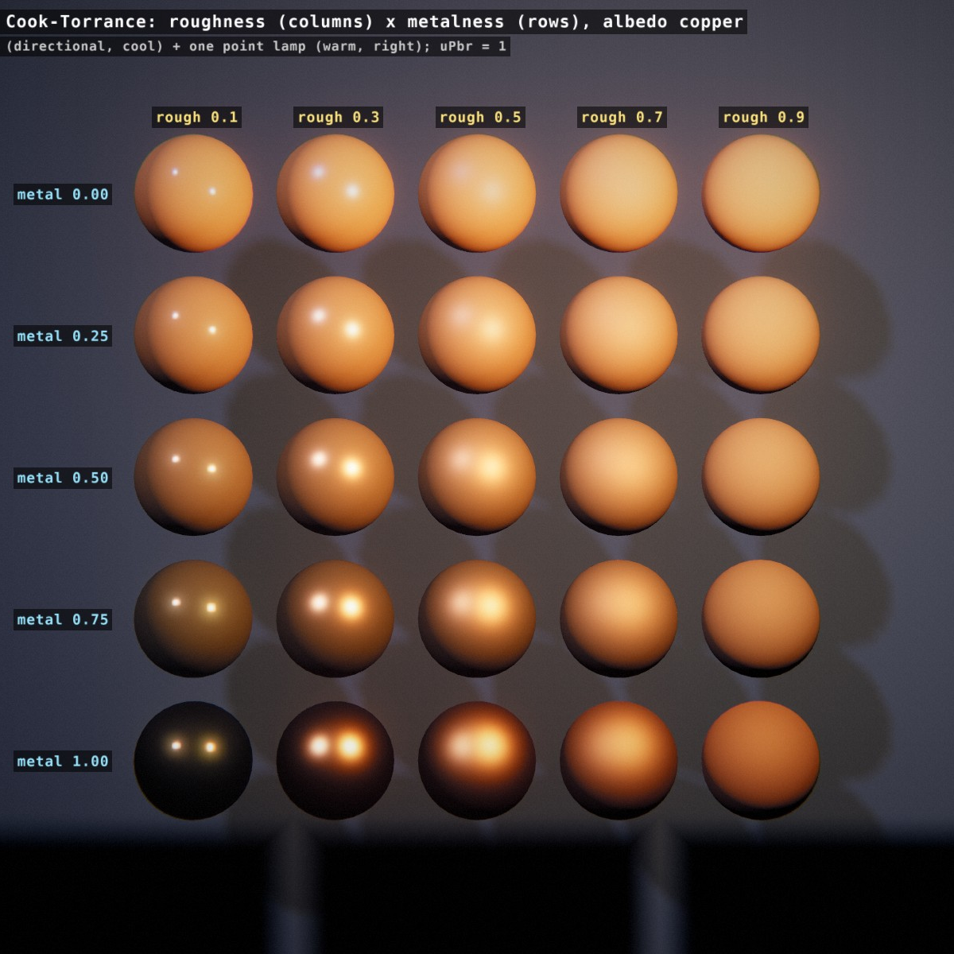
4 | CONSTRUCTION
Building with primitives
cube + sphere + cylinder → objects
M = T · R · S per part, parent × child
5,414
400
primitive leaves
bunker parts
255
75
tank parts
parts per soldier
158
1253
UAV parts
base apron parts
Notes:
Every visible solid is one part: a unit cube, sphere or cylinder drawn with its own matrix M equals T times R times S. Parts are grouped in a hierarchy, so a track link moves with its tank. The scene has 5,414 primitive leaves in total. For example the bunker has 400 parts, the tank 255, the radar 108, the UAV 158 and the helicopter 91. Cones are just cylinders with a different top radius.

Slide 5
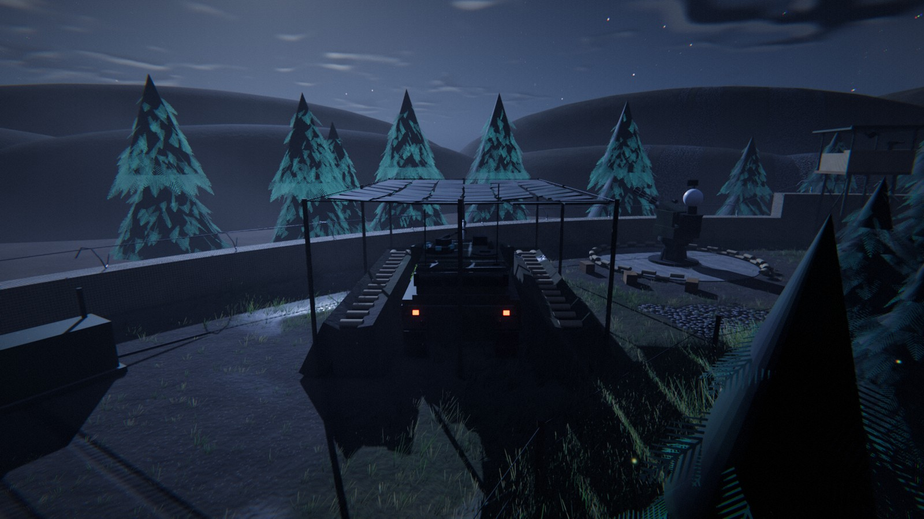
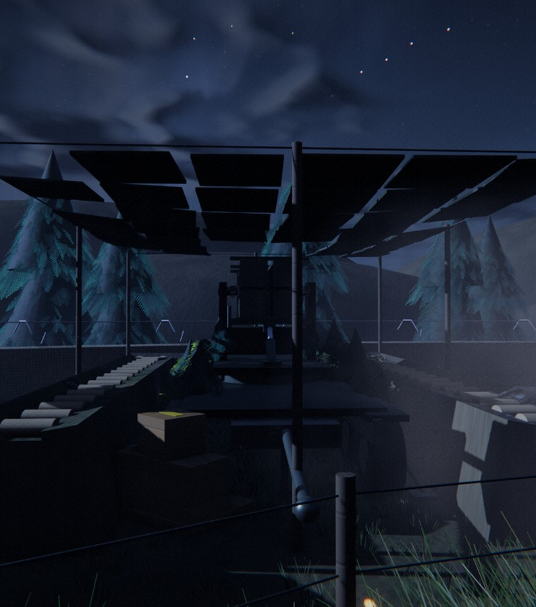
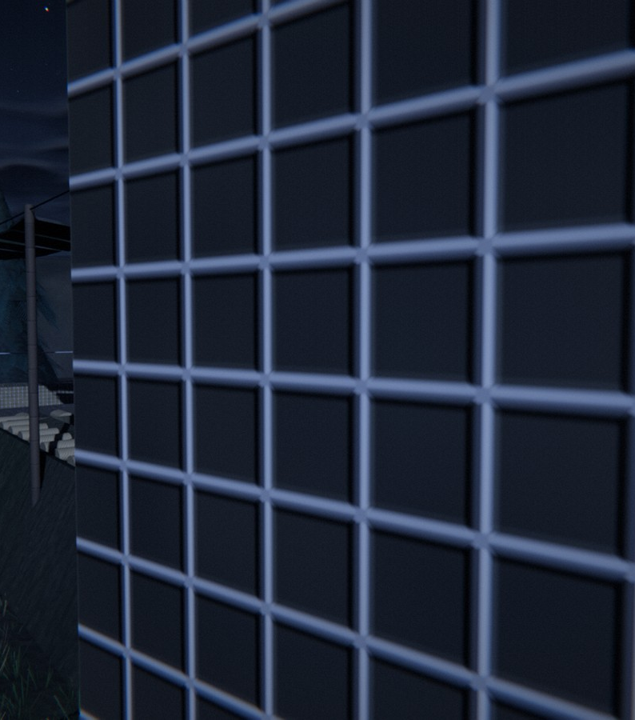
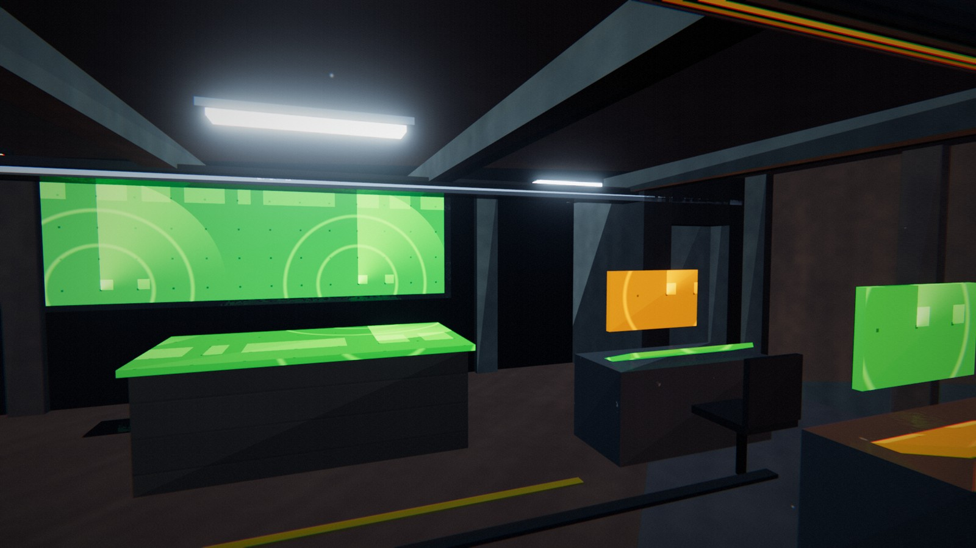
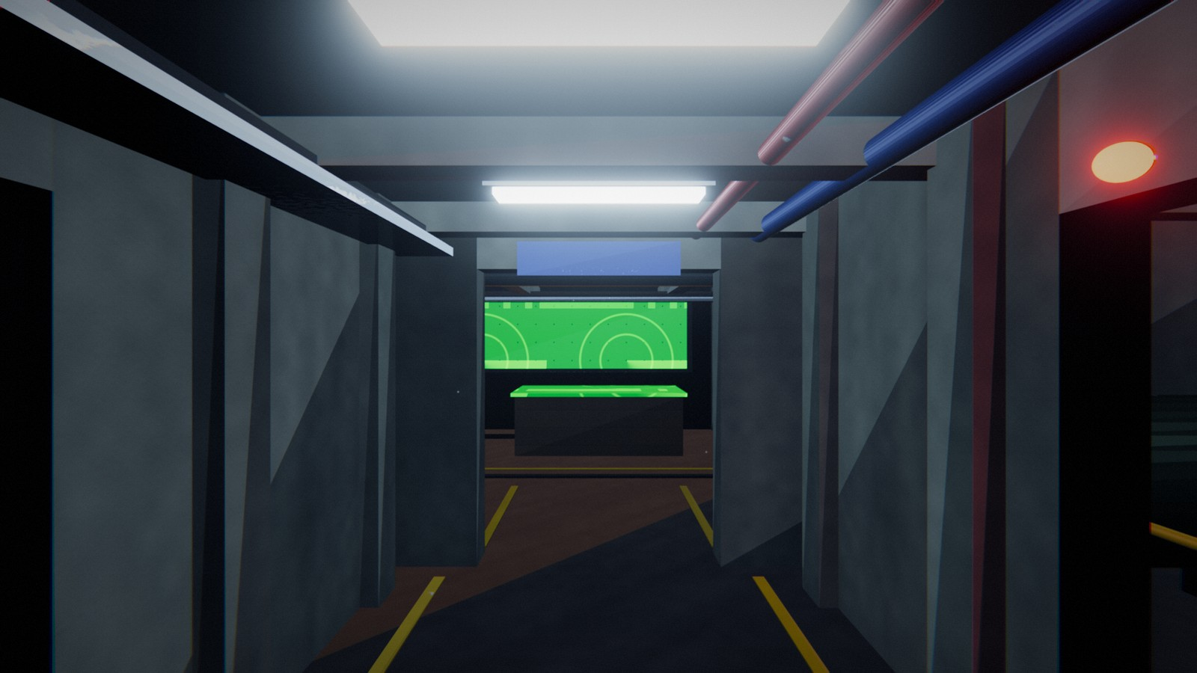
5 | ENVIRONMENT
Hidden army camp and underground bunker
Camp under camo nets, light discipline
SAM launcher
MLRS truck
1253
400
base parts
bunker parts
Command room (walkable)
Tunnel and blast door
Notes:
The base is a hidden army camp. It keeps light discipline: dim red and blue-green tactical lamps, blacked-out windows, so at night it reads only by moonlight, searchlights and explosions. Camo nets cover the vehicles, SAM and MLRS launchers and the bunker entrance, and tanks sit in earth revetments. Below ground is the walkable bunker with blast doors, a tunnel, command room, bunk room and generator room, all with collision volumes.

Slide 6
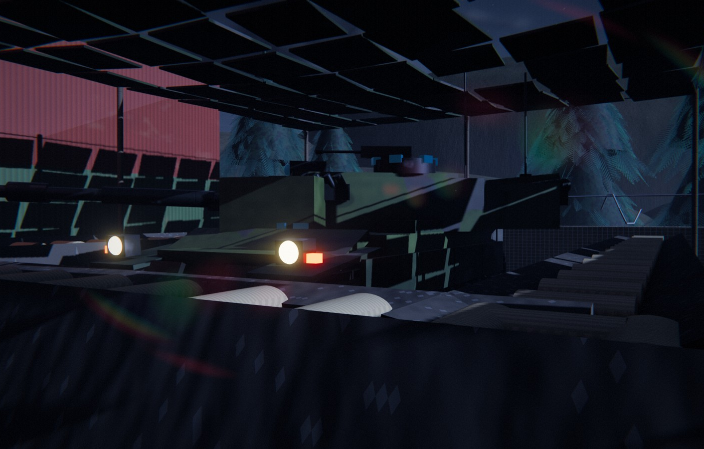
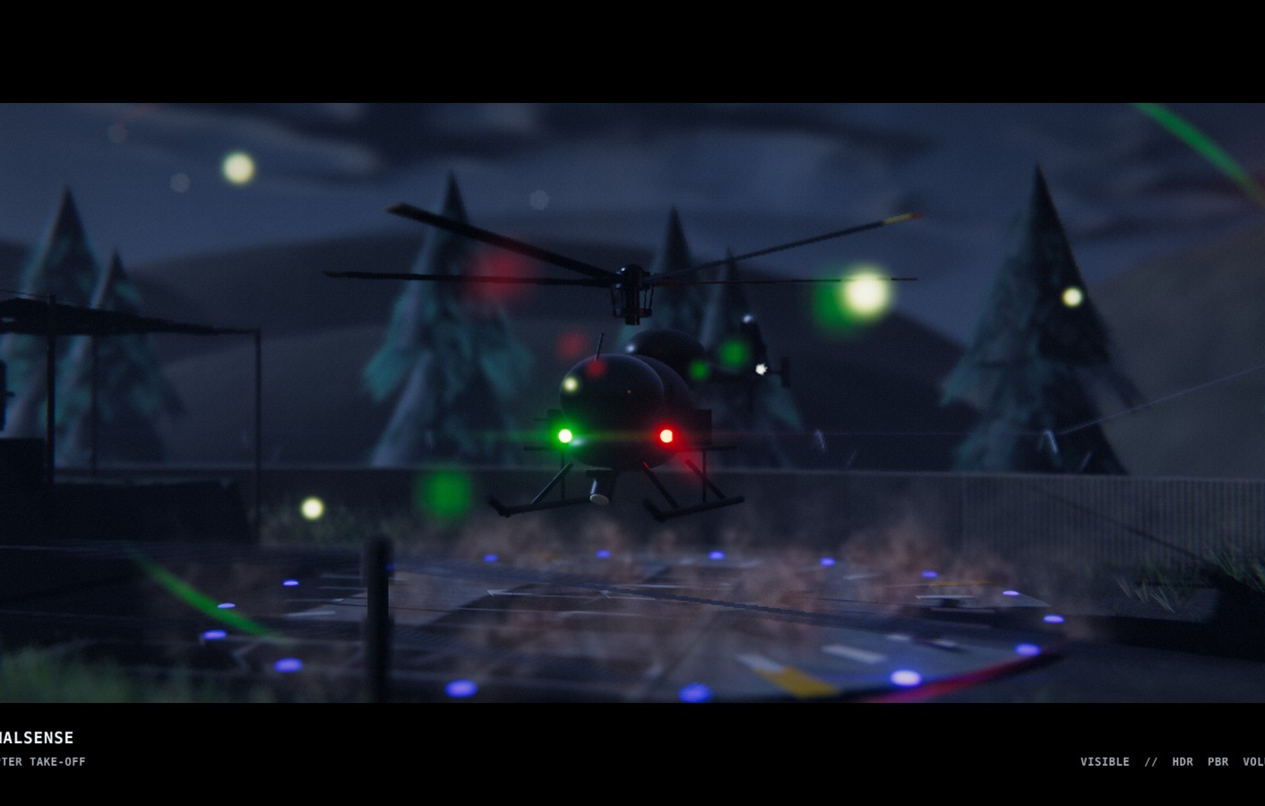
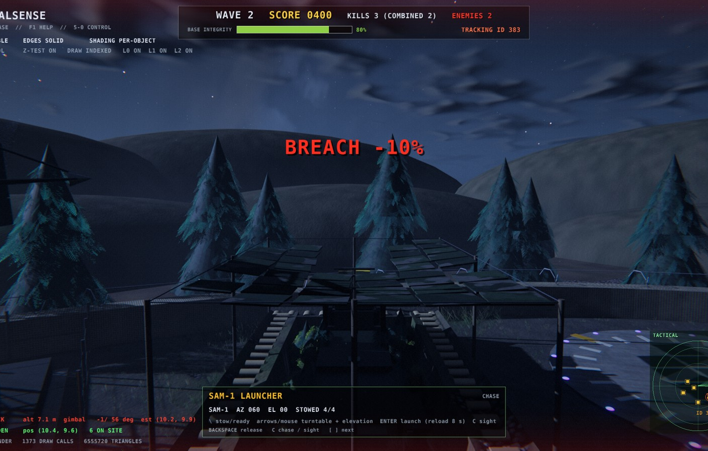
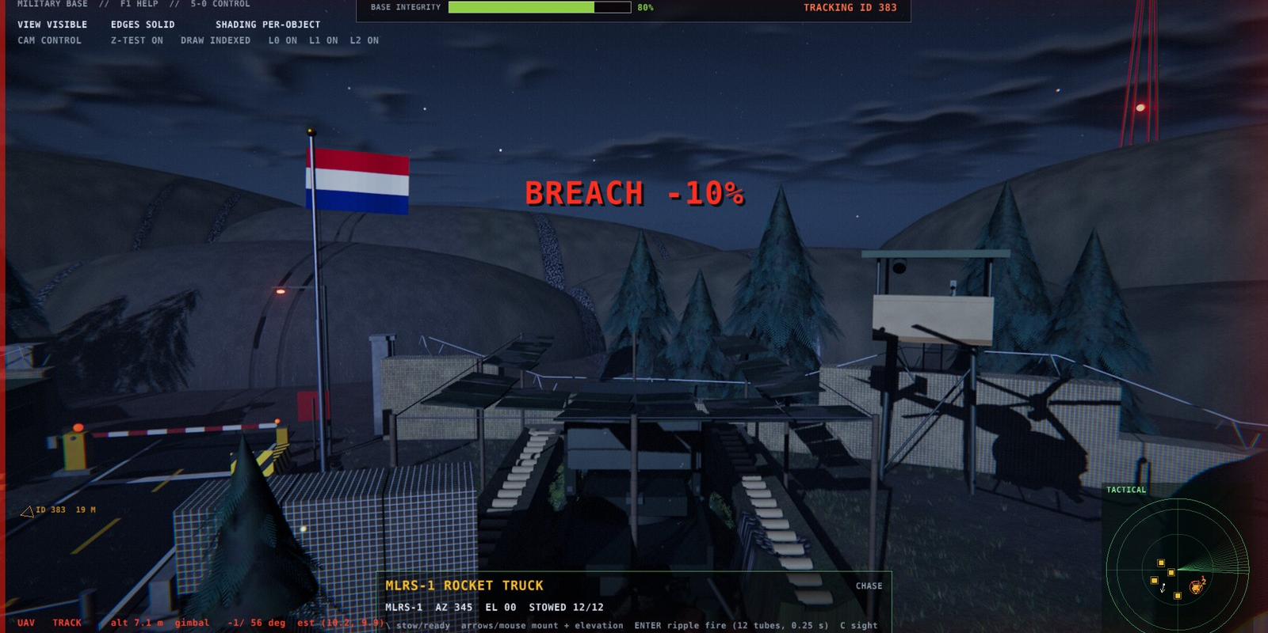
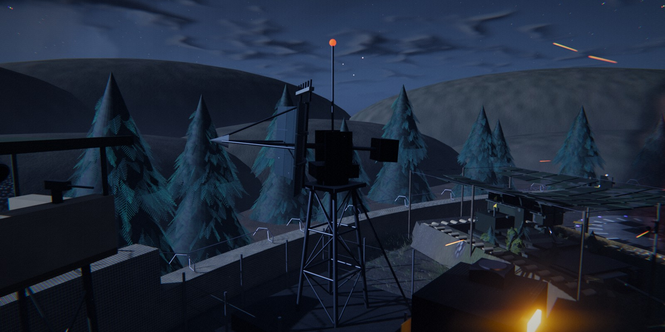
6 | CONTROL
Controllable objects and complex motion
Tank: 80 track links, turret
Helicopter: rotor flapping
SAM: turntable + canisters
Key map
5 tank 6 heli 7 AA gun 8 radar
9 doors 0 UAV [ ] SAM / MLRS / gate
F3 soldier Backspace release
WASD move arrows aim Enter fire
MLRS: 6x2 tube pod
Radar, AA gun, doors, barrier
18 possessable: 9 vehicles and devices + 8 soldiers + the SKY clock (v6)
Notes:
Nine vehicles and devices can be possessed with the number keys or the bracket keys: the UAV, tank, helicopter, AA gun, radar, blast doors, SAM launcher, MLRS truck and gate barrier. Each has real hierarchical motion: tank track links, rotor flapping with a spring-damper attitude, Gatling spin-up, a turntable with elevating canisters, eased sliding doors. With the eight soldiers and the sky clock from version six that makes 18. Backspace releases control.

Slide 7
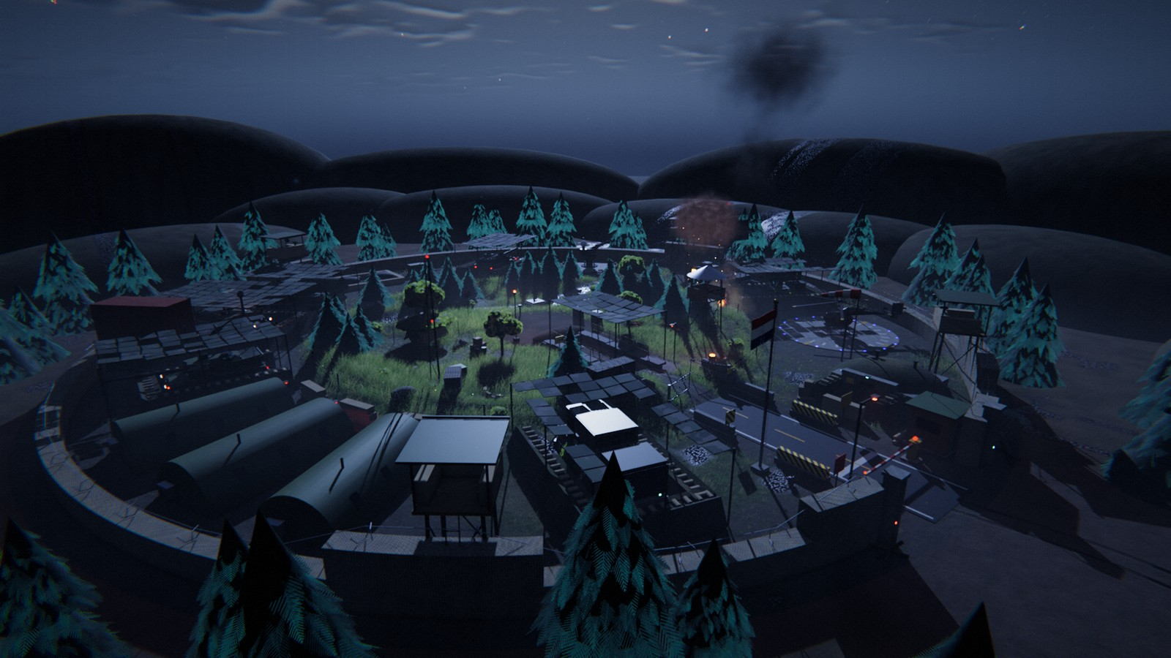
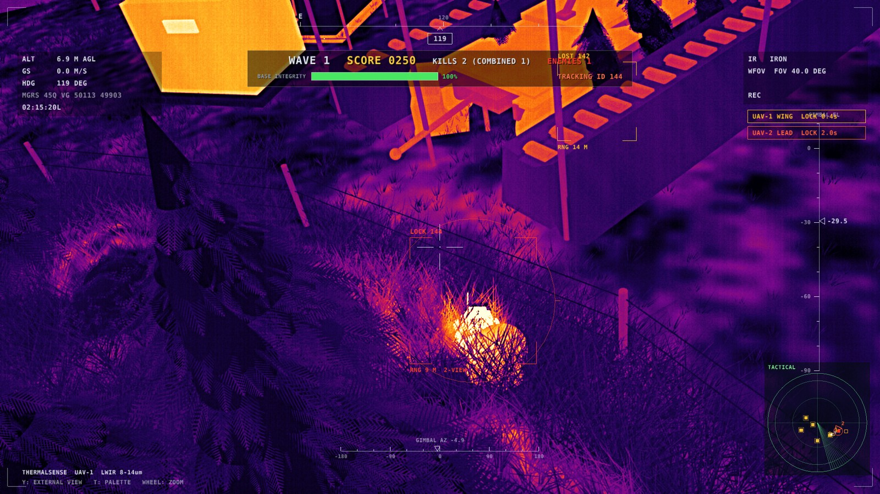
7 | RENDERING
Rendering pipeline
Visible: PBR, shadows, fog
Thermal sensor view
PBR GGX
Shadows
SSAO
Fog
TAA
SSR
Bloom
Thermal sensor
Notes:
The frame is rendered in linear light into an HDR target. GGX Cook-Torrance PBR is the base, with cascaded shadows, screen-space ambient occlusion, volumetric fog with light shafts, temporal anti-aliasing, screen-space reflections in puddles and bloom, finished by an ACES tone curve. The thermal view is a sensor model: automatic gain, noise, shimmer and a FLIR style HUD. The preset is chosen automatically, EPIC on the RTX 4070.

Slide 8
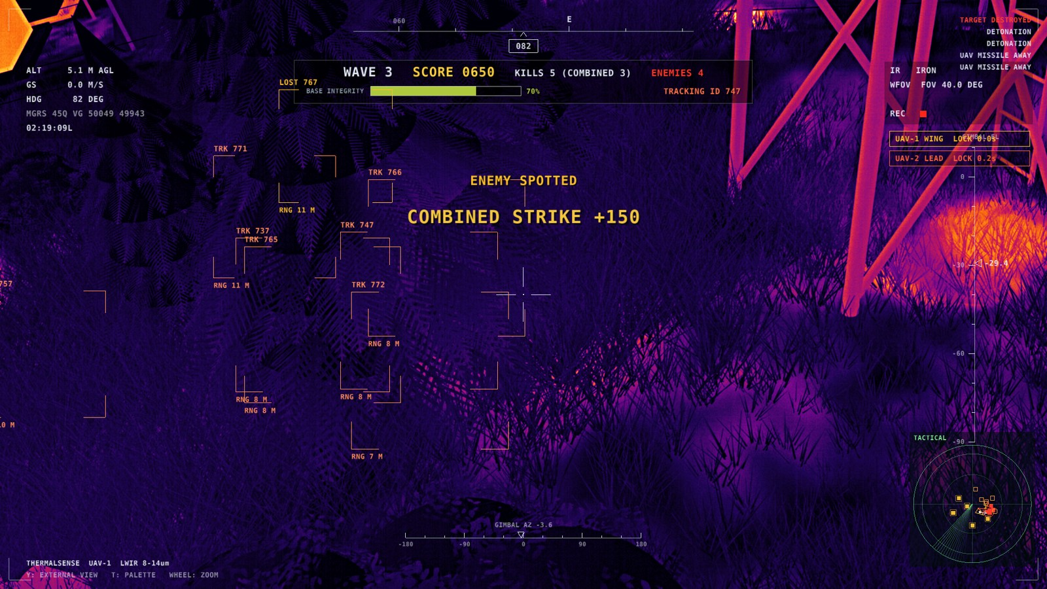
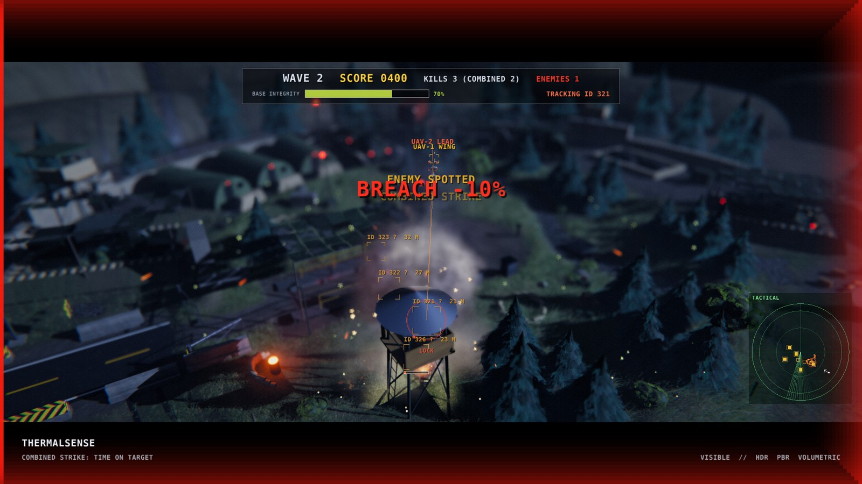
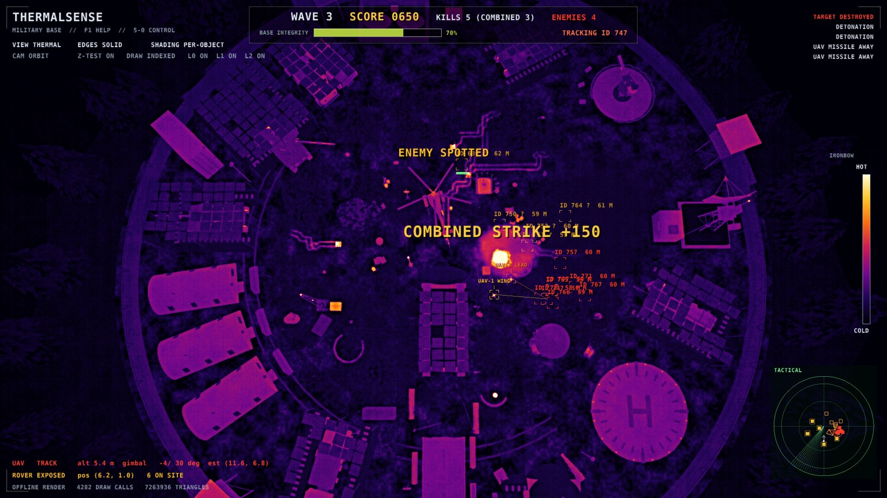
8 | SIMULATION
Autonomy and the game loop
CV tracks, IDs, LOCK
Combined strike
Tactical map / kill banner
2 UAVs
CV pipeline
Shared tracker
Two-view triangulation
thermal cameras
threshold, despeckle, union-find, moments
Kalman + Hungarian
ray midpoint
Lead / wing
Time-on-target
4-5 hits = 1 kill
Waves, score, base
roles, 90 deg geometry
combined strike
armoured rovers
integrity: the game loop
Rovers: MicroMouse flood fill on a cost map (distance + exposure + noise) so paths are random each wave
Notes:
Here is the game loop. Each of the two UAVs runs a computer vision pipeline on its own thermal image: threshold, despeckle, union-find connected components and moments. A shared Kalman and Hungarian tracker, with two-view triangulation, keeps IDs and velocities. The best-placed drone becomes lead, the other the wingman, and a time-on-target strike lands both rounds together. Four to five hits kill an armoured rover. Kills feed waves, score and base integrity.

Slide 9
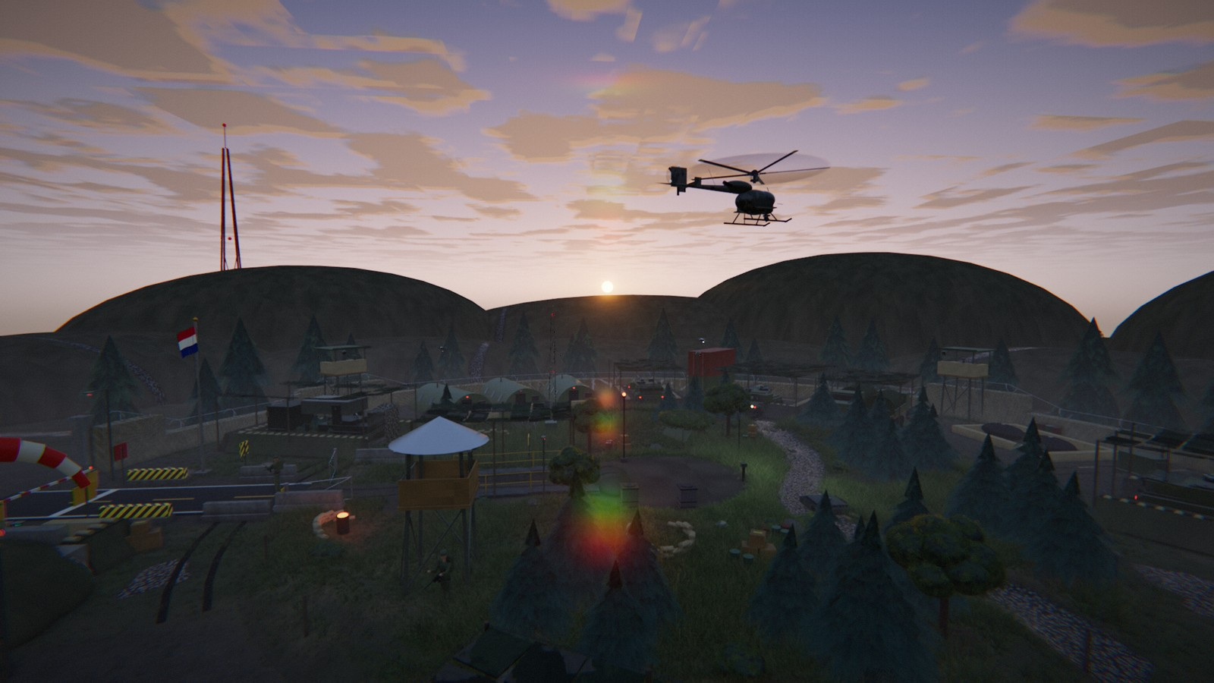
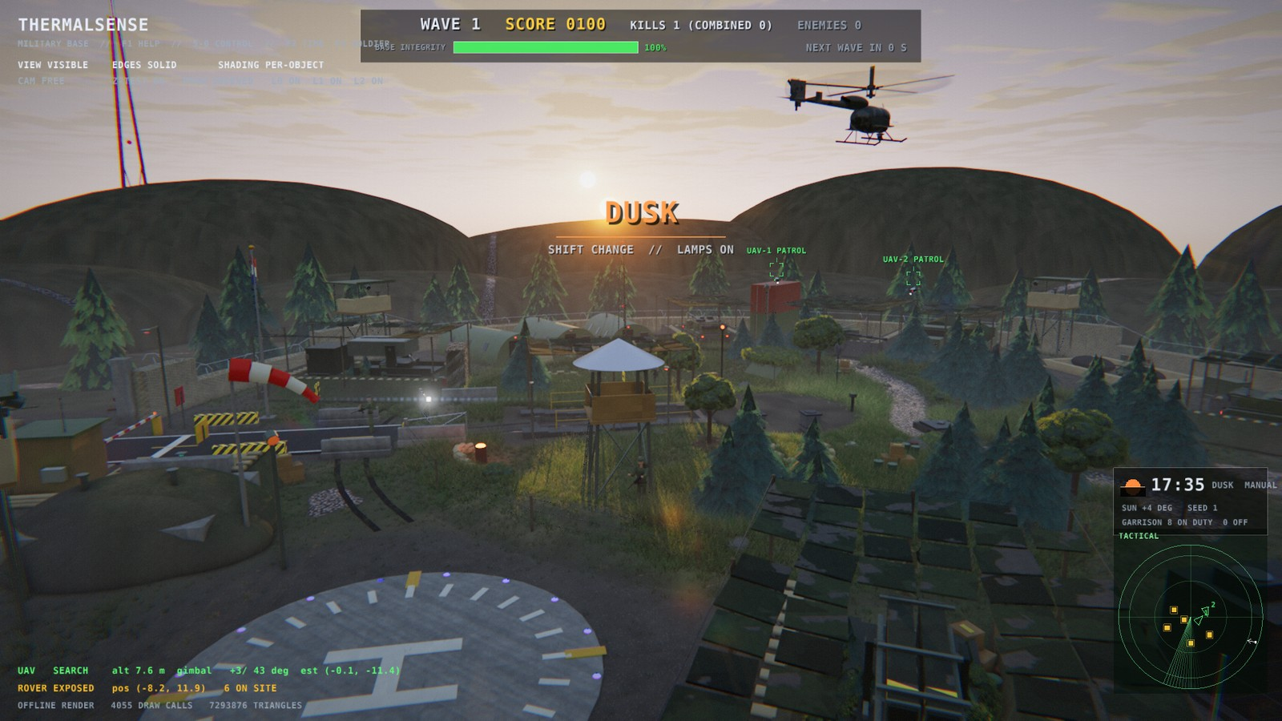
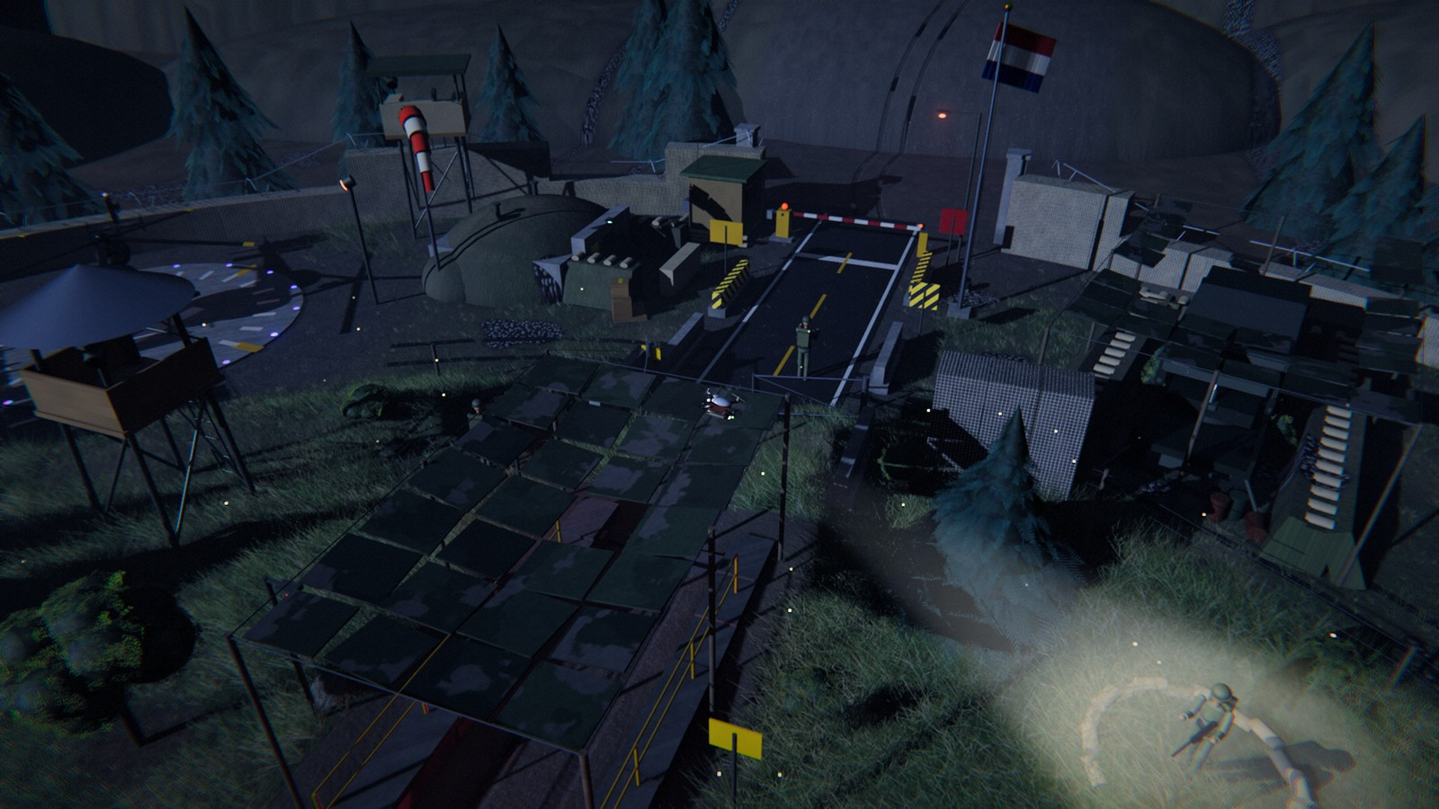
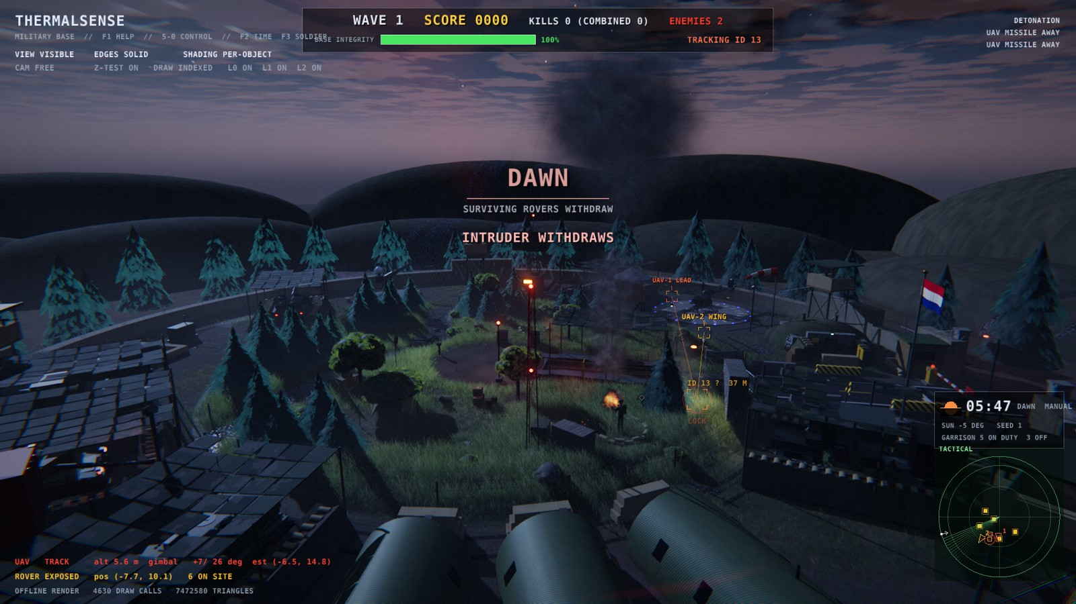
9 | V6 | TIME OF DAY
Day and night cycle
sin e = sin φ sin δ + cos φ cos δ cos H
φ = 22.8° δ = -4.6° H = 15° × (t − 12 h)
Key light: sun (e > −1°) or the v5 moon; night preset = v5 bit for bit
Lamps fade by day; searchlights below −2°; cloud shadows sweep the camp
F2 auto / manual , . scrub / next phase
06:08
17:52
62.6°
290 s
Sunset: air-mass reddened sun, twilight sky
sunrise
sunset
noon elevation
auto cycle
Day: UAVs patrol, no waves
Dusk: shift change
Night: searchlights, waves
Dawn: intruders withdraw
Notes:
Version six adds time. The sun position comes from the solar elevation formula at latitude 22.8 degrees: sunrise about 06:08, sunset 17:52. The key light switches between sun and moon, reddened through the air mass near the horizon; lamps fade out by day and searchlights only run at night. A drifting cloud layer also casts moving shadows. Intruders attack only at night and withdraw at dawn. F2, comma, period and slash control the clock.

Slide 10
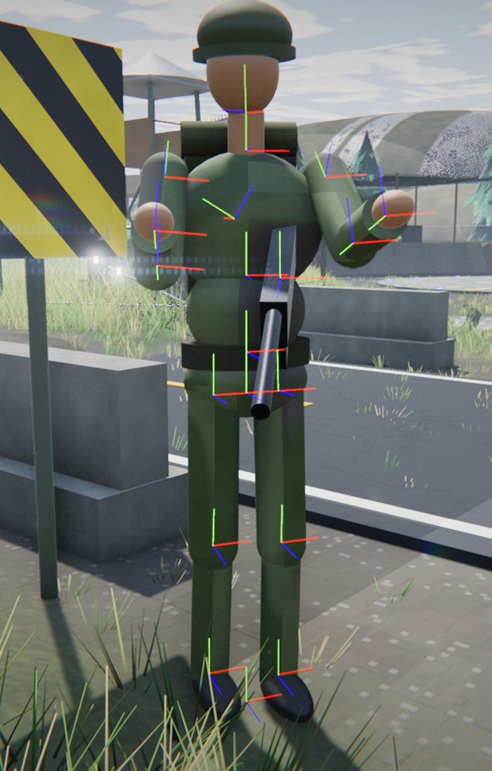
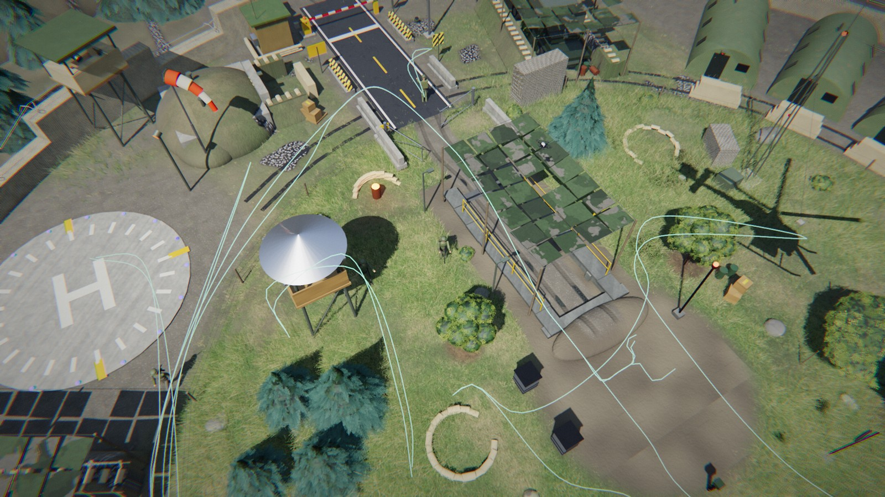
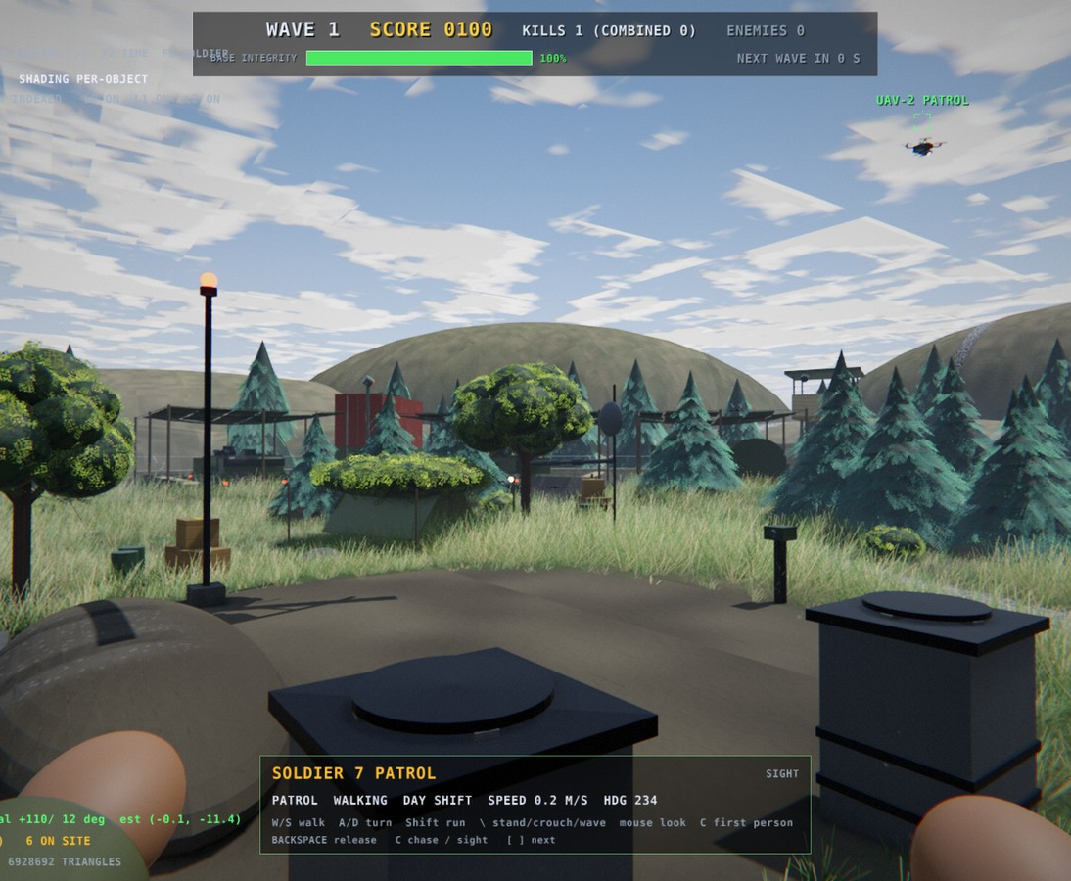
10 | V6 | GARRISON
Soldiers: Catmull-Rom paths and IK gait
8
75
soldiers
parts each
7
17
hierarchy levels
spline routes
Patrol splines through the camp
KEY FORMULAS
tᵢ₊₁ = tᵢ + |Pᵢ₊₁ − Pᵢ|^α, α = 0.5
v = v_max / (1 + 1.5 κ)
cos θ_knee = (a² + b² − d²) / 2ab
a = 0.46 m (thigh), b = 0.44 m (shin)
Planted stance foot, swing arc, arm swing
Shift change at dusk and daybreak
Joint frames of the hierarchy
F3: possessed soldier, first person
Notes:
Eight soldiers live on the base, each built from 75 primitives in a hierarchy seven levels deep. They walk centripetal Catmull-Rom splines, which never overshoot or loop, and slow down in tight bends. The gait is forward kinematics with two-link inverse kinematics for the legs, so the feet stay planted on the ground. By day they work on the tank, carry crates and patrol; at night some go off duty into the bunker. F3 possesses one.

Slide 11
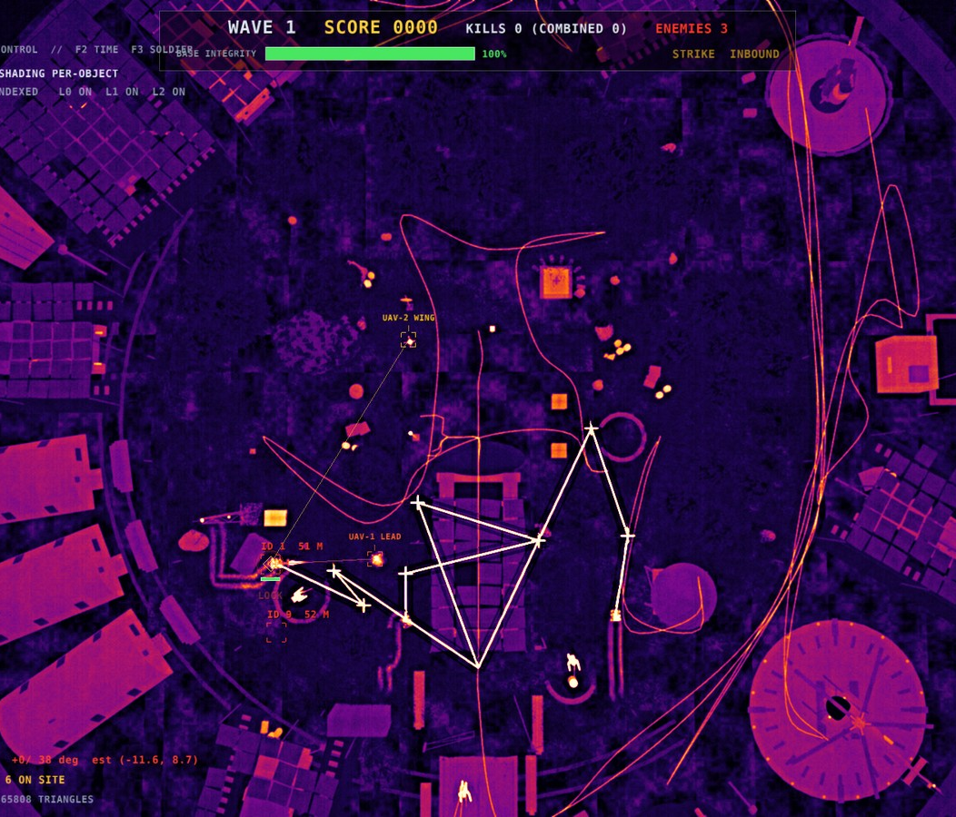
11 | V6 | INTRUDERS
Random rover routes
Spawn on a ring (±1.2 m), not within ±18° of the gate road
0-3 via points in a ±70° sector, radius 4-15 m
Objective switch with p = 0.3 after 8-22 s
Personality: speed 0.8-1.25, noise and exposure weights, pauses in cover
Seeded patrols for the UAVs too (seed 0 = the exact v5 run)
0
42 = 42
≠
spawns by day
seed 42 twice: identical
seed 43: other run
PER-ROVER PLANNER
cost = dist + w_e·exposure + w_n·noise
flood fill on cost, line follower on path
seed = deriveSeed(run seed, stream)
Planned routes on the thermal plan view
Notes:
Rover routes are no longer predictable. Each rover spawns on a jittered ring, picks up to three via points inside a seventy degree sector, and may switch objective mid-route. Each one has a personality: speed, noise and exposure weights for its MicroMouse cost map, and pauses in cover. Everything is seeded: the same seed gives a byte-identical six hundred second run, another seed a different one. No rover spawns by day.

Slide 12
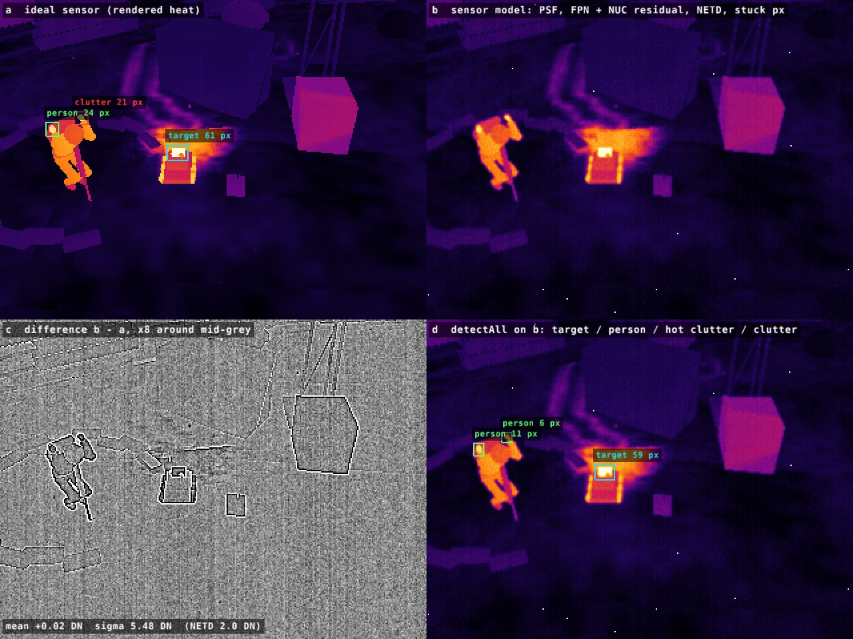
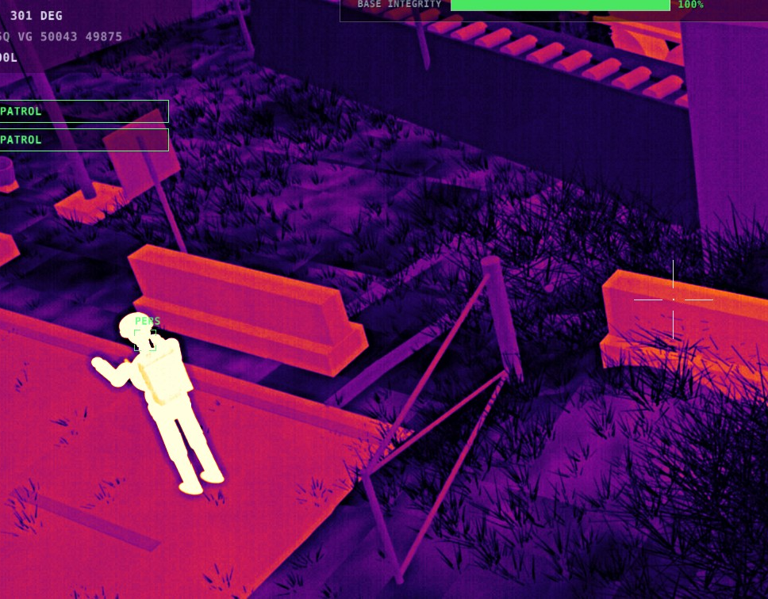
12 | V6 | VISION
Real computer vision under sensor noise
SENSOR MODEL
y = Q( g · (PSF * x) + o + c + n )
g, o fixed pattern c stripes n NETD 2.0 DN
0.990
0.938
1 %
P_d, distant rover
P_d at NETD 8 DN
frames dropped
Persons never become targets
Blind squad never fires
Ideal heat image | sensor model | difference ×5 | detectAll:
threshold max(0.80, Otsu) → components → target / person / clutter
Seeded: same seed, same noise
Day thermal: PERS bracket, not a target
Notes:
The vision is now real: each drone sees its rendered heat image through a sensor model with temporal noise, fixed-pattern gain and offset, column stripes, a blur kernel, stuck pixels, gimbal jitter and one percent dropped frames. Detection still works: probability 0.990 for a distant rover at the default noise. Warm soldiers are classified as persons and never targeted, and a squad that sees nothing never fires: no hidden true positions.

Slide 13
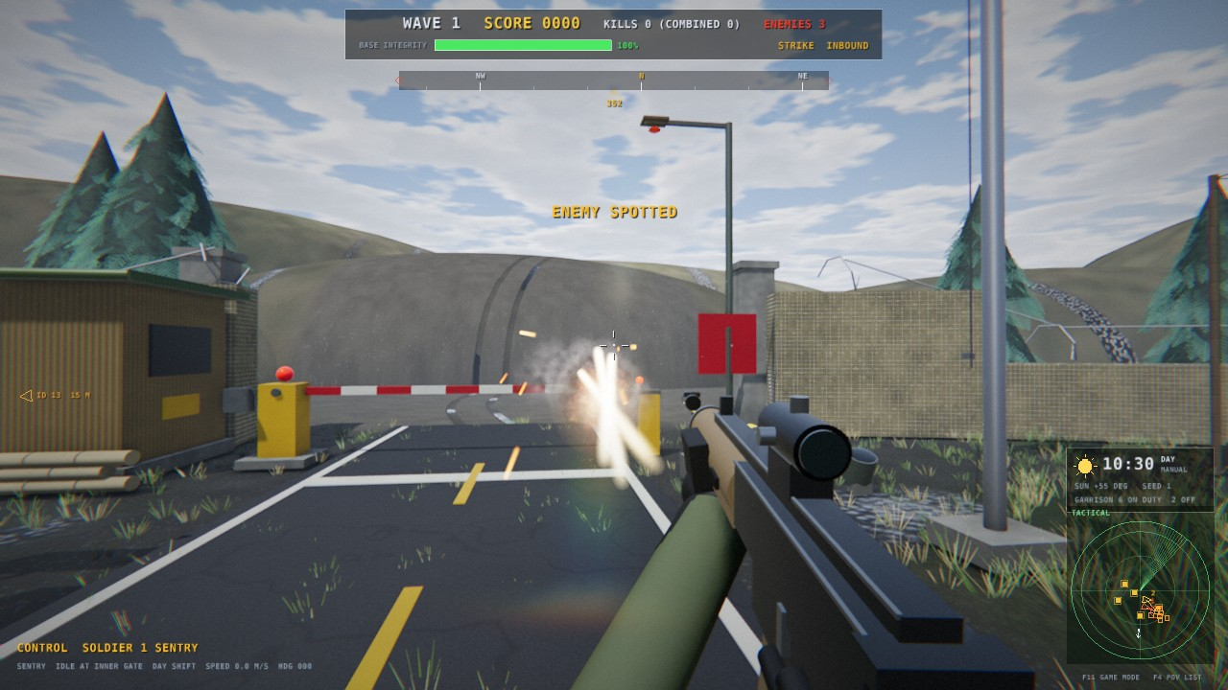
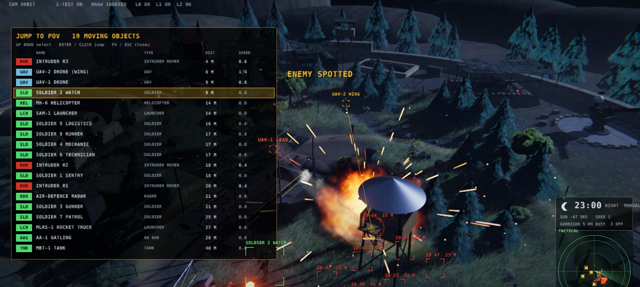
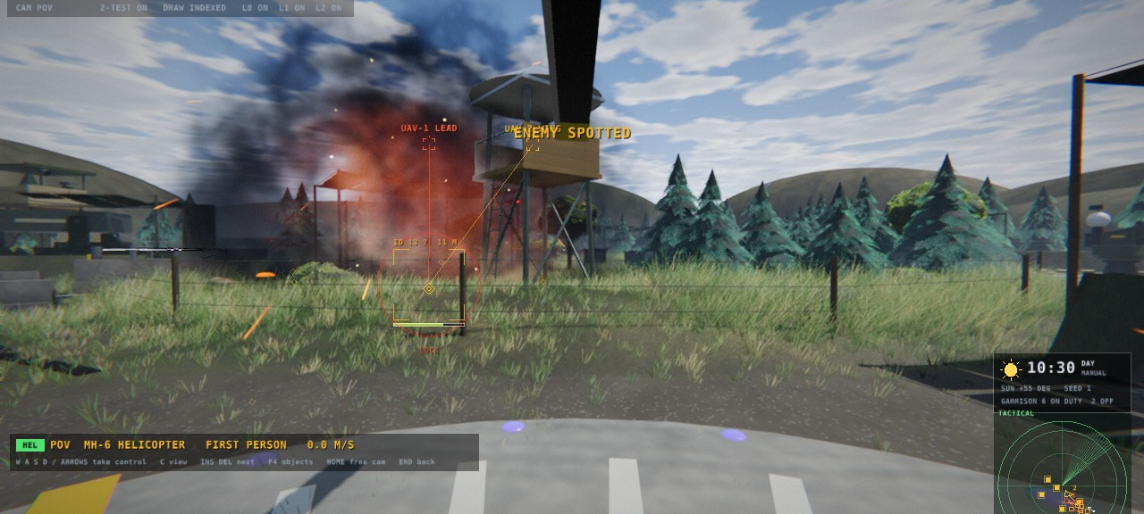
13 | V7 | PLAY
Game camera: jump into any point of view
F4: POV picker, every moving object
Soldier first person: rifle, tracers, game HUD (F11)
Helicopter cockpit
F4
Ins / Del
Middle click
Home / End
F11
L-Ctrl / L-Alt
POV picker
next / previous POV
jump into it
free fly / back
game mode HUD
soldier: fire / crouch
Notes:
Version seven makes it feel like a game. F4 opens a list of every moving object, sorted by distance, and the camera jumps into any of them with a critically damped spring blend. Insert and Delete cycle, a middle click jumps into whatever is under the cursor, and Home starts a free fly camera. Riding along, any drive key takes control: a soldier with a rifle, an intruder rover the drones still hunt, a drone or the helicopter.

Slide 14
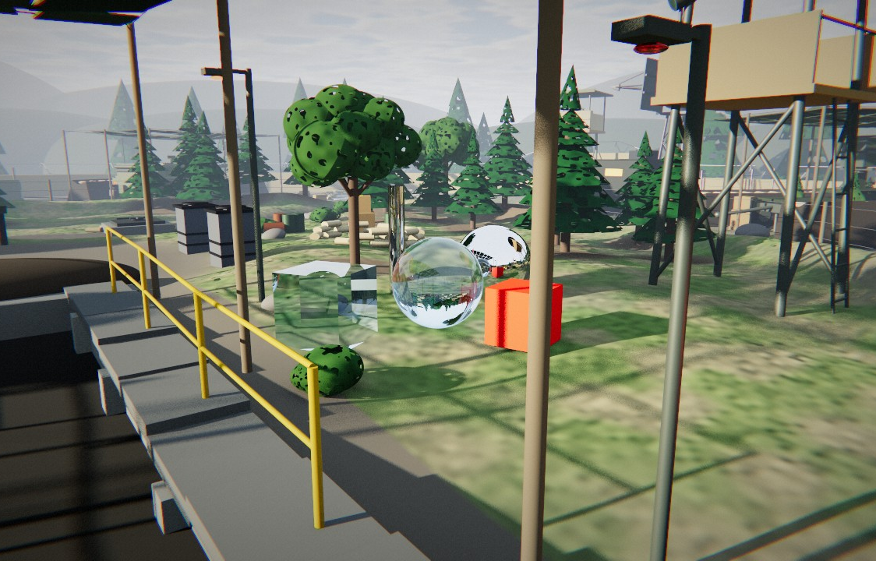

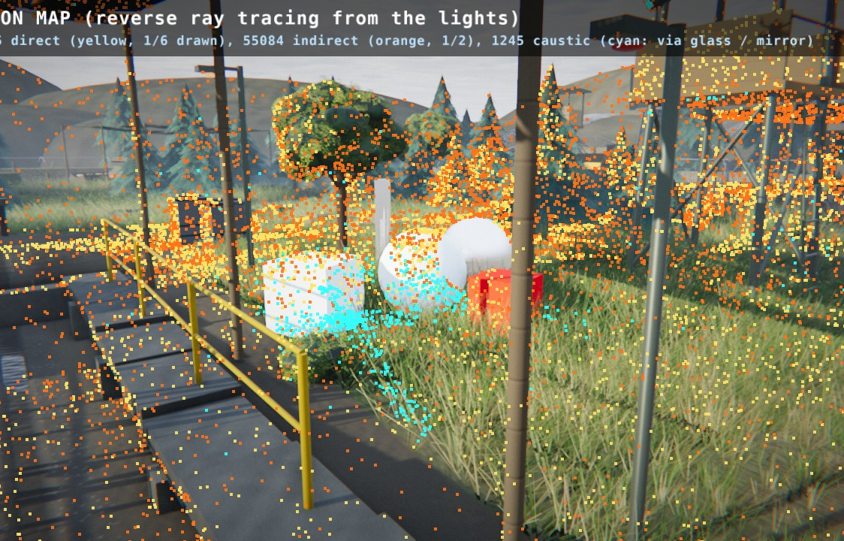
14 | V7 | RAY TRACING
Three ways to trace light
Whitted (recursive)
Path tracing
Light tracing (reverse)
Shadow rays, mirror reflection, Snell refraction with exact Fresnel
Next event estimation, cosine + GGX sampling, Russian roulette
256K paths / frame from sun, moon, searchlight, lamps
Converges softly while the camera is still
1 sample / frame, accumulated, à-trous denoise
Each vertex splatted to the camera: caustics (cyan)
η₁ sin θ₁ = η₂ sin θ₂
L = Le + ∫ f · L · cos θ dω
W = Npix / (A cos⁴ θ)
One scene, one BVH, exact intersectors: only spheres, boxes, cylinders and cones, no triangles.
Notes:
The semicolon key switches the renderer between raster, hybrid and three full ray tracers, all on the GPU in compute shaders. Whitted tracing is deterministic: shadow rays, mirror reflection and refraction with exact Fresnel. The path tracer solves the rendering equation by Monte Carlo sampling with next event estimation and a denoiser. Light tracing runs the other way: paths start at the lights and are splatted to the camera, which shows caustics.

Slide 15
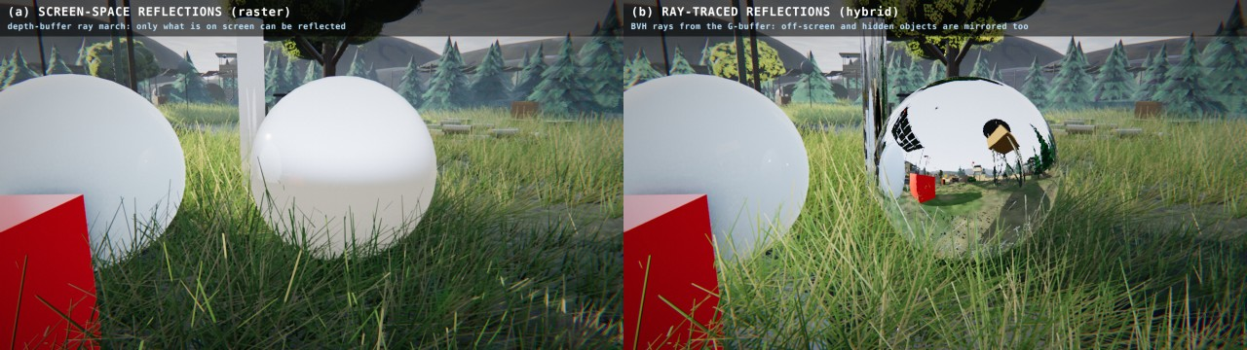
15 | V7 | RAY TRACING
BVH with the surface area heuristic
SAH SPLIT COST
BVH (SCHEMATIC)
C = C_trav + (A_L/A)·N_L·C_isect
+ (A_R/A)·N_R·C_isect
root
Exact unit shapes: ray to local space with M⁻¹, normal with M⁻ᵀ
node
node
Binned SAH, 16 bins; leaves of up to 16 primitives
Refit per frame (one reverse sweep); rebuild when the cost exceeds 1.6×
sphere
box
cylinder
cone
Terrain: 289² height field, 8×8-cell min/max blocks skip empty space
Hybrid mode: (a) screen-space reflection vs (b) BVH reflection rays
Flattened to SSBOs for the GLSL 4.30 compute tracer
~5.1k
~8.5k
61 ms
< 1 ms
primitives
BVH nodes
build, once
refit / frame
Notes:
Because the scene is built only from primitives, every part is traced exactly: the ray goes into the part's local space with the inverse matrix and meets a unit sphere, box, cylinder or cone. About five thousand primitives sit in a bounding volume hierarchy built with the surface area heuristic. Moving objects only refit the boxes each frame, under one millisecond. In hybrid mode these rays replace screen-space reflections, so off-screen objects appear in mirrors.

Slide 16
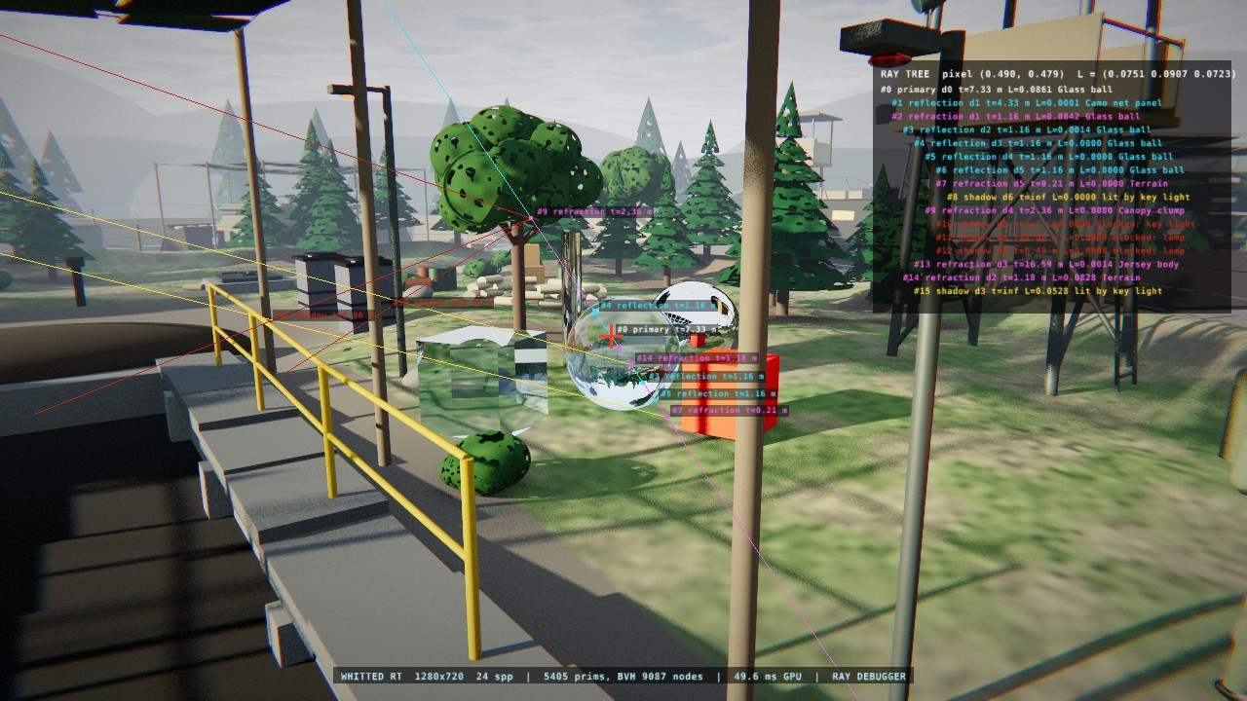
16 | V7 | RAY TRACING
Ray-tree debugger
RAY COLOURS
primary
shadow, lit
shadow, blocked
reflection
refraction
diffuse bounce
THIS PIXEL
#0 primary → glass ball
#1 reflection → camo net
#2 refraction → glass ball
#3-6 internal reflections
#8 shadow: lit by key light
' on, left click a pixel: rt::debugTrace re-traces it (Whitted, CPU) → 16 rays, depth 6; the tree stays in 3D while the camera moves
Notes:
To see what a ray tracer actually does, the apostrophe key turns on the ray debugger. Clicking a pixel re-traces it on the CPU with the same intersectors and draws its ray tree in 3D. Here a click on the glass ball gives 16 rays, 6 levels deep: the primary ray, a Fresnel reflection, refraction through the ball, internal reflections, and shadow rays that are lit or blocked. Each label shows depth, distance and contribution.

Slide 17
17 | V7 | RAY TRACING
Ray tracing timings on the RTX 4070
Mode (internal resolution)
Day
Night
RT pass
Frame time by day, ms (lower is faster)
Raster (v7, EPIC)
11.7 ms
12.7 ms
-
Raster
11.7
Hybrid RT (1280x720)
20.3 ms
20.5 ms
9.5-10 ms
Hybrid RT
20.3
Whitted (960x540)
25.7 ms
27.7 ms
20-22 ms
Whitted
25.7
Path (640x360, 1 spp)
21.9 ms
28.6 ms
18-24 ms
Path
21.9
Light (640x360, 256K paths)
39.0 ms
30.7 ms
26-33 ms
Light
39.0
Day 16:30, night 23:00. CPU fallback (TS_RT_CPU=1, 160x90): Whitted 60, path 144, light 238 ms
WP-Q: raster EPIC 157 → 11.7 ms (instancing, grass fix, async readback)
Entry-distance BVH stack, smaller stacks: Whitted 49 → 34 ms
Hybrid adds ~10 ms of rays on top of the raster frame
Source: report/figures_v7/raytrace_perf.json (CAP), RTX 4070 via Mesa d3d12, 1280x720 output, EPIC, wall clock with glFinish
Notes:
These are the measured frame times on the RTX 4070 through the WSL Direct3D 12 path at 720p output. The full ray tracers run at reduced internal resolution and are fast: Whitted about 29 milliseconds, path tracing 27, light tracing 45 by day. Surprisingly the raster EPIC frame is the slow one on this driver path, about 155 milliseconds, and hybrid inherits it; the ray-traced pass itself adds only 14 to 21.

Slide 18
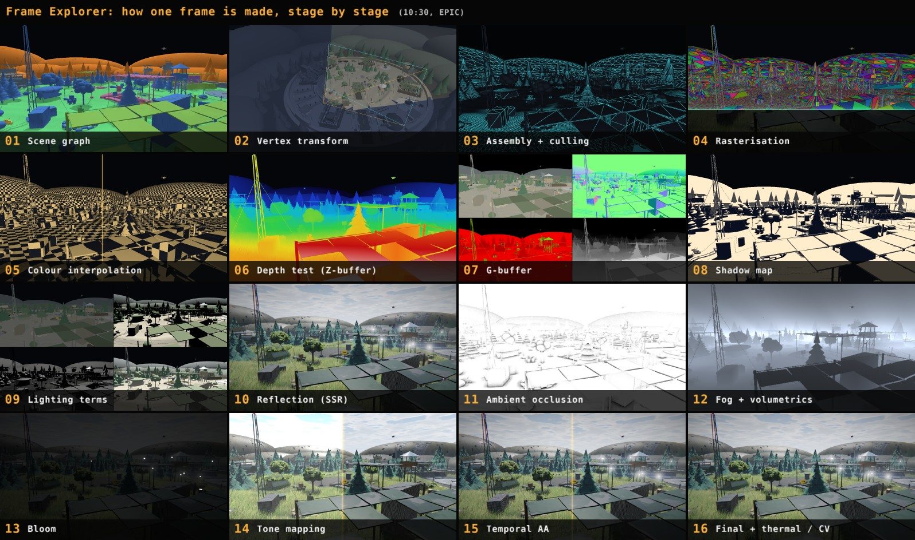
18 | V7 | FRAME EXPLORER
Frame Explorer: one frame, 16 stages
01
Scene graph
09
Lighting
02
Vertex transform
10
Reflection
03
Assembly + culling
11
SSAO
04
Rasterisation
12
Fog
05
Colour interpolation
13
Bloom
06
Depth test
14
Tone mapping
07
G-buffer
15
TAA
08
Shadow map
16
Final + CV
INSIDE THE EXPLORER
← → stage ↑ ↓ layer 1-0 jump
W wipe M magnifier I inspector
P image lab Space play ` / Esc close
` freezes the frame: 8 TAA frames + 7 variants (SSR / SSAO / fog off, Blinn-Phong, TAA off, thermal, raw heat) through the real renderer
Notes:
The backtick key freezes the current frame and replays how it was made, in sixteen stages, from the scene graph to the final thermal and computer vision view. Every stage is a real buffer of that frame, with a caption, the key formula and a probe pixel that every card follows. Arrows step through stages and layers, W wipes against the previous stage, I inspects a pixel in every buffer, and P opens an image processing lab.

Slide 19
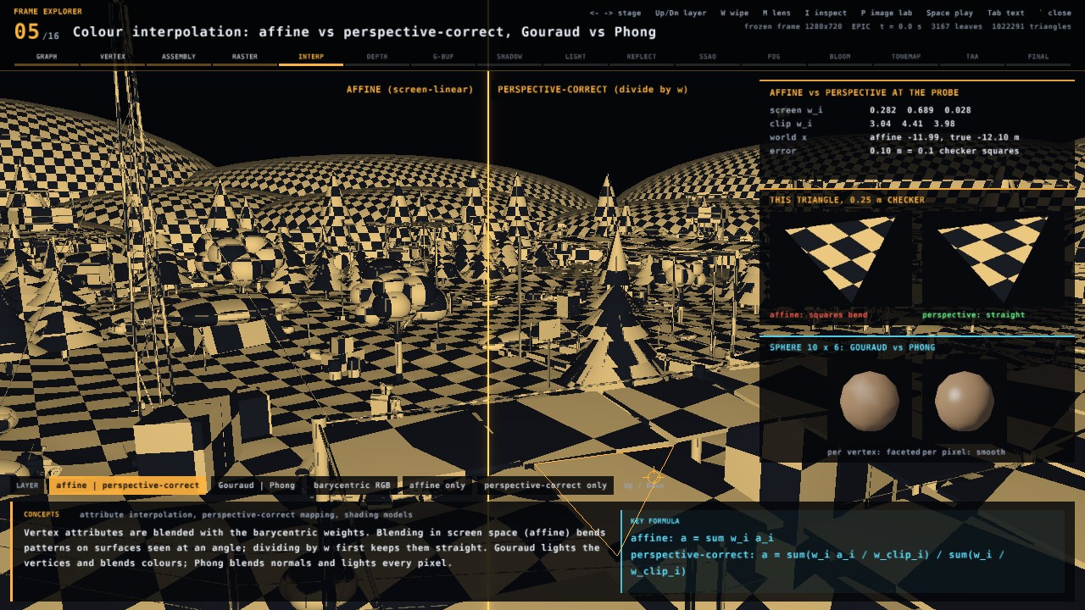
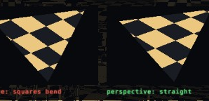
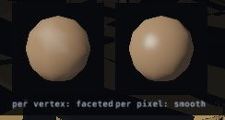
19 | V7 | FRAME EXPLORER
Colour interpolation: affine vs perspective
Probe triangle: affine bends, perspective is straight
Coarse sphere: Gouraud vs Phong
λᵢ = Eᵢ(p) / (E₀ + E₁ + E₂) affine: a = Σ λᵢ aᵢ
perspective-correct: a = Σ (λᵢ aᵢ / wᵢ) / Σ (λᵢ / wᵢ)
Notes:
Stage five shows colour interpolation, the heart of rasterisation. A checkerboard on every surface makes the difference visible: blending vertex attributes linearly in screen space bends the squares, while dividing by w before blending and multiplying back keeps them straight. The cards zoom into one probe triangle, and a coarse sphere compares Gouraud, which lights the vertices, with Phong, which lights every pixel.

Slide 20
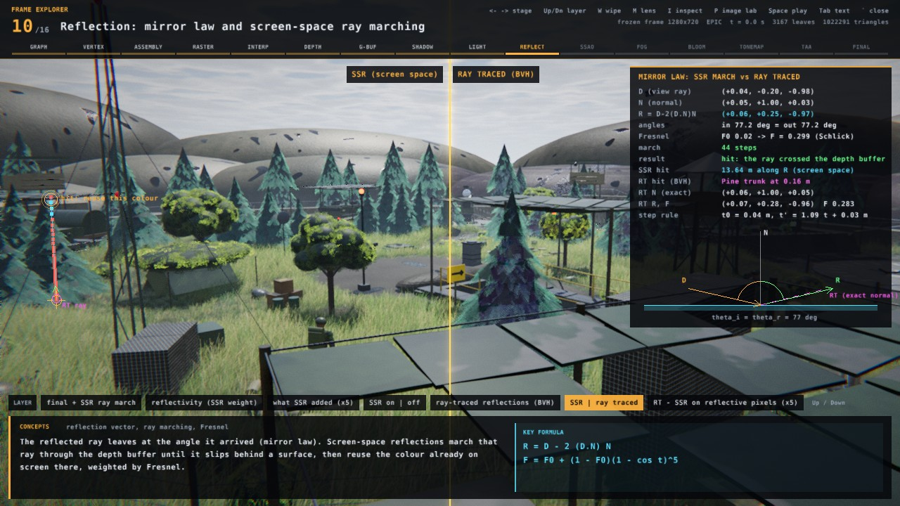
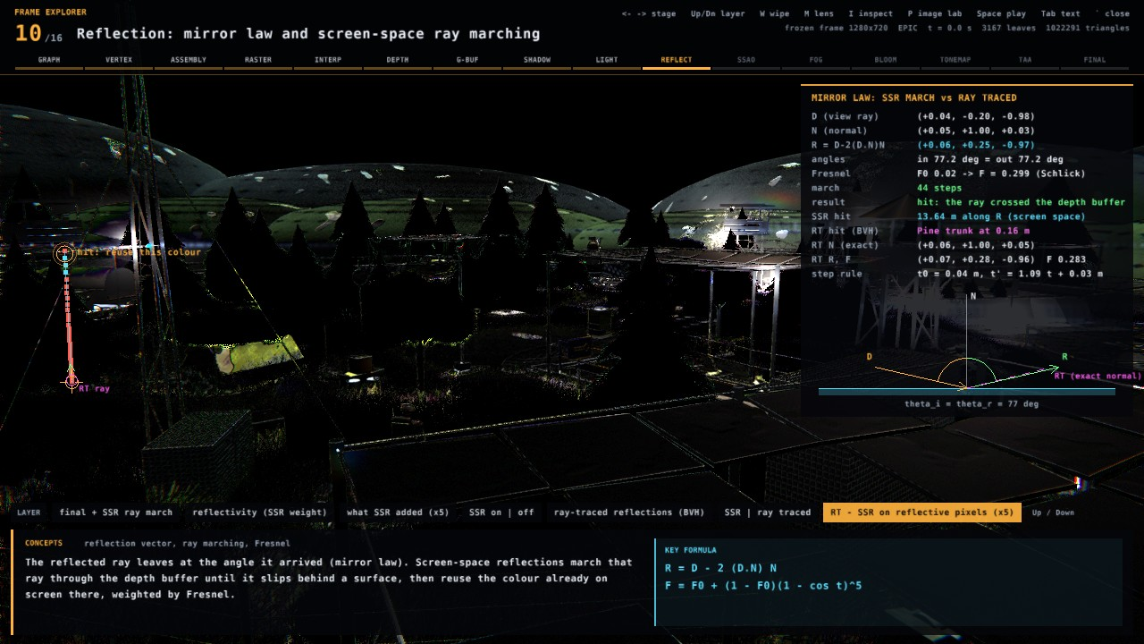
20 | V7 | FRAME EXPLORER
Reflection: screen-space vs ray traced
RT − SSR on reflective pixels (×5)
SSR (screen space)
Marches the depth buffer; reuses on-screen colour; blind off-screen
Ray traced (BVH)
Hybrid G-buffer + BVH rays; finds off-screen and hidden objects
R = D − 2 (D·N) N F = F₀ + (1 − F₀)(1 − cos θ)⁵ (Schlick)
Notes:
Stage ten explains reflection. The reflected ray leaves at the angle it arrived. Screen-space reflection marches that ray through the depth buffer and reuses colour already on screen, so it is cheap but cannot see anything off-screen or hidden. The same frame with ray-traced reflections follows the ray through the BVH instead. The split view and the difference image show exactly where the two disagree.

Slide 21
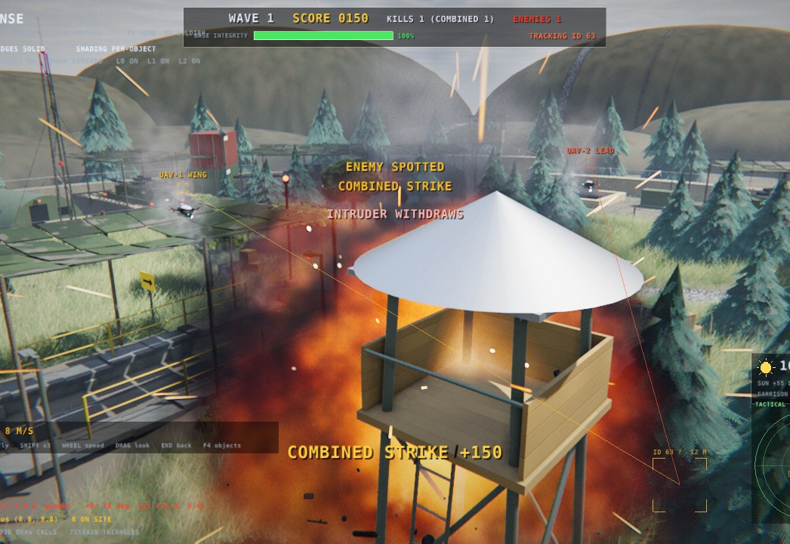
21 | RESULTS
Testing and results
289 / 289
5,414
18
5 + 16
automated tests pass
primitive leaves
possessable objects
render modes + explorer stages
600 s traces: seed 42 twice byte-identical, seed 43 differs
0 spawns by day; every kill from a vision-designated round
Night regression matches v5 (static shots MAE 0.4-5.8 / 255)
Raster 11.7 ms; ray traced: Whitted 25.7 ms, path 21.9 ms on the RTX 4070
Workbook verify PASS; Windows exe + WSLg build, no sudo
Free camera over a combined strike (+150)
Notes:
Results. All 289 automated tests pass, covering primitives, vision, tracking, soldiers, the day cycle, the game camera, ray tracing and the explorer. Six hundred second traces are deterministic per seed, no rover spawns by day, and every kill comes from a round aimed at a vision track. The night preset still matches the version five figures. The Windows executable and the WSL window both build without administrator rights.

Slide 22
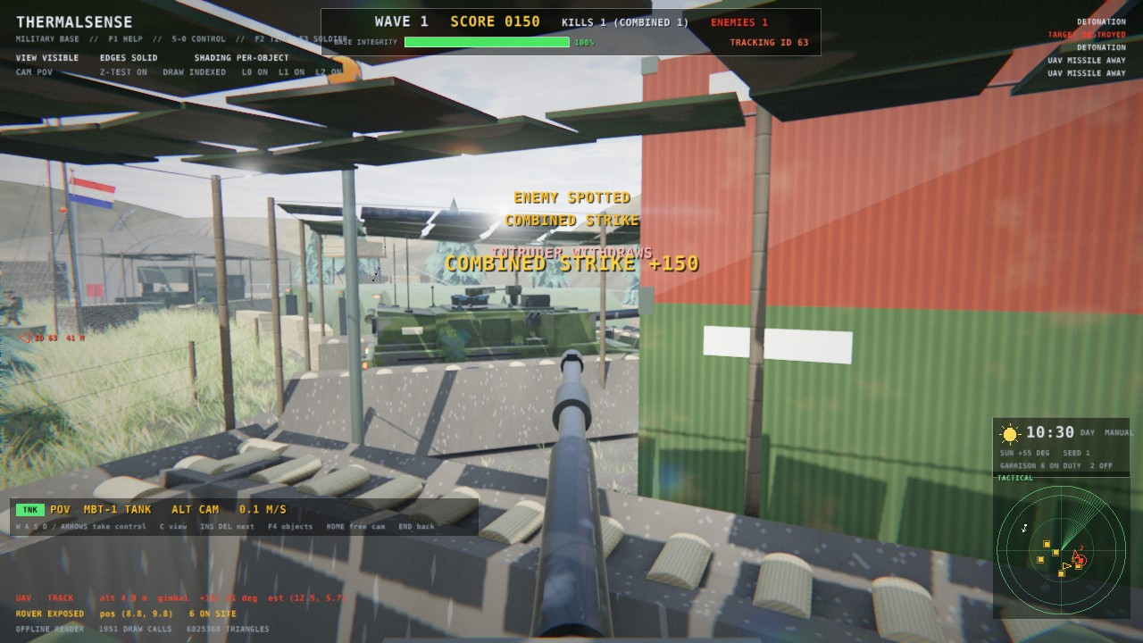
22 | DEMONSTRATION, 2.5 MINUTES
Demo video
TODO: record report/demo_v7.mp4
./ThermalSense --headless --quality epic --record report/demo_v7.mp4 150
v7 director cut: 23 segments, ~150 s, procedural sound; this slide embeds the file once it exists
Notes:
And now the demonstration, recorded in the program itself with its procedural sound. The version seven director cut runs about two and a half minutes: the night attack and combined strike, dawn, the soldiers by day, jumps into a soldier, a rover, a drone and a missile, the five render modes with the ray debugger, and the Frame Explorer stepping through a frame. Thank you; questions are welcome afterwards.

