Slide 1
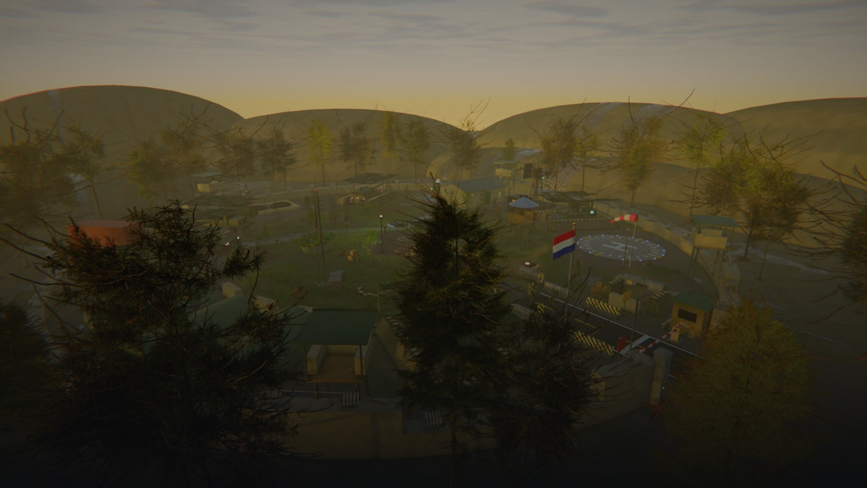
ThermalSense
3D Graphics Pipeline & Autonomous Outpost Simulation
Md. Shakhoyat Rahman Shujon | Roll 2107104
Computer Graphics Laboratory (CSE 4102)
Khulna University of Engineering & Technology (KUET)
11 October 2026
1 / 10
Notes:
ThermalSense: a military outpost renderer and simulation for Computer Graphics Laboratory, CSE 4102, written in C++17 and OpenGL 3.3 core.

Slide 2
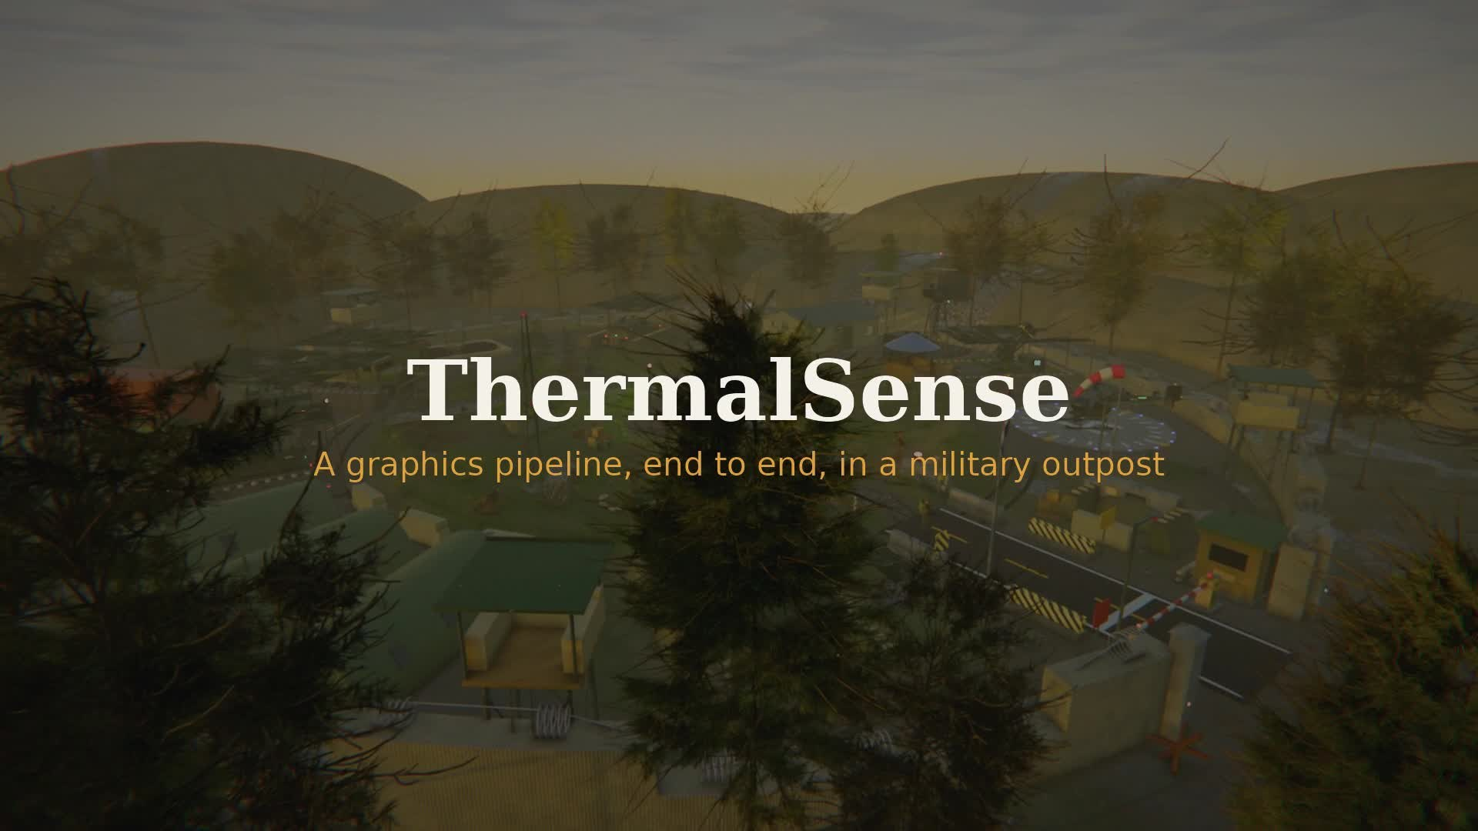
Project Showcase Film | 3 min 38 s (1080p Full HD · Audio)
11 October 2026
2 / 10
Notes:
The project showcase film in 1080p with full soundtrack, 3 minutes 38 seconds.

Slide 3
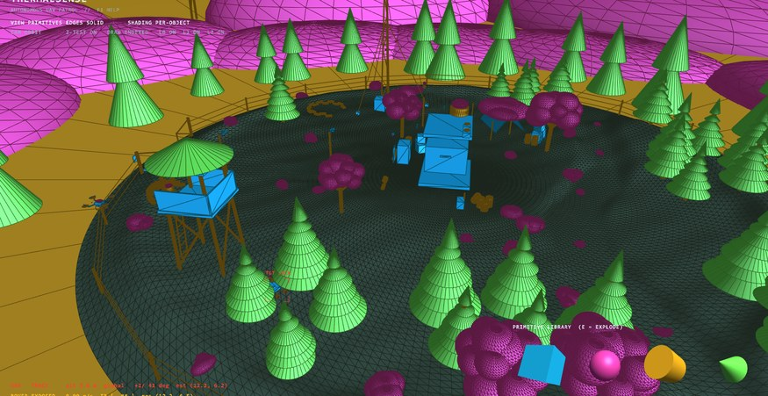
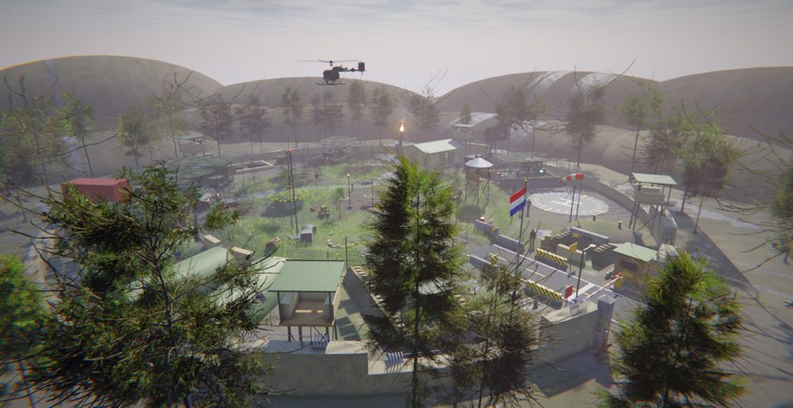
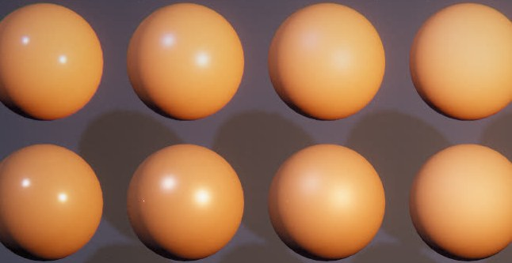
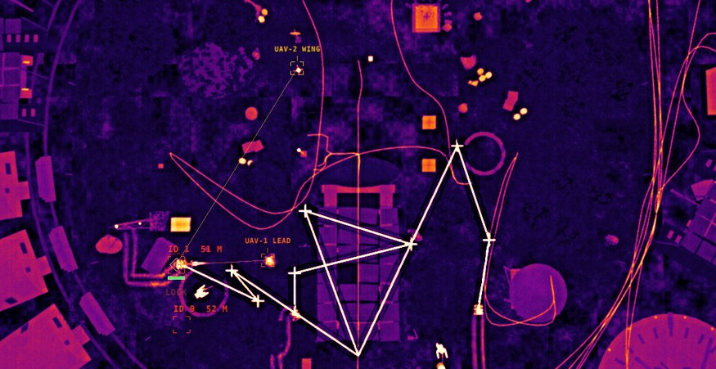
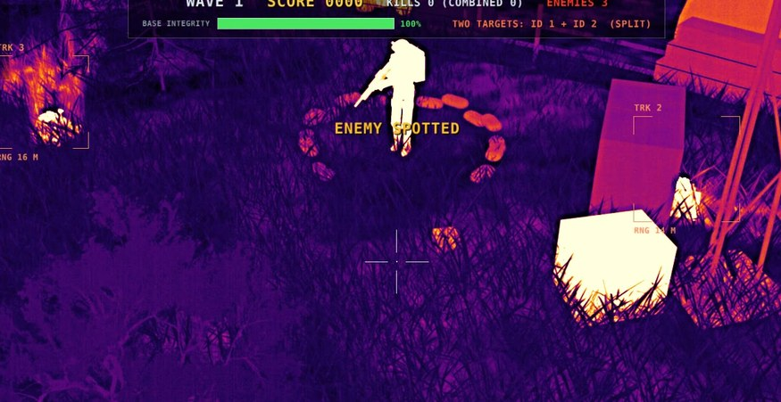
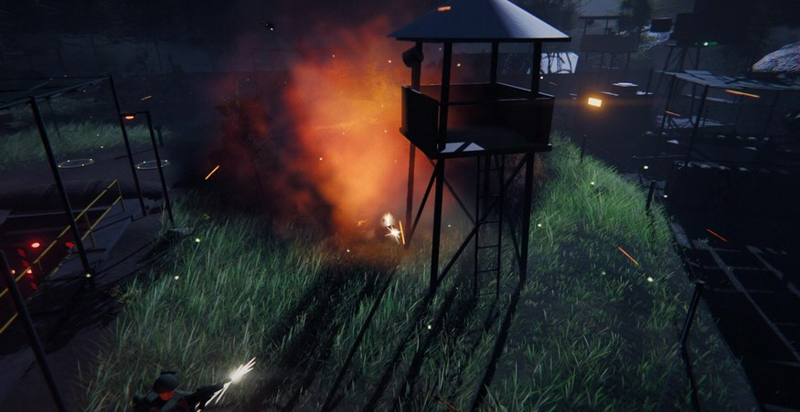
3 | CONTENTS
Presentation Overview
04
Graphics Pipeline
05
Project Scale
06
Custom Shading
07
Autonomous Routing
08
Real-Time Tracking
09
Combat & Vehicles
11 October 2026
3 / 10
Notes:
Six core modules: graphics pipeline architecture, project scale, custom illumination, autonomous rover routing, real-time computer vision, and interactive vehicle combat.

Slide 4
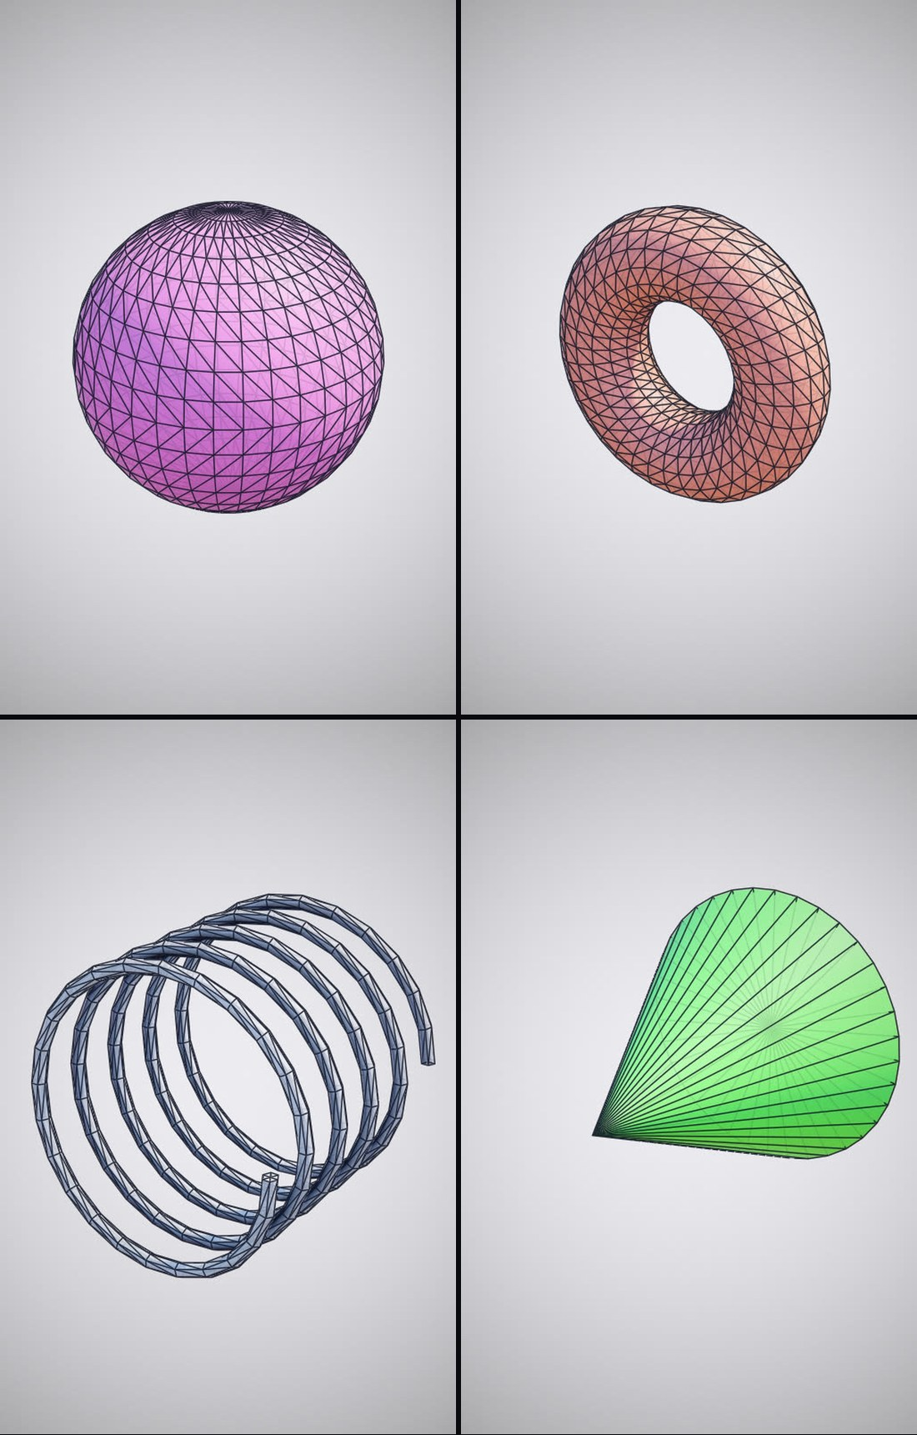
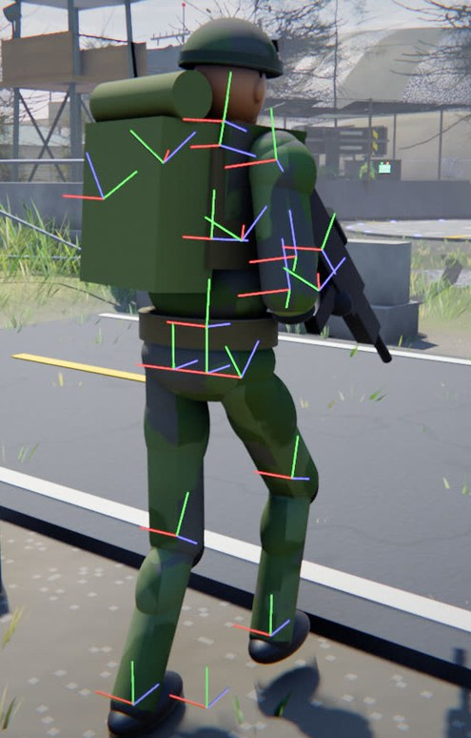

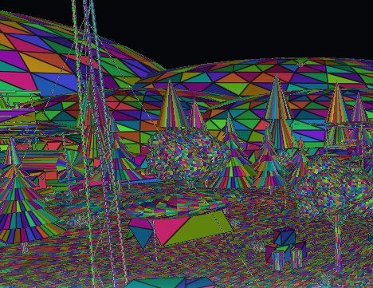
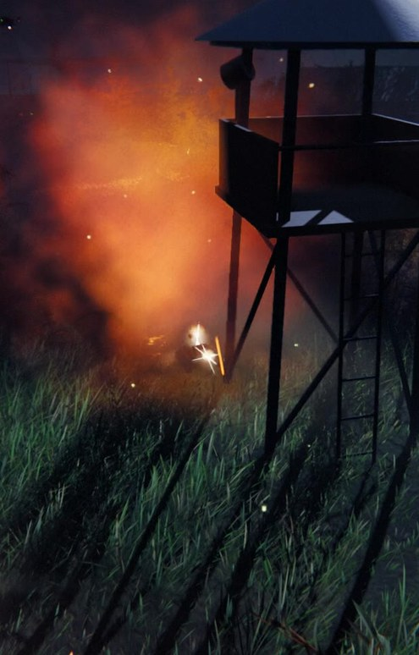
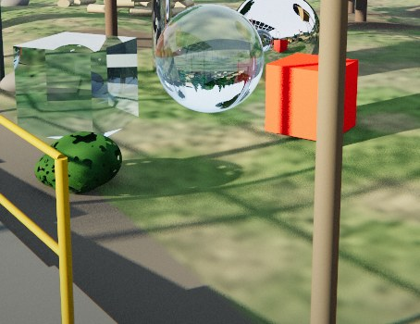
4 | END-TO-END FLOW
Graphics Pipeline Architecture
1
2
3
4
5
3D Primitives
16 procedural shapes
Scene Graph
Hierarchical transforms
Custom Shading
Hand-coded vector math
Render Modes
Raster & ray tracing
Post-Effects
Bloom, fog & tonemapping
Zero external math libraries | 905 hand-written math calls in shaders | Pure C++17 & OpenGL 3.3 Core
11 October 2026
4 / 10
Notes:
The graphics pipeline from scratch: procedural primitives, hierarchical scene transforms, hand-crafted vector illumination, raster and compute ray tracing, and post-processing filters.

Slide 5
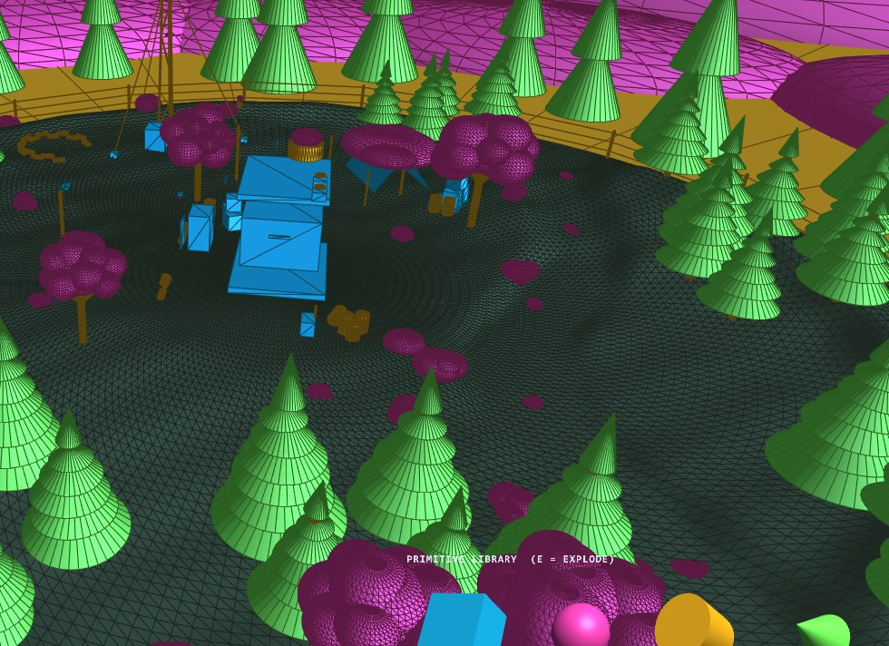
5 | IMPLEMENTATION SCALE
Project Scale & Key Metrics
System Component | Specification
Procedural Primitives | 16 generators in C++
Modular 3D Models | 62 unique designs
Scene Complexity | 5,474 rendered parts
Custom Math Invocations | 905 calls in 13 shaders
Automated Test Suite | 396 unit tests passing
Technical Report | 192 comprehensive pages
Showcase Video | 3 min 38 s (1080p)
Primary Pipeline | C++17 & OpenGL 3.3 Core
Compute Ray Tracer | OpenGL 4.3 Compute
External Math Libraries | None (100% custom)
Exploded 3D outpost geometry classified by primitive shape
11 October 2026
5 / 10
Notes:
Summary metrics: 16 primitive generators, 62 modular designs, 5,474 rendered scene parts, 905 custom shader math calls, 396 unit tests, and a 192-page comprehensive report.

Slide 6




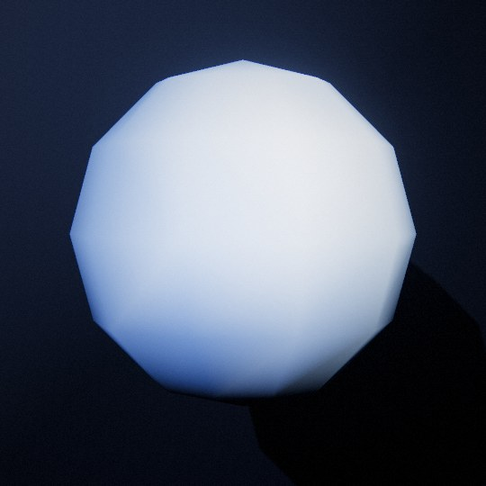
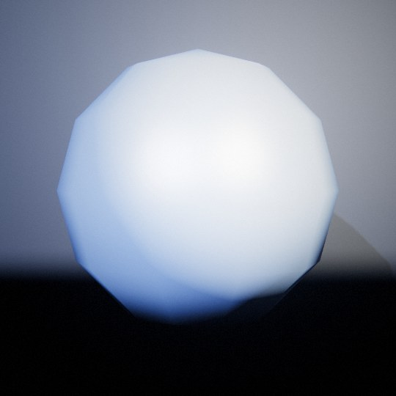
6 | LIGHTING MODELS
Illumination & Shading by Hand
HAND-WRITTEN VECTOR MATH
tsDot tsLength
tsNormalize tsCross
tsReflect tsRefract
tsMix tsClamp
tsStep tsSmoothstep
905 calls in 13 shaders
Flat one normal per face
Gouraud vertex interpolation
Phong per-pixel evaluation
Refusal of GLSL built-ins
11 October 2026
6 / 10
Notes:
Hand-crafted illumination: Blinn-Phong specular evaluation with half-vector optimization. Comparison across Flat, Gouraud, and Phong shading models with custom vector operations.

Slide 7
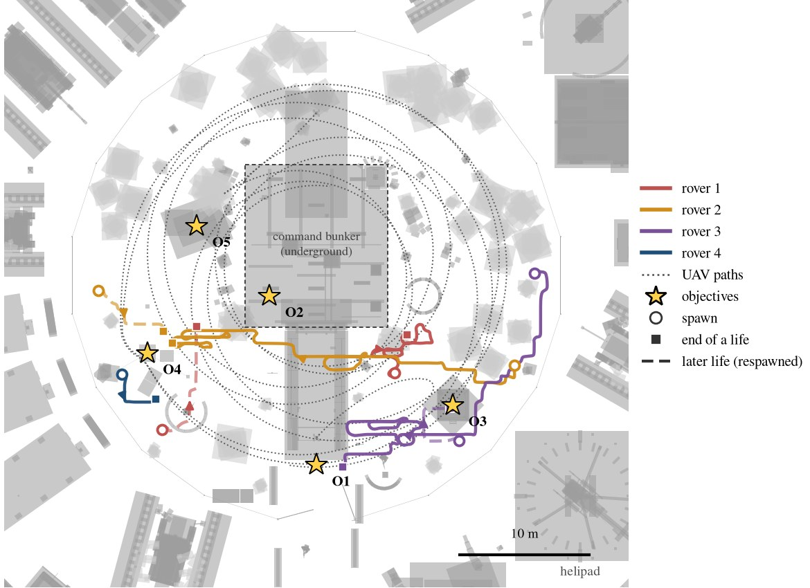
7 | SEARCH & CONTROL
Autonomous Rover Path Planning
1 Safe Zones
BFS flood fill
2 Route Search
Dijkstra cost map
3 Trajectory
5-sensor PD control
Algorithm | Role in Engine | Time | Space
Flood Fill | Safe distance transform | O(N) | O(N)
Dijkstra | Exposure-weighted path | O(N log N) | O(N)
Gradient Descent | Waypoint trajectory | O(L) | O(L)
Line Follower | 5-sensor wheel control | O(M) | O(M)
Grid: 80 × 80 cells (0.5 m); evaluated in real time
Dynamic re-planning: 0.4 s evasive, 1.6 s patrol
PD steering controller: Kp = 3.2, Kd = 0.25
Multi-agent routing: 4 rovers evading dual UAVs (uncrewed aerial vehicles)
11 October 2026
7 / 10
Notes:
Autonomous rover navigation: BFS flood fill computes safe-zone distance transforms, Dijkstra solves visibility-weighted routes, and a 5-sensor PD controller guides steering.

Slide 8
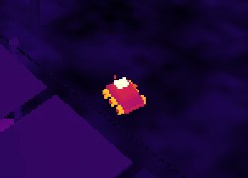

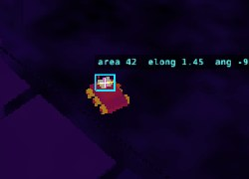
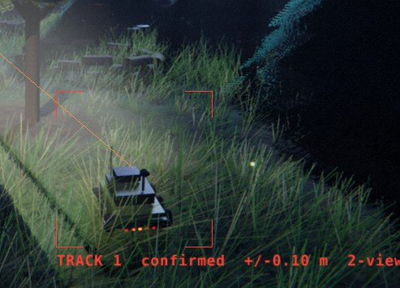
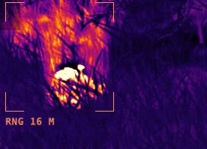
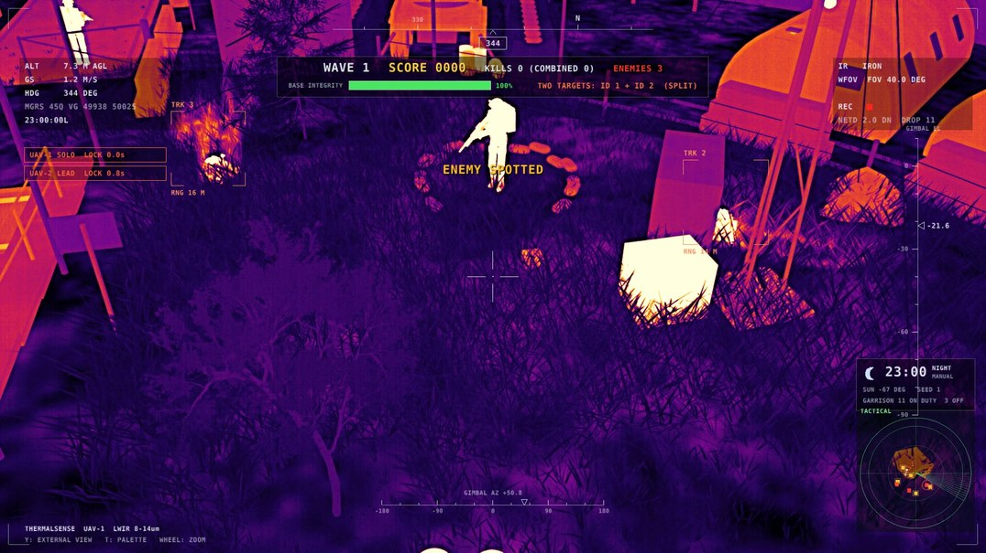
8 | TARGET DETECTION & TRACKING
Real-Time Thermal Vision Pipeline
1
2
3
4
5
Thermal Feed
320 × 240 IR image
Segmentation
Otsu threshold (204)
Blob Extraction
Two-pass union-find
Kalman Filter
State & velocity filter
Target Lock
Gated Hungarian association
Pipeline Stage | Method | Cost
Threshold & Despeckle | Histogram + 3 × 3 filter | O(P)
Connected Components | Two-pass union-find | ≈ O(P)
Kalman Filtering | State (x, z, vx, vz) per track | O(T)
Data Association | Gated Hungarian (χ² = 9.21) | O(n³)
Benchmark Runtime | Both UAVs on worker thread | 2.9 ms
FLIR thermal camera view with automated tracking locks
P = 76,800 pixels/frame; T active tracks; n targets
11 October 2026
8 / 10
Notes:
Real-time thermal vision pipeline: Otsu segmentation, union-find blob extraction, Kalman state estimation, and gated Hungarian tracking running under 2.9 ms per frame.

Slide 9

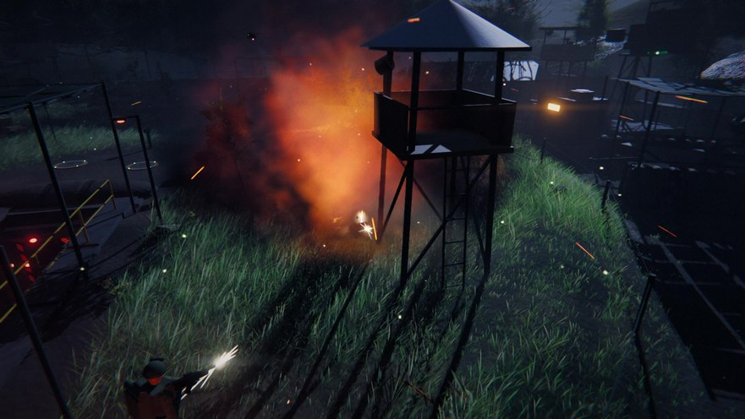
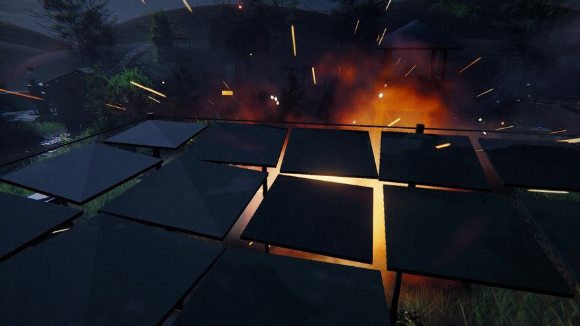
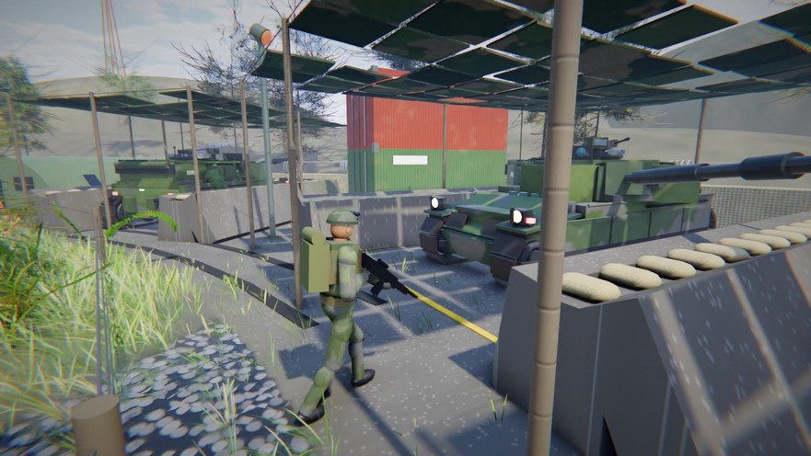
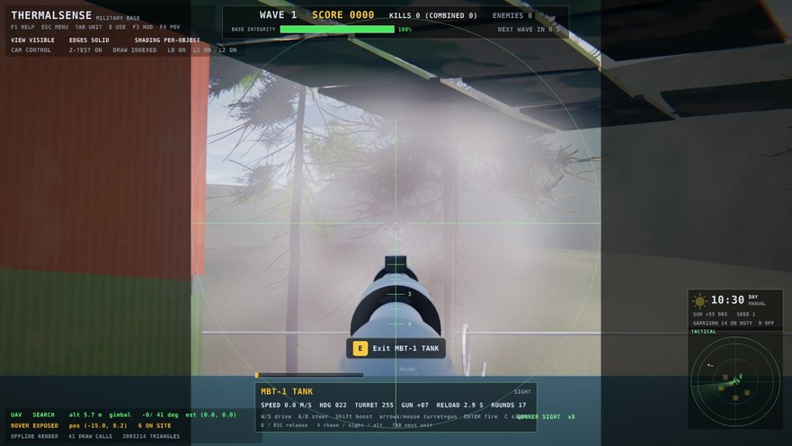

9 | SWARM STRIKES & DIRECT CONTROL
Autonomous Defense & Playable Vehicles
Autonomous Defense: Dual UAV swarm strikes with synchronized missile arrival
Target Lock: FLIR tracking
Single Strike: Solo engagement
Dual Strike: Synchronized impact
Interactive Vehicles: Walk up to any outpost station (Press E) for direct control
Boarding: Mount vehicle
Tank: First-person gunner sight
AA Cannons: Rapid-fire turret
11 October 2026
9 / 10
Notes:
Autonomous swarm defense with dual UAV synchronized strikes, plus fully interactive outpost vehicles including drivable tanks, anti-aircraft cannons, and missile launchers.

Slide 10
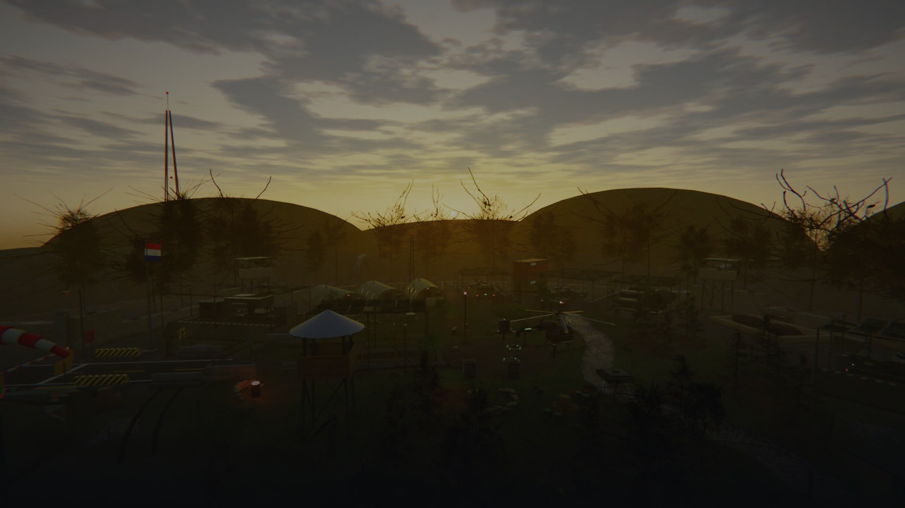
Thank You
Questions & Discussion
Md. Shakhoyat Rahman Shujon | Roll 2107104 | Computer Graphics Laboratory (CSE 4102)
11 October 2026
10 / 10
Notes:
Thank you for your attention. Questions and feedback are welcome.

