Slide 1

Bangladesh Army University of Science and Technology
Project Proposal Report
Course Title: Software Development Project II Course Code: CSE 2200 Supervised By:
Md. Toukir Ahmed
Lecturer,
Dept. of Computer Science and Engineering,
Bangladesh Army University of Science & Technology (BAUST), Saidpur Cantonment, Saidpur, Nilphamari.
Submitted by:
Student Name: Md. Shakib Al Shajid
Roll: 180201082 Batch: 8th
Level: 2 Term: II
Sec and Group: B Sec, G2 Dept. of CSE, BAUST.
Date of submission: 29-11-2020

Slide 2
Project Name
Hostel Management System.
Hostel Management System.
1
Hostel Management System

Slide 3
Objective
Hostel management
This is a application for computer. The main objective of the project will manage the details of the hostel, rooms, registration and the students record. In our project, there will be two parts, one for the administrator and another for the students. Only the administrator can be update and change the management system. Students can see the details about hostel rooms, seat vacancy.
2
Hostel Management System

Slide 4
Apparatus for project
Windows XP, 7 or 10.
Code Block.
C++ language.
3
Hostel Management System

Slide 5
Working Method
Hostel management
By using this software any hostel can easily manage their all students details. And they also maintain room details, seat details. They also find the details about any students easily. Using this software they will save their time. They also manage easily.
4
Hostel Management System

Slide 6
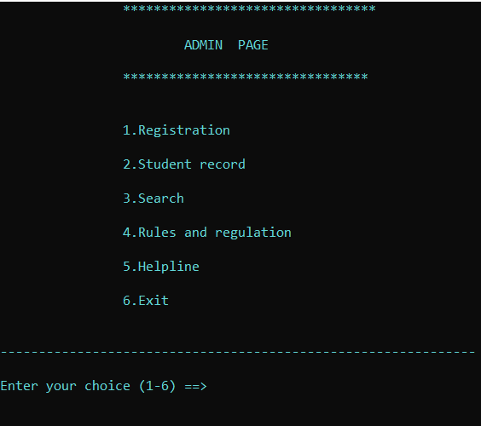
Output
This is admin page. After giving correct password we will enter in admin page. Then we will see those options. And user will take input for their own.
5
Hostel Management System

Slide 7
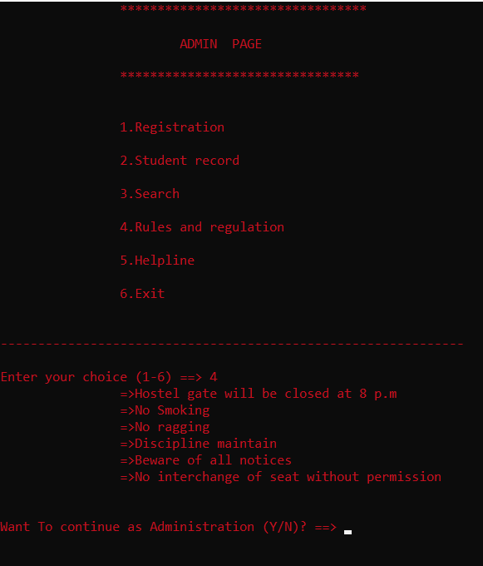
Output
Suppose admin gives 4 number. Then they will see “Rules and Regulations” of that hostel.
6
Hostel Management System

Slide 8
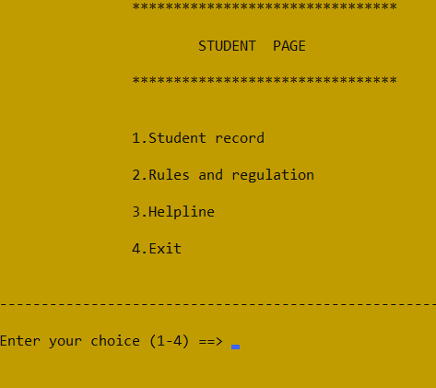
Output
This is student page. Anyone can access this page. After enter this page they will see those options. And user will take input for their own.
7
Hostel Management System

Slide 9
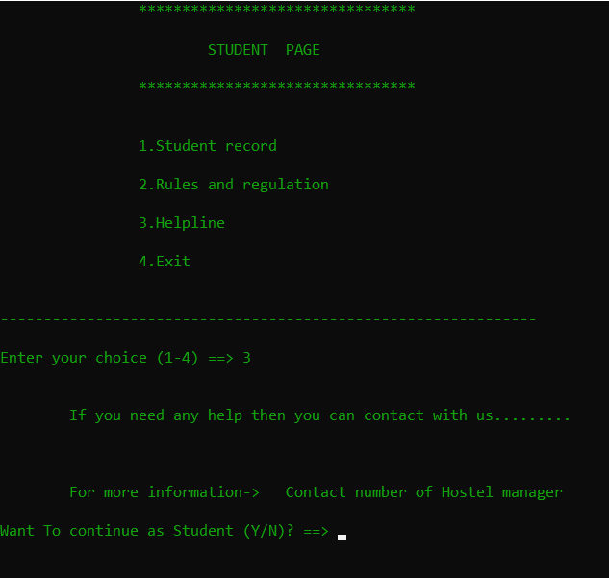
Output
Suppose user gives 3 number. Then user will see “Helpline” of that hostel.
8
Hostel Management System

Slide 10
Output
9
Hostel Management System

Slide 11


