Slide 1
WELCOME TO OUR PROJECT PRSENTATION

Slide 2
Our Team Member s:
Khan Mahedi Hasan Nayeem
ID : 171-15-1157
Shakib Shalim Tonmoy
ID : 171-15-1171
Hridoy Mahmud Rasel
ID : 171-15-1169

Slide 3
“university management system”
Project Presentation
Introduction to Bio-Informatics
CSE-234

Slide 4
Content :
Short description about “University Management System”.
How this project works?
Limitations.
Conclusion.

Slide 5
What is university management system :
Is the initiative by university manages/administrators to properly and effectively attend to the concerns, queries, proposals, grievances and feedbacks of students, academic and non-academic staff promptly

Slide 6
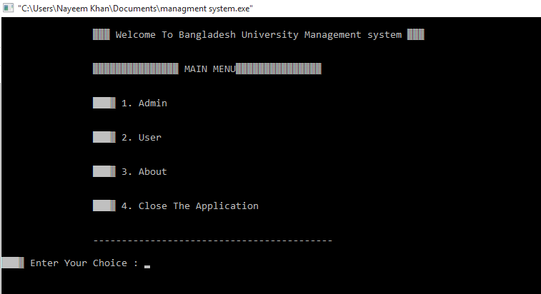
How this project works?

Slide 7
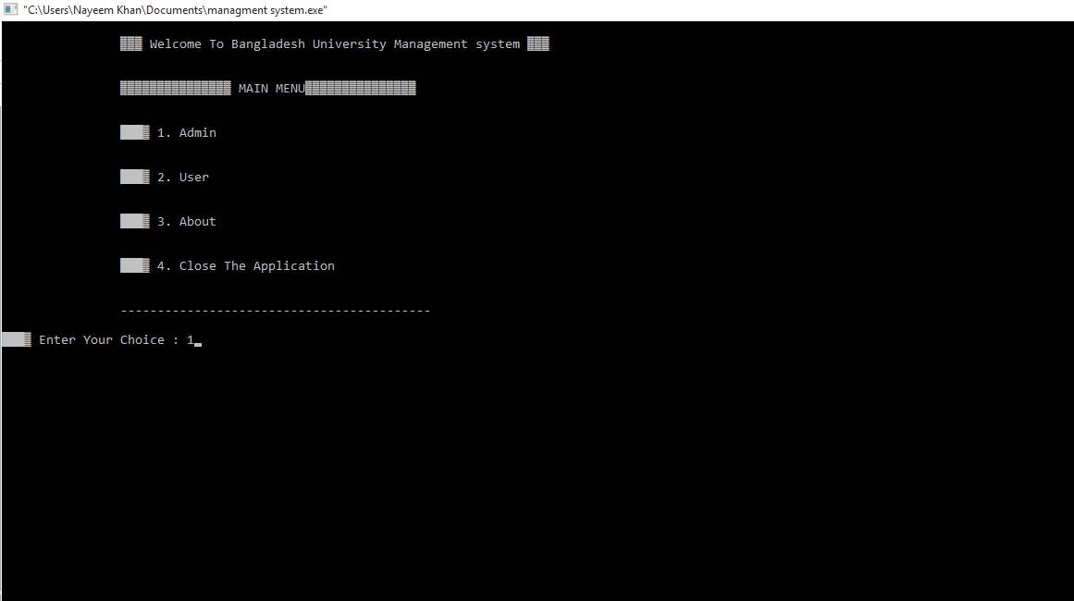

Slide 8



Slide 9

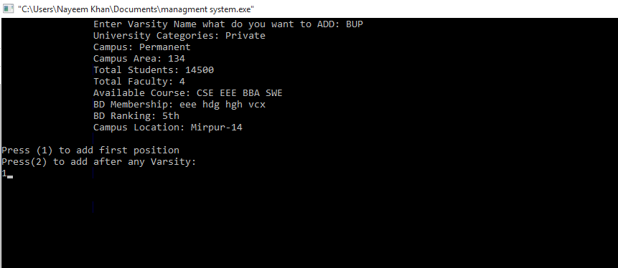

Slide 10
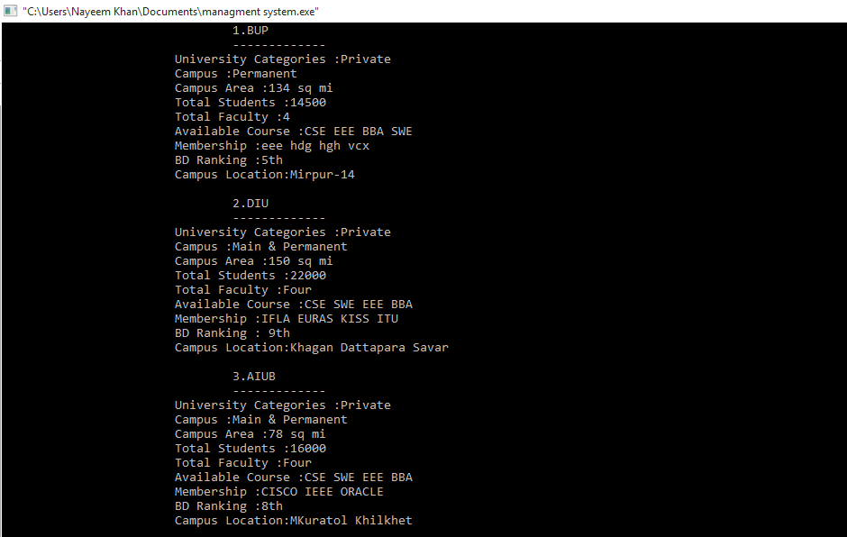

Slide 11

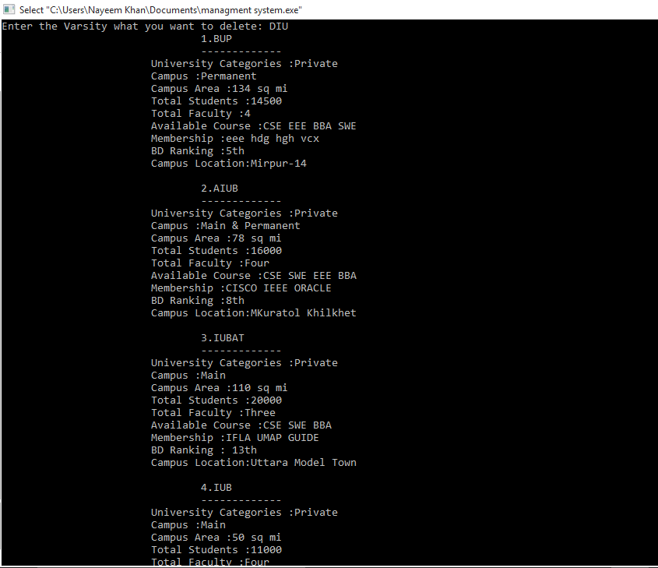

Slide 12
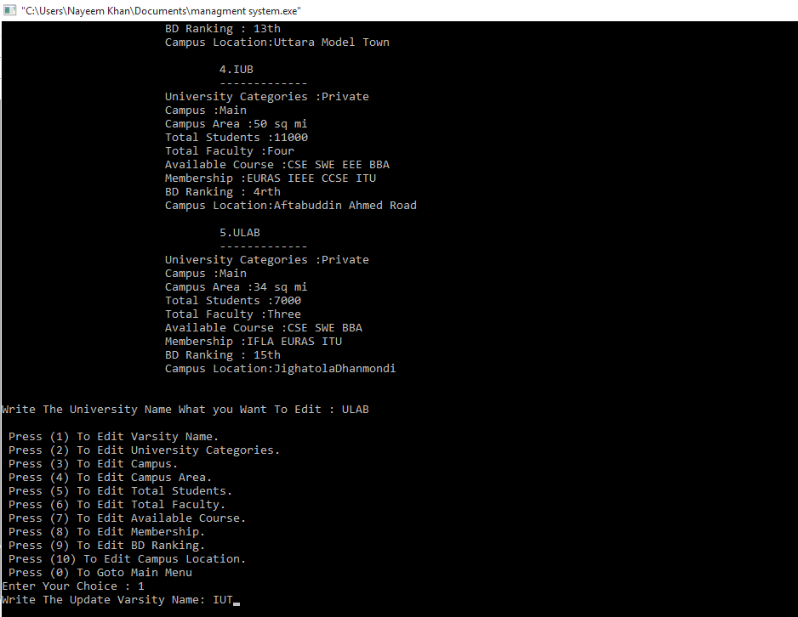

Slide 13
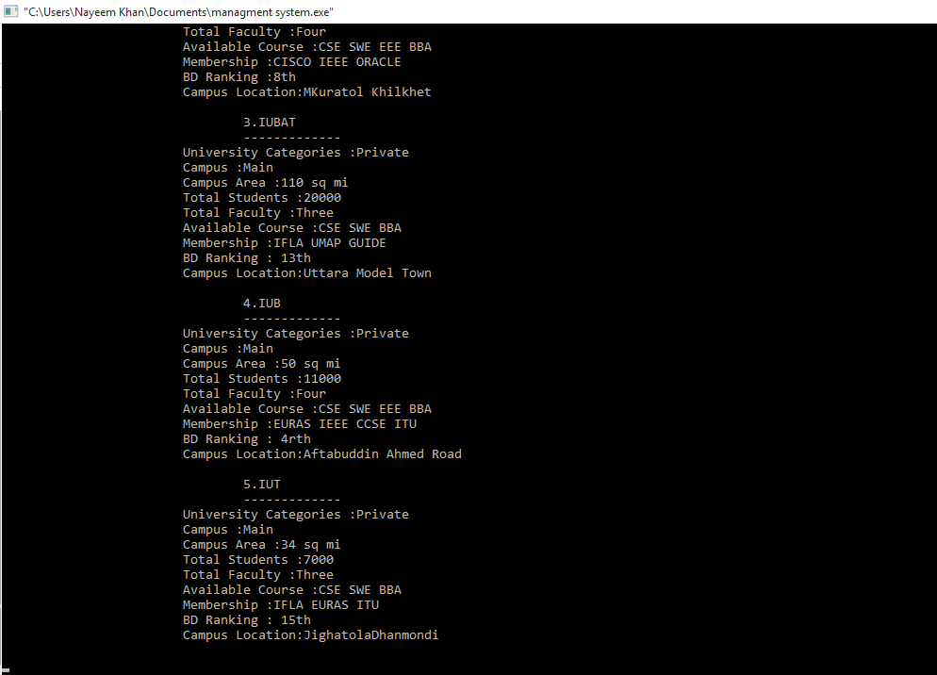

Slide 14
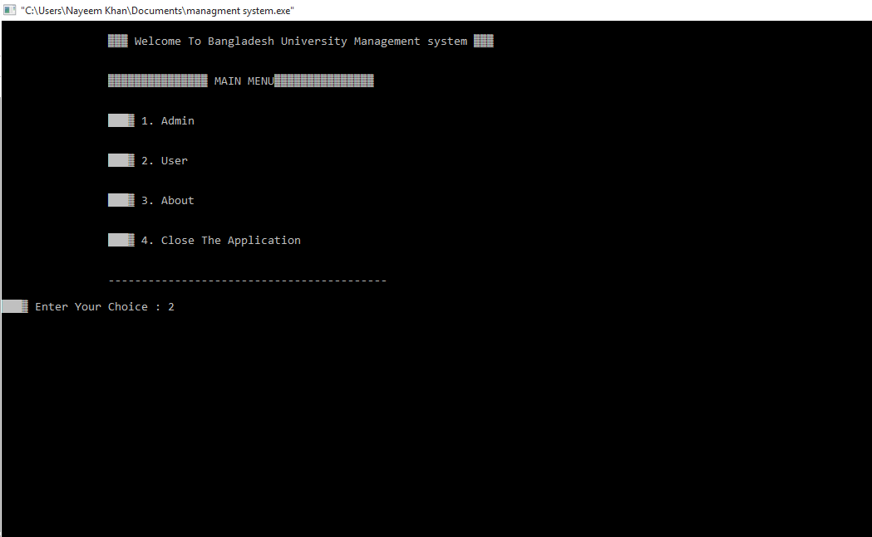
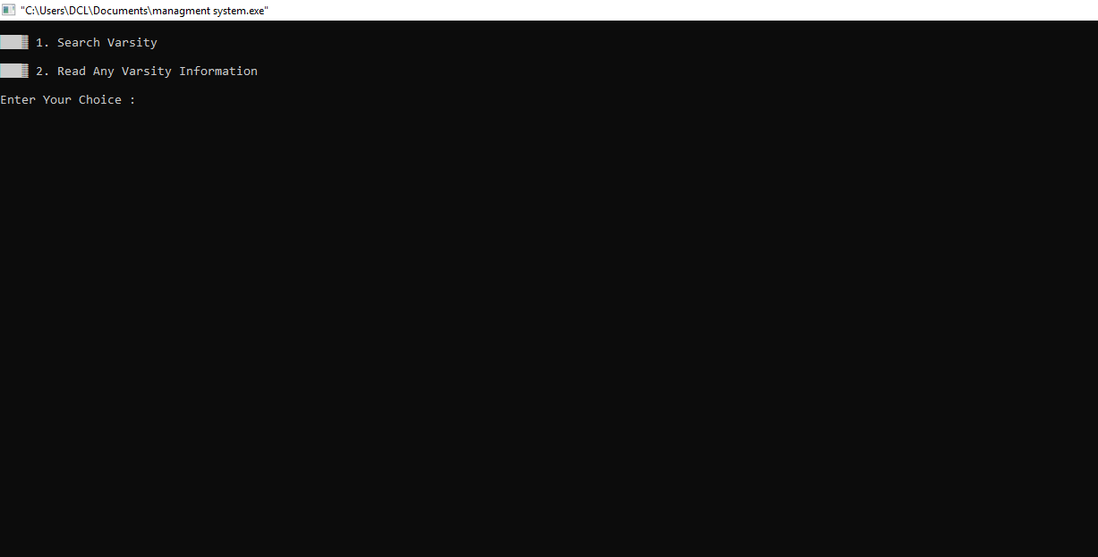

Slide 15

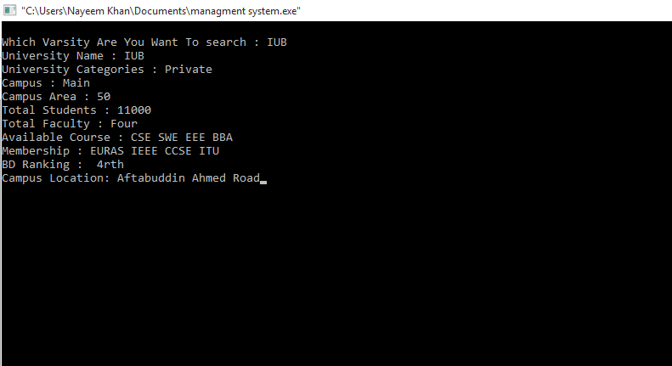

Slide 16
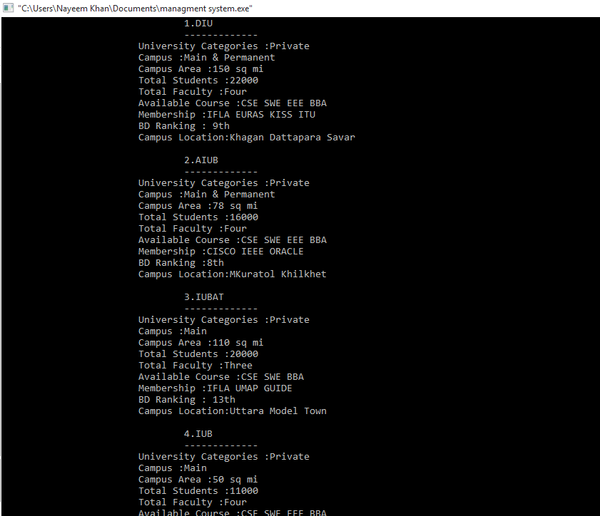

Slide 17
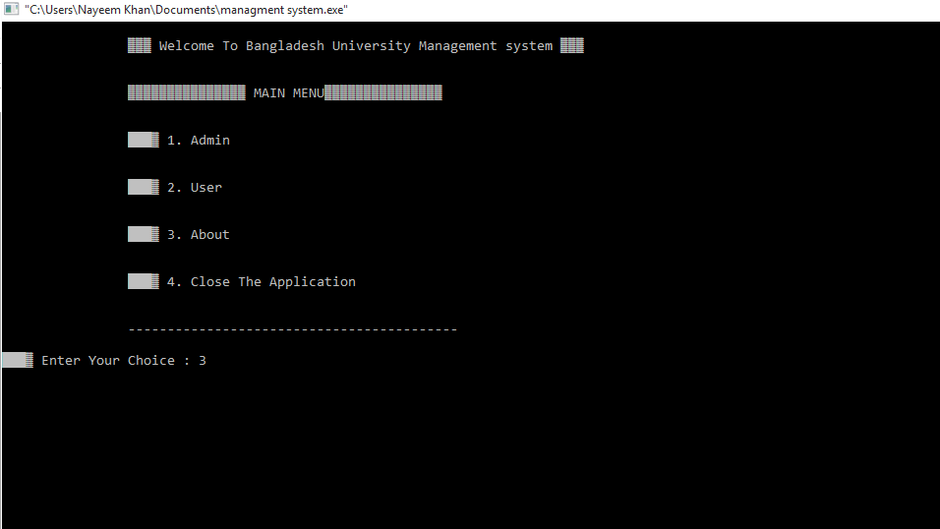


Slide 18
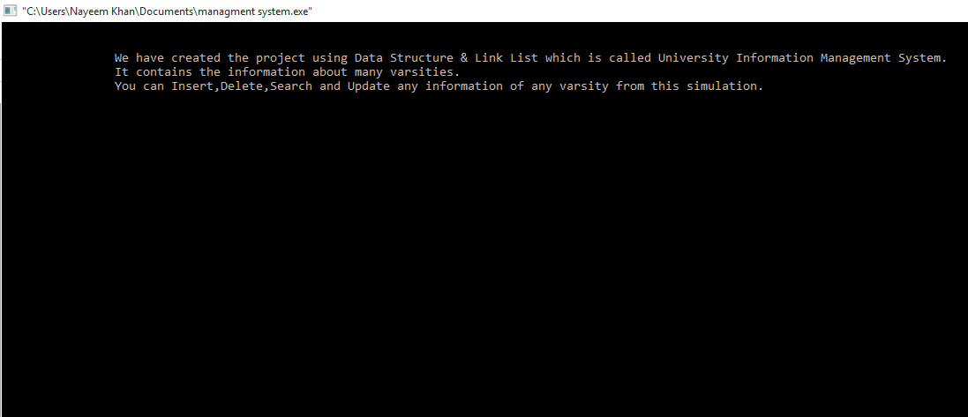
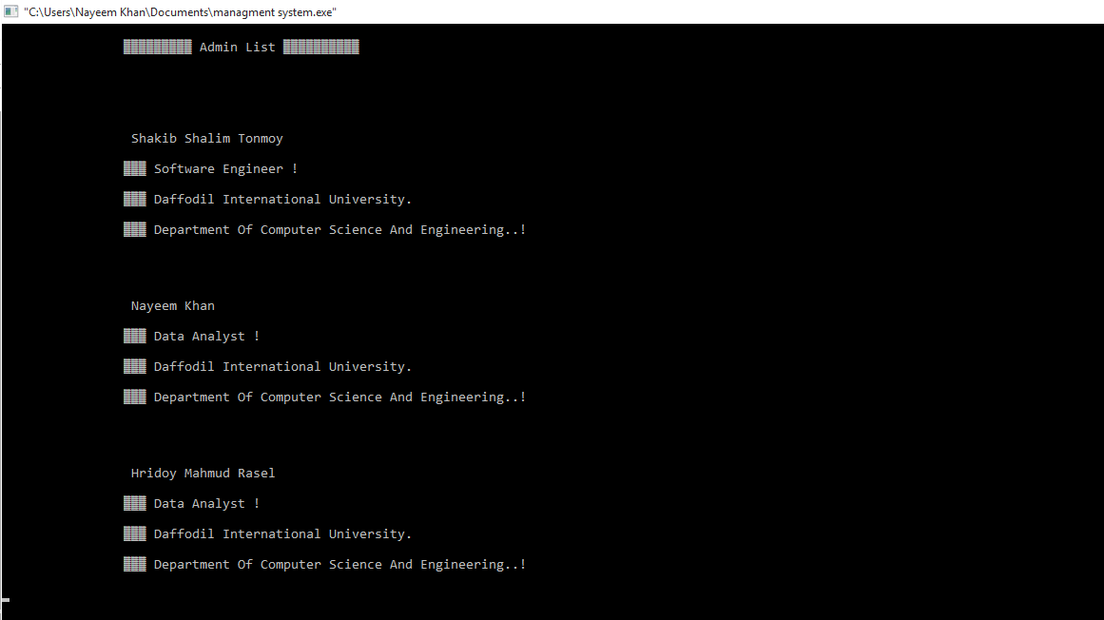

Slide 19


Slide 20
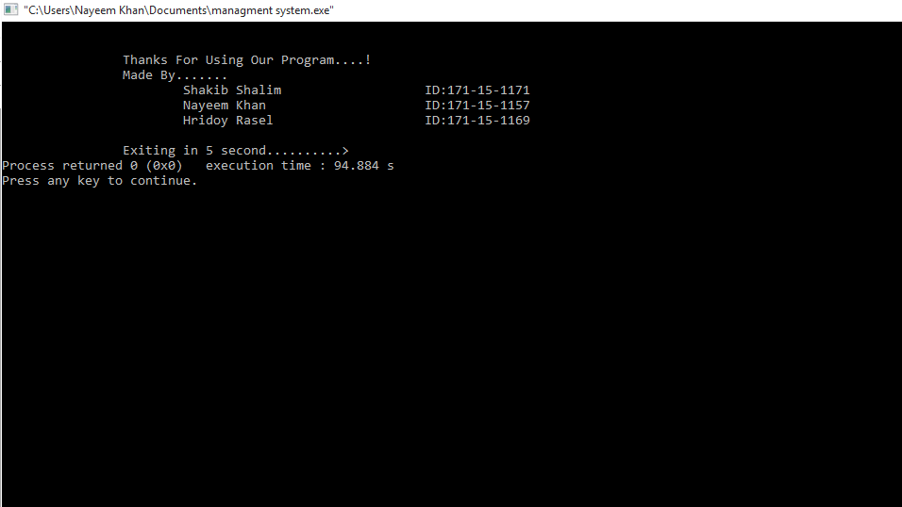

Slide 21
Conclusion :
Finally, I want to say, this is a project that can collect all the information from different universities, and then delete and give it. And all the information about this university can be known with this project.

Slide 22


