Slide 1
In peer-to-peer networks such as gnutella, each host must search out other hosts. When a host finds another host, these hosts become neighbors. Often a host will continue to search for peers until a sufficient number of hosts have been found. Lets assume that a host will continue to search for hosts until it has N neighbors.
In this project, peer-to-peer neighborhoods are made and maintained. Each host maintains list of neighbors and sends hello packets to these neighbors every 10 seconds. If a host is on the neighbor list, and no hello packet is received from the host for 40 seconds, then this host is removed from the neighbor list. If a node does not have enough neighbors, then it selects an address (e.g., IP and port) at random and tries to become its neighbor.

Slide 2
Objectives
Find N neighbors
A node is a neighbor if two-way communication is possible and verified
Two-communication == bidirectional link
Maintain N neighbors
If two-way communication is no longer verified, the node is no longer a neighbor

Slide 3
Detecting Bidirectional Links
Node A has a bidirectional with node B if
Node A can hear node B
Node B can hear node A
To determine if a link between node A and B is bidirectional
Node A sends a message to node B
Node B sends a message to node A saying that it can hear node A
Now node A believes the link is bidirectional
Node A sends a message to node B saying that it can hear node B
Now node B believes the link is bidirectional
In general, to determine is links are bidirectional
Send hello messages where the message includes a list of all nodes that have been heard
Upon receiving a hello message,
If you are listed as one of the nodes that has been recently heard, then the link is bidirectional
Add the sender of the hello to the list of nodes that you can hear

Slide 4
I am A
I have heard: no one
A
B
Have heard list
Have heard list

Slide 5
I am A
I have heard: no one
A
B
Have heard list
Have heard list
A

Slide 6
I am B
I have heard: A
A
B
Have heard list
Have heard list
A

Slide 7
I am B
I have heard: A
A
B
Have heard list
Have heard list
B and B hears me
A

Slide 8
I am A
I have heard: B
A
B
Have heard list
Have heard list
B and B hears me
A

Slide 9
I am A
I have heard: B, C, D
A
B
Have heard list
Have heard list
B and B hears me
A and A hears me

Slide 10
Neighbor States
nothing
Received a hello and this node is not listed in the hello as a recently heard node
No hello received for a long time
one-way
(receivable)
Received a hello with this node listed as recently heard
Received a hello with this node listed as recently heard
Received a hello and this node is not listed as recently heard
No hello received for a long time
bidirectional

Slide 11
Neighbor States
nothing
Received a hello and this node is not listed as recently heard
No hello received for a long time
unidirectionalNeighbors
Received a hello with this node listed as recently heard
Received a hello with this node listed as recently heard
Received a hello and this node is not listed as recently heard
No hello received for a long time
bidirectionalNeighbors

Slide 12
Neighbor List Activity Diagram
waiting
Hello arrived from node B
This node is listed in the hello as a recently heard node
Node B is neither list
Put B into bidirectionalNeighbors
Node B is unidirectionalNeighbors
Node B is bidirectionalNeighbors
This node is NOT listed in the hello as a recently heard node
Put B into unidirectionalNeighbors
This node is listed in the hello as a recently heard node
This node is NOT listed in the hello as a recently heard node
Move B from bidirectionalNeighbors to unidirectionalNeighbor
Move B from unidirectionalNeighbors to bidirectionalNeighbors

Slide 13
Lists
C++ Standard template library list
Add the following to the top of cpp file
#include <list>
using namespace std;
E.g., list of ints
making a list of ints
list<int> myList;
Add an element to myList
myList.push_back(1);
myList.push_back(2);
myList.push_back(1);
Iterate through the list and print each element
for( list<int>::iterator it=myList.begin(); it!=myList.end(); ++it)
printf(“entry=%d\n”,*it);
Remove an element from the list
int elementToRemove = 2;
for( list<int>::iterator it=myList.begin(); it!=myList.end(); ++it)
{
if (*it == elementToRemove)
{
myList.erase(it);
break; // not breaking would result in a crash
}
}
Alternatively
myList.remove(1); // removes all elements == 1. But this requires == operator, which exists for int, but might not for other types

Slide 14
for( list<int>::iterator it=myList.begin(); it!=myList.end(); ++it)
printf(“entry=%d\n”,*it);
Boost foreach.hpp
foreach( int x, mylist)
printf(“entry=%d\n”,x);

Slide 15
Classes
Packet
ptr: holds the data as a char buffer
totalSize:
When data is being written to the pkt, totalSize is the size of the buffer, which is Packet::bufferLength, which is 2000
When data is being read from pkt, total size is the total amount to data available for rading
offset: where data should be read or written from
E.g.,
writing a char c to pkt
*(char *)pkt.getPtr() = c;
Pkt.incOffset(sizeof(c ));
Writing an int x to pkt
*(boost::int16_t *)pkt.getPtr() = htons((boost::int16_t)x);
pkt.incOffset(sizeof(boost:int16_t));
Reading char c from pkt
C = *(char *)pkt.getPtr();
Pkt.incOffset(sizeof(char)();
Reading int x from pkt
X = ntohs(*(boost:int16_t *)pkt.getPtr()));
Pkt.incOffset(sizeof(boot::int16_t));
Before writing to pkt
Pkt.getReadyForWriting();
UdpSocket
E.g., bind socket to port 10000
UdpSocket udpSocket;
udpSocket.bindToPort(10000);
Get packet is ready
Packet pkt;
If (udpSocket.checkForNewPacket(pkt, 2)>0)
// process data
else
// data is not ready
e.g., send pkt
Packet pkt;
pkt.getReadyForWriting();
….
udpSocket.sendTo(pkt,destinationHostId)
// see HostId class

Slide 16
Classes
Packet
ptr: holds the data as a char buffer
totalSize:
When data is being written to the pkt, totalSize is the size of the buffer, which is Packet::bufferLength, which is 2000
When data is being read from pkt, total size is the total amount to data available for rading
offset: where data should be read or written from
E.g.,
writing a char c to pkt
*(char *)pkt.getPtr() = c;
Pkt.incOffset(sizeof(c ));
Writing an int x to pkt
*(boost::int16_t *)pkt.getPtr() = htons((boost::int16_t)x);
pkt.incOffset(sizeof(boost:int16_t));
Reading char c from pkt
C = *(char *)pkt.getPtr();
Pkt.incOffset(sizeof(char)();
Reading int x from pkt
X = ntohs(*(boost:int16_t *)pkt.getPtr()));
Pkt.incOffset(sizeof(boot::int16_t));
Before writing to pkt
Pkt.getReadyForWriting();

Slide 17
Classes
UdpSocket
E.g., bind socket to port 10000
UdpSocket udpSocket;
udpSocket.bindToPort(10000);
Get packet is ready
Packet pkt;
If (udpSocket.checkForNewPacket(pkt, 2)>0)
// process data
else
// data is not ready
e.g., send pkt
Packet pkt;
….
udpSocket.sendTo(pkt,destinationHostId)
// see HostId class

Slide 18
Classes
HostId
char _address[ADDRESS_LENGTH];
Boost::uint16_t _port;
E.g., set address and port
HostId host(address, port);
E.g., get HostId from packet
Packet pkt;
HostId host;
If (udpSocket.checkForNewPacket(pkt, 2)>0)
host.getFromPacket(pkt);
E.g., put HostId onto packet
HostId thisHost;
… thisHost is the the ip and port of this host
Packet pkt;
thisHost.addToPacket(pkt);
udpSocket.sendTo(pkt, hostId);
E.g., check if thisHost is the same as hostId
If (thisHost == hostId) {
// yes, they are the same
}
E.g., send pkt with thisHost to all host in allHost list
Packet pkt;
thisHost.addToPacket(pkt);
foreach(HostId &hostid, allHost)
udpSocket.sendTo(pkt, hostId);

Slide 19
classes
NeighborInfo
HostId hostId; // the id of neighbor
time_t timeWhenLastHelloArrived;
Functions
addToPacket
getFromPacket
updateTimeToCurrentTime()
==
Only checks hostId’s match, ignores timeWhenLastHelloArrived
E.g.,
Packet pkt;
Foreach( NeighborInfo &neighbor, allNeighbors)
Neighbor.addToPkt(pkt);

Slide 20
classes
HelloMessage
boost::uint8_t type // not important for this project
HostId source;
Boost::uint16_t numberOfNeighbors;
list<HostId> neighbors;
Functions
Show
addToPacket
getFromPacket
addToNeighborList
E.g., add neighbors to helloMessage
HelloMessage helloMessage;
helloMessage.type = HELLO_MESSAGE_TYPE;
helloMessage.source = thisHost;
foreach(NeighborInfo &neighborInfo , bidirectionalNeighbors)
helloMessage.addToNeighborList(neighborInfo.hostId);
Packet pkt;
helloMessage.getPktReadyForWriting….
helloMessage.addToPacket(pkt);
udpSocket.sentTo(pkt, someDestinationHostId);

Slide 21
List
Check if thisHost is in list of neighbors received from neighbor
Packet pkt;
If (udpSocket.checkForNewPacket(pkt, 2)>0)
{
HelloMessage helloMessage;
helloMessage.getFromPacket(pkt);
foreach(HostId &hostId, helloMessage.neighbors) {
if (thisHost == hostId) {
// yes it is
}
}
}
}
}
Remove element from list
List<NeighborInfo> neighbors;
….
NeighborInfo neighborToRemove;
…
neighbors.remove(neighborToRemove);
Remove a host
List<NeighborInfo> neighbors;
….
HostId hostToRemove(address, port);
NeighborInfo neighborToRemove(hostToRemove);
neighbors.remove(neighborToRemove);
/// or
list<NeighborInfo>::iterator it;
for(it = neighbors.begin(); it!=neighbors.end(); ++it) {
if (it->hostId == hostToRemove) {
neighbors.erase(it);
break; // would crash without this break
}
}

Slide 22
Neighbor List Activity Diagram
waiting
Hello arrived from node B
This node is listed in the hello as a recently heard node
Node B is neither list
Put B into bidirectionalNeighbors
Node B is unidirectionalNeighbors
Node B is bidirectionalNeighbors
This node is NOT listed in the hello as a recently heard node
Put B into unidirectionalNeighbors
This node is listed in the hello as a recently heard node
This node is NOT listed in the hello as a recently heard node
Move B from unidirectionalNeighbors to bidirectionalNeighbors
Move B from bidirectionalNeighbors to unidirectionalNeighbors

Slide 23
Neighbor List Activity Diagram
waiting
Hello arrived from node B
This node is listed in the hello as a recently heard node
else
Put B into bidirectionalNeighbors
checkIfInList(sender,
unidirectionalNeighbors)
==true
checkIfInList(sender,
bidirectionalNeighbors)
==true
This node is NOT listed in the hello as a recently heard node
Put B into unidirectionalNeighbors
This node is listed in the hello as a recently heard node
This node is NOT listed in the hello as a recently heard node
Move B from unidirectionalNeighbors to bidirectionalNeighbors
Move B from bidirectionalNeighbors to bidirectionalNeighbors

Slide 24
Neighbor List Activity Diagram
int udpSocket.checkIfPacketIsReady(Packet &pkt, int TimeOut)
else
Hello arrived
Extract sender from hello
else
This node is listed in the hello as a recently heard node
Put B into bidirectionalNeighbors
checkIfInList( sender,
unidirectionalNeighbors )
==true
checkIfInList( sender, biidirectionalNeighbors )
==true
This node is NOT listed in the hello as a recently heard node
Put B into unidirectionalNeighbors
This node is listed in the hello as a recently heard node
This node is NOT listed in the hello as a recently heard node
Move B from unidirectionalNeighbors to bidirectionalNeighbors
Move B from bidirectionalNeighbors to unidirectionalNeighbors

Slide 25
thisHost
int main(int argc, char* argv[])
{
HostId thisHost;
fillThisHostIP(thisHost); // provided in someFunctions.cpp
thisHost._port = atoi(argv[1]);
…

Slide 26
checkIfThisHostIsInRecentlyHeardNeighbors
foreach(HostId &advertisedNeighbor, helloMessage.neighbors) {
if (advertisedNeighbor == thisHost) {
// thisHost is advertised by neighbor

Slide 27
Neighbor List Activity Diagram
int checkForNewPacket(SOCKET UDPSock, char *pkt, int TimeOut)
else
Hello arrived
Extract sender from hello
This node is listed in the hello as a recently heard node
else
Put B into bidirectionalNeighbors
checkIfInList(sender,
unidirectionalNeighbors)
==true
checkIfInList(sender, bidirectionalNeighbors)
==true
This node is NOT listed in the hello as a recently heard node
Put B into bidirectionalNeighbors
This node is listed in the hello as a recently heard node
This node is NOT listed in the hello as a recently heard node
Move B from unidirectionalNeighbors to biidirectionalNeighbors
Move B from bidirectionalNeighbors to unidirectionalNeighbors

Slide 28
Neighbor List Activity Diagram
int checkForNewPacket(SOCKET UDPSock, char *pkt, int TimeOut)
else
Hello arrived
Extract sender from hello
This node is listed in the hello as a recently heard node
else
Put B into bidirectionalNeighbors
checkIfInList(sender,
unidirectionalNeighbors)
==true
checkIfInList(sender, bidirectionalNeighbors)
==true
This node is NOT listed in the hello as a recently heard node
Put B into unidirectionalNeighbors
This node is listed in the hello as a recently heard node
This node is NOT listed in the hello as a recently heard node
Move B from unidirectionalNeighbors to biidirectionalNeighbors
Move B from bidirectionalNeighbors to unidirectionalNeighbors

Slide 29
Lists
C++ Standard template library list
#include <list>
using namespace std;
Making a list of ints
list<int> myList;
Add an element to myList
myList.push_back(1);
myList.push_back(2);
myList.push_back(1);
Remove an element from the list
int elementToRemove = 2;
myList.remove(elementToRemove);
alternatively
for( list<int> iterator::it=myList.begin(); it!=myList.end(); ++it)
{
if (*it == elementToRemove)
{
myList.erase(it);
break; // not breaking would result in a crash
}
}

Slide 30
Objectives
Find N neighbors
A node is a neighbor if two-way communication is possible and verified
Two-communication == bidirectional link
Maintain N neighbors
If two-way communication is no longer verified, the node is no longer a neighbor

Slide 31
To do
While (1)
Receive hello
Process neighbor states (as we just talked about)
Search for more neighbors?
Check and if so, search
Update neighbor set
If some neighbors have timed out, remove them
Send hello messages to neighbors
Send every 10 sec

Slide 32
To do
While (1)
Receive hello
Process neighbor states (sort of like what we did)
Search for more neighbors?
Check and if so, search
Update neighbor set
If some neighbors have timed out, remove them
Send hello messages to neighbors
Send every 10 sec

Slide 33
Search for more neighbors
int main(int argc, char* argv[])
{
bool searchingForNeighborFlag = false;
readAllHostsList(argv[2], allHosts); // provided
while (1)
{
if (bidirectionalNeighbors.size() + unidirectionalNeighbors.size() < TARGET_NUMBER_OF_NEIGHBORS && searchingForNeighborFlag ==false)
{
searchingForNeighborFlag = true;
tempNeighbor = selectNeighborAtRandom(bidirectionalNeighbors, unidirectionalNeighbors, allHost, thisHost); // provided
}
….

Slide 34
To do
While (1)
Receive hello
Process neighbor states (sort of like what we did)
Search for more neighbors?
Check and if so, search
Update neighbor set
If some neighbors have timed out, remove them
Send hello messages to neighbors
Send every 10 sec

Slide 35
Neighbor List Activity Diagram
int checkForNewPacket(SOCKET UDPSock, char *pkt, int TimeOut)
This node is listed in the hello as a recently heard node
Put B into bidirectionalNeighbors
else
This node is NOT listed in the hello as a recently heard node
Hello arrived
Extract sender from hello
Put B into bidirectionalNeighbors
else
checkIfInList(sender,
unidirectionalNeighbors)
==true
checkIfInList(sender, bidirectionalNeighbors)
==true
sender==tempNeighbor
searchingForNeighborFlag = false
This node is listed in the hello as a recently heard node
This node is NOT listed in the hello as a recently heard node
checkIfThisHostIsInRecently
HeardNeighbors(pkt,thisHost)==true
checkIfThisHostIsInRecently
HeardNeighbors(pkt,thisHost)
==false
Move B from unidirectionalNeighbors to biidirectionalNeighbors
Move B from bidirectionalNeighbors to unidirectionalNeighbors
Put sender into bidirectionalNeighbors
Put sender into unidirectionalNeighbors

Slide 36
To do
While (1)
Receive hello
Process neighbor states (sort of like what we did)
Search for more neighbors?
Check and if so, search
Update neighbor set
If some neighbors have timed out, remove them
Send hello messages to neighbors
Send every 10 sec

Slide 37
Neighbor List Activity Diagram
int checkForNewPacket(SOCKET UDPSock, char *pkt, int TimeOut)
This node is listed in the hello as a recently heard node
Put B into bidirectionalNeighbors
else
This node is NOT listed in the hello as a recently heard node
updateLastReceivedTime
Hello arrived
Extract sender from hello
Put B into bidirectionalNeighbors
else
updateLastReceivedTime
checkIfInList(sender,
unidirectionalNeighbors)
==true
checkIfInList(sender, bidirectionalNeighbors)
==true
sender==tempNeighbor
searchingForNeighborFlag = false
This node is listed in the hello as a recently heard node
This node is NOT listed in the hello as a recently heard node
checkIfThisHostIsInRecently
HeardNeighbors(pkt,thisHost)==true
checkIfThisHostIsInRecently
HeardNeighbors(pkt,thisHost)
==false
Move B from unidirectionalNeighbors to biidirectionalNeighbors
Move B from bidirectionalNeighbors to unidirectionalNeighbors
Put sender into bidirectionalNeighbors
Put sender into unidirectionalNeighbors
updateLastReceivedTime
updateLastReceivedTime
updateLastReceivedTime
updateLastReceivedTime

Slide 38
Lists
foreach(NeighborInfo & neighborInfo, bidirectionalNeighbors) {
If (neighborInfo.hostId == helloMessage.source) {
neighborInfo. updateTimeToCurrentTime();
break;
}
}

Slide 39
To do
While (1)
Receive hello
Process neighbor states (sort of like what we did)
Search for more neighbors?
Check and if so, search
Update neighbor set
If some neighbors have timed out, remove them
Send hello messages to neighbors
Send every 10 sec

Slide 40
Send hello messages to neighbors every 10 sec
#include <time.h>
#include <sys/types.h>
#include <sys/timeb.h>
int main(int argc, char* argv[])
{
….
time_t lastTimeHellosWereSent;
time( &lastTimeHellosWereSent );
time_t currentTime;
while (1)
{
time( &currentTime );
if (difftime(currentTime, lastTimeHellosWereSent) >= 10)
{
lastTimeHellosWereSent = currentTime;
sendHellos(…)
}
….

Slide 41
Send hello messages to neighbors every 10 sec
#include <time.h>
#include <sys/types.h>
#include <sys/timeb.h>
int main(int argc, char* argv[])
{
….
time_t lastTimeHellosWereSent;
//time( &lastTimeHellosWereSent );
lastTimeHellosWereSent = 0;
time_t currentTime;
while (1)
{
time_t( &currentTime );
if (difftime(currentTime, lastTimeHellosWereSent) >= 10)
{
lastTimeHellosWereSent = currentTime;
sendHellos(…)
}
….

Slide 42
sendHellos(…)
sendHelloToNeighbors
Hello must include all heard neighbors
bidirectionalNeighbors
unidirectionalNeighbors
Not tempNeighbor
Hello must be sent to
bidirectionalNeighbors
unidirectionalNeighbors
AND tempNeighbor
Steps
HelloMessage helloMessage;
// fill out helloMessage
Packet pkt;
pkt.getPacketReadyForWriting();
helloMessage.addToPacket(pkt);
// send to all neighbors
udpSocket(pkt, hostId)

Slide 43
boost
Get boost library
Put it somewhere and decompress
Add it to include path

Slide 44
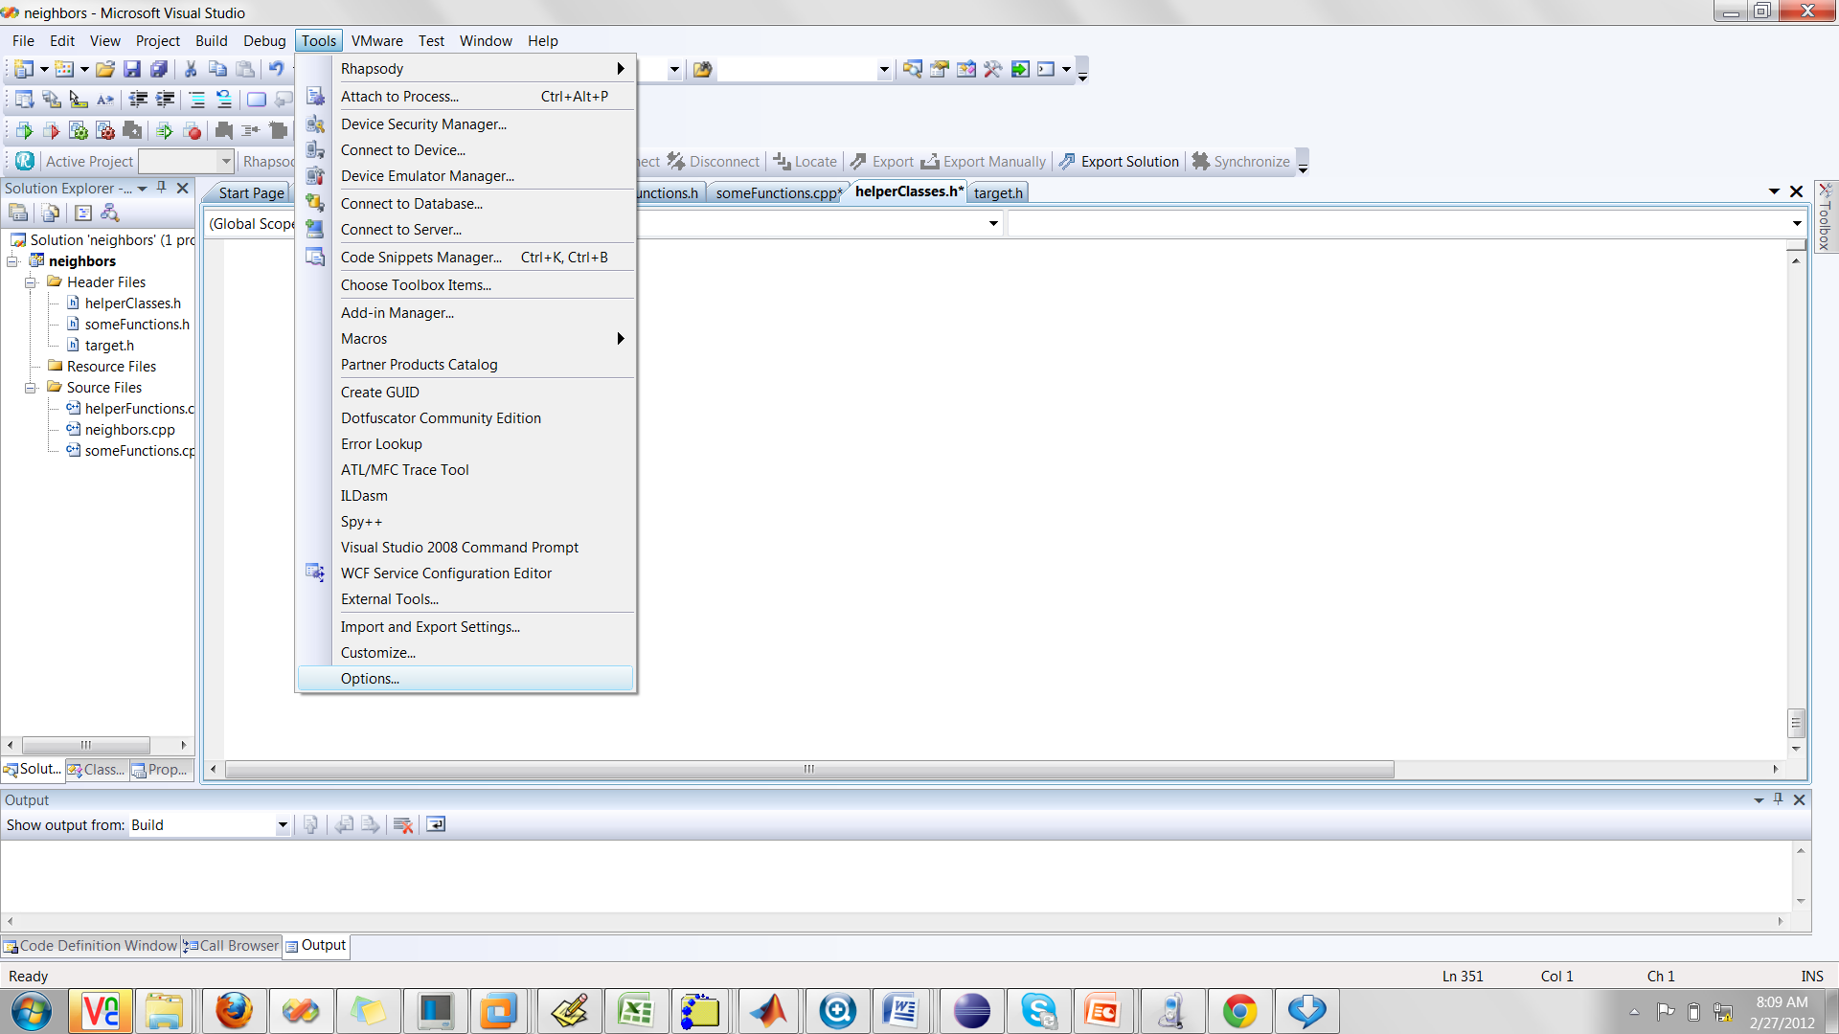
Add boost to include path
In visual studio: Tools ->options

Slide 45
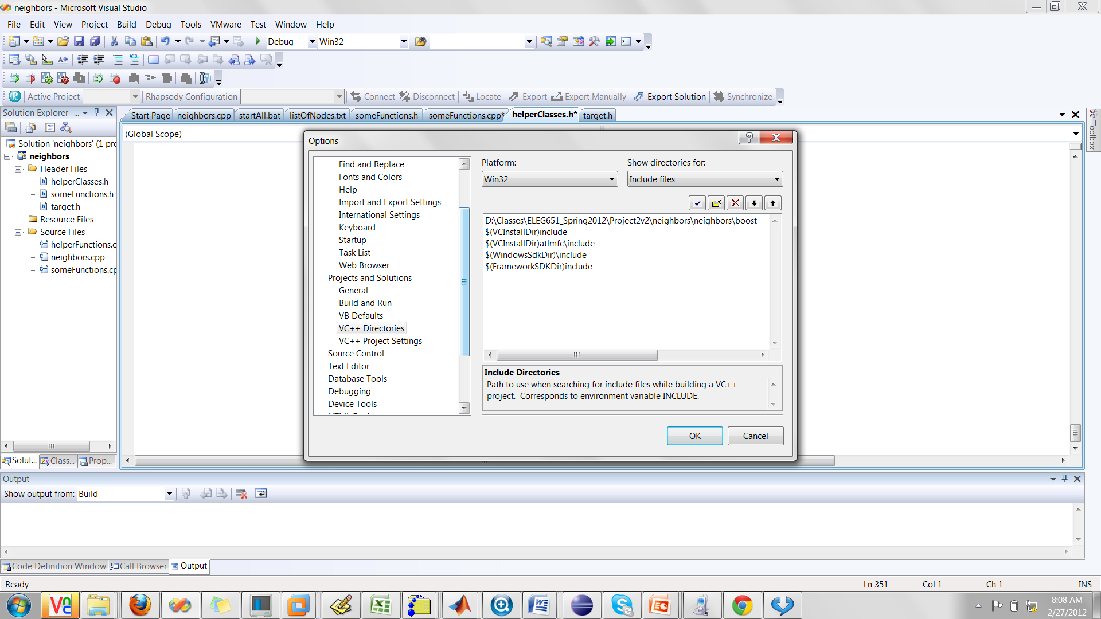
Add boost to include path
Along the left, find “Projects and Solutions” group
Expand and find “VC++ Directories”
In the upper right, select “Include Files”

Slide 46
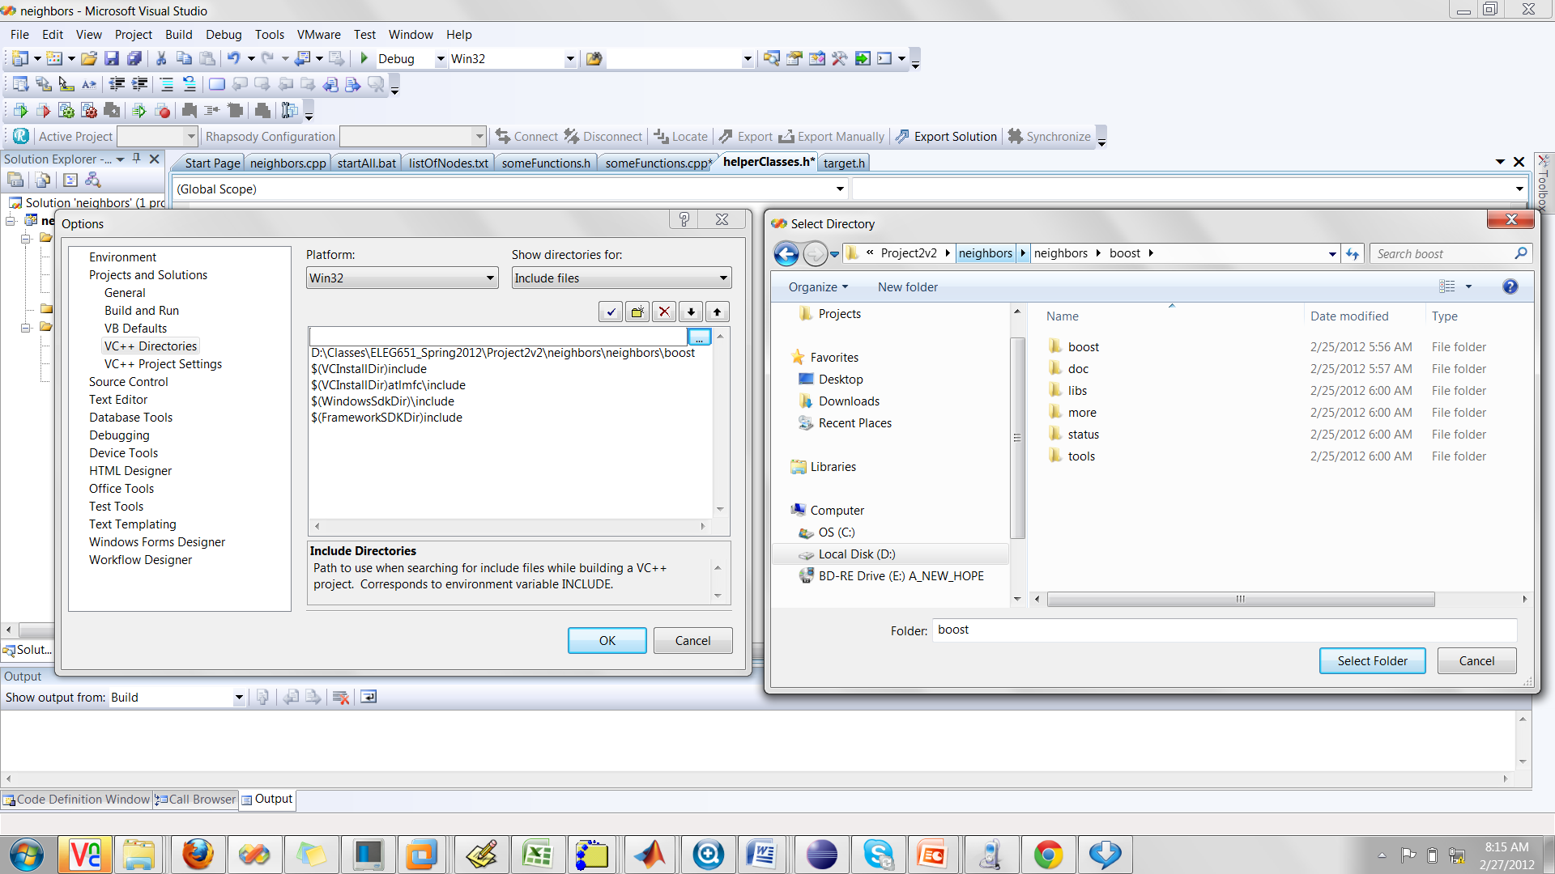
Add boost to include path
Add the directory of boost
3. This is the right directory. You can see that boost, docs etc are subdirectories of this directory
2. Press to select directory
1. Add directory

Slide 47
Strcpy security error
The code has several security issues including that it uses insecure string handling functions
The use of these functions gives an error that includes the text _CRT_SECURE_NO_WARNINGS
To fix this error, go to project->properties->configuration properties -> C/C++ -> Command line
In the box in the lower right, add the text
/D _CRT_SECURE_NO_WARNINGS
Note that there is a space between /D and _CRT_SECURE_NO_WARNINGS

Slide 48
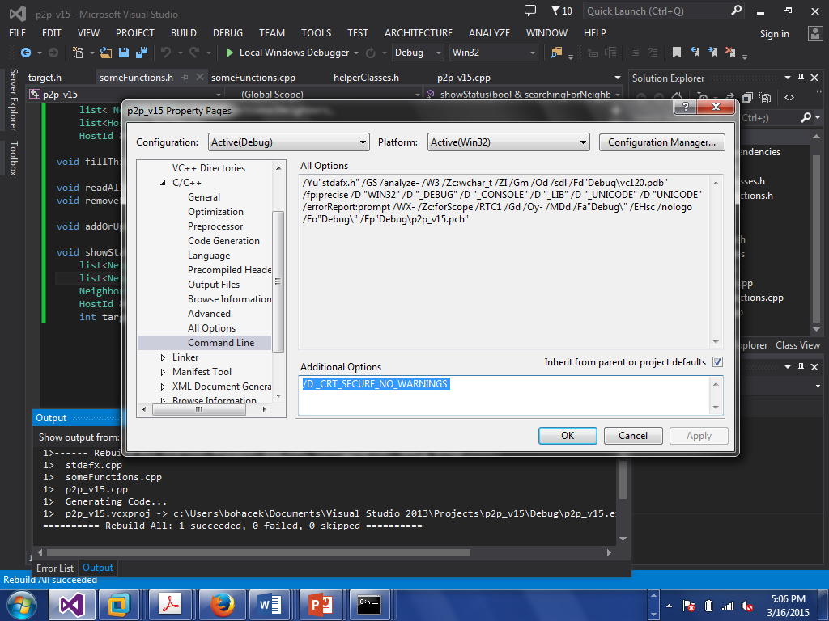
There is a space between /D and _CRT_SECURE_NO_WARNINGS

