Slide 1
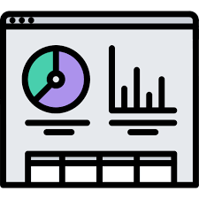
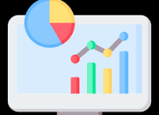
Chapter 1-Measurement
Software Metrics-(SE-611)
Md Shakibul Islam Shakib-1404
Md Nowsad Hossen Munna-1407
Nazmus Shakib-1452
Most. Nusrat Sharmin-1441
Farjana Sarkar Naima-1449
Shahria Sultana Elin-1445

Slide 2
Want to buy a sofa for your room?

Slide 3

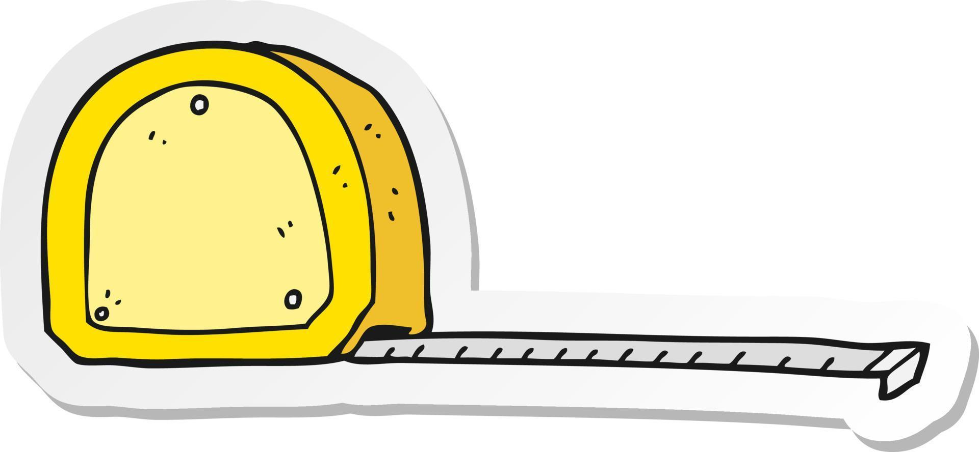
Entity: Your room (a real-world object)
Attribute: Length, width (properties)
10
Rule: Use a measuring tape to follow the standard method
8
10 feet x 8 feet (numbers assigned)

Slide 4
Definition:
Measurement is assigning numbers or symbols to the attributes of entities based on rules, so we can describe them.

Slide 5
Measurement in Software Engineering:
Entity: Calculate_discount(Real object of the code)
def calculate_discount(price, discount_rate):
if price <= 0:
return 0
discount = price * discount_rate
final_price = price - discount
return final_price
Attribute: Size
Rule: Line of code
6 Loc

Slide 6
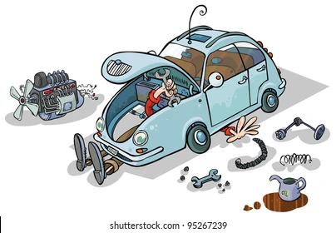

Internal and External Attributes
Internal attributes: Engine size, wiring, gearbox – engineers care
External attributes: Comfort, looks – users care

Slide 7

Internal and External Attributes
def calculate_discount(price, discount_rate):
if price <= 0:
return 0
discount = price * discount_rate
final_price = price - discount
return final_price
Internal attributes:LOC, Cyclomatic Complexity, modularity
External attributes: Usability, reliability, maintainability

Slide 8

Is Measurement Necessary in SE?
⚠️ Risk:
No targets
Saying "make it fast" instead of "under 2s response time"
No cost tracking
Not knowing if most money goes into testing or bug fixing
No quality assurance
User can’t trust your app if you don’t show reliability (e.g., 99.9% uptime)
So Measurement is a must.

Slide 9

What are Metrics?
In a Basketball game
Metrics :
Standard ways to measure Entity’s attribute
Points scored = Metric of performance
Time per play = Metric of speed
Fouls = Metric of discipline

Slide 10

What are Metrics in SE?
In Software Engineering
Metrics :
Standard ways to measure Entity’s attribute
LOC = Size metric
Bugs/KLOC = Quality metric
Story points/team member = Productivity

Slide 11
Mathematical Perspective of Metrics
Let,
x = current code version
y = new code version
m(x,y) = how different they are in design/structure
Properties:
m(x,x) = 0 → No difference between the same version
m(x,y) = m(y,x) → Distance is the same both ways

Slide 12
Challenges in Software Metrics
Not physical | You can't touch "usability" or "reliability" like a chair
Metrics become outdated | Old KPIs in a modern DevOps team may be useless today
Right metric selection | Like choosing the right health test: blood pressure vs cholesterol
Hard to define | How do you measure "maturity" or "flexibility"?
Too many metrics | Like tracking 100 health stats and not knowing which one matters most
Metric manipulation | People "gaming the system" to look good, like writing more LOC to seem productive

Slide 13


Objectives of Measurement in SE
Developer’s View Goals
Are requirements testable?
Are faults found?
Did we meet goals?
What about future?
A MANAGER VIEW Goals
Cost of each process?
Productivity of staff?
Code quality?
Will users like it?
How to improve?

Slide 14

Scope of Software Metrics
The scope of software metrics refers to the range of areas within software engineering where measurements are applied to evaluate, monitor, and improve various aspects of software products and development processes.

Slide 15
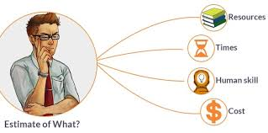
1. Cost and Effort Estimation Models and Measures
Definition: Estimating how much money and time a software project will take.
Example: You use the COCOMO model to estimate the effort (in person-months) based on the number of lines of code (LOC).
🛠️ If you plan to build a system with 20,000 LOC, COCOMO might tell you:
It will need 5 developers working for 3 months = 15 person-months.

Slide 16

2. Data Collection
Definition: Collecting information (quantitative or qualitative) about the software and development process.
Example: You track:
Number of bugs
Lines of code written
Time taken to fix bugs
📋 These metrics help improve productivity and quality in future iterations.

Slide 17
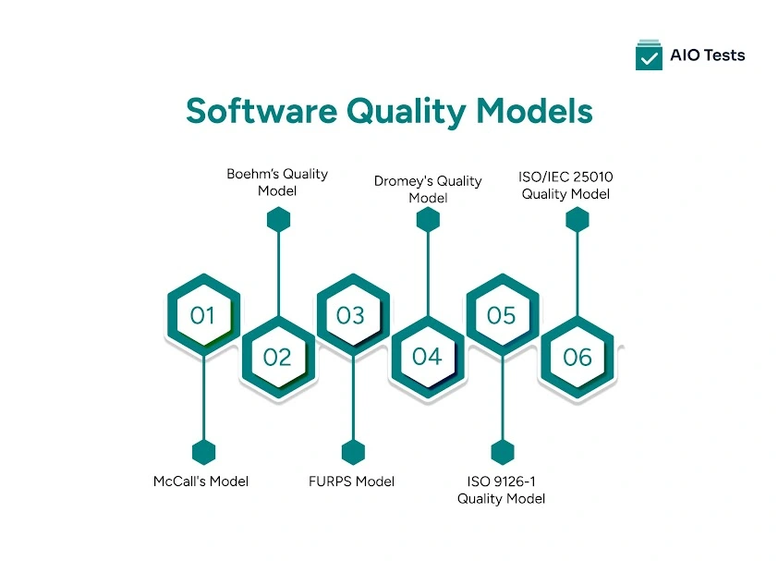
3. Quality Models and Measures
Definition: Measuring how good your software is across various quality attributes.
Example: You use ISO 25010 quality model and measure things like:
Maintainability: How easy it is to fix/update code
Usability: How easy it is for users to interact with the UI
🔍 You might conduct surveys or use tools to measure usability scores.

Slide 18
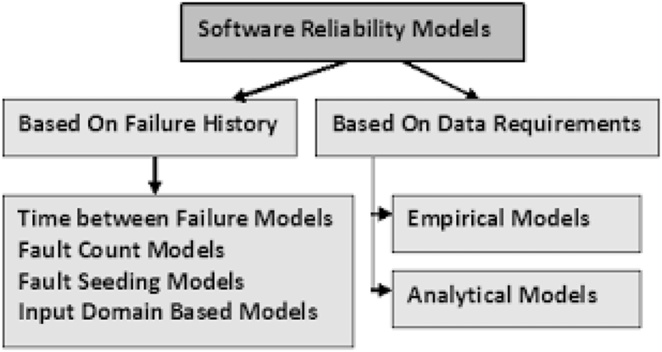
4. Reliability Models
Definition: Measuring how consistently the software performs under specific conditions.
Example: MTTF (Mean Time To Failure) — measures how long the software runs before failing.
🚀 A flight reservation system with MTTF = 1000 hours means on average, it will crash once every 1000 hours.

Slide 19
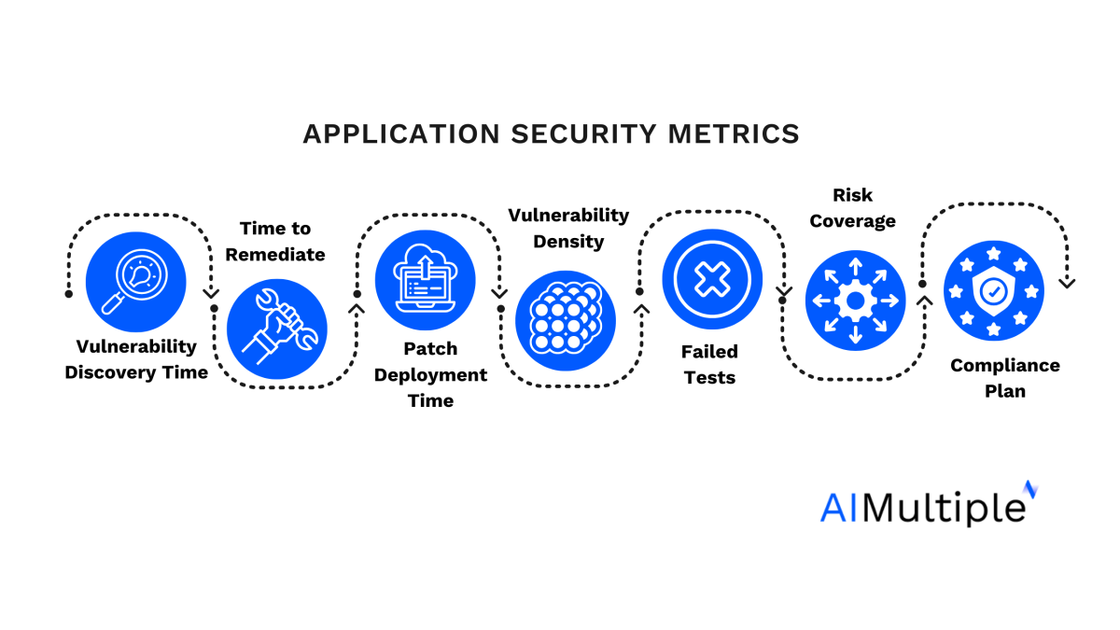
5. Security Metrics
Definition: Measuring how secure the software is from both internal design flaws and external threats.
Example: You track:
Number of vulnerabilities found
Time to patch security flaws
Threat likelihood vs. impact (using risk matrices)
🛡️ If your system handles financial data, you might apply OWASP Top 10 vulnerability checks and measure exposure.

Slide 20
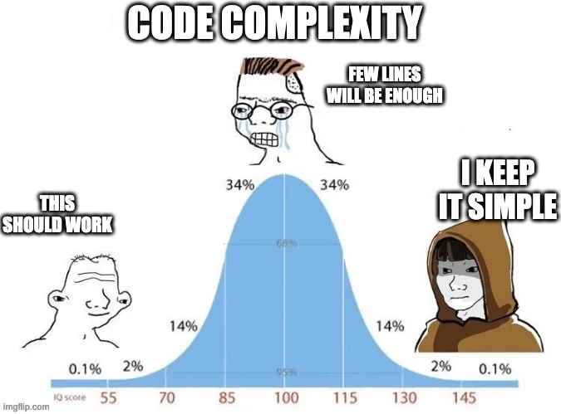
6. Structural and Complexity Metrics
Definition: Measuring the structure, modularity, and complexity of the source code.
Example:
Cyclomatic Complexity: Number of independent paths through a function
Depth of Inheritance Tree: How deep class inheritance goes
📦 If a function has a cyclomatic complexity of 20+, it might be too complex and error-prone.

Slide 21
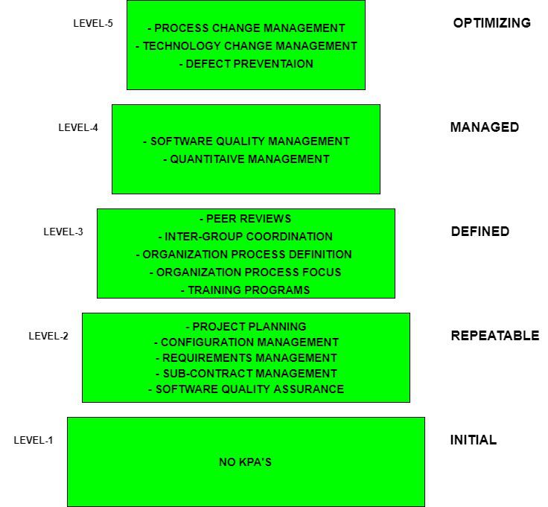
7. Capability Maturity Assessment
Definition: Assessing the maturity level of your organization’s software development process using models like CMMI.
Example:
Level 1: Ad hoc, unpredictable
Level 5: Optimizing, continually improving
🏢 A startup may be at Level 2, while Google-like companies often operate at Level 4/5.

Slide 22
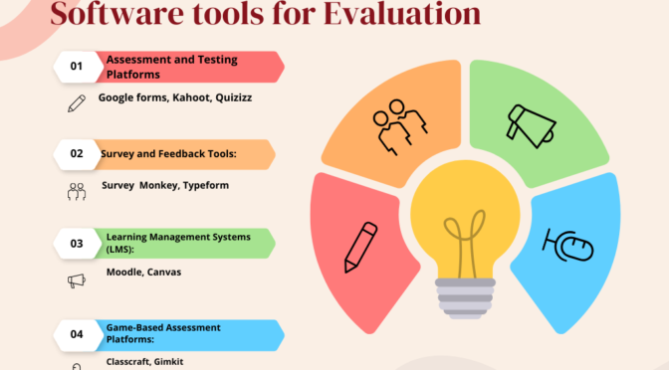
8.Evaluation of Methods and Tools
Definition: Evaluating how effective your development methods and tools are.
Example:
Compare if Test-Driven Development (TDD) reduces bugs more than traditional testing
Check if a new IDE boosts productivity
🧪 You measure before and after applying tools/methods and compare metrics.

Slide 23
Now Let’s Measure A Real Time Software With 8 Steps

Slide 24

Launching "EduSync" – A Learning Platform
Company: CodeNest Ltd. Project: EduSync, an online education platform Goal: Improve software quality and on-time delivery

Slide 25

Document the Software Development Process
📋 CodeNest maps out its development life cycle: They use Agile Scrum, with 2-week sprints, code reviews, unit tests, and CI/CD pipelines.
🛠 They document:
Sprint planning rituals
Dev/test responsibilities
Deployment workflows

Slide 26

State the Goals
🎯 The team sets two key goals:
Reduce bug count in production by 40%
Improve on-time sprint delivery to 95%

Slide 27

Define Metrics Required to Reach Goals (GQM)
📐 They apply the GQM (Goal-Question-Metric) approach:
Goal: Reduce bugs ↪️ Question: How many bugs escape testing? ↪️ Metric: Defect leakage rate
Goal: Improve delivery ↪️ Question: How often do we miss deadlines? ↪️ Metric: Planned vs. Actual Sprint Velocity

Slide 28
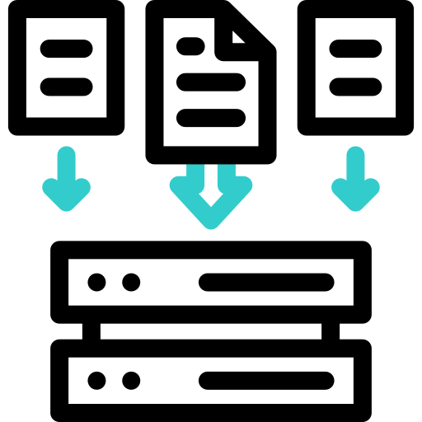
Identify Data to Collect
📊 They decide to collect:
Number of bugs reported post-deployment
Story points planned vs. completed
Code coverage %
Time spent in each sprint phase

Slide 29
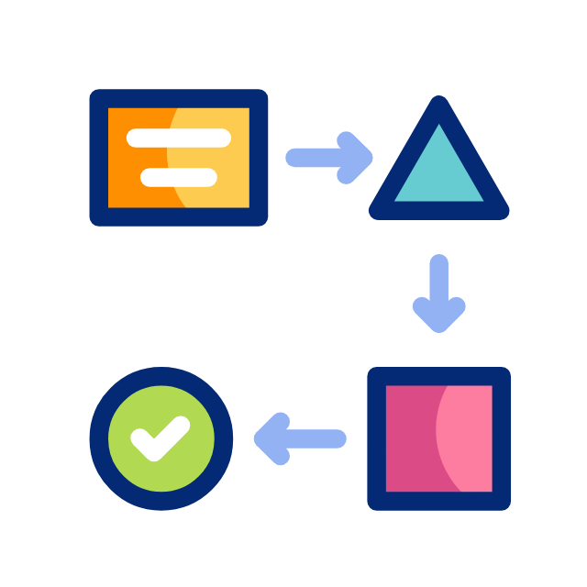
Define Data Collection Procedures
📝 They ensure:
Jira is updated daily with sprint progress
QA team logs defects with tags
GitHub Actions generates code coverage reports
Developers log time via a built-in timesheet plugin

Slide 30

Assemble a Metrics Toolset
🧰 They select:
Jira for velocity tracking
SonarQube for code quality and coverage
Excel + PowerBI for dashboard reporting

Slide 31

Create a Metrics Database
💾 They set up a database that:
Pulls data weekly from Jira, GitHub, and SonarQube
Organizes by sprint, developer, and module
Feeds data into real-time dashboards

Slide 32
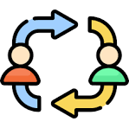
Define the Feedback Mechanism
🔁 Every sprint:
PM shows graphs in retro: "Defects dropped 10%!"
Developers use the data to reflect on coding issues
QA discusses where tests failed or missed logic
Management reviews team performance monthly using trends

Slide 33
In 3 months, bugs dropped by 45%, and on-time delivery hit 97%. The metrics program became part of every new project at CodeNest 🚀.

Slide 34
Thank
You

