Slide 1
EEE 454
VLSI Circuits and Design I Laboratory
Project Group -7
Project Title
VLSI Design Project: Configurable Logic Block (CLB)
Logic Family: Standard CMOS
Logic Function: NAND (A,B,C)
Group Members:
1. Arnob Roy Shaon (1506093)
2. Shakil Ahmed (1606140)
3. Ishraq Tashdid (1606142)

Slide 2
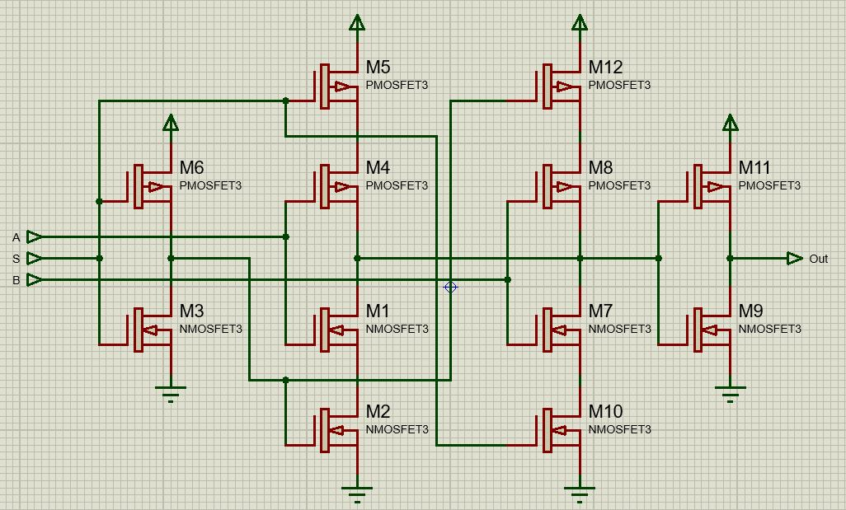
HOW WE ARE BETTER?
Requires 12 MOS
2 Extra NOT gates
Fig 1: Reference MUX

Slide 3
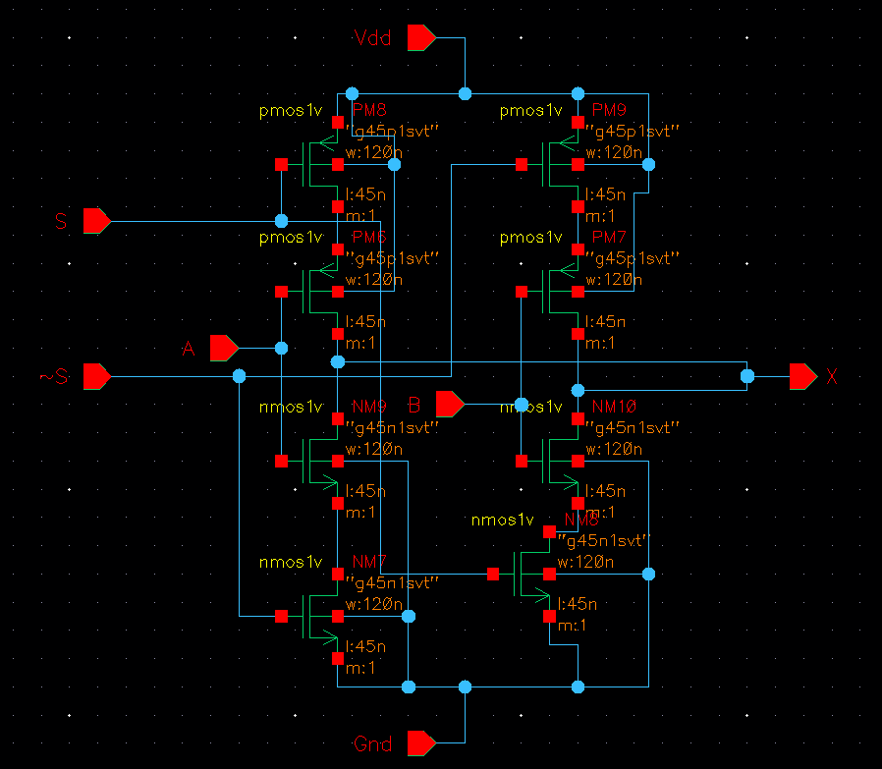
HOW WE ARE BETTER?
Requires 8 MOS
Using 8 MUX
Overall saves 24 MOS
Fig 2: Designed MUX

Slide 4
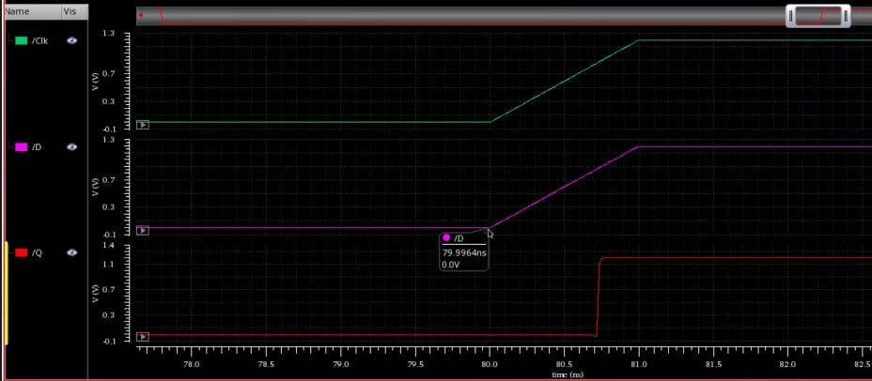
HOW WE ARE BETTER?
Fig 3: D Flip Flop
The minimum setup time for D flip flop is only 3.6ps.
Thus, maximum operating frequency is 5.045GHz.

Slide 5
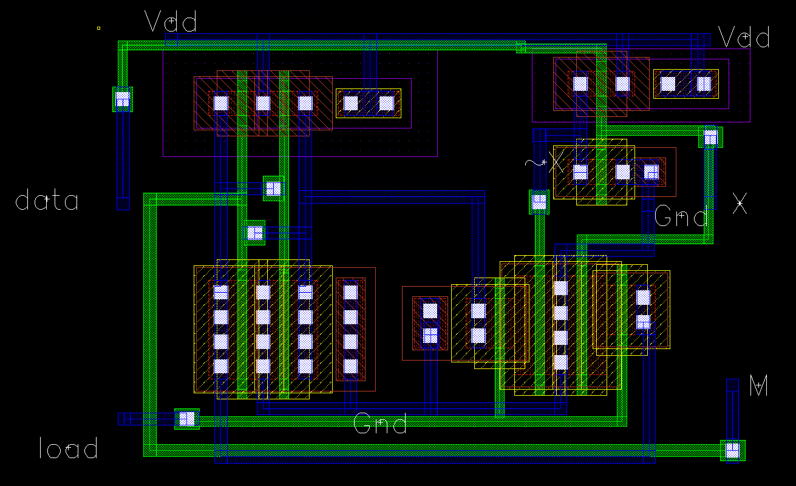
HOW WE ARE BETTER?
All the NMOS (6) are merged.
Metal1 wires and Poly wires are overlapped.
Fig 4: SRAM Layout

Slide 6
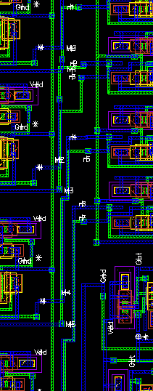
HOW WE ARE BETTER?
Minimum Gaps have been maintained to avoid DRC error.
Poly and Metal1 lines have been overlapped
Fig 5: CLB snippet

Slide 7
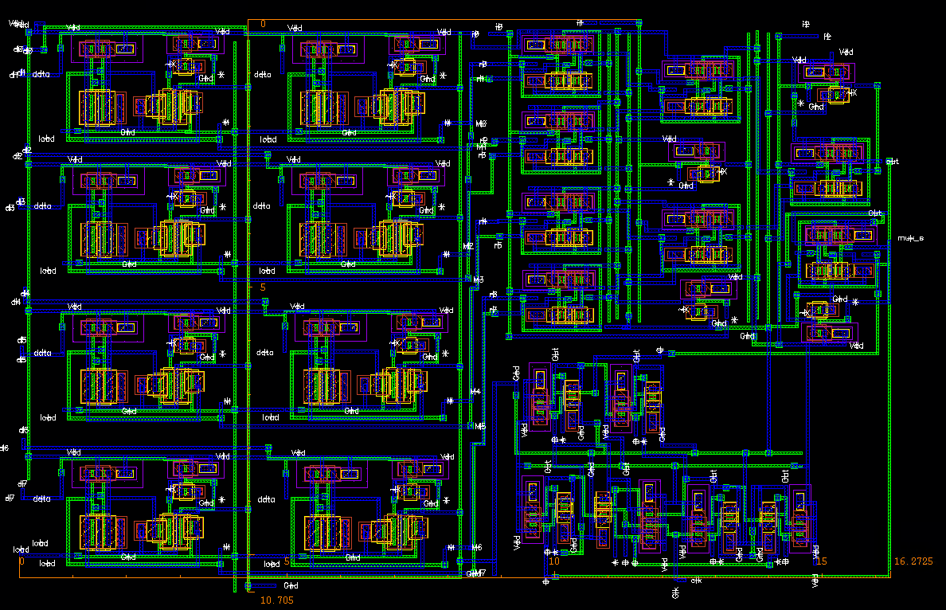
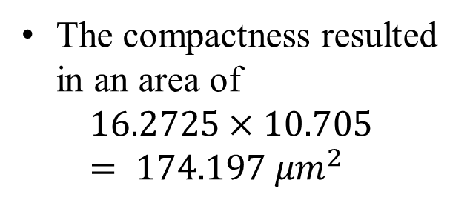
HOW WE ARE BETTER?
The compactness resulted in an area of
$$16.2725×10.705= 174.197 μm^{2}$$
Fig 6: CLB Layout

Slide 8
Design Metrics:
Propagation Delay
Transition type | Fall Delay (ps) | Rise Delay (ps)
000 | 194.6 | 97.64
001 | 100.0 | 127.7
010 | 171.1 | 102.0
011 | 97.21 | 102.0
100 | 192.0 | 130.2
101 | 125.4 | 129.3
110 | 170.2 | 176.5
Transition type | Fall Delay (ps) | Rise Delay (ps)
000 | 148.8 | 15.64
001 | 120.1 | 6.019
010 | 115.6 | 6.565
011 | 64.79 | 48.47
100 | 122.3 | 22.43
101 | 70.63 | 67.43
110 | 69.32 | 80.70
Table 1: Propagation delay for CLB
Table 2: Propagation delay for CMOS NAND3

Slide 9
Design Metrics:
Energy Calculation
Transition type | Fall Active Energy(fJ) | Rise Active Energy(fJ) | Maximum Leakage Energy(fJ) | Minimum Leakage Energy(fJ)
000 | 5.982 | 1.808 | 2.909 | 2.239
001 | 4.130 | 2.395
010 | 5.063 | 1.792
011 | 2.793 | 2.386
100 | 5.272 | 1.782
101 | 3.432 | 2.388
110 | 3.849 | 1.733
Average | 4.360 | 2.041 | -
Total Average | 3.2005 |  | 2.592
Table 3: Active and Leakage Energy for CLB

Slide 10
Design Metrics:
Energy Calculation
Transition type | Fall Active Energy(fJ) | Rise Active Energy(fJ) | Maximum Leakage Energy(fJ) | Minimum Leakage Energy(fJ)
000 | 0.6419 | 0.03791 | 0.11280 | 0.00277
001 | 0.5105 | 0.06420
010 | 0.4953 | 0.06582
011 | 0.3669 | 0.16230
100 | 0.5413 | 0.16580
101 | 0.6851 | 0.06753
110 | 0.6752 | 0.16630
Average | 0.5594 | 0.10427
Total Average | 0.331835 |  | 0.03447
Table 4: Active and Leakage Energy CMOS NAND

Slide 11
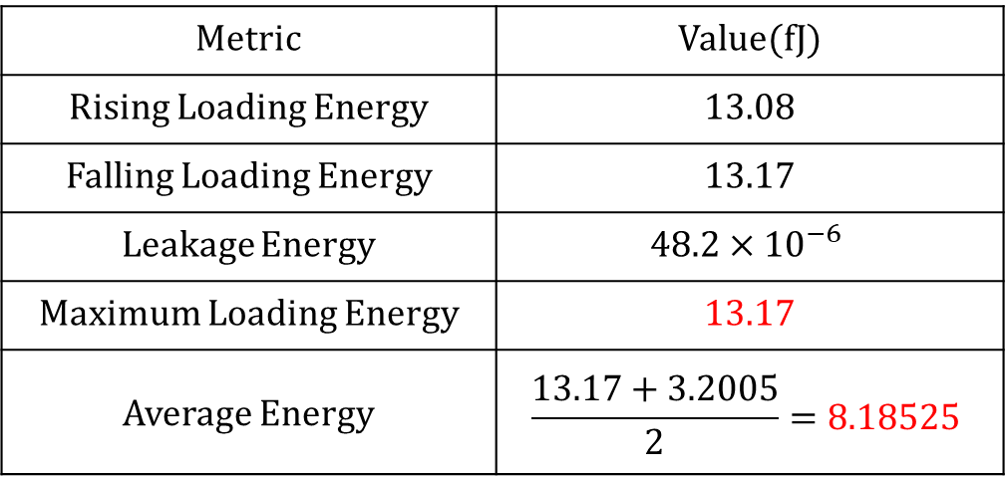
Design Metrics:
Energy Calculation for SRAM
Metric | Value(fJ)
Rising Loading Energy | 13.08
Falling Loading Energy | 13.17
Leakage Energy | $$48.2×{10}^{−6}$$
Maximum Loading Energy | 13.17
Average Energy | $$\frac{13.17+3.2005}{2}=8.18525$$
Table 5: Energy Calculation

Slide 12
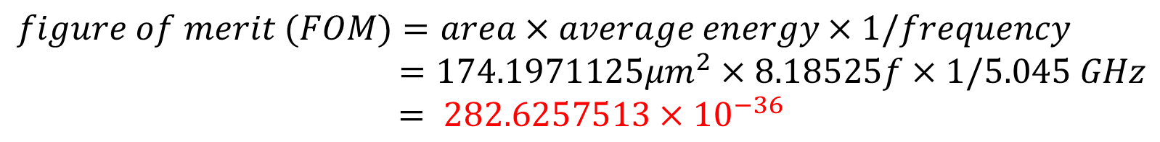
Figure Of Merit (FOM)
$$figure of merit (FOM)=area×average energy×1/frequency$$
$=174.1971125μm^{2}×8.18525f×1/5.045 GHz$
$$= 282.6257513×{10}^{−36}$$

Slide 13
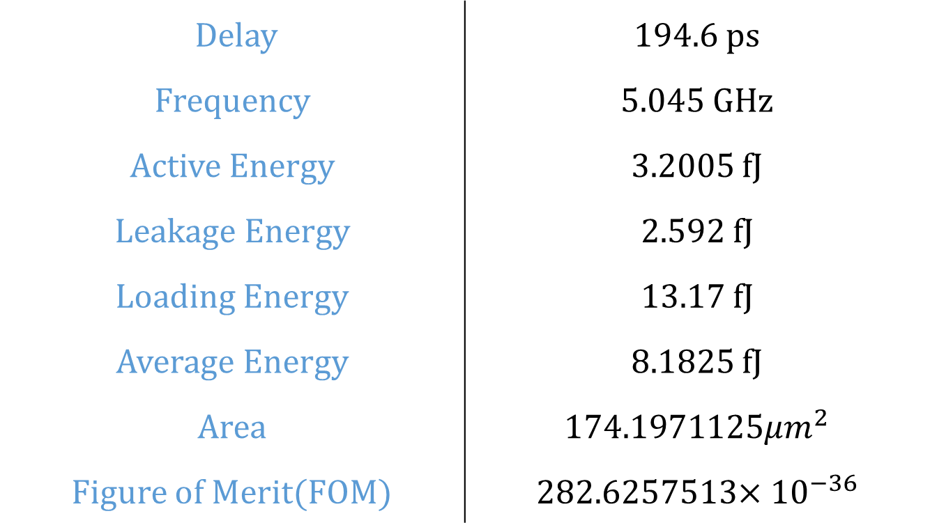
SUMMARY
Delay | 194.6 ps
Frequency | 5.045 GHz
Active Energy | 3.2005 fJ
Leakage Energy | 2.592 fJ
Loading Energy | 13.17 fJ
Average Energy | 8.1825 fJ
Area | $174.1971125μm^{2}$
Figure of Merit(FOM) | 282.6257513$×{10}^{−36}$

