Slide 1
AI 565
Project Name: Topics Models (Polya Distribution)
Shakil Ahmed Sumon, Derek Helms

Slide 2

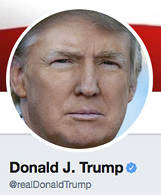
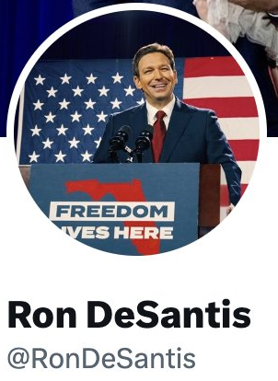
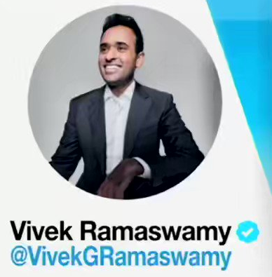
AI 565 Project: Topics Models
“You know, with Biden, you go like this – whew – and he goes down.”
“The presidency is not a job for someone that's 80 years old”
“Biden running for re-election is ‘elder abuse’ by ‘managerial class’ ”

Slide 3
AI 565 Project: Topics Models
“You know, with Biden, you go like this – whew – and he goes down.”
Biden
“The presidency is not a job for someone that's 80 years old”
“Biden running for re-election is ‘elder abuse’ by ‘managerial class’ ”

Slide 4
AI 565 Project: Topics Models
“You know, with Biden, you go like this – whew – and he goes down.”
Election
“The presidency is not a job for someone that's 80 years old”
“Biden running for re-election is ‘elder abuse’ by ‘managerial class’ ”

Slide 5
AI 565 Project: Topics Models
“You know, with Biden, you go like this – whew – and he goes down.”
Politics
“The presidency is not a job for someone that's 80 years old”
“Biden running for re-election is ‘elder abuse’ by ‘managerial class’ ”

Slide 6

AI 565 Project: Topics Models
4
7
13
…
5
9
21

Slide 7

AI 565 Project: Topics Models
4
7
13
…
5
9
21
0
22
31
…
54
1
1

Slide 8
AI 565 Project: Topics Models
4
7
13
…
5
9
21
0
22
31
…
54
1
1
21
1
0
…
0
1
98

Slide 9
AI 565 Project: Topics Models
4
7
13
…
5
9
21
0
22
31
…
54
1
1
21
1
0
…
0
1
98
1
77
10
…
0
11
8

Slide 10
AI 565 Project: Topics Models
4
7
13
…
5
9
21
T1, T3
0
22
31
…
54
1
1
T2, T3
21
1
0
…
0
1
98
T3, T4
1
77
10
…
0
11
8
T1, T4

Slide 11
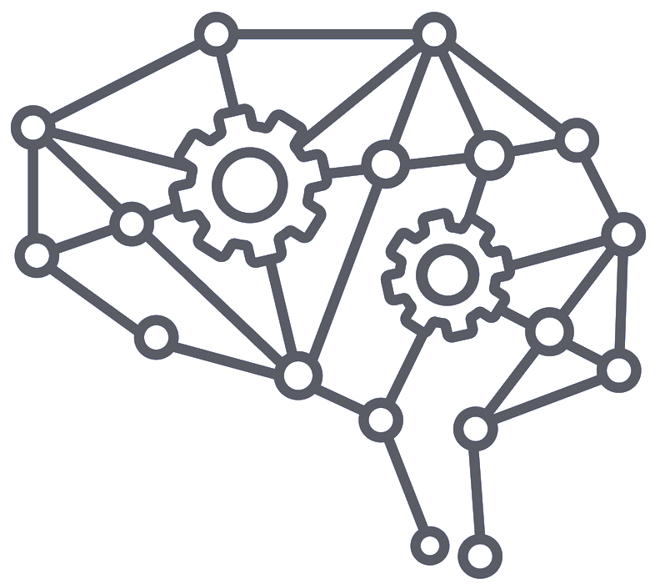




AI 565 Project: Topics Models
$$θ1$$
4
7
13
…
5
9
21
$$θ2$$
$$θ3$$
0
22
31
…
54
1
1
.
.
.
.
.
.
.
21
1
0
…
0
1
98
1
77
10
…
0
11
8
$$θn$$
Model
Parameters
Bag of words

Slide 12
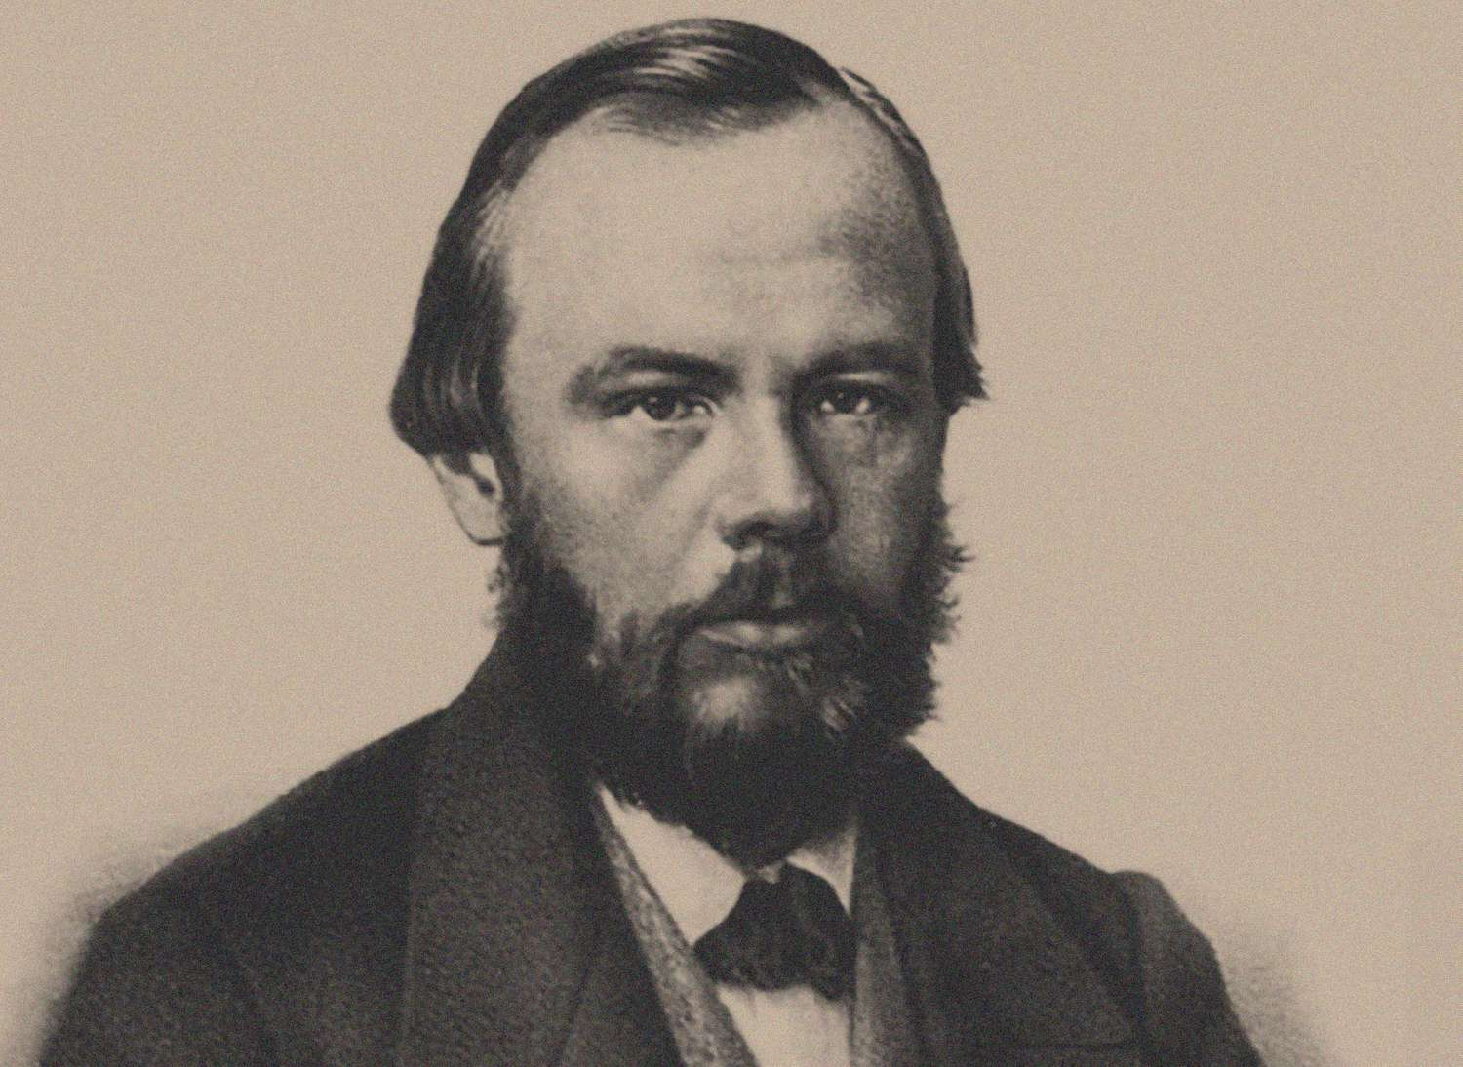
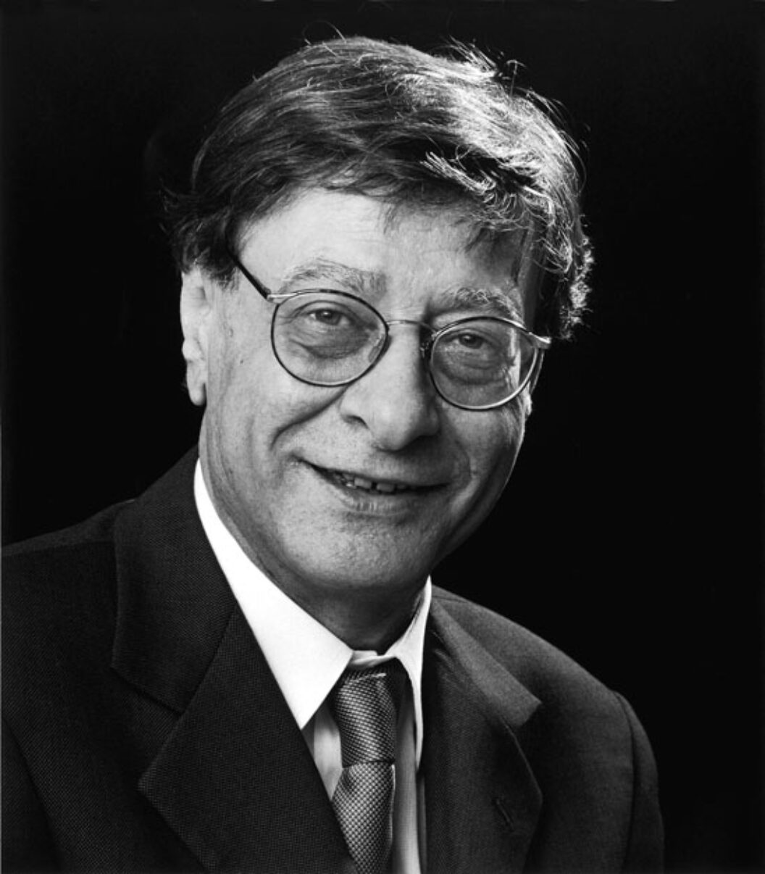
AI 565 Project: Topics Models
Hypothetical Example
Dostoevsky
Suffering, Depression, Loneliness, Struggle, Pain
Darwish

Slide 13
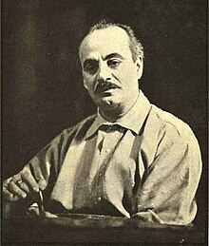
AI 565 Project: Topics Models
Hypothetical Example
Suffering, Depression, Loneliness, Struggle, Pain
Darwish
Hope, Love, Spirituality
Gibran

Slide 14
AI 565 Project: Topics Models
Hypothetical Example
Hope, Love, Spirituality
Gibran

Slide 15
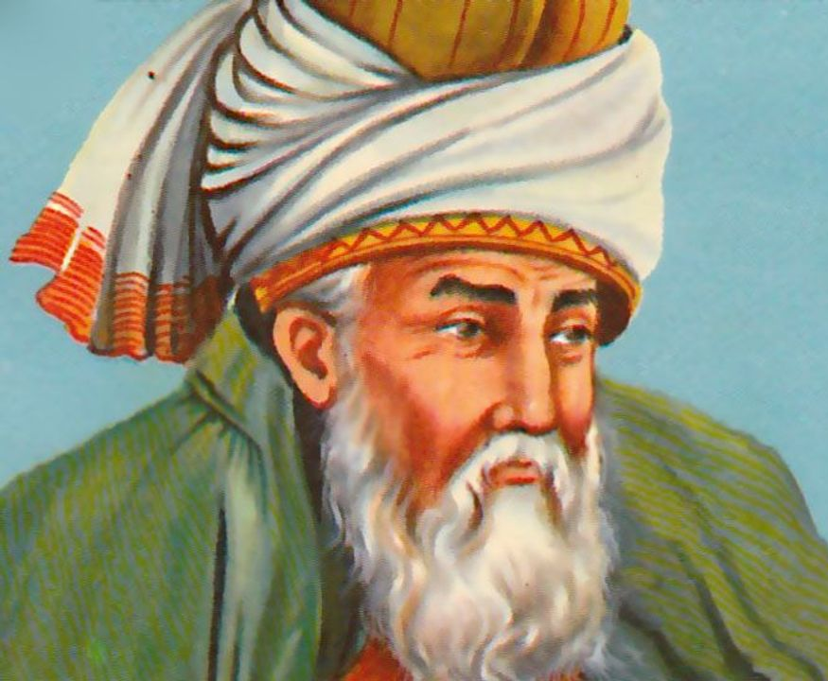
AI 565 Project: Topics Models
Hypothetical Example
Gibran
Hope, Love, Spirituality
Rumi

Slide 16
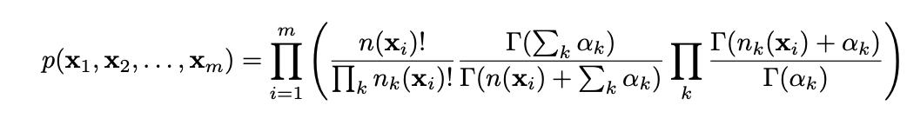
AI 565 Project: Topics Models
Project Setting
Polya Distribution:

Slide 17
AI 565 Project: Topics Models
Project Setting
Number of Samples
Length of document
Parameters

Slide 18


AI 565 Project: Topics Models
Project Setting
$$α1$$
$$κ∈$$
1,2
Beta-binomial Model
Parameters:
$$α2$$
Our vocabulary has only two words

Slide 19
AI 565 Project: Topics Models
Data Generation
Probability Vector
Word Vector
0.4
1

Slide 20
AI 565 Project: Topics Models
Data Generation
Probability Vector
Word Vector
0.4
1
0
0.6

Slide 21
AI 565 Project: Topics Models
Data Generation
Probability Vector
Word Vector
0.4
1
0
1
0.6
0.5

Slide 22
AI 565 Project: Topics Models
Data Generation
Probability Vector
Word Vector
0.4
1
0
1
0
0
1
0.6
0.5
0.7
0.8
0.1

Slide 23
AI 565 Project: Topics Models
Data Generation
Probability Vector
Word Vector
0.2
1
0
1
0
0
1
0.1
0.2
1
1
1
1
1
0
0.1
0.3
0.9

Slide 24
AI 565 Project: Topics Models
Data Generation
Probability Vector
Word Vector
0.8
1
0
1
0
0
1
0.6
0.5
1
1
1
1
1
0
0.4
1
1
1
0
1
0
0.7
0.5

Slide 25
AI 565 Project: Topics Models
Data Generation
Probability Vector
Word Vector
0.1
1
0
1
0
0
1
0.2
0.3
1
1
1
1
1
0
0.9
1
1
1
0
1
0
0.9
0.5
0
0
0
1
1
1

Slide 26

AI 565 Project: Topics Models
Data Generation
Word Vector
1
0
1
0
0
1
3 3
1
1
1
1
1
0
1 5
1
1
1
0
1
0
2 4
0
0
0
1
1
1
3 3

Slide 27
AI 565 Project: Topics Models
Data Generation
Bag of words
Word Vector
1
0
1
0
0
1
3 3
1
1
1
1
1
0
1 5
$$α1$$
Model
$$α2$$
1
1
1
0
1
0
2 4
0
0
0
1
1
1
3 3

Slide 28
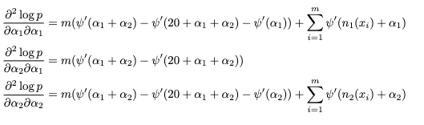
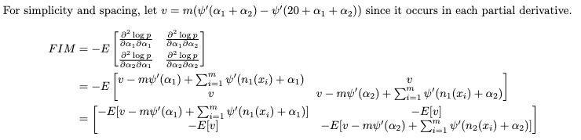
AI 565 Project: Topics Models
CRLB Calculation
Second Derivatives
FIM

Slide 29
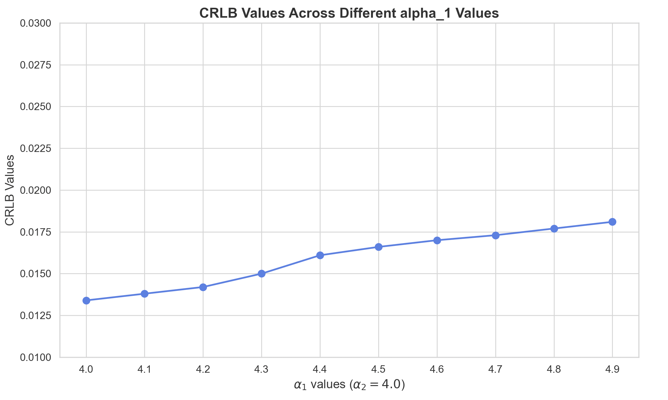
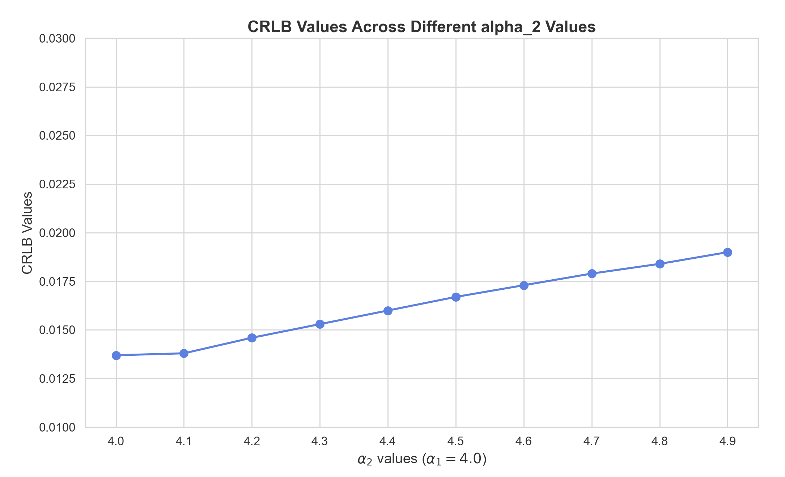
AI 565 Project: Topics Models
CRLB Calculation

Slide 30
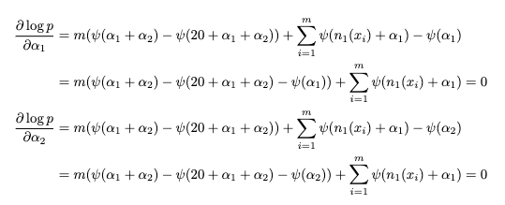
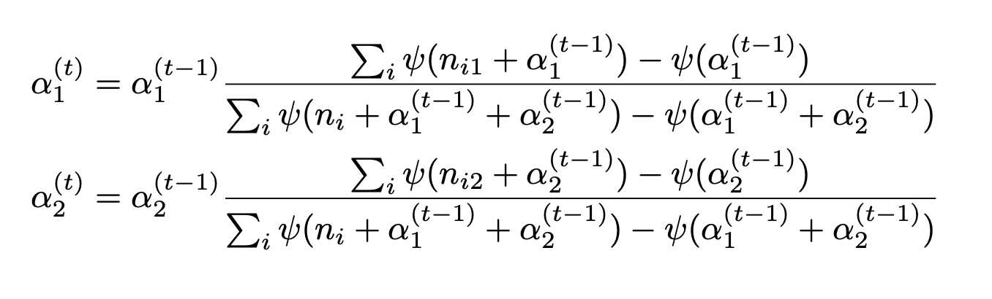
AI 565 Project: Topics Models
MSE Calculation
MLE equations
Iterative equation

Slide 31
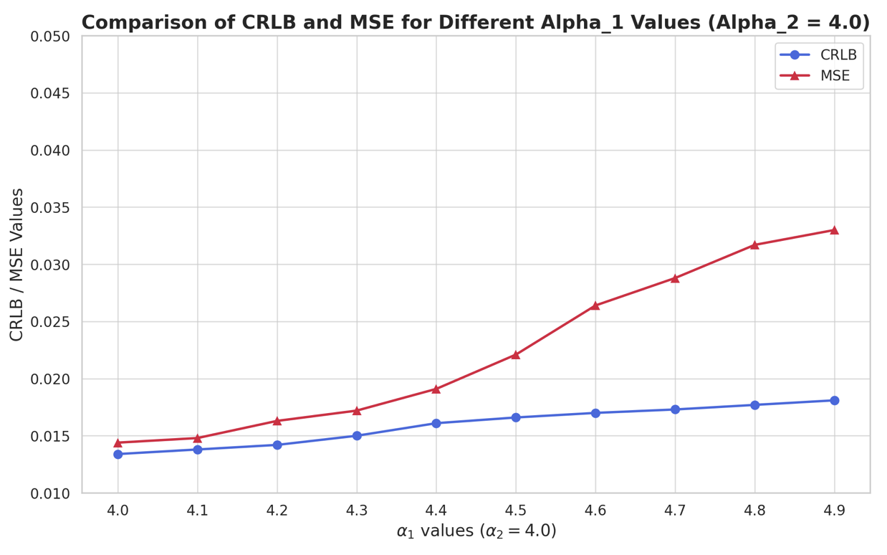
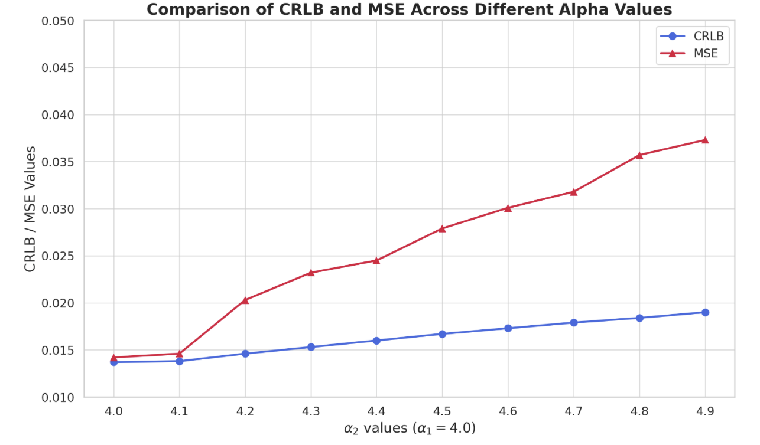
AI 565 Project: Topics Models
MSE Calculation

Slide 32
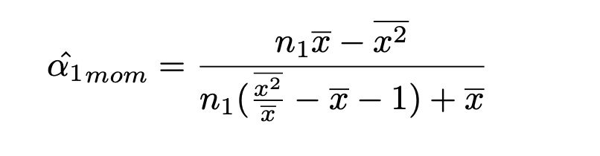
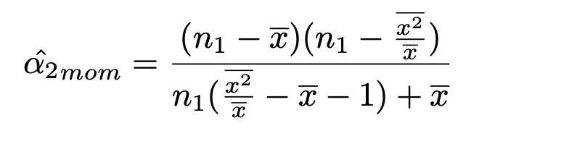
AI 565 Project: Topics Models
MoM Calculation

Slide 33
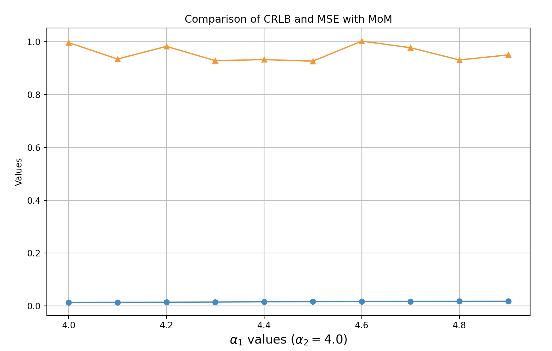
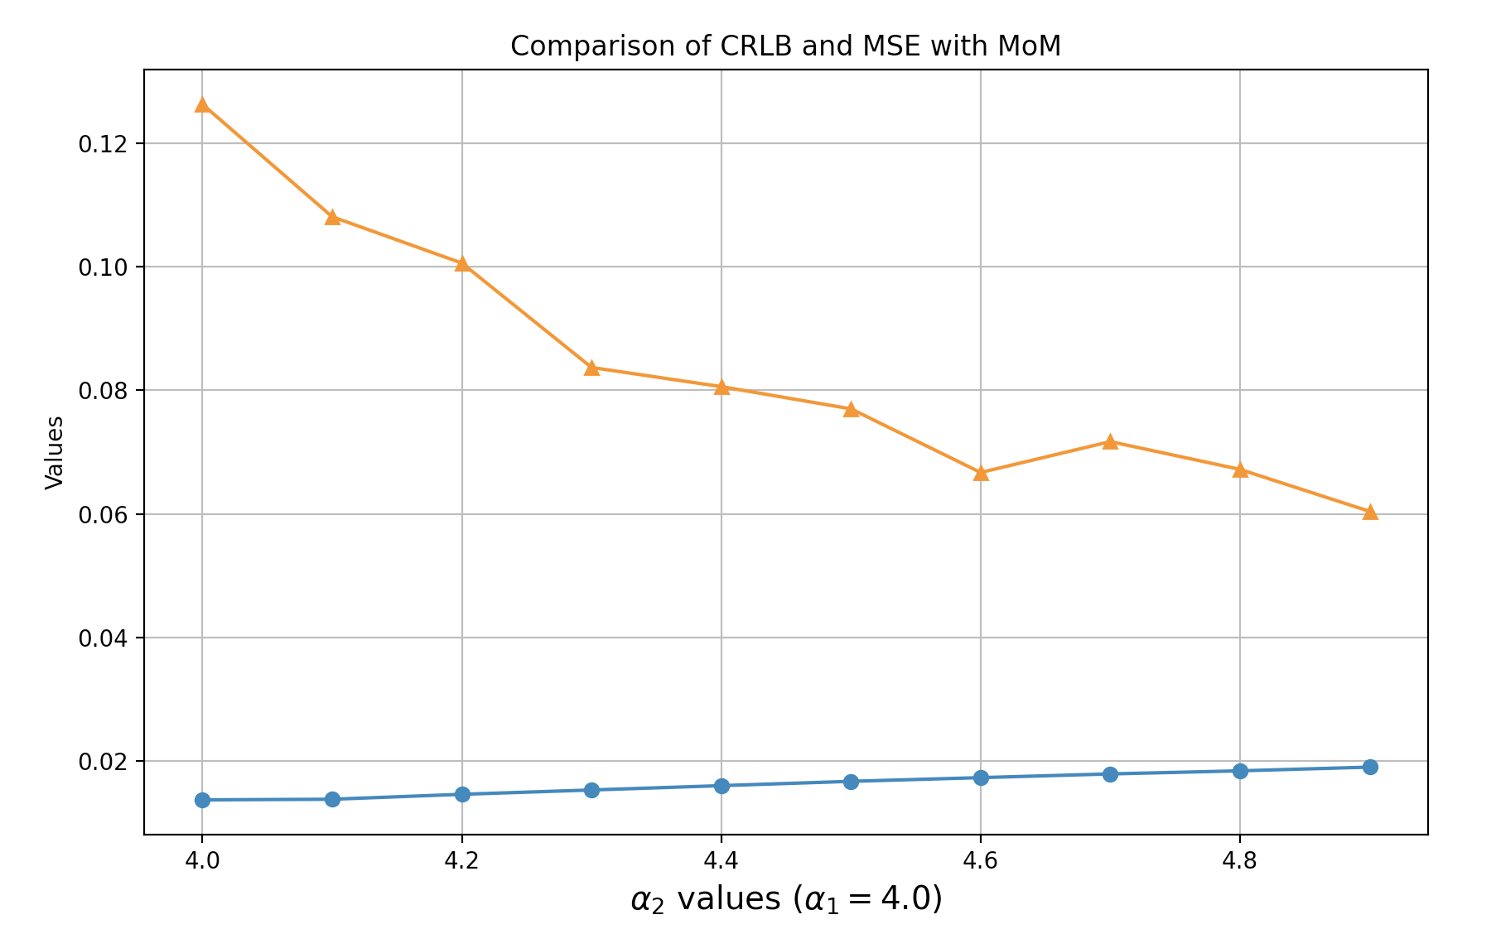
AI 565 Project: Topics Models
MoM Calculation

Slide 34
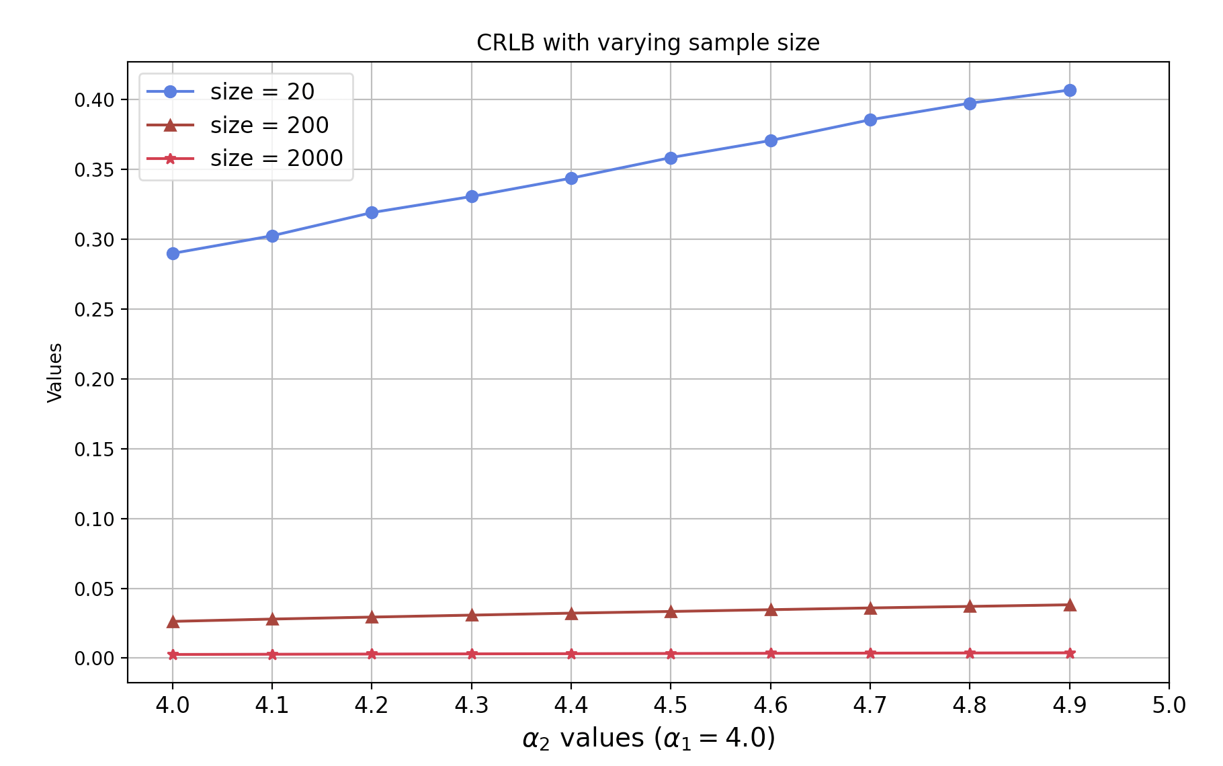
AI 565 Project: Topics Models
Observations
CRLB decreases with increasing number of samples

Slide 35
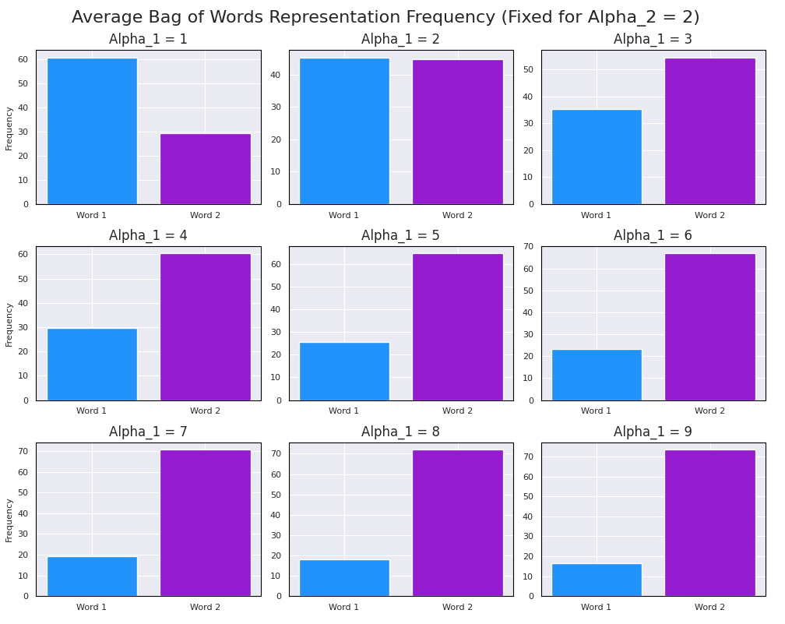
AI 565 Project: Topics Models
Observations
Impact of word frequency

Slide 36
AI 565 Project: Topics Models
Questions?

