Slide 1
Tritron online Judge
Md. Razibul Hasan Mithu
161-15-882
Syed Mohammad Fahim Abrar
161-15-903
Mohammad Sakil Mahmud
161-15-884
Frof. Dr. Syed Akhter Hossain
Head
Department of CSE
Daffodil International University
Tuesday 26 November 2019

Slide 2
Outline
Introduction
Problem definition
Objective
Challenges and Limitations
Tools and Component
Result
Conclusion
Reference

Slide 3
Introduction
Tritron Online Judge is an automated code judging solution. It can automate the
process of checking individuals code against a set of input-output with the generated
output while executing the code. Without any doubt, it will add a huge advantage in
evaluating student’s code in academic purpose. The automatic environment will save
the time of professors on the other hand students will able to evaluate themselves
immediately from the verdict of the automated judge. This will increase the
algorithmic skills of students.

Slide 4
Problem definition
The typical issues of manual judging of lab performance of students, for example, in
traditional way lab instructors have to collect code from all computers from lab
manually in storage devices ,then have to go through all the students code manually
compiling them and giving input in a console and observing output of the code and
judge them if the output was correct. Collecting code itself is a lengthy process then
compiling one by one and judge them manually is a painful and brainstorming time
killing job.

Slide 5
Continue…
Another factor is that in this way students are bound to submit one code script for
each question only. And there was no opportunity to know if their code was right or
wrong in real-time. They have only the opportunity to know the final grade when the
final result is published. There was no way to practice the questions later after lab
evaluation finished. But solving after the exam is the most important factor to sharpen
algorithmic knowledge and correction of their common mistakes.

Slide 6
Objective
● Paperless exam for lab evaluation of programming and algorithmic courses.
● Time-efficient lab evaluation system.
● Realtime verdict for students code.
● Realtime rank list based on a timely fashion.
● Unlimited submission for single question script.
● Opportunity to observe previously submitted code.
● Practice offline problem-solving.
● Introducing students to programming content and online judges.
● Reduce manpower for arranging programming lab evaluation.
● Reducing human error in judging answer scripts.
● The easy re-judging system if there is a question error.

Slide 7
Challenges & Limitations
Code Sandboxing for malicious code
Multithreading
Visibility Problem
Flag continuation in the compiler

Slide 8
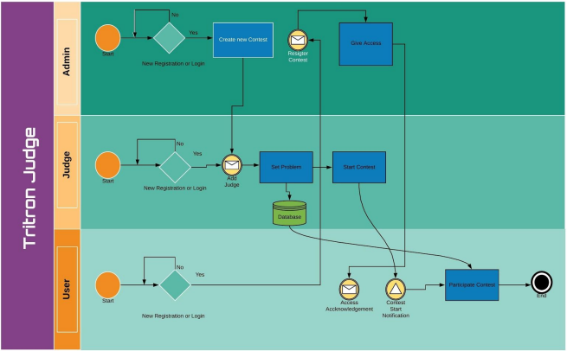
Business Process Modeling

Slide 9
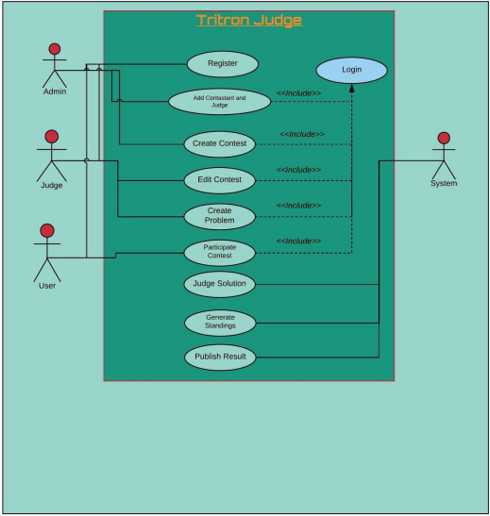
Use Case Diagram

Slide 10
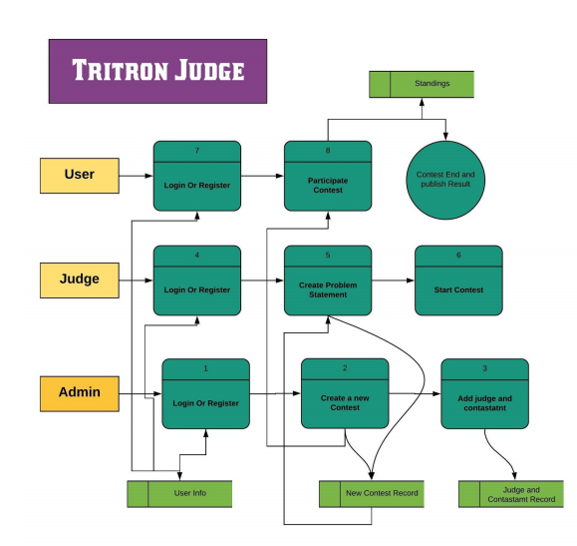
Data Flow Diagram

Slide 11
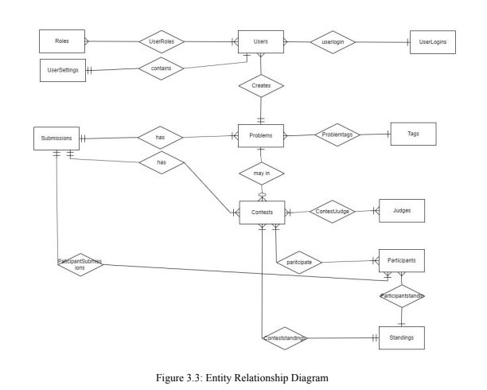
E-R Diagram

Slide 12
Tools and Component

Slide 13
Front-end Design
HTML
CSS
Bootstrap
JavaScript

Slide 14
Back-end Design
Asp.net MVC5
SQL Server and Entity Framework
Identity Framework
SignalR and SQL Dependency

Slide 15
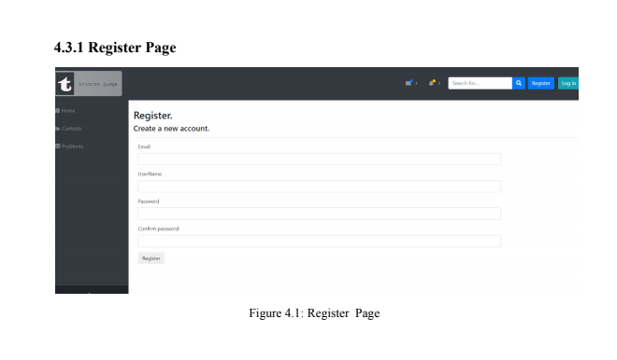
Registration Page

Slide 16
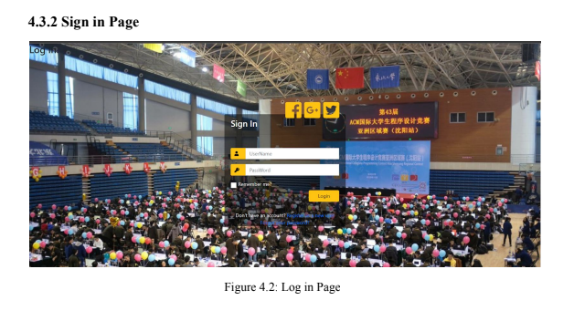
Sign in page

Slide 17
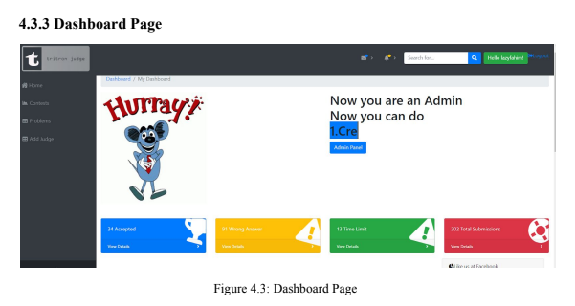
Dashboard page

Slide 18
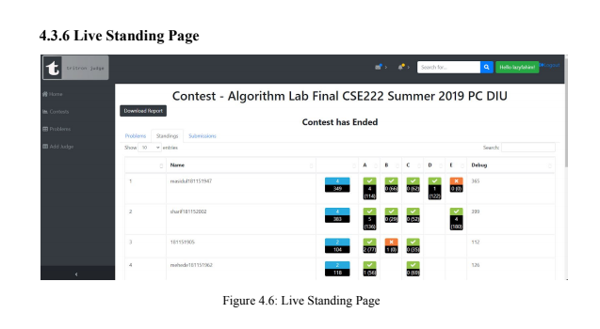
Standings page

Slide 19
Conclusion
Tritron Online Judge empowers not only in programming contest sector but also in
taking lab evaluation and can be used in academic sector and as well as software
engineer recruitment. It’s barrier less access to set algorithmic problem in the website
will help to grow problem setters and solvers community among the students.

Slide 20
References
[1] CodeMarshal, available at <<https://algo.codemarshal.org/>>, last accessed on 16-10-2019 at 10:00 PM.
[2] HackerRank, available at <<https://www.hackerrank.com/home>>, last accessed on 16-10-2019 at 10:50 PM.
[3] LightOj , available at<<http://lightoj.com/login_main.php>>,last accessed on 16-10-2019 at 10:50 PM.
[4] HTML, available at <<https://en.wikipedia.org/wiki/HTML>>, last accessed on 19-10-2019 at 08:00 PM.
[5] Cascading Style Sheets, available at <<https://en.wikipedia.org/wiki/Cascading_Style_Sheets>>, last accessed on 19-10-2019 at 08:20 PM.

Slide 21
[6] Why do we use Bootstrap?, available at <<https://www.quora.com/Why-do-we-use-Bootstrap>>, last accessed on 19-10-2019 at 08:40 PM.
[7] JavaScript, available at <<https://en.wikipedia.org/wiki/JavaScript>>, last accessed on 19-10-2019 at 09:10 PM.
[8] What’s New in ASP.NET MVC 5 that make your MVC web sites shine, available at
<<https://www.dotnetcurry.com/aspnet-mvc/975/new-features-aspnet-mvc-5>>, last accessed on 19-10-2019 at 10:15 PM.
[9] EntityFrameowork?,availableat<<https://docs.microsoft.com/en-us/ef/>>, last accessed on 19-10-2019 at 11:00 PM.

