Slide 1
Brazilian E commerce Public Dataset
A statistical approach.
Shakirali Vijapura

Slide 2
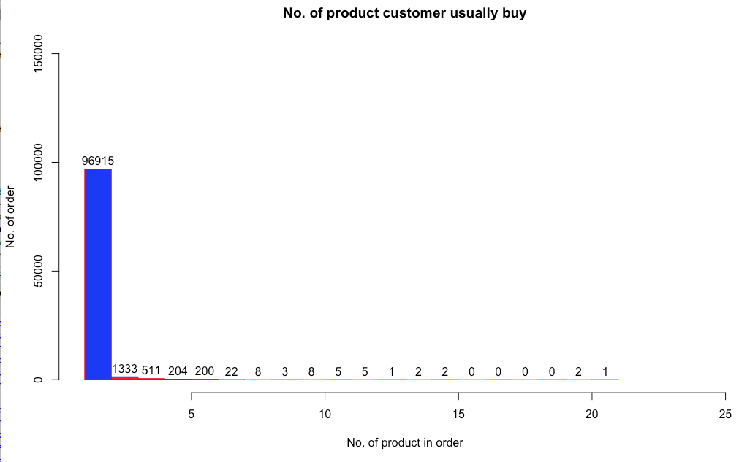
Number of products people usually buy per transaction

Slide 3
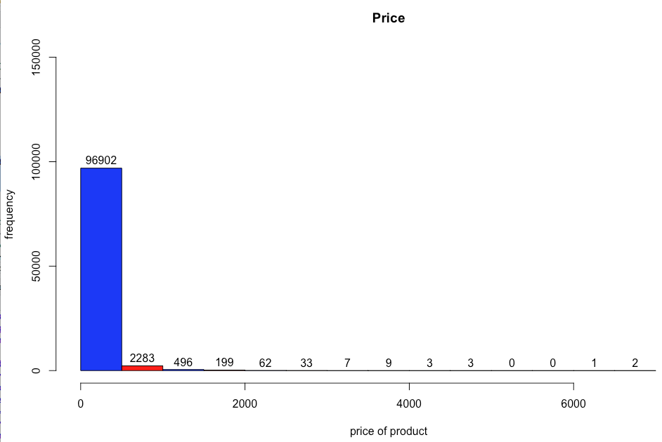
The most common product bought by the people in terms of price

Slide 4
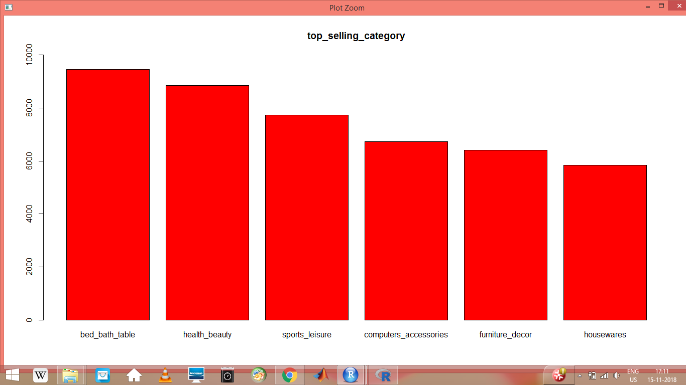
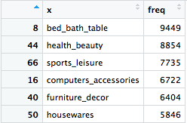
Which product category is purchased the most?

Slide 5
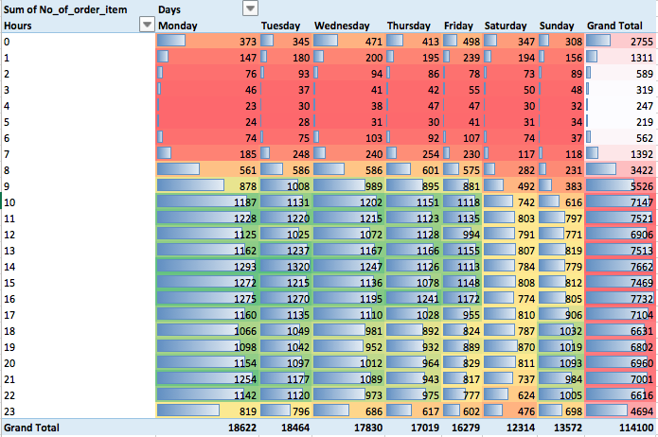
Heatmap of hourly transactions on different days of the week

Slide 6
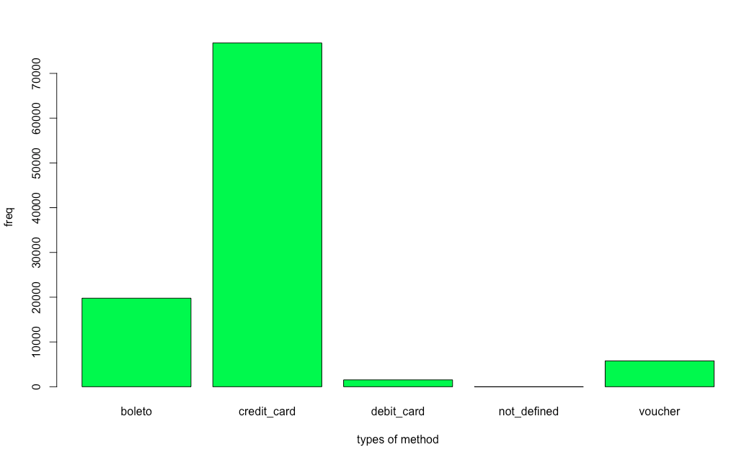
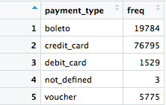
Which payment mode is preferred by the people more?

Slide 7
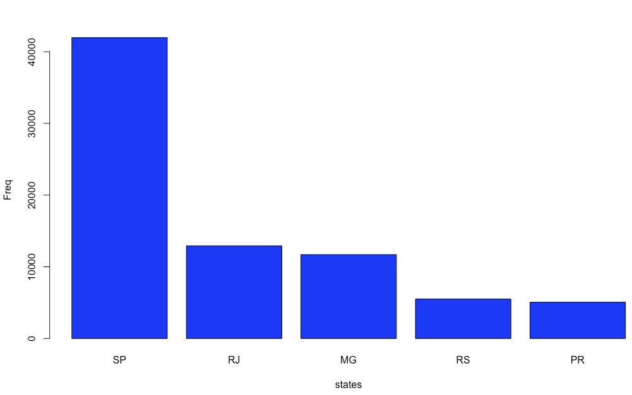
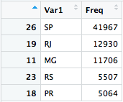
Which state has maximum buyers?

Slide 8
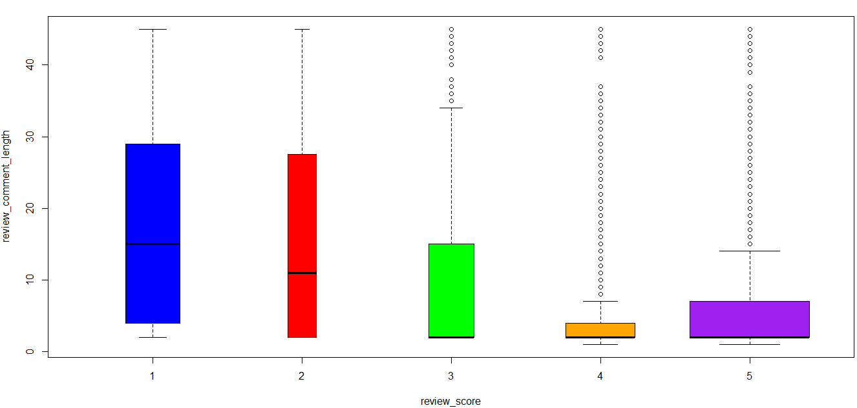
Analysis of review comment length

Slide 9
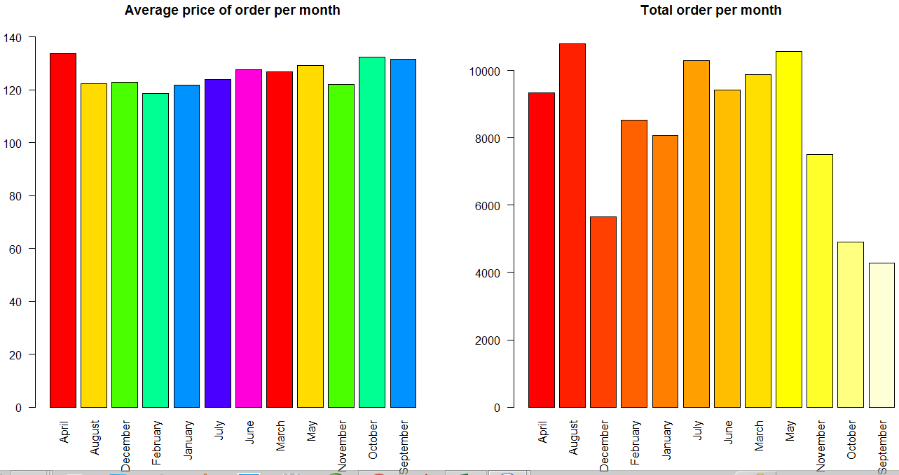
Analysis of average price of order per month and total volume of order per month

Slide 10
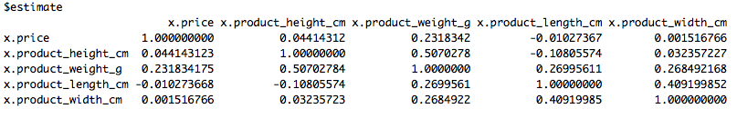
To identify the correlation

Slide 11
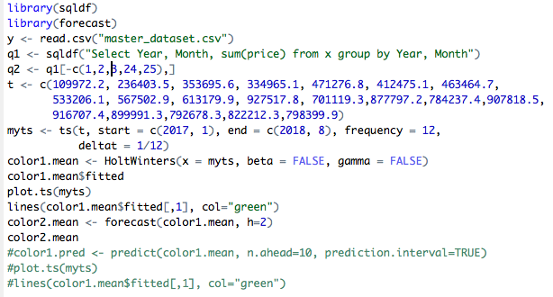

Analysis of sales over months

Slide 12
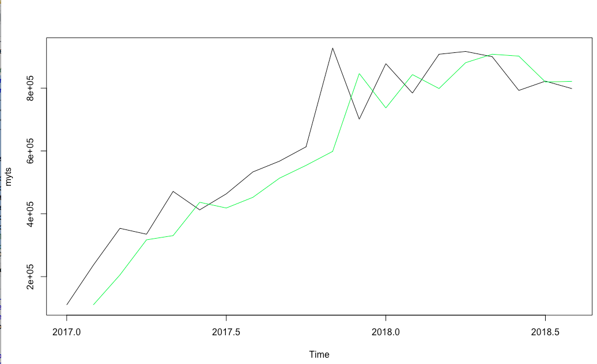
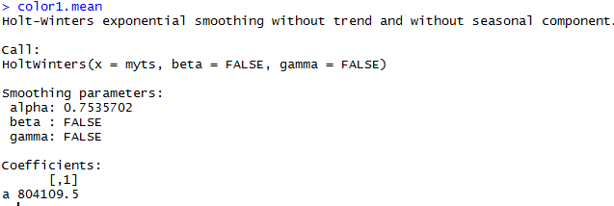

Slide 13
Testing of hypothesis
Mu price = 125. 7572399
Mu freight value = 20.18720002
We drew a large sample of 100 and a small sample of 20 out of the population.

Slide 14
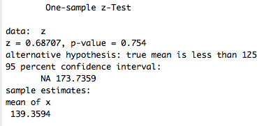

Considering the larger sample at 5% alpha can we say that the average price of the commodity is less than125?
H0 = Mu = 125
H1 = Mu<125
Alternate hypothesis was accepted
i.e. average price of a commodity is less than 125

Slide 15
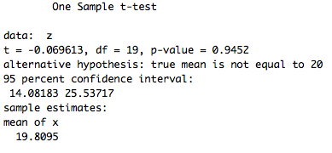

Considering the smaller sample can we say that the freight price is 20, at 1% alpha?
H0 = Mu = 20
H1 = Mu<>20
Alternate hypothesis was accepted
i.e. freight price is not equal to 20.

Slide 16
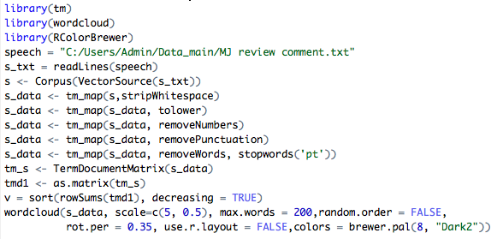
Sentiment analysis of review comment of MJ state having vote less than and equal to 3

Slide 17
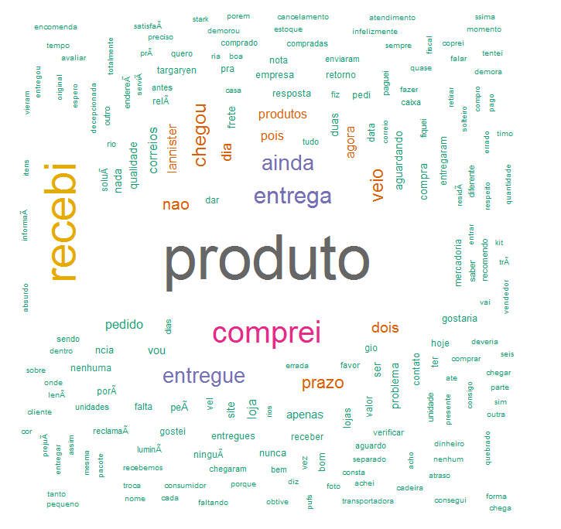
Produto | Product
comprei | bought
ainda | still
entrega | issue
frete | freight
nunca | never
errada | wrong
falta | lack
problema | problem

Slide 18


