Slide 1
Enhancing Agents Performance in VizDoom using Reinforcement Learning
Group Members:
Shakir Jan Samina Kousar
Munahil Yaqoob

Slide 2
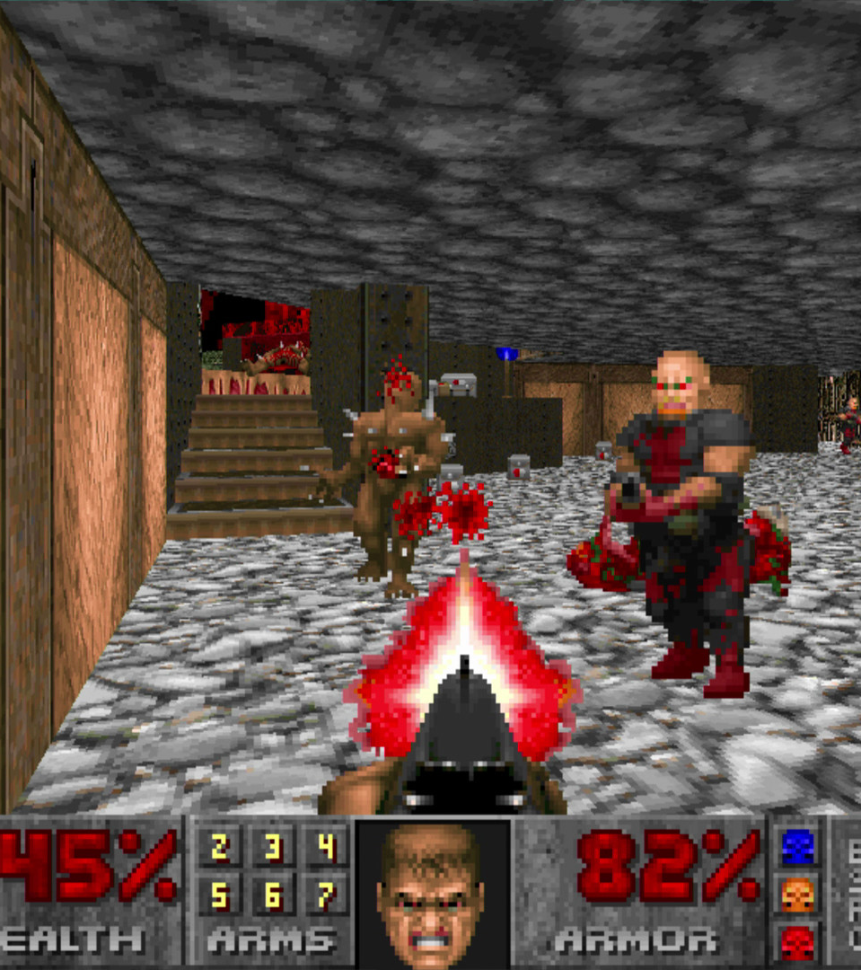
Introduction:
VizDoom:
Is a platform to train AI agents for playing Doom Game using visual information.
Doom:
First-person shooter video game where an AI agent plays the Doom game and controls it using visual information.
This can be done using reinforcement learning where the agent learns to play the game by trial and error.
Reinforcement Learning:
Here an agent interacts with the environment through trial-and-error method.

Slide 3
Objective:
Creating an intelligent AI agent that can play Doom video game with improved decision-making skills in different scenarios using reinforcement learning.
The agent will face various conditions like different no of enemies, different gaming levels which will improve its behavior and decisions through experiences.

Slide 4

Problem Description:
Currently, standard agents may struggle to make efficient decisions in various gaming environments, limiting their effectiveness.
That may be due to complex environments, incomplete information
It is much important for an AI agents to make efficient decisions in complex environments like healthcare systems, autonomous systems and robotics.

Slide 5

Methodology:
Choose a reinforcement learning algorithm: (PPO, A2C and DDDQN).
Why Proximal Policy Algorithm (PPO):
1. Empirical Success:
It has been successfully in both research and industry applications.
2. Sample Efficiency:
It can achieve good results with fewer samples from the environment by adjusting how much it changes its strategy each times it learns.
3. Stable Training:
PPO compares how likely the new strategy is compared to the old one and makes small adjustments accordingly. This helps the agent learn steadily without sudden swings or forgetting what it's learned before.

Slide 6
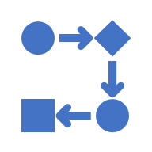
Why Advantage Actor Critic (A2C):
1. Value and Policy Learning:
Value-based methods in reinforcement learning estimate how good different situations or actions are, while policy-based methods directly learn the best way to act in each situation without worrying about estimating values.
2. Efficiency in Utilizing Experience:
It efficiently utilizes the agent’s experience by updating both functions simultaneously using the same set of experiences leading to faster learning.
3. Flexibility in architecture:
It can be implemented with various neural network architecture for the actor (action) and critic (value) networks making it suitable for different problem domains.

Slide 7

Why Double Dueling Deep Q-Network (DDDQN):
1. Improved learning stability
Builds upon the traditional DQN algorithm by adding the concept of Double Q learning which helps in stabilizing the learning process and mitigating over estimation bias.
2. Enhanced Exploration-Exploitation tradeoff
By using 2 separate Q Networks for action selection and evaluation DDDQN can better balance exploration (trying new actions) and exploitation (using learned actions).
3. Dueling Architecture:
It separates the value and advantage components of the Q values allowing the agent to learn the value of being in a particular state regardless of the chosen action.

Slide 8
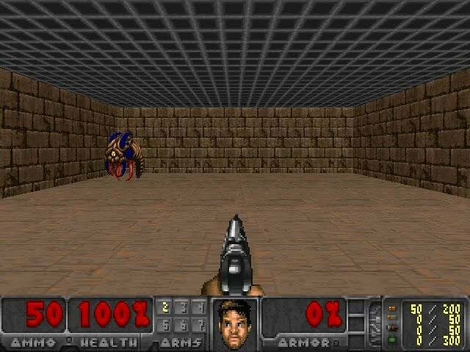
Basic Scenario
Agent has the properties of attacking, moving right and left.
Agents reside in a room with a single enemy.

Slide 9
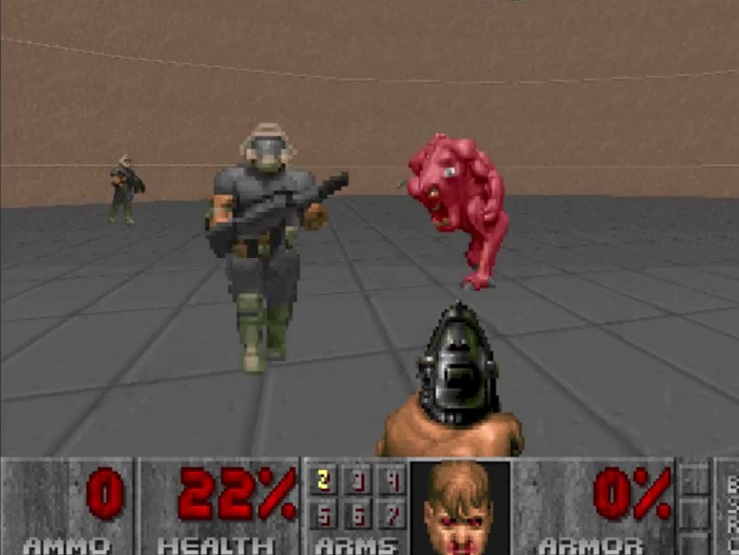
Defend the Center
Agent can only turn and shoot left and right.
Agent has limited ammunition.
Goal is to kill as many enemies as possible and agent receives a reward for killing the opponent.

Slide 10
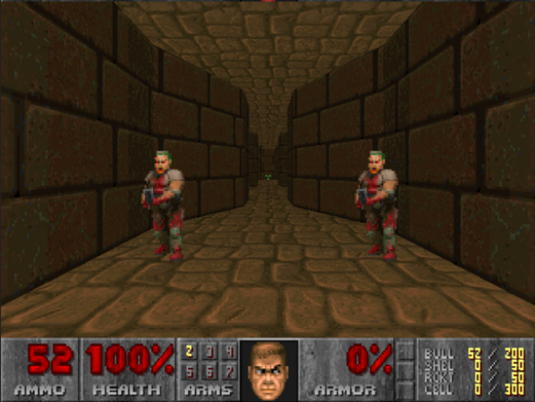
Deadly Corridor
Agent has the properties of moving left, right, forward, backward, turning left, right and attacking.
Main aim is to reach the goal.
Agent appear in a room with 6 enemies at left and right.

Slide 11
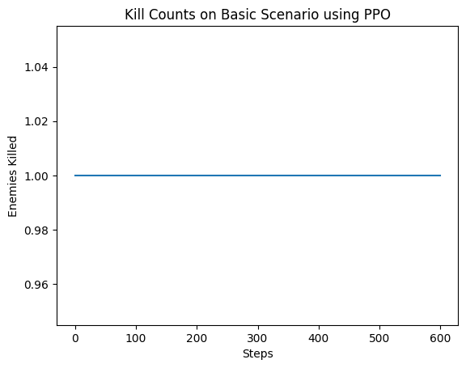
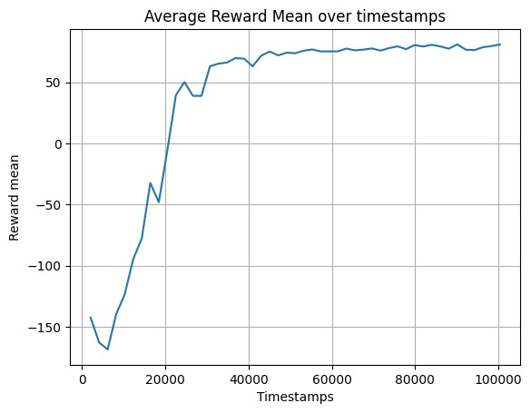
Graphs of Basic Scenario
Kills using PPO Average Reward using PPO

Slide 12
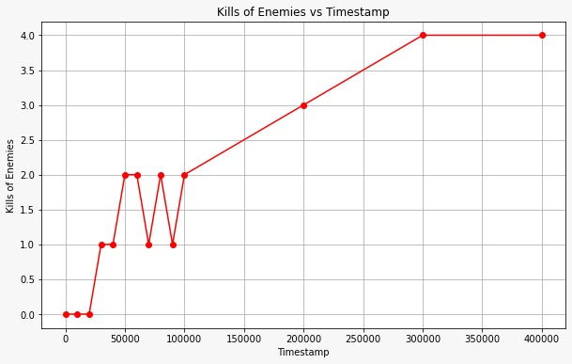
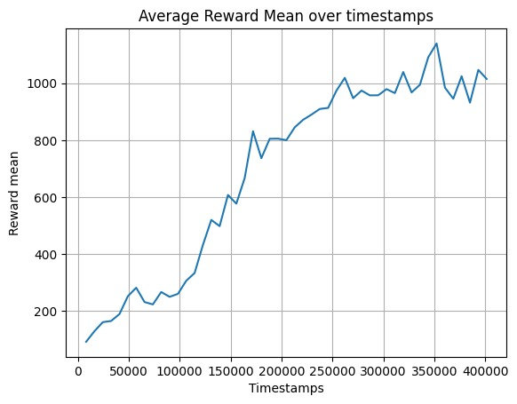
Graphs of Deadly Corridor Scenario
Kills using PPO Average Reward using PPO

Slide 13
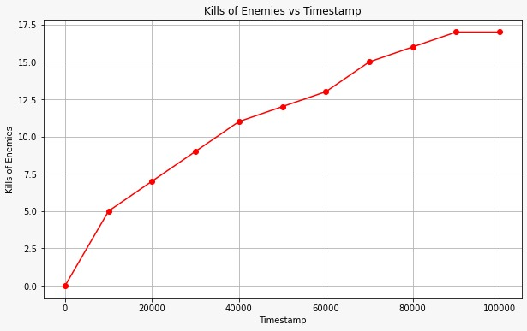
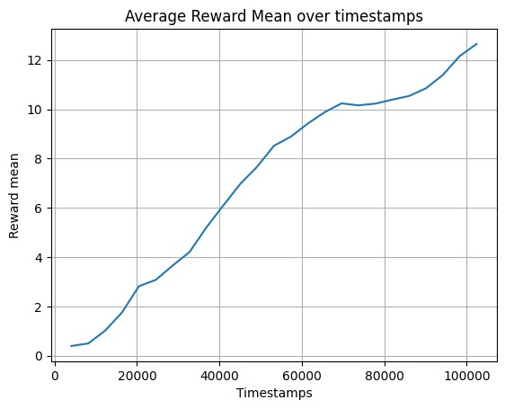
Graphs of Defend the Center Scenario
Kills using PPO Average Reward using PPO

Slide 14
Hyperparameters
1. Learning Rate:
High Learning rate agent initially learns quickly but could overshoot the policy and become unstable. It is the opposite for low learning rate agent.
2. Timesteps:
Shorter timesteps trained agent might not have enough time to explore the environment fully and learn an optimal policy. It is opposite the other way.
3. Batch Size:
Smaller batch trained agents might experience more variability in learning due to noisy updates. On the flip side larger ones could have smoother learning but require more memory and resources.
4. Number of Steps:
It determines the length of the trajectories used to estimate the policy gradient. Larger values may lead to more accurate gradient estimates but require more computational resources.

Slide 15
Hyperparameters in Training
A2C Training:
Agent = A2CAgent(INPUT_SHAPE, ACTION_SIZE, SEED, device, GAMMA, ALPHA, BETA, UPDATE_EVERY, Actor Cnn, Critic Cnn)
DDDQN Training:
def train(self, game, total_episodes = 100, pretrain = 100, frame_skip = 4, enhance = ‘dueling', lr = 1e-4, max_tau = 100, explore_start = 1.0, explore_stop = 0.01, decay_rate = 0.0001, gamma = 0.99, freq = 50, init_zeros = False
PPO:
model = PPO(‘Cnn Policy', env, tensorboard_log=LOG_DIR, verbose=1, learning_rate=0.0001, n_steps=2048)

Slide 16


