Slide 1
Enhancing Agents Performance in VizDoom using Reinforcement Learning
Group Members:
Shakir Jan Samina Kousar Munahil Yaqoob

Slide 2
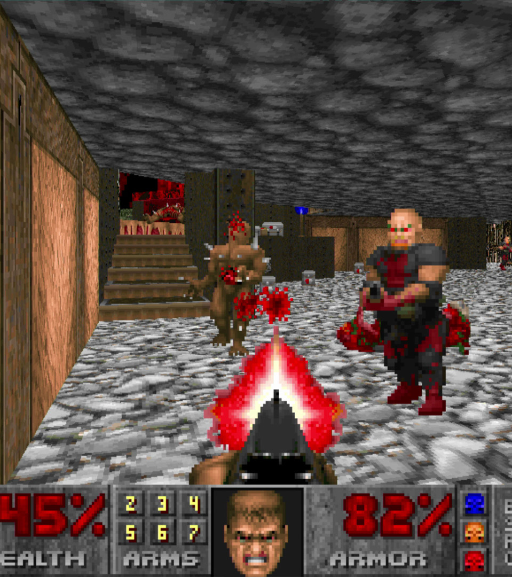
Introduction:
VizDoom:
Is a platform to train AI agents for playing Doom Game using only visual information.
It is based on the popular Doom video game engine and allows researchers to train AI agents to play the game using visual information only.
Doom:
First-person shooter video game.
To play you have to create an AI agent that plays the Doom game that controls it using visual information.
This can be done using reinforcement learning where the agent learns to play the game by trial and error.

Slide 3
Objective:
Creating an intelligent AI agent that can play Doom video game with improved decision-making skills in different scenarios using reinforcement learning.
We will be providing controlled gaming environment where the agent will face different conditions like varying no of enemies, different gaming levels which will improve its behavior and decisions through experiences.

Slide 4

Problem Description:
Currently, standard agents may struggle to make efficient decisions in various gaming environments, limiting their effectiveness.
That may be due to complex environments, incomplete information
It is much important for an AI agents to make efficient decisions in complex environments like healthcare systems, autonomous systems and robotics.

Slide 5

Methodology:
Choose a reinforcement learning algorithm: (PPO, TD3, DDDQN).
Both are relatively easy to train and use.
Have been shown to display state-of-the-art results in a variety of video games.
PPO needs small amount of data to train on and deliver results.
TD3 makes it easy for agents to decide on which action to take quickly gets out of overestimation bias .
Design custom game scenarios:
By providing controlled scenarios we will enhance the agent’s capabilities to face all sorts of challenges in the game.
Train the agent:
Repeatedly training the agent on a custom designed game scenario with specified conditions until it achieves the desired functionality.
Evaluate the agent’s performance:
We will test the agent in the scenarios we trained it for.

Slide 6
Project Scope:
Design and develop custom game scenarios tailored to the specific challenges of the VizDoom environment.
Implement reinforcement learning algorithms to train the agent on the custom game scenarios.
Evaluate the agent's performance on a variety of unseen VizDoom scenarios.
Analyze the agent's performance to identify areas for improvement.

Slide 7
Feasibility Study:
Project taking longer time, can be resolved by breaking down the project into smaller, manageable chunks and then working on it.
Agents that are unable to perform well can be resolved by different reinforcement learning algorithms and custom game scenarios.
Designing diverse game scenarios, can reduce the risk of the agent overfitting and improve its ability to generalize its performance to new and unseen VizDoom scenarios.

Slide 8
Solution Application Areas:
Gaming: Trained AI agents can create more fun and engaging NPCs.
Robotics: Trained agents can control robots that can be used to carry out dangerous, repetitive tasks and everyday human tasks.
Self-driving-cars: Trained AI agents control these cars that lead to more safety and less accidents.
Finance: Trained AI agents improve the financial market by making intelligent trading decisions.
Healthcare: Trained AI agents can develop new medical treatments and diagnose diseases.

Slide 9
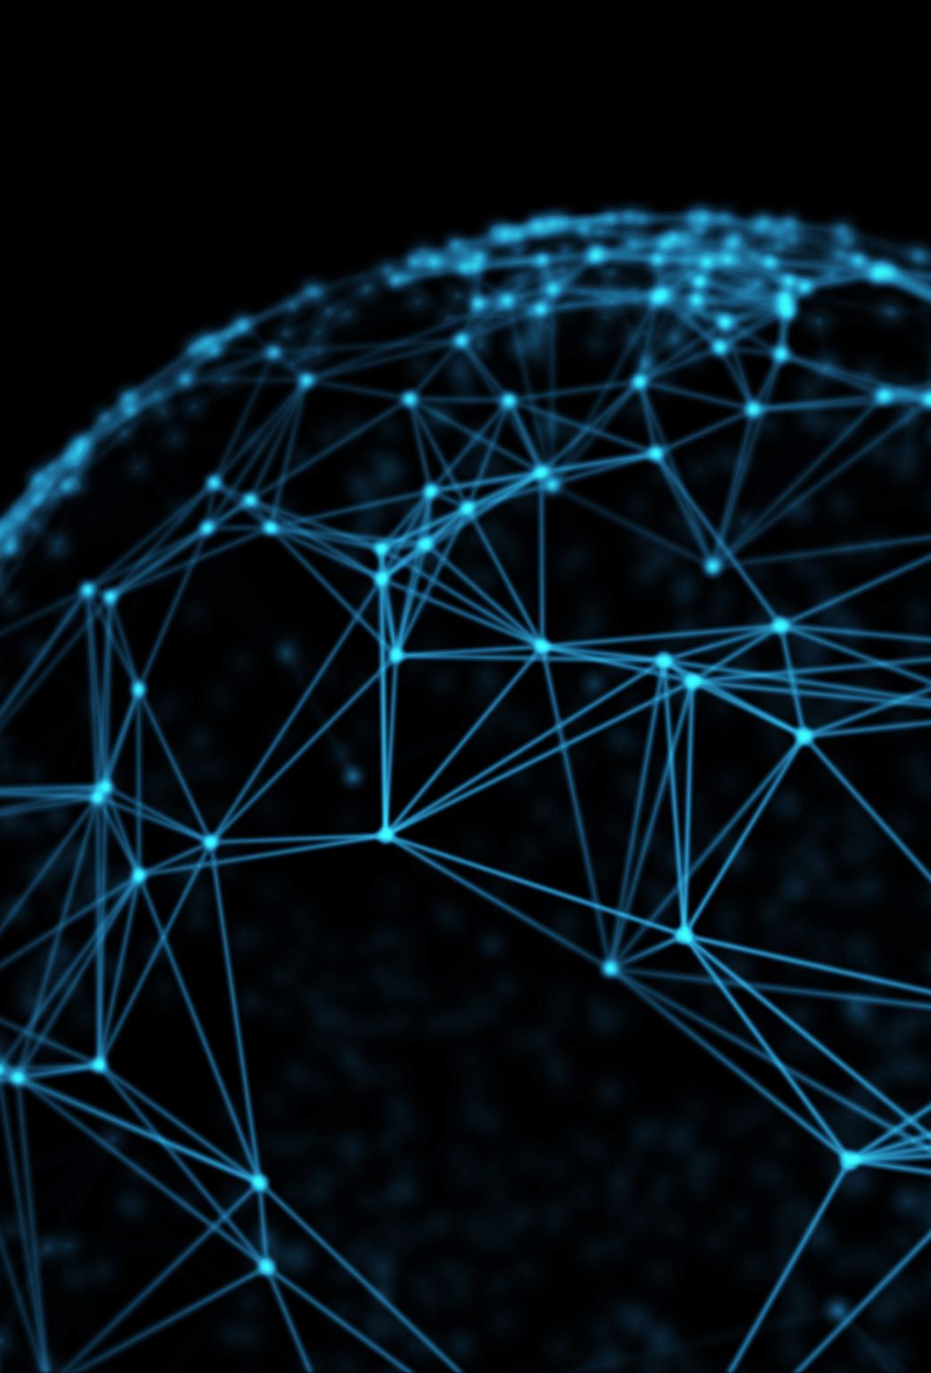
Tools/Technology:
Hardware:
A computer with a powerful CPU and GPU.
Software:
The VizDoom environment.
The TensorFlow reinforcement learning library.
The Python programming language.
Additional tools and technologies:
A cloud computing platform (such as Google Cloud Platform or Amazon Web Services).
The PyCharm IDE.
The Git version control system.
The PyLint debugging tool.

Slide 10


