Slide 1

GradientBoostingRegressor

Slide 2
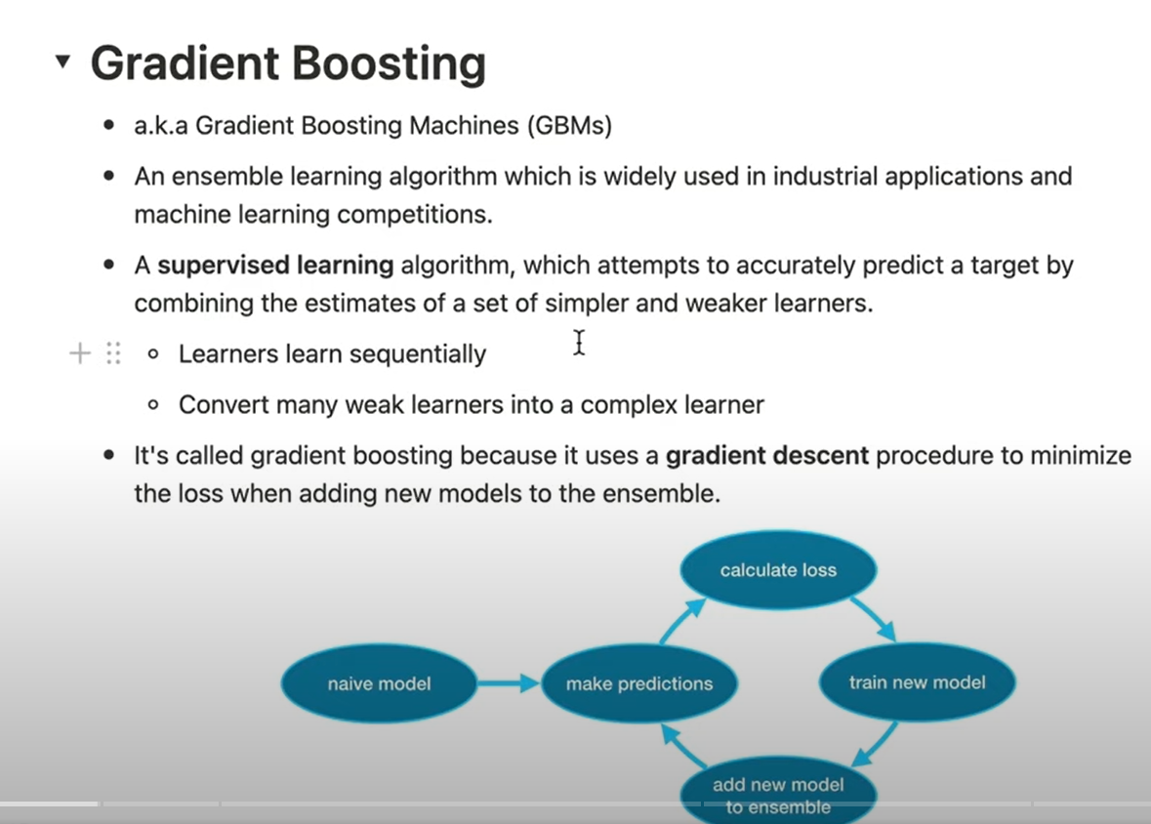
This estimator builds an additive model in a forward stage-wise fashion; it allows for the optimization of arbitrary differentiable loss functions. In each stage a regression tree is fit on the negative gradient of the given loss function.

Slide 3
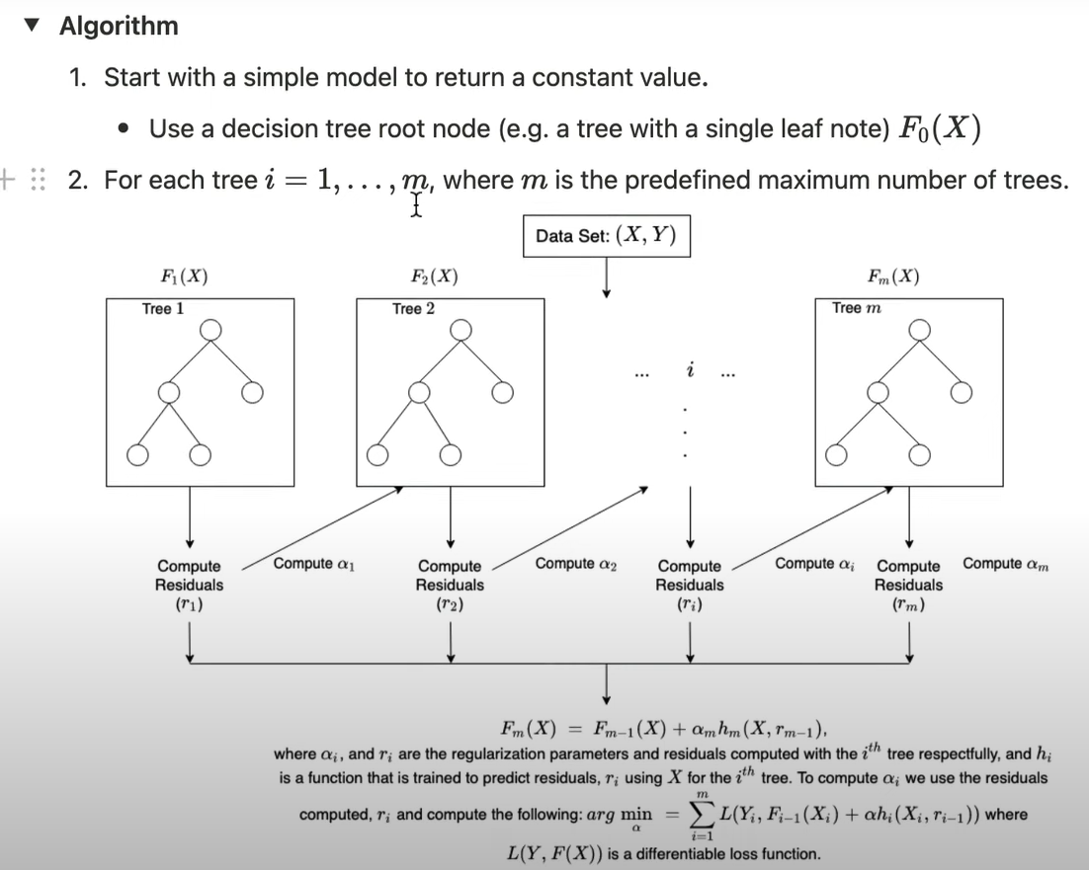

Slide 4


Slide 5
THANK YOU

