Slide 1
FurlenCode 2016
Team : GeekOn
Members:
Sujeet Pandey
Manish Kumar Singh
Shalaka Mane

Slide 2
Promblem Statement: NightOwl
Technologies used:
HTML 5 , CSS3 , JAVA Script
Bootstrap3, Google Map api
JAVA REST
Maven
MySql

Slide 3
Idea & Target User
Late nights people face issues in getting medicines or to be more causal “tea, Liquor,cigratte etc”.
We are basically consider these small store as our target customer and providing a way to solve this problem through our product.
The approch is simple and user-friendly.

Slide 4
Approach
The main approch is as follows:
User opens the hompage of our site, he will initially get a veiw of all the store nearby area from his current location.
He can filters the search and get corrosponding results.
He can check in at any store , which also update the store location and time into our database.

Slide 5
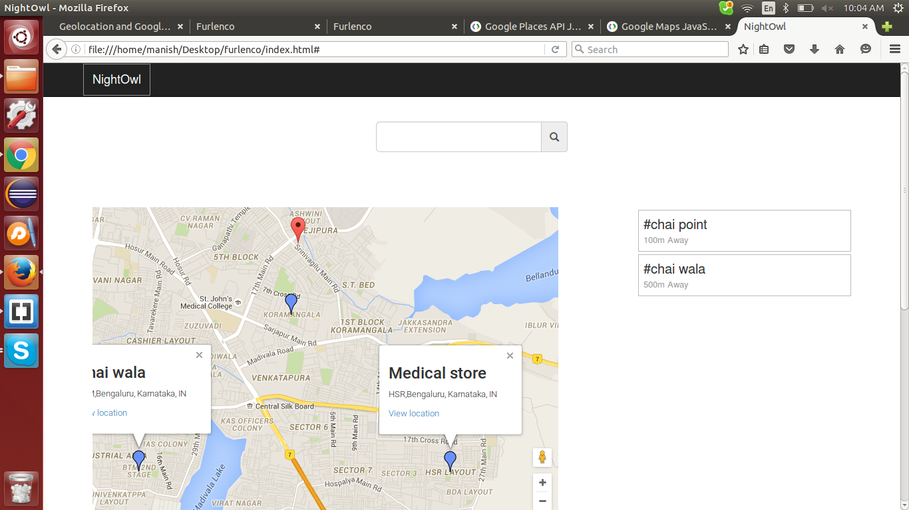
Homepage

Slide 6
Conclusion
Initial is done.
Planning to add some more features to the product.

Slide 7
Thank You

