Slide 1
Tic – Tac – toe Using socket programming
Shaktha Shetty (PES1UG20E336)
Yashas kumara adi (PES1UG20EC349)

Slide 2
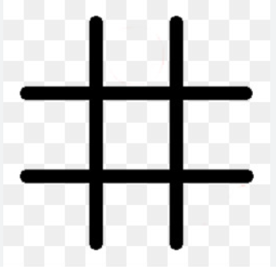
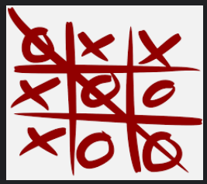
Tic tac toe
Tic-Tac-Toe is a game played using X’s and O’s, The person who gets either of them in a diagonal fashion as well as consecutively in straight line is declared the Winner. It is a fun game which most of us would have played in our leisure time. It is also called the game of Noughts and Crosses

Slide 3
Socket programming
It is a way of connecting two nodes on a network to communicate with each other. One socket(node) listens on a particular port at an IP, while the other socket reaches out to the other to form a connection. The server forms the listener socket while the client reaches out to the server.
A Socket has a typical flow of events. In a connection-oriented client-to-server model, the socket on the server process waits for request from a client. To do this, the server first establishes (binds) an address that client can use to find the server
Sockets are used to send messages across a network. They provide a form of inter-process communication(IPC).
A socket is an one endpoint of a two-way communication link between two programs running on the network. A socket is bound to a port number so that the TCP layer can identity the application that data is destined to be sent to

Slide 4
working
The Tic-Tac-Toe game client application provides an intuitive user interface for connecting to the server and playing the game. Initially a connect "frame" is opened where a player enters the name and connects to the server.
The game server listens for and accepts clients connections. The server binds the host to the port , executes game rule, coordinates player’s turn , etc.
Pygame which is an inbuilt python module is used for GUI .

Slide 5
Thank You!

