Slide 1

customer shopping behavior project using python, sql and power bi

Slide 2
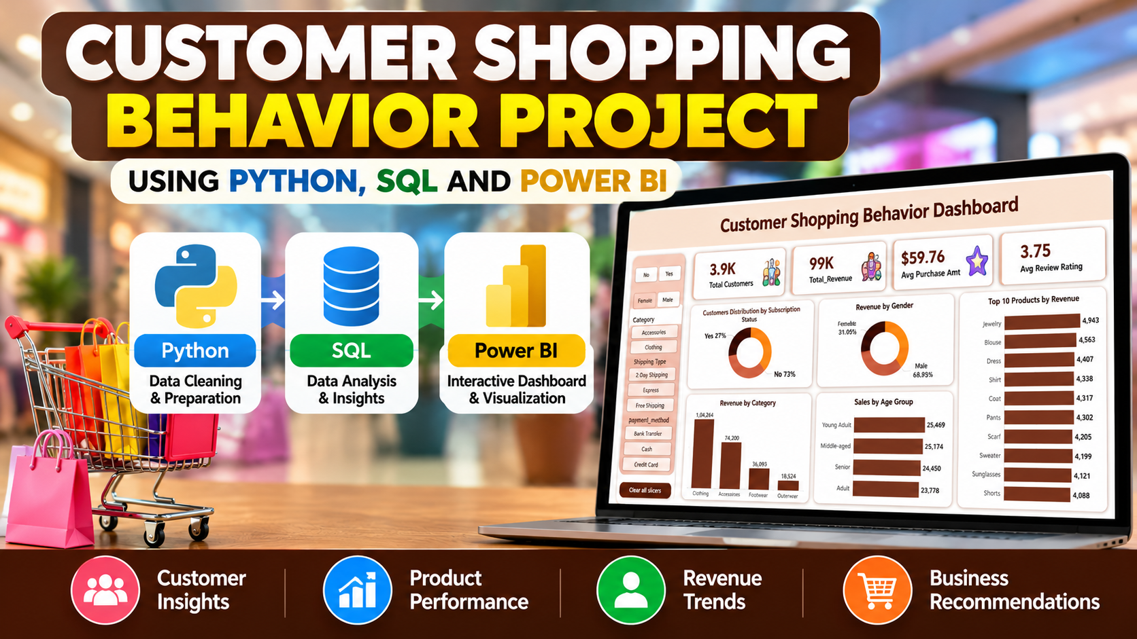

Slide 3
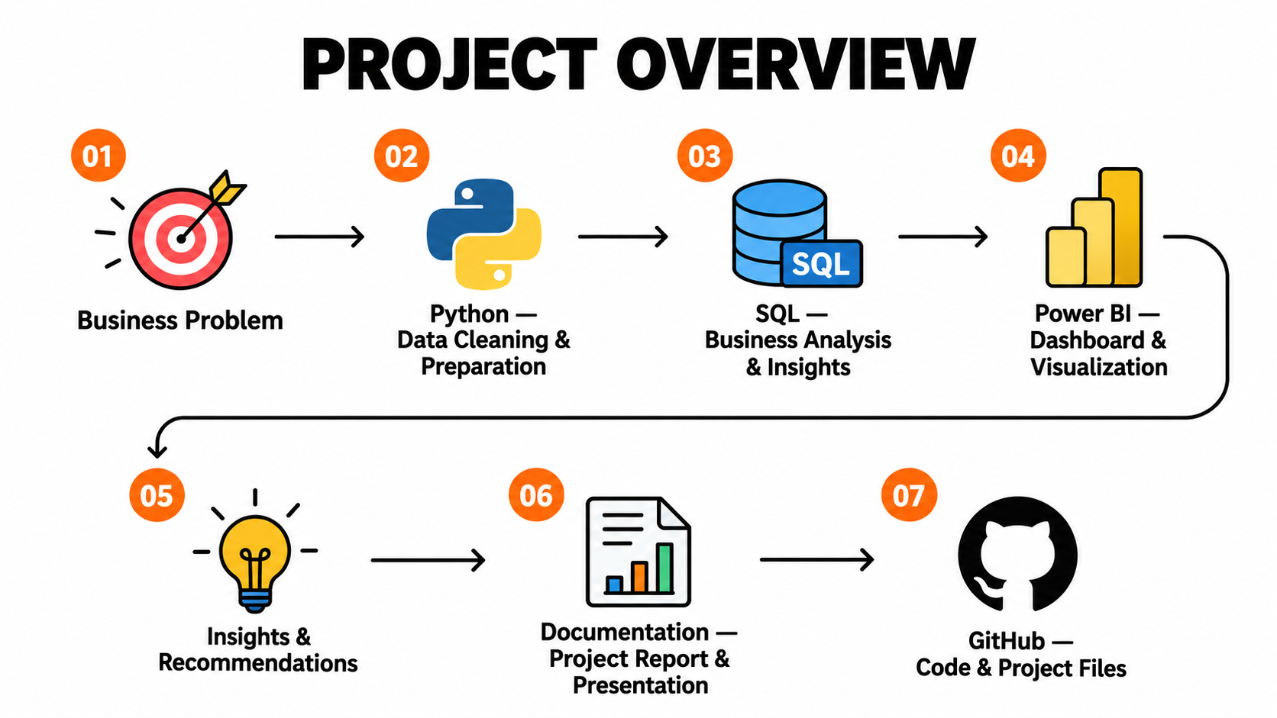

Slide 4
BUSINESS PROBLEM STATEMENT
A retail company wants to understand customer shopping behavior to improve sales, customer engagement, customer loyalty, and marketing effectiveness.
The company wants to identify how customer demographics, product preferences, discounts, shipping methods, reviews, and subscription status relate to purchasing behavior and revenue.
Main business question
How can the company use customer shopping data to identify purchasing trends, improve customer engagement, and optimize marketing and product strategies?

Slide 5
PROJECT DELIVERABLES
1. Data Cleaning & Preparation (Python)
Clean and transform the raw dataset, handle missing values, standardize column names, and prepare data for analysis.
2. Business Data Analysis (SQL)
Analyze customer shopping behavior using SQL queries to uncover insights into revenue, product performance, discounts, and customer loyalty.
3. Dashboard & Visualization (Power BI)
Build an interactive dashboard to visualize key metrics, customer trends, and business performance.
4. Business Insights & Recommendations
Summarize key findings and recommend actionable strategies to improve customer engagement, marketing, and sales.
5. Project Documentation & GitHub
Organize the Python notebook, SQL queries, Power BI dashboard, and project documentation for portfolio presentation.

Slide 6
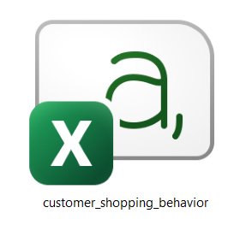
Understand Data

Slide 7
DATA CLEANING & PREPARATION
(PYTHON)
Missing Value Treatment — Imputed 37 missing review ratings using the median rating of each product category.
Column Name Standardization — Converted column names into lowercase snake_case format for consistency.
Feature Engineering — Created an age_group column to categorize customers into four age groups.
Data Transformation — Converted purchase frequency categories into numeric day values.
Redundant Column Removal — Removed promo_code_used after confirming it matched discount_applied across all records.
Data Validation — Verified that no missing values remained after the cleaning process.

Slide 8
DATA ANALYSIS (SQL)
Revenue Analysis — Compared total revenue generated by male and female customers.
Discount & Spending Analysis — Identified discount users whose purchase amounts were at or above the overall average.
Product Rating Analysis — Ranked the top 5 products by average review rating.
Shipping Analysis — Compared average purchase amounts for Standard and Express shipping.
Subscription Analysis — Compared customer counts, average spending, and total revenue between subscribers and non-subscribers.
Discount Dependency Analysis — Identified the top 5 products by percentage of purchases with discounts applied.
Customer Segmentation — Classified customers into New, Returning, and Loyal segments based on previous purchases.
Product Popularity Analysis — Identified the top 3 most purchased products within each category.
Repeat Buyer Analysis — Compared subscription status among customers with more than 5 previous purchases.
Age Group Revenue Analysis — Compared total revenue across customer age groups.

Slide 9
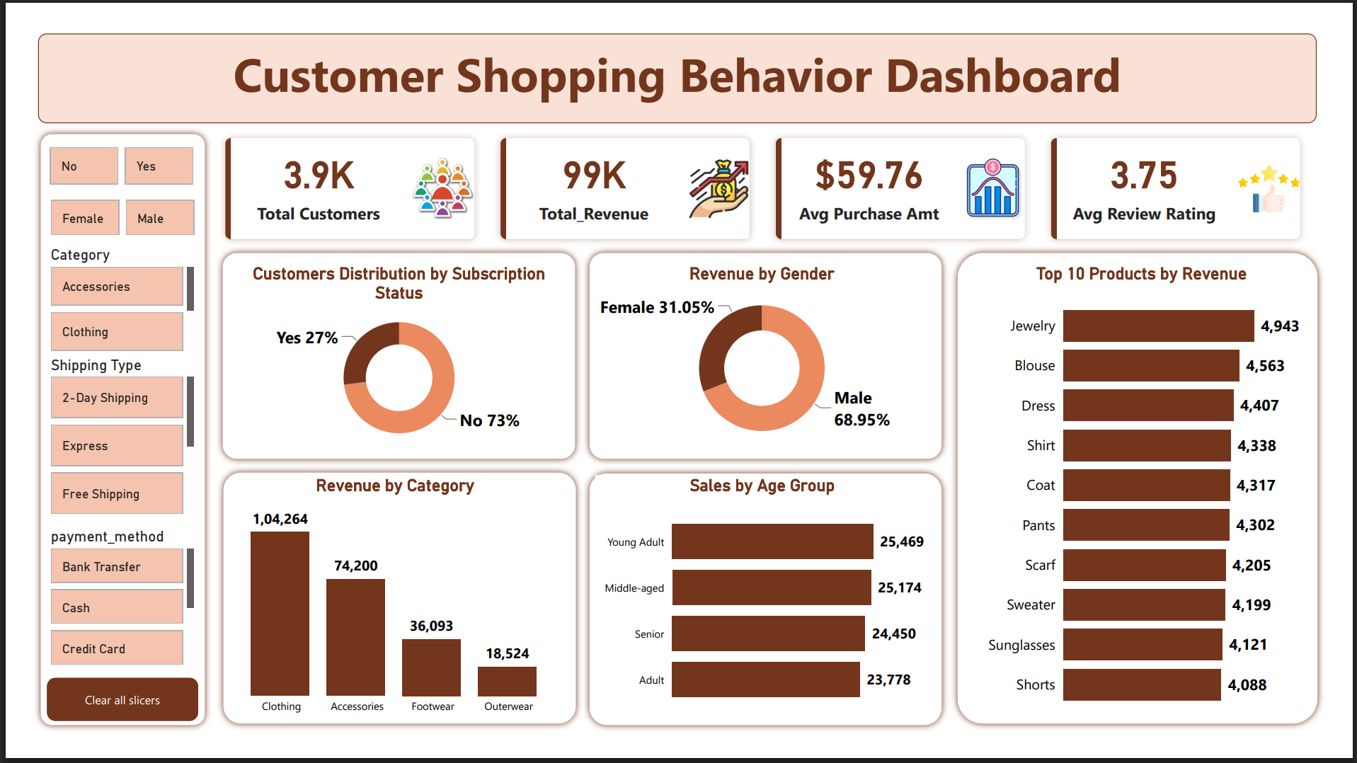

Slide 10
POWER BI DASHBOARD
1. Key Performance Indicators (KPIs)
Total Number of Customers
    Total Purchase Revenue
    Average Purchase Amount
    Average Review Rating
2. Data Visualizations
    Customer Distribution by Subscription Status
    Revenue by Product Category
    Sales by Age Group
    Purchase Amount by Gender
    Top 10 Products by Revenue
3. Interactive Slicers
    Subscription Status
    Gender
    Product Category
    Shipping Type
    Payment Method

Slide 11
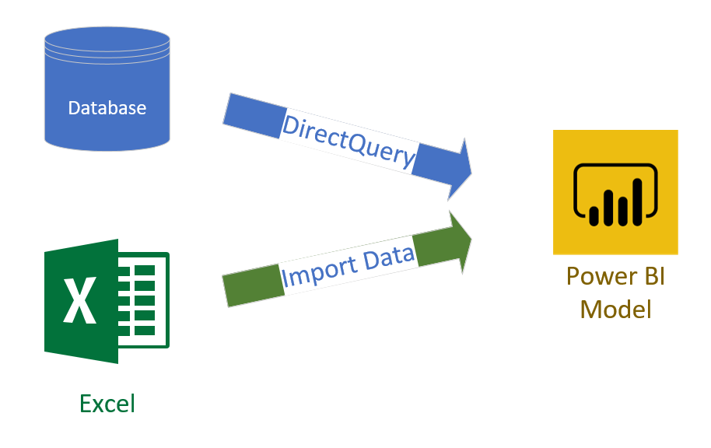

Slide 12
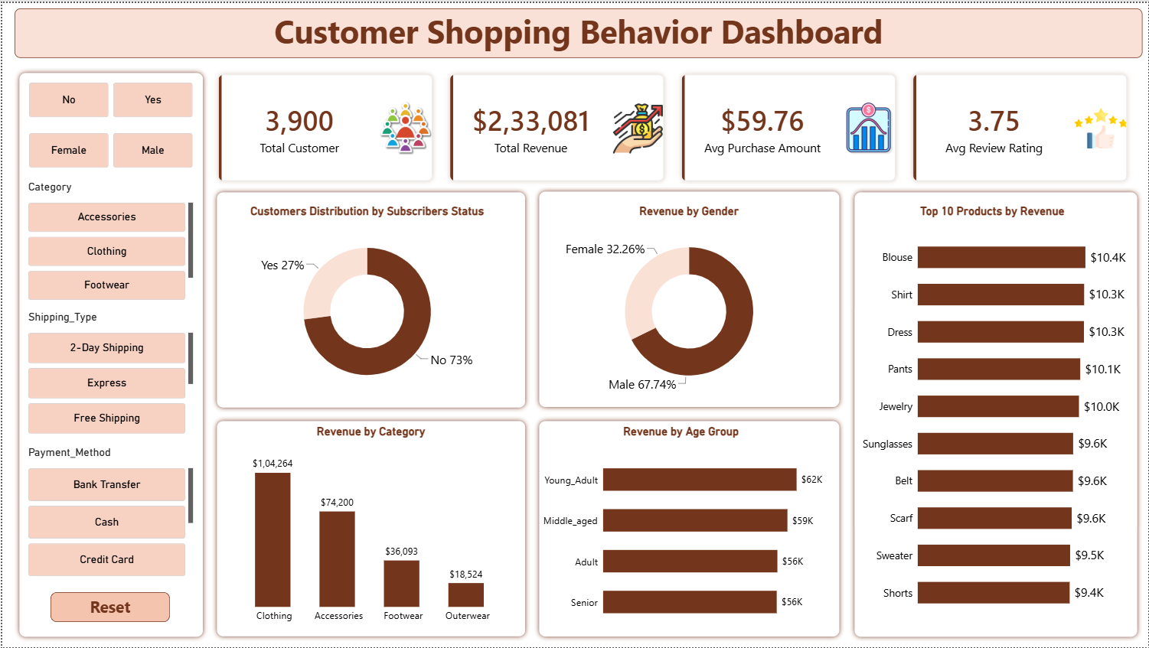

Slide 17
BUSINESS PROBLEM STATEMENT
A retail company wants to understand customer shopping behavior to improve sales, customer engagement, customer loyalty, and marketing effectiveness.
KEY BUSINESS OBJECTIVES
01
Identify shopping trends
Compare demographics, product categories, and purchasing patterns.
02
Understand customer behavior
Explore discounts, reviews, seasons, and payment preferences.
03
Improve business performance
Find opportunities to increase engagement, repeat purchases, and sales.

