Slide 1



Retail-Sales-Analysis
Project

Slide 2
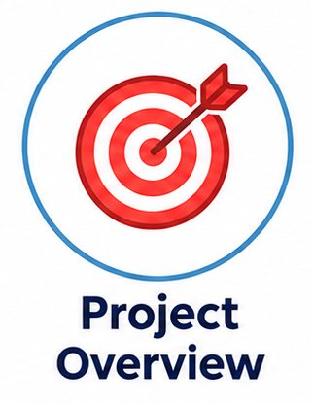
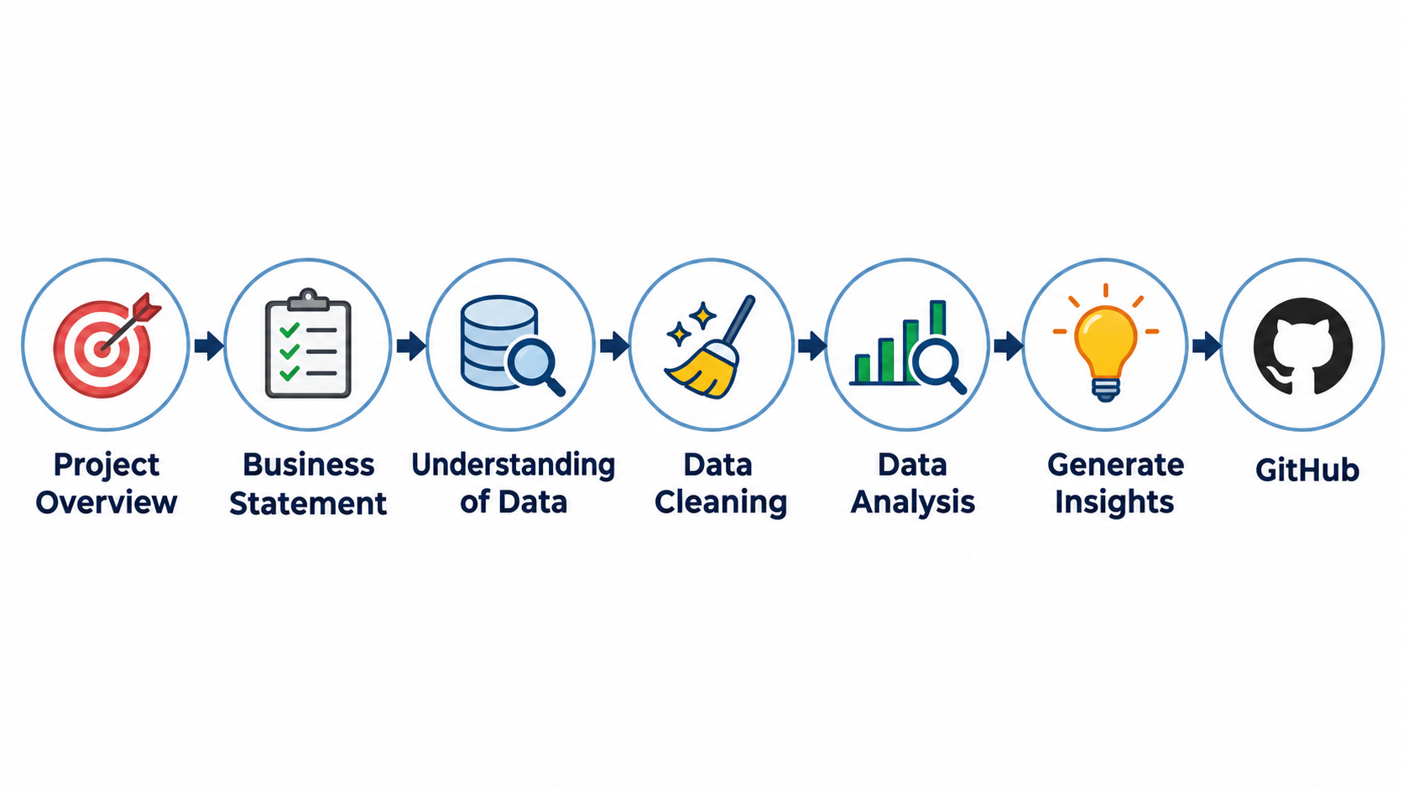


Slide 3
Business Statement
A retail business wants to understand its sales performance, customer behavior, and product category trends to identify opportunities for growth.
The objective is to analyze the data using SQL to identify high-performing product categories, valuable customers, monthly sales trends, and purchasing patterns. These findings will help the business understand its performance and make data-driven decisions.

Slide 4
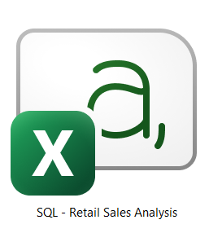
Understanding the Data

Slide 5
Understanding the Data
The dataset contains retail transaction records with the following columns:
Transaction ID: Unique identifier for each transaction.
Sale Date: Date on which the transaction occurred.
Sale Time: Time at which the transaction occurred.
Customer ID: Unique identifier for each customer.
Gender: Gender of the customer.
Age: Age of the customer.
Category: Product category purchased.
Quantity: Number of units purchased.
Price per Unit: Price of a single product unit.
COGS: Cost of goods sold.
Total Sale: Total sales amount for the transaction.

Slide 6
Data Cleaning
Identify records containing missing or NULL values.
Remove records containing missing or blank values.
Standardize gender values by replacing M with Male and F with Female.
Verify the cleaned data before proceeding with the analysis.

Slide 7
Data Analysis
Sales on a Specific Date: Retrieve transactions made on November 5, 2022.
Clothing Sales Analysis: Identify Clothing transactions with quantities greater than 10 during November 2022.
Sales Performance by Category: Calculate total sales revenue and transaction counts for each category.
Customer Demographics: Calculate the average age of customers purchasing Beauty products.
High-Value Transactions: Identify transactions with sales exceeding 1,000.
Gender-Based Sales Analysis: Compare transaction counts by gender and product category.
Monthly Sales Trends: Identify the best-selling month in each year based on total revenue.
Top Five Customers: Identify customers with the highest total spending.
Customer Analysis by Category: Calculate the number of unique customers purchasing from each category.
Sales by Time Shift: Analyze transaction counts across Morning, Afternoon, and Evening shifts.

Slide 8


Let’s Get Started

Slide 9
Generate Insights from the Data

Slide 10
GitHub Repository
SQL-Retail-Sales-Analysis

